Slide 1
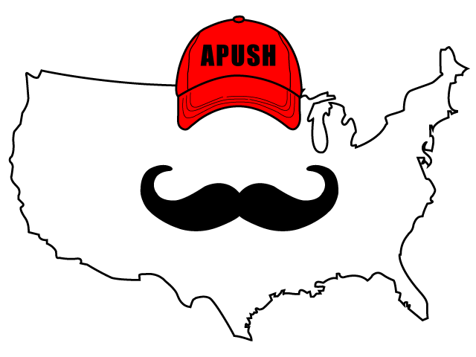
APUSH Review: America’s History, 8th Edition
Chapter 30

Slide 2
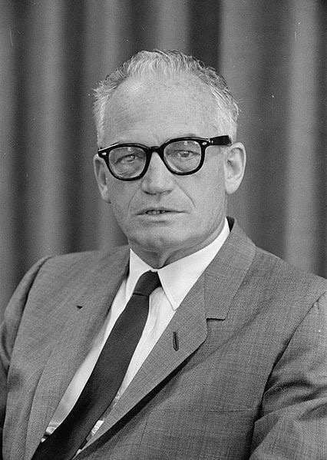

The Rise Of The New Right
Barry Goldwater and Ronald Reagan:
  Reagan became anti-communist in the 1950s
  Supported Barry Goldwater in 1964:
    A Time For Choosing
The Conscience of a Conservative
  Written by Goldwater
  Anti-New Deal and anti-communism
Grassroots Conservatism
  Phyllis Schlafly - A Choice Not an Echo
    Anti-moderate Republicans
  Reagan became governor of California in 1966 and 1970

Slide 3
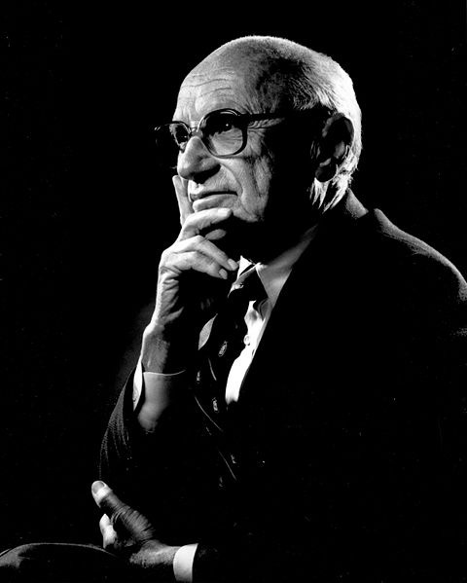
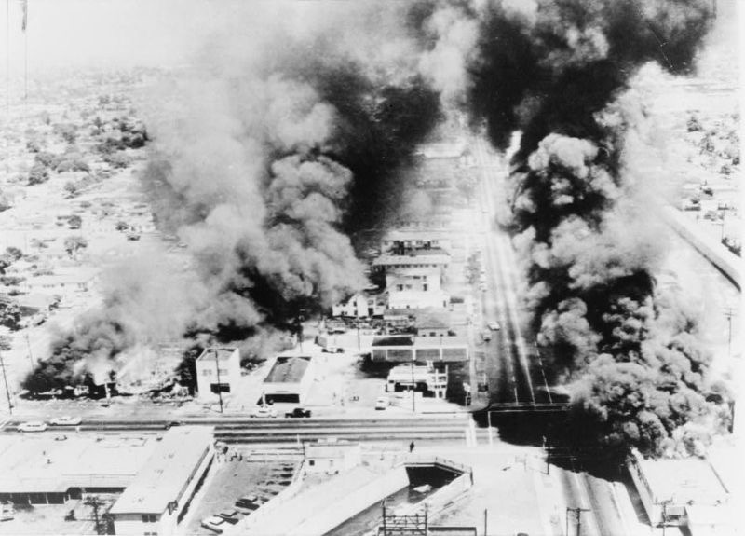
The Rise Of The New Right
Free-Market Economics and Religious Conservatism
  Characteristics of the New Right
    Anti-communist, focus on religion and free markets
    Milton Friedman linked economic freedom with political freedom
  Religious Right:
    Rose to prominence beginning in the 1970s
    Saw American society as immoral
    Anti: divorce and abortion (Roe v. Wade)
  Why did Conservatism begin to appeal to voters?
    Vietnam War, abortion, riots of the 1960s, and increase in the size of the federal government

Slide 4
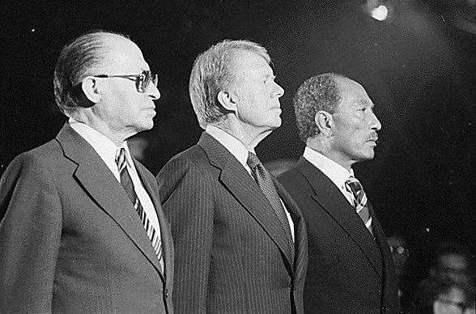
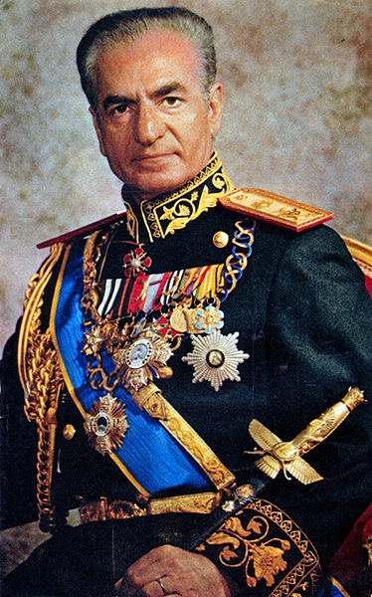
The Rise Of The New Right
The Carter Presidency
  Seen as a political outsider
  Camp David Accords (1978)
    Treaty between Egypt and Israel
  SALT II
Hostage Crisis:
  Shah of Iran (backed by US) was overthrown in 1979
  Ayatollah Khomeini became leader of Iran
  US admitted the Shah for medical treatment
    In response, 66 Americans were held hostage at the US Embassy in Tehran
    Eventually were released after Carter left office

Slide 5
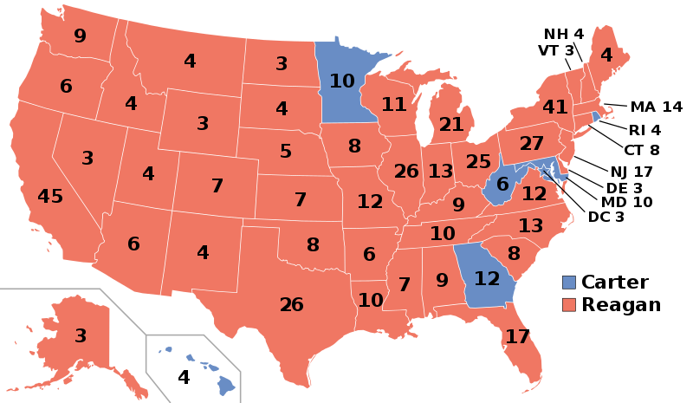
The Rise Of The New Right
The Carter Presidency
The Election of 1980:
  Carter v. Reagan
  Economy was struggling:
    Stagflation, high interest rates (mortgages)
    Reagan promised to shrink the size of the government

Slide 6
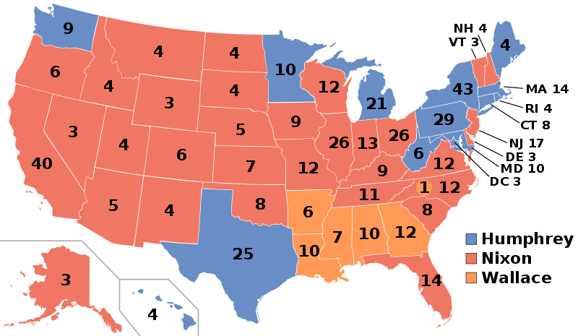
The Dawning of the Conservative Age
The Reagan Coalition
  Those that favored lower taxes, balanced budgets, smaller government, states’ rights, and being tough on crime
  Reagan Coalition:
    Southern whites also supported Reagan - Nixon’s “Southern Strategy”
  Moral Majority:
    Religious Right group led by Jerry Falwell
  Reagan Democrats:
    Many blue-collar workers that became weary of protests and welfare spending

Slide 7
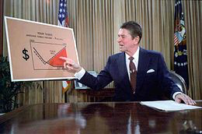
The Dawning of the Conservative Age
Conservatives in Power
Reaganomics:
  Supply-side economics - advocated lowering taxes and investing in businesses to improve the economy
  Economic Recovery Tax Act:
    Large tax cut
  Social Security and Medicare remained in tact - powerful voting block
  The national debt increased under Reagan - increased military spending

Slide 8


The Dawning of the Conservative Age
I issued an executive order that requires two federal regulations to disappear for every one new regulation.
Deregulation
  Decrease in government regulation (connect to President Trump)
    Led to lower spending by government
  At the end of his presidency, the size of the government remained virtually unchanged
Remaking the Judiciary:
  Sandra Day O’Connor - first female justice
  Under the Rehnquist court (1986 - 2005), the Supreme Court did not make drastic changes in either direction
HIV/AIDS:
  Nearly 100,000 Americans died in the 1980s from AIDS
  During Reagan’s last year in office (1988), the federal government devoted resources to treatment

Slide 9
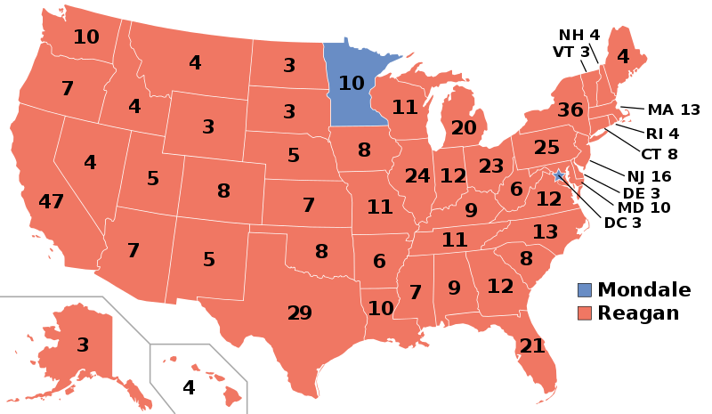
The Dawning of the Conservative Age
Morning in America
  Tax increase in 1982 - high interest rates and unemployment
Election of 1984:
  Reagan easily defeated Walter Mondale
  Reagan projected an image of small town America and optimism
Return to Prosperity:
  1985 - first time in 70 years the US imported more than exported
  Union jobs began to shrink - outsourcing jobs to other countries
  “Rust Belt” - decline of auto, steel, etc. industries

Slide 10
The Dawning of the Conservative Age
Culture of Success
  Celebration of wealth in the 1980s - similar to 1920s
  Wall Street - Greed is good
  Donald Trump - real estate in NYC
The Computer Revolution:
  Rise of Microsoft, Apple, and IBM

Slide 11
The End of the Cold War
U.S.-Soviet Relations in a New Era
  Reagan saw the Soviets as an “Evil Empire”
Reagan’s Cold War Revival:
  Policy shifted from containing communism to defeating it
  Strategic Defense Initiative (“Star Wars”):
    Plan to destroy missiles launched by the Soviets
  US supported anticommunism throughout the world
    Even if the regimes were not democratic
Iran-Contra:
  US sold weapons to Iran and sent $ to the Contras of Nicaragua
    Goal was to overthrow the Sandinista government
    Congress forbid providing aid to the Contras

Slide 12
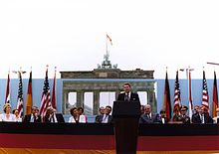
The End of the Cold War
Gorbachev and Soviet Reform
  Soviet economy weakened throughout the 1980s
  Soviet invasion of Afghanistan led to a long, drawn-out war
  2 Gorby policies
    Glasnost - allowed more freedoms or openness
    Perestroika - introduced some elements of capitalism
    Both encouraged criticism of the government
  Reagan and Gorby pursued détente
  Solidarity:
    Polish trade union that helped overthrow the Soviets
  1989 - fall of the Berlin Wall - symbolic end of the Cold War

Slide 13
The End of the Cold War
A New Political Order at Home and Abroad
  Reagan’s administration promoted beliefs about prosperity and smaller government - influenced many Americans
Election of 1988:
  Bush v. Dukakis
  Bush promoted family values
Middle East:
  Bush’s “New World Order”:
    US and allies would play a significant role in international affairs
  US continued to support Israel in the Middle East

Slide 14
The End of the Cold War
Persian Gulf War:
  Iraq led by Saddam Hussein invaded Kuwait
  UN and Congress supported the use of force
  Hussein was pushed out of Kuwait
  Led to economic sanctions against Iraq
  “By God, we’ve kicked the Vietnam syndrome once and for all”

Slide 15
Quick Recap
  **Reasons for the rise of Conservatism**
  Characteristics of the New Right - religion
  Iran Hostage Crisis
  Camp David Accords
  Reaganomics
  Deregulation
  Gorby - glasnost and détente
  Iran-Contra Affair
  Symbolic end of the Cold War
  Persian Gulf War

Slide 16
See You Back Here For The LAST Chapter!
Thanks for watching
Best of luck!

