Slide 1
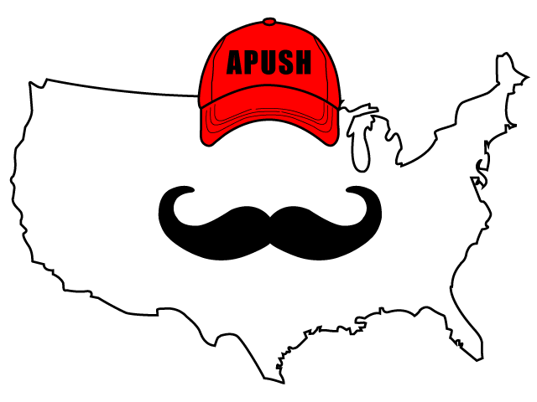
APUSH Review: PEEP Why 1763 Was So Important
PEEP Why 1763 Was A Watershed Year

Slide 2
1763 = Watershed Year
Watershed = turning point
W
D
A
E
T
H
E
S
R

Slide 3
1763 = PEEP
Pontiac’s Rebellion
End of 7 Years’ War
End of Salutary Neglect
Proclamation Line of 1763

Slide 4
1
P
3
P
7
E
6
E

