Slide 1

APUSH Review: Technology and Transportation During The Market Revolution
Everything You need to know about technology and transportation during the market revolution to succeed in apush
Shout-out Time: Mr. Windt’s class from Bay City Central, Fischetti’s class, Mr. Barne’s class from OBI, and Mrs. Splain’s class. Thanks for the support, best of luck!

Slide 2
The Market Revolution
What is it?
  Revolution in transportation, farming, and production of goods
  Increase use of canals, roads, steamboats, and RRs
  Switch from subsistence to cash-crop farming
  Goods were produced increasingly outside the home
Occurs PRIOR to the Civil War (Antebellum America)

Slide 3
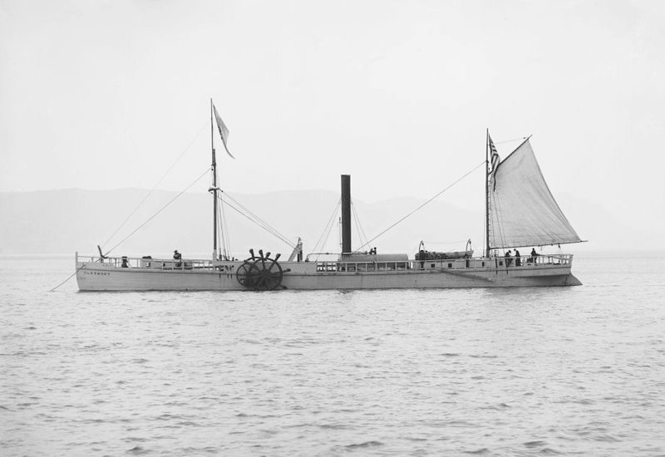
Transportation Improvements
Roads - Cumberland (National) Road
  Connected MD to OH
  Funded by the federal government (interstate)
Canals - Erie
  363 miles - Albany to Buffalo
  Paid entirely by NY (intrastate)
Steamboat
  Robert Fulton - boats could travel AGAINST the current

Slide 4
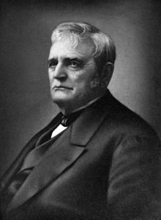
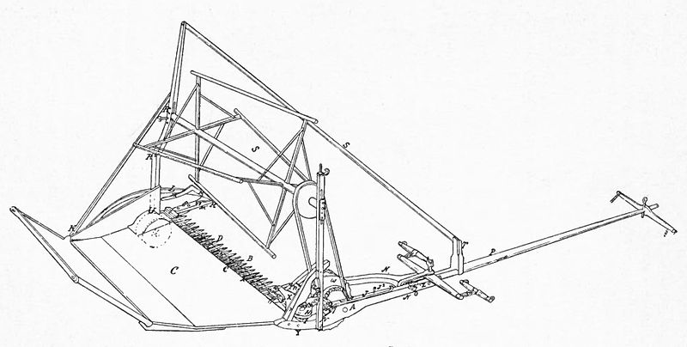
Agricultural Improvements
Cotton Gin:
  Eli Whitney
  Drastically increased cotton production and demand for slaves
Steel plow:
  Farmers could break soil more easily
  Benefitted the Midwest
McCormick Reaper:
  Farmers could harvest crops more quickly
  Increased efficiency of harvesting

Slide 5
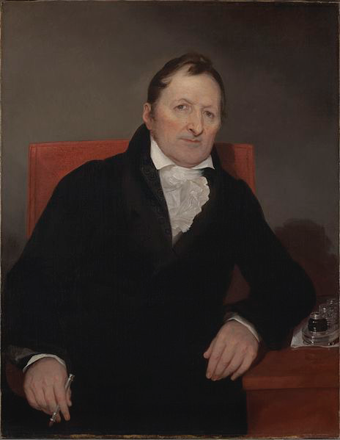
Technological Improvements
Interchangeable Parts:
  Eli Whitney
  “Cookie cutter” parts
  Mass production of goods - increased production and efficiency rates
Telegraph:
  1844 - “What hath God wrought?”
  Increased communication in the US

Slide 6
Test Tips
Multiple-Choice and Short Answer
  KNOW specific inventions and be able to explain the impact (by region as well)
Essay:
  Part of broader essay about the Market Revolution and regional specialization

Slide 7
That’s It!
Thanks for watching
Good luck in May!

