Slide 1
APUSH Review: The First Party System
Everything You Need To Know About The First Party System To Succeed In APUSH

Slide 2
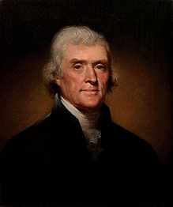
What The Curriculum States…..
Key Concept 3.2, III, B:
  Political leaders in the 1790s took a variety of positions on issues such as the relationship between the national government and the states, economic policy, foreign policy, and the balance between liberty and order. This led to the formation of political parties - most significantly the Federalists, led by Alexander Hamilton, and the Democratic-Republican Party, led by Thomas Jefferson and James Madison.”

Slide 3
So…. Why did they develop?
4 Main Reasons:
Power of the Federal Government
Foreign Policy (Stemming from the French Revolution)
Economic Policy (Stemming from Hamilton’s Financial Plan)
Balance between liberty and order (Stemming from Alien and Sedition Acts)

Slide 4
Power of the Federal Government
Federalists favored a stronger national (federal, central) government
Democratic-Republicans favored a smaller federal government
  Madison and Jefferson argued that states should be able to nullify federal laws
    VA and KY Resolutions

Slide 5
Foreign Policy
Democratic-Republicans tended to support France
  France provided aid during Rev. War
  Declaration of Independence inspired the French Rev.
Federalists wanted to have a beneficial relationship with England
  Major trading partner
  Jay’s Treaty (1794)
When France and England went to war in 1790s, Dem-Reps wanted to support France, Federalists wanted to remain neutral
  Washington’s Neutrality Proclamation

Slide 6
Economic Policy
Hamilton’s Financial Plan pitted Hamilton against Jefferson and Madison
Bank of the US (BUS) was the most controversial aspect
  Strict (Democratic-Republicans) vs. Loose (Federalists) Interpretation of the Constitution
Ultimately, Washington supports the BUS and sides with the Federalists

Slide 7
Balance Between Liberty and Order
Alien and Sedition Acts (1798, Adams Administration)
  Meant to silence Adams’ Democratic-Republican opponents
  Punishments for criticizing included fines and/or jail time
Jefferson (Adams’ VP) and Madison responded with the VA and KY Resolutions
  Urged states to nullify the Alien and Sedition Acts
You Will NOT Silence Me!

Slide 8
Check Out the Hamilton Soundtrack….
Cabinet Battle #1 (Bank and Financial Plan)
Cabinet Battle #2 (Conflict between France and England)
One Last Time (Washington’s Farewell Address)
Every other song because they’re amazing

Slide 9
A Short Answer Question….
A. Briefly explain how ONE of the following was most significant in the formation of political parties in the late-18th century:
  Relationship between the national government and the states
  Economic policy
  Foreign policy
B. Provide ONE piece of historical evidence that supports your choice in part a.
C. Briefly explain why one of the other options is not as significant in the formation of political parties in the late 18th century.

Slide 10
An Essay Topic…..
Explain the reasons for the formation of political parties in the late 18th century.
  (Causation)

Slide 11
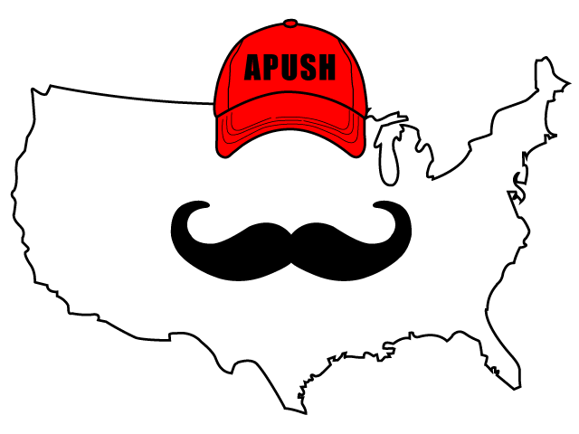
Thanks For watching!
Best of luck in May!

