Slide 1
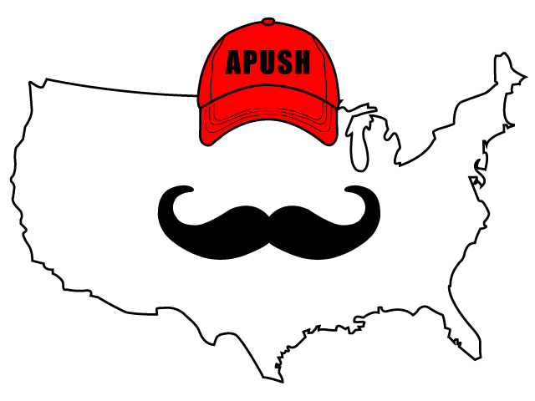
APUSH Review: The Second Party System
Everything You Need To Know About The Second
VS.

Slide 2
1820s - 1830s
Rise of new political parties:
Whigs - Henry Clay!
Democrats - Andrew Jackson
This time saw increased political participation:
Elimination of property requirements for adult, white males
Differences between the two parties?
Role and power of the federal government
National Bank (2nd BUS)
Tariffs
Federally funded internal improvements
American System

Slide 3
Role and power of the federal government
Whigs tended to favor a stronger central government
Supported Henry Clay’s American System
Democrats tended to favor more power for states
Opposed the American System
National Bank (BUS)
Internal Improvements
Protective Tariff (1816)

Slide 4
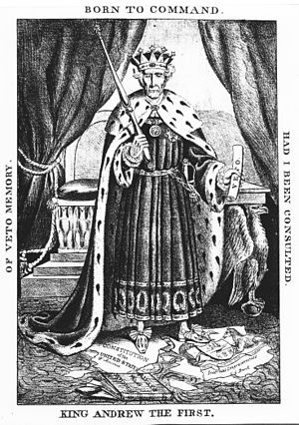
National Bank (2nd Bus)
Andrew Jackson’s veto of the 3rd BUS in 1832
Whigs formed in response to “King Andrew 1st”
Who would agree with this image? Who would disagree?

Slide 5
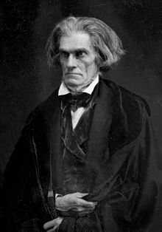
Tariffs
What is a tariff?
Tax on imported goods - favored in North and by industries, disliked in the South
Whigs tended to support tariffs, Democrats did not
Tariffs of 1828 and 1832
High tariff rates
South Carolina Exposition and Protest - John C. Calhoun - VP to AndrewJackson
Compromise Tariff of 1833:
Lowered rates over 8 years
Henry Clay!

Slide 6
Federally Funded Internal Improvements
Key component of Henry Clay’s American System
Debates over federally funded intrastate (one state) improvements
Andrew Jackson’s Maysville Road Veto
Sorry bro, no improvements for you…..

Slide 7
Test Tips
Multiple-Choice and Short Answer:
Causes of the rise of the 2nd Party System
Differences between the two parties
Characteristics of supporters
Essays:
Almost any essay on the Antebellum time period
Possible synthesis point:
Connecting to debates during the 1st party system

Slide 8
Short Answer Question
Answer all 3 parts:
A) Briefly explain how ONE of the following was most significant in the formation of political parties in the early 19th century (Whigs and Democrats)
National Bank (BUS)
Tariffs
Federally funded internal improvements
B) Provide ONE piece of historical evidence that supports your choice in part A).
C) Briefly explain why one of the other options is not as significant in the formation of political parties in the early-19th century.

Slide 9
Thanks For Watching!
Good luck on your exams!

