Slide 1
America’s History, 8th Edition, Chapter 10 Review Video
www.Apushreview.com
A Democratic Revolution (1800 – 1844)
Check out the description for videos that match up with the new curriculum.

Slide 2
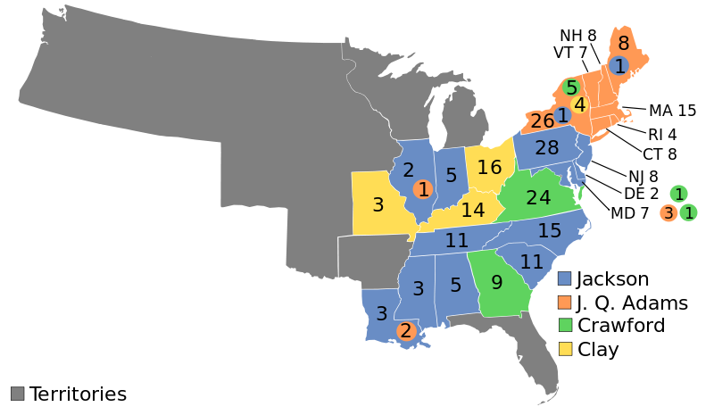
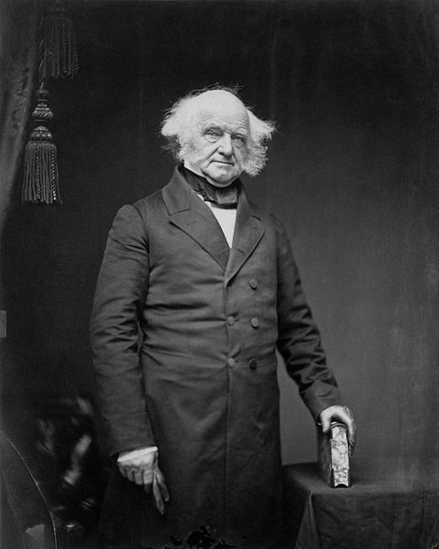
The Rise of Popular Politics, 1810 - 1828
The Decline of the Notables and the Rise of Parties
The Rise of Democracy:
More Americans (white males) participated in politics
Property requirements and taxpaying requirements disappeared in many states
Western states gain more prominence
Parties Take Command:
Martin Van Buren helped introduce political machines – rewarded supporters with jobs (patronage, spoils system)
The Election of 1824 (The “Corrupt Bargain”):
4 candidates for the election of 1824
None win an electoral majority, although Andrew Jackson has most electoral and popular votes
According to the 12th Amendment, the House would then decide on the top 3 candidates
Henry Clay (Speaker of the House), finished 4th and was out of the running
He threw his support behind JQA
Adams becomes president, Henry Clay becomes his Secretary of State (stepping stone to the presidency)

Slide 3
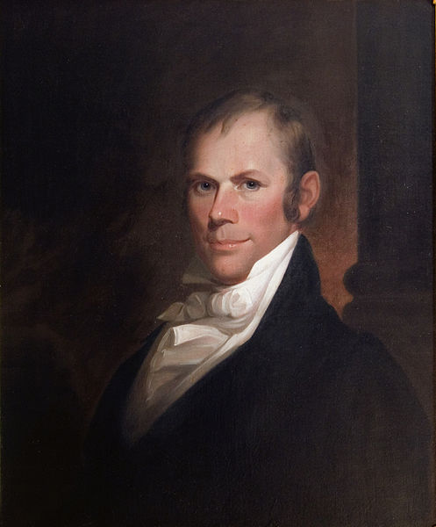
The Rise of Popular Politics, 1810 - 1828
The Last Notable President: JQA
JQA favored the American System
3 parts – internal improvements, tariffs, BUS
The Fate of Adams’s Policies:
Many Jacksonians rejected the American System
The Tariff Battle:
Tariff of Abominations (1828):
Raised tariff rates drastically
Hated by South
Favored by manufacturers in NE
“The Democracy” and the Election of 1828
John C. Calhoun ran as Jackson’s VP
Increased voter turnout in 1828 (Jackson won by a large margin)

Slide 4
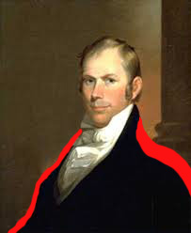
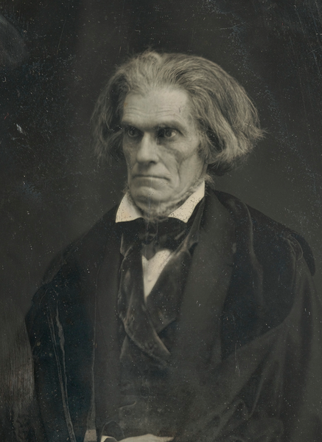
The Jacksonian Presidency, 1829 – 1837
Jackson’s Agenda: Rotation and Decentralization:
Kitchen Cabinet:
Group of official and unofficial advisors to Jackson
The Tariff and Nullification:
Slave owners feared high tariffs -> feared that slavery would be outlawed next
John C. Calhoun (sitting VP)
Wrote South Carolina Exposition and Protest (1828)
Urged states to nullify the Tariff of Abominations
Argued since the states created the federal government, they had the ability to nullify federal laws
Drew on VA and KY Resolutions
Webster-Hayne Debate:
States’ Rights (Hayne) v. National Power (Webster)
Hayne advocated nullification
“Second Reply to Hayne”
Webster advocated national power
“Liberty and Union, now and forever, one and inseparable.”
Compromise Tariff of 1833 (Henry Clay):
Reduced tariff rates by 10% per year for 8 years
Force Bill:
President could use military in future to collect tariffs

Slide 5
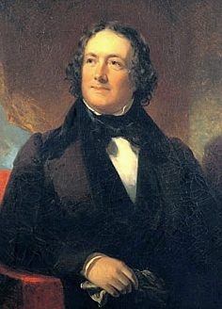
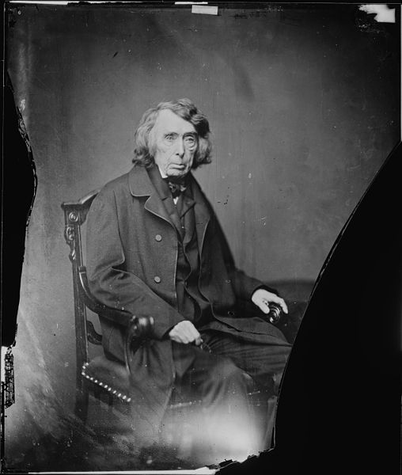
The Jacksonian Presidency, 1829 – 1837
The Bank War:
Nicholas Biddle:
President of the BUS
1832 veto:
Jackson vetoes the re-charter of the BUS (BUS would expire in 1836)
Removal of Bank Deposits:
Jackson removed all government deposits from the BUS and placed in state “pet” banks
Biddle called in loans -> economic crisis ensues
Roger B. Taney
Jackson’s Treasury Secretary, appointed Chief Justice of the Supreme Court after Marshall died (1835)

Slide 6
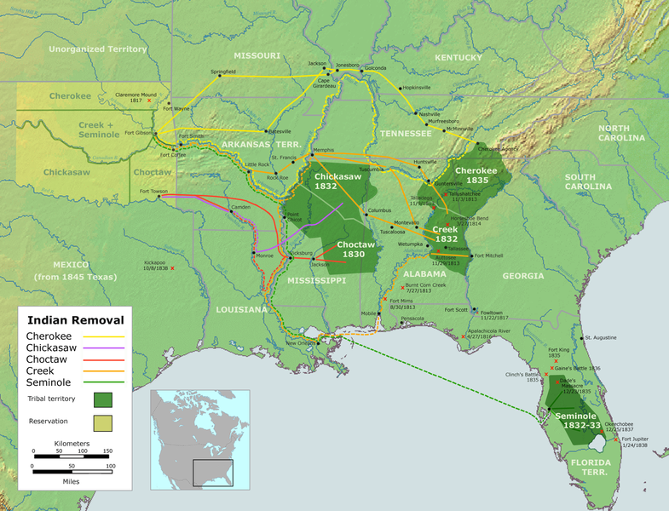
The Jacksonian Presidency, 1829 – 1837
Indian Removal
Jackson advocated removal of Natives west of Mississippi River
“5 Civilized Tribes”
Located in the South – GA, AL, MS, FL
Indian Removal Act (1830)
Aimed to move southern tribes to west of MS River
Worcester v. Georgia (1832)
Supreme Court stated Natives could NOT be forced to move
Jackson ignores the decision
Trail of Tears:
Winter of 1838
Forced removal of 1,000s of Natives
Thousands died during or shortly after arriving out west

Slide 7
The Jacksonian Presidency, 1829 – 1837
The Jacksonian Impact:
Jackson drastically increased the power of the executive branch
The Taney Court:
Charles River Bridge v. Warren Bridge (1837):
Contracts could be breached if it benefited the community
In essence, it reversed Dartmouth College v. Woodward

Slide 8
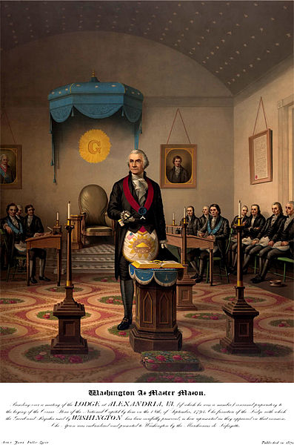
Class, Culture, and the Second Party System
The Whig Worldview:
Formed in response to “King Andrew I”
Favored strong central government
Promoted industry and internal improvements (especially in the West)
Anti-Masons Become Whigs:
1st 3rd Party
Anti-secret society
Election of 1836:
MVB vs. several Whigs (hope to send to the House a la 1828)
MVB wins, is plagued by the Panic of 1837:
Causes:
Overspeculation, crop failures, panics in Europe
Effects:
100s of banks failed, unemployment grew, prices of land dropped

Slide 9
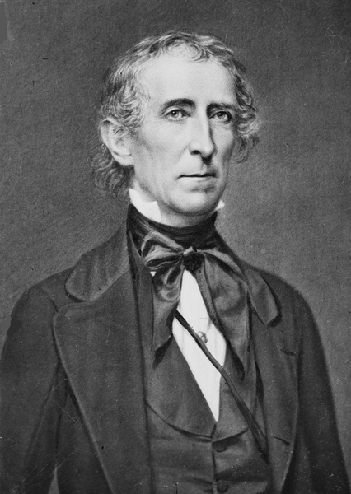
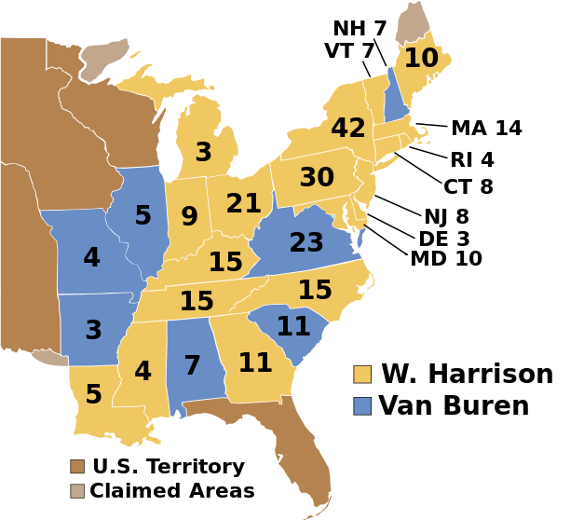
“Tippecanoe and Tyler Too”
Election of 1840
MVB v. “Tippecanoe and Tyler Too”
“Log Cabins and Hard Cider”
“Get the ball rolling”
WHH dies 30 days into his presidency
Tyler “His Ascendency”
Democrat at heart, hated Jackson
Once in office, Tyler rejected many Whig programs, became a president without a party
Ethnocultural politics – voting along ethnic and/or religious lines
Irish, Germans, and Catholics tended to vote Democratic

Slide 10
Quick Review
Corrupt Bargain of 1824
Jacksonian Democracy = increased suffrage for white males
Tariff of Abominations
Nullification Crisis
Bank War
Formation of the Whigs
Indian Removal Act -> Trail of Tears

Slide 11
Thanks for watching!
Good luck on your tests
Check out videos matching the new curriculum
Spread the word
Subscribe
Comment
I left the presidency in March of 1845. As of 2014, I have a grandchild that is STILL alive…..

