Slide 1
America’s History, 8th Edition, Chapter 11 Review Video
www.Apushreview.com
Religion and Reform (1800 – 1860)
Check out the description for videos that match up with the new curriculum.

Slide 2
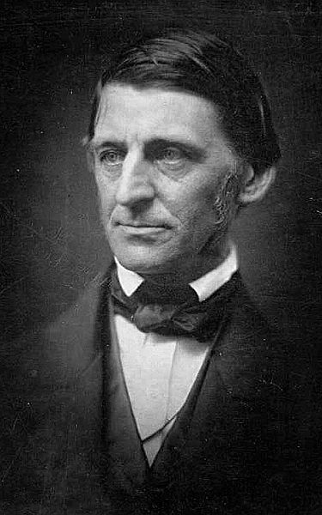
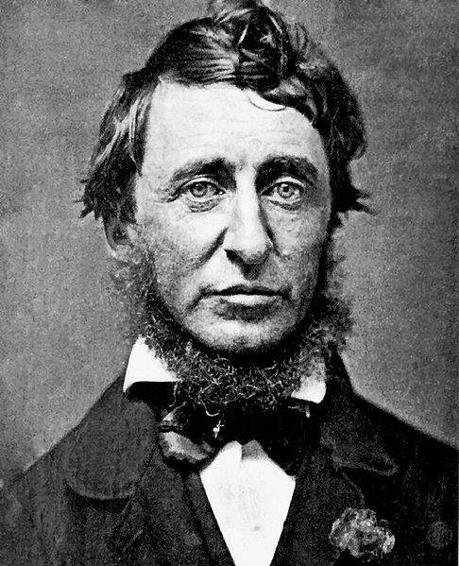
Individualism: The Ethic of the Middle Class
Ralph Waldo Emerson and Transcendentalism:
Transcendentalism:
Every person possesses an inner light that can illuminate the highest truth and put him/her in direct touch with God
Ralph Waldo Emerson:
“Self-Reliance”
Emerson’s Literary Influence:
Henry David Thoreau:
Walden – Thoreau lived alone in nature for 2 years
Civil Disobedience – urged individuals to resist unjust laws
Margaret Fuller:
Argued for women’s social independence
Walt Whitman:
Leaves of Grass – focus on the individual

Slide 3
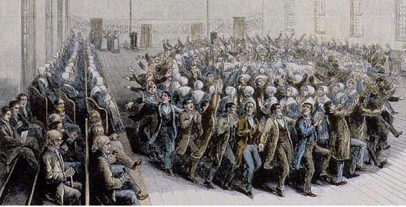
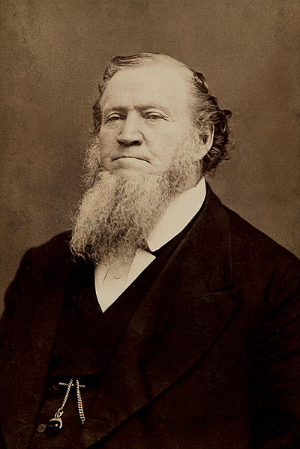
Rural Communalism and Urban Popular Culture
Utopias:
Societies that sought to achieve perfection
The Utopian Impulse:
Shakers:
Founded by Ann Lee
Advocated celibacy, equal rights for women
Oneida – “Free love”, sought to achieve perfection
Silverware production
Joseph Smith and the Mormon Experience:
Mormons (Church of Jesus Christ of Latter Day Saints)
Smith and his brother were murdered
Brigham Young led the Mormons to Utah

Slide 4
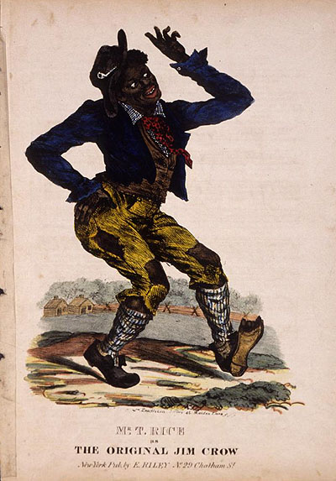
Rural Communalism and Urban Popular Culture
Urban Popular Culture:
Minstrel Shows:
White actors used blackface in shows that promoted racism and stereotypes
“Jim Crow” was a major character
Nativist Movements:
Distain for immigrants
Called for an end to immigration
Aimed mostly at Irish (Catholics) who tended to vote Democrat

Slide 5
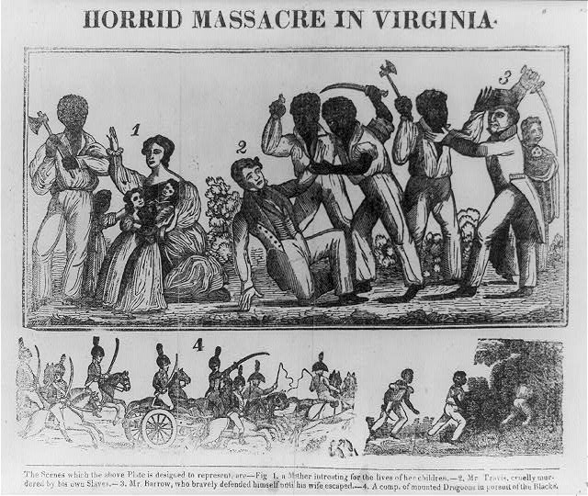
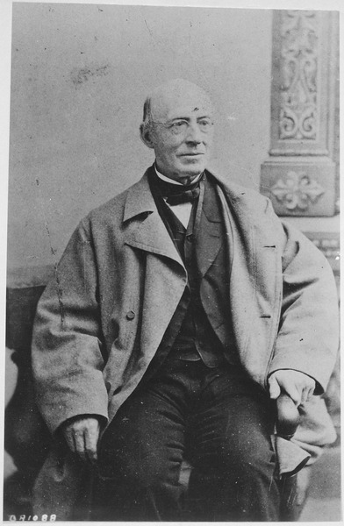
Abolitionism
Black Social Thought: Uplift, Race Equality, and Rebellion:
David Walker:
An Appeal… to the Colored Citizens of the World
Advocated violence to end slavery
Nat Turner’s Rebellion (1831):
Claimed to have revelations from Jesus
Rebellion in VA that killed 55 whites
60 blacks, including Turner, were killed in retaliation
As with all rebellions, slave laws became more harsh
Evangelical Abolitionism:
***William Lloyd Garrison:***
Radical abolitionist (for his time)
Published The Liberator – immediate and uncompensated end to slavery
The American Anti-Slavery Society:
Founded by Garrison and Theodore Weld
Helped show the violence of slavery
Underground RR:
1,000 slaves a year – Harriet Tubman

Slide 6
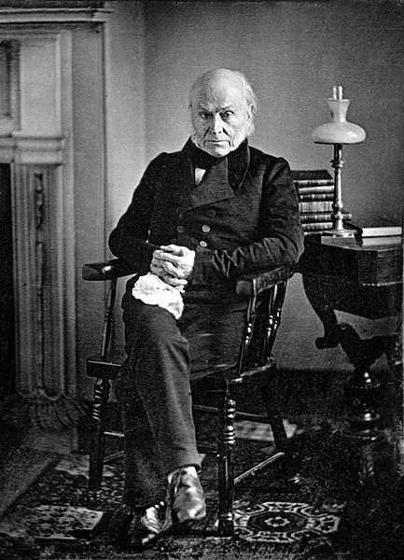
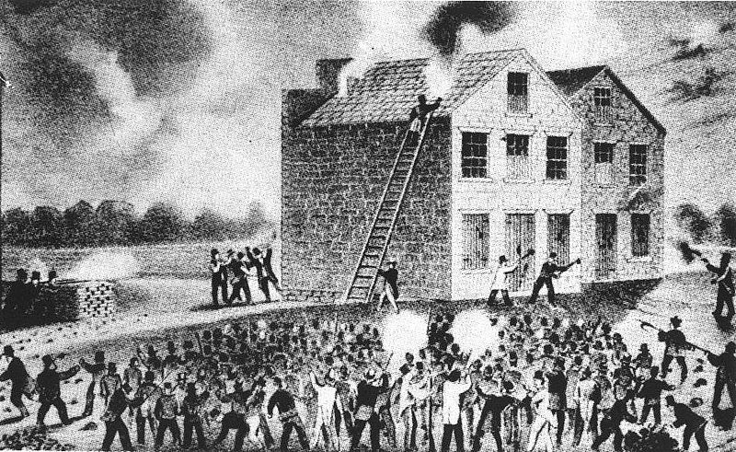
Abolitionism
Opposition and Internal Conflict:
Abolitionists were few in number
Many in the North benefitted from slavery (textile manufacturers, hog farmers)
Amalgamation:
Many whites opposed the intermarriage of whites and blacks
Elijah Lovejoy:
Murdered in Illinois, outspoken abolitionist and editor of newspaper
Gag Rule – All anti-slavery petitions in the House would not be discussed; later overturned by JQA
The abolitionist movement split over women’s rights
Garrison’s American Anti-Slavery Society supported women’s rights

Slide 7
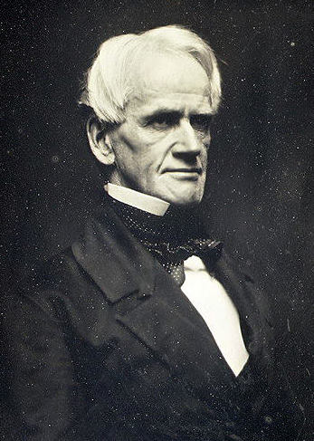
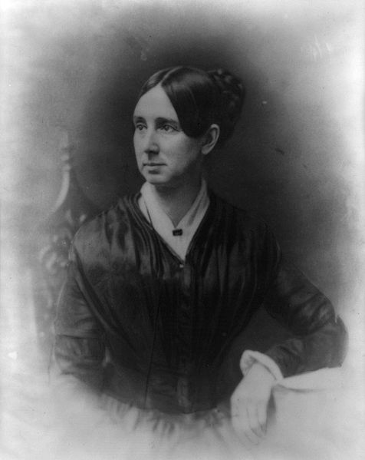
The Women’s Rights Movement
Women played a large role in trying to reform American Society
Origins of the Women’s Movement:
Separate Sphere – expectation that women had different roles in society
Dorothea Dix – mental health reform
Horace Mann – “Father of Education”
Tax-Supported elementary schools
Schools in the South and West were inferior to the North
From Black Rights to Women’s Rights:
Uncle Tom’s Cabin:
Harriet Beecher Stowe – portrayed the evils of slavery
Seneca Falls Convention:
Elizabeth Cady Stanton and Lucretia Mott
Declaration of Sentiments – “All men and women are created equal”

Slide 8
Quick Review
Transcendentalism
Henry David Thoreau
Minstrel Shows
Nativism
Nat Turner’s Rebellion
William Lloyd Garrison
Abolitionist Movement split over women’s rights
Dorothea Dix
Seneca Falls Convention

Slide 9
Thanks for watching!
Good luck on your tests
Check out videos matching the new curriculum
Spread the word
Subscribe
You can thank me for getting your education….

