Slide 1
America’s History, 8th Edition, Chapter 12 Review Video
www.Apushreview.com
The South Expands: Slavery and Society (1800 – 1860)
Check out the description for videos that match up with the new curriculum.

Slide 2
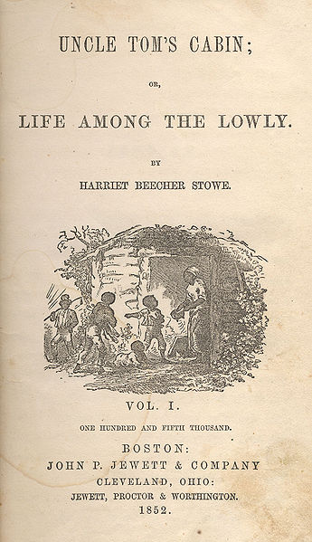
The Domestic Slave Trade
The Upper South Exports Slaves:
Many plantation owners moved South (AL, MI)
By 1850s, most African Americans lived in the Deep South
Sugar cultivation was incredibly arduous
The Impact on Blacks:
Slave Codes:
Regulated behavior of slaves:
Could not own property, be out after dark, strike a white person, receive an education
Slave trade ripped families apart
1/4 marriages
1/3 of children under 14

Slide 3
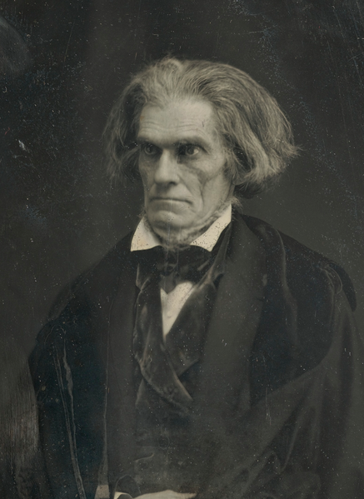
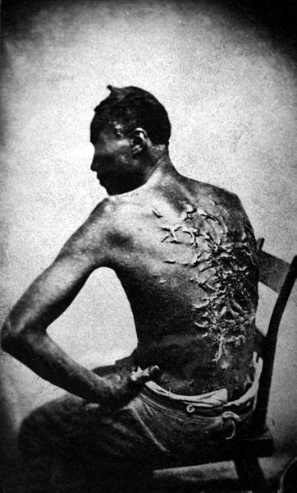
The World of Southern Whites
The Dual Cultures of the Planter Elite:
The Traditional Southern Gentry:
Lived in the Chesapeake, SC, and GA
Viewed themselves as nobles in other countries
Children married other aristocratic planters
The Ideology and Reality of “Benevolence”:
By the 1830s, southerners argued slavery was a “positive good” – John C. Calhoun
Religion was used to justify slavery – Jesus did not condemn slavery
Cotton Entrepreneurs:
Overseers worked on many plantations – pay was based on production
Gang-labor system – enhanced productivity, made work harder for slaves

Slide 4
The World of Southern Whites
Planters, Smallholding Yeomen, and Tenants
Most southerners did not own slaves (3/4)
Planter Elites:
5% of the South’s population controlled much of the economy
Why were plantation owners so influential?
They controlled markets, credit, machines
They often had many relatives in town
Many lawyers doubled as plantation owners, often elected to public office
Smallholding Planters and Yeomen:
Husbands had control over their homes in every aspect
Poor Freemen:
Few educational opportunities in the rural south

Slide 5
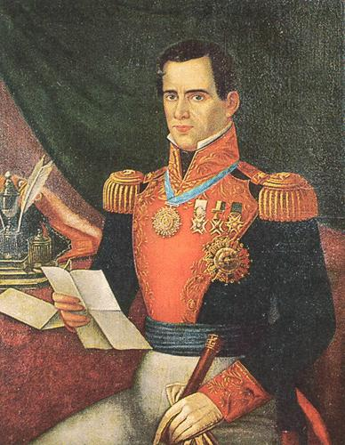
Expanding and Governing the South
The Settlement of Texas:
Mexico encouraged the migration of Americans
Immigrants were to be Catholic
1830, Mexico emancipated slaves, tensions between Mexico and US
Texas declares independence in 1836
Alamo: 13 day siege, all Americans are killed
Battle of San Jacinto:
Sam Houston captures Santa Anna, sign treaties
Texas wants to join Union
Fear from North over slavery
The Politics of Democracy:
AL granted suffrage to all white men
90% of AL legislators owned slaves
Why did the South not industrially develop ?
$ could be made in agriculture
Capital was tied up in farming
Lack of adequate infrastructure (railroads, canals, etc.)

Slide 6
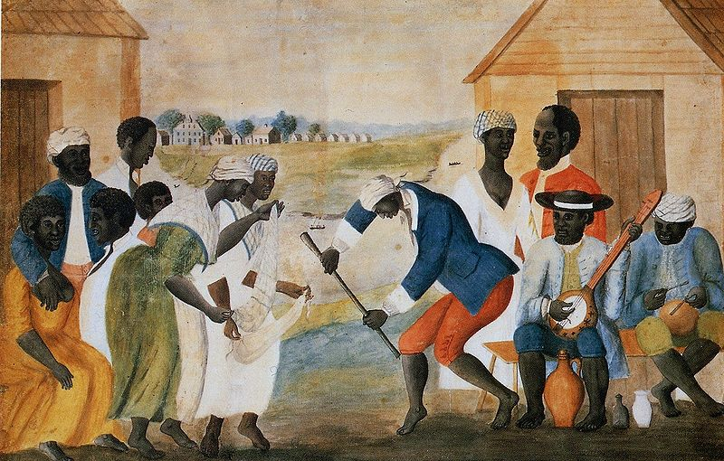
The African American World
Evangelical Black Protestantism:
Black Protestantism – did not follow predestination
Develop distinctive mass services – “ring shout”
Forging Families and Communities:
Combining of American and African cultures and languages
Pronouncing “th” as “de”
Slaves would get married, but were not binding
Surrogate families were often used
A frequent cause of running away was to be reunited with family
Negotiating Rights:
Task System: completing a specific job each day
Resisting slavery:
Resistance took many forms:
Passive – working slowly, faking illness, running away, breaking tools
Slave rebellions did occur, but were rare (Nat Turner, Prosser)

Slide 7
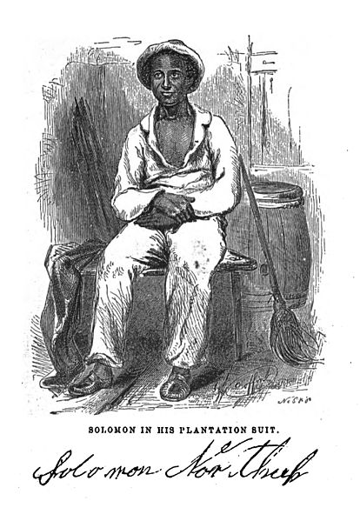
The African American World Cont.
The Free Black Population:
Roughly 250,000
Free blacks in the North faced discrimination:
Lower-paying jobs, segregation, prohibited from voting
Free blacks in the South:
Over 200,000 by 1860
Faced similar discrimination as the North
Denied trials by jury
Kidnapped and sold into slavery

Slide 8
Quick Review
Slave Codes
Slavery as a “necessary evil” to a “positive good”
TX and slavery
African American culture
Resistance to slavery

Slide 9
Thanks for watching!
Good luck on your tests
Check out videos matching the new curriculum
Spread the word
Subscribe

