Slide 1
America’s History, 8th Edition, Chapter 13 Review Video
www.Apushreview.com
Expansion, War, and Sectional Crisis: 1844 – 1860
Check out the description for videos that match up with the new curriculum.

Slide 2
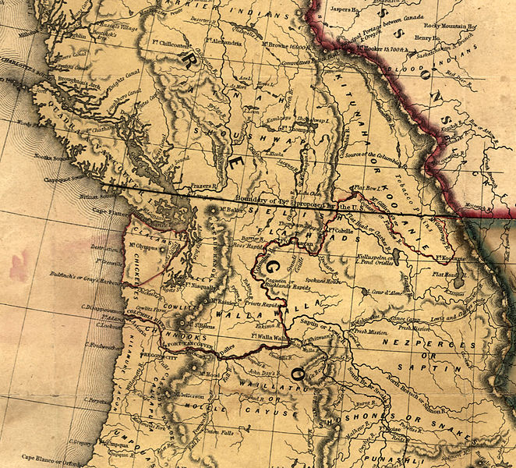
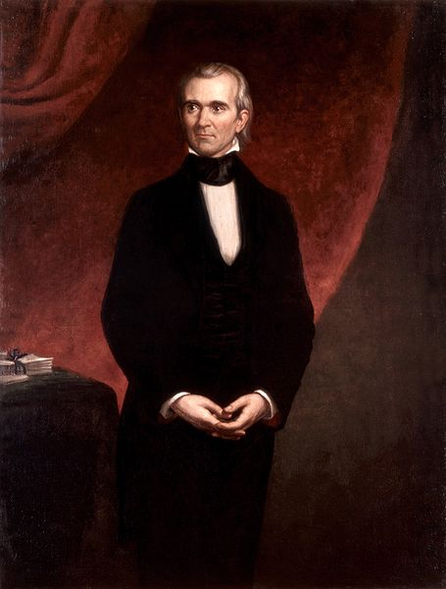
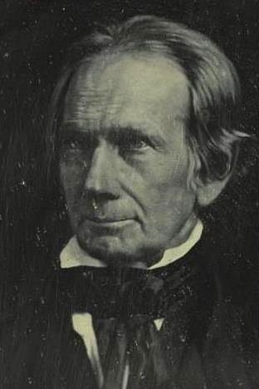
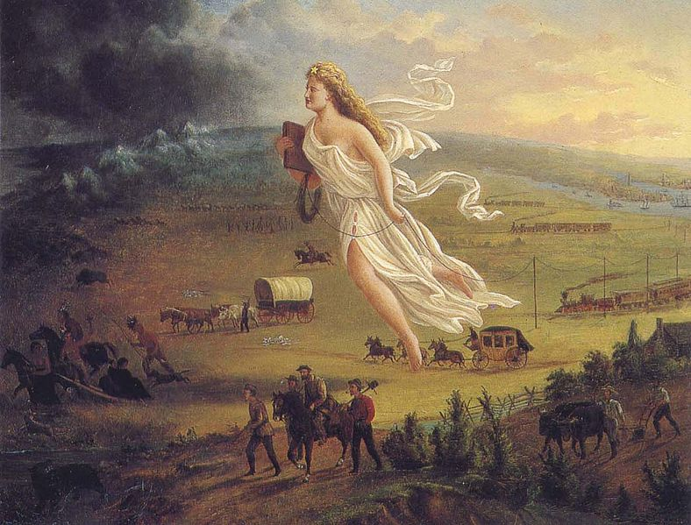
Manifest Destiny: South and North
“Manifest Destiny”
God-given right to expand from coast to coast
Coined by John O’Sullivan
Oregon:
Joint Occupation with Britain
“54°40’ or Fight!”
Eventually, the US and Britain settle on the 49th parallel
California:
Part of Mexico – series of missions
Indians on the Great Plains:
Somewhat sedentary – hunted bison
European weapons transformed life on the Plains
The Election of 1844 (Video in Description):
Polk fully supports annexation
TX is annexed via a joint resolution in February 1845, admitted into the country in December
Henry Clay and some Whigs resisted expansion – feared tensions over slavery

Slide 3
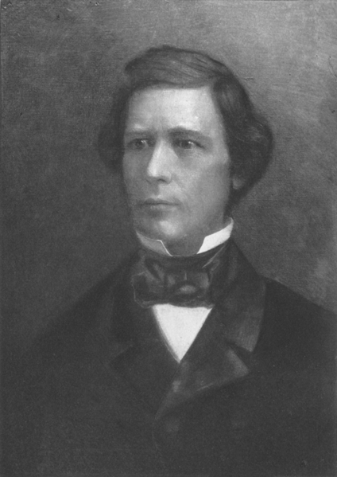
War, Expansion, and Slavery, 1846 – 1850
Mexican-American War:
Slidell Mission – Polk sent John Slidell to buy CA and NM for $30 million, Mexico refused to meet with him
Boundary issue:
TX claimed the Rio Grande, Mexico claimed to the Nueces River
Conscience Whigs – those that opposed the war on moral grounds
“Mexico will poison us” - Emerson
***Wilmot Proviso***
David Wilmot (D – NY)
Introduced an amendment to a bill stating slavery would NOT exist in any land gained from Mexico
Passed the House (more population in North), but NOT the Senate
Free-Soil Party:
Were against the extension of slavery into territories – took away jobs from whites
“Free labor, free soil, free men”

Slide 4
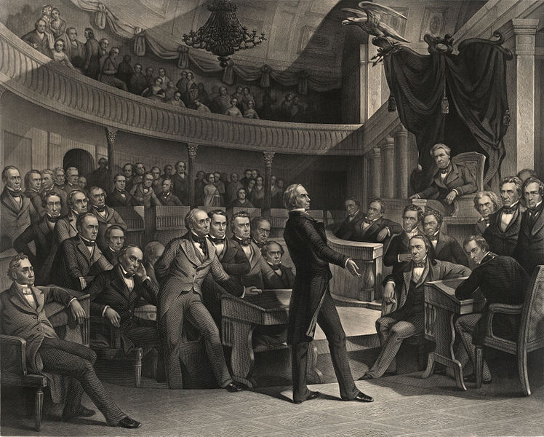
War, Expansion, and Slavery, 1846 – 1850
Election of 1848:
General Zachary Taylor wins (Whig)
Gold Rush:
John Sutter’s mills
49ers
Mostly men – population increases from 14,000 to 220,000 in 4 years
Many Mexicans and Californios were forced off their lands
Compromise of 1850: (5 parts)
Popular Sovereignty in the Mexican Cession
California is admitted as a free state (free states have an advantage in the Senate)
More strict fugitive slave law (most divisive part of Compromise)
Slave trade is outlawed in DC
Texas paid money to relinquish some land in dispute

Slide 5
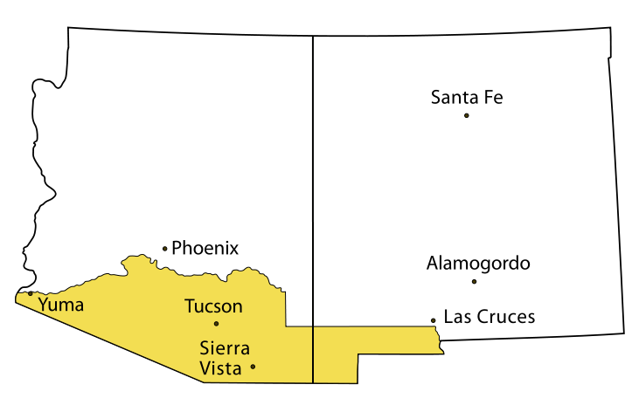
The End of the Second Party System, 1850 - 1858
Impact of the Fugitive Slave Act:
**Personal Liberty Laws**:
Laws passed by Northern states that barred involvement in returning runaway slaves
The Wisconsin state supreme court declared the Fugitive Slave Act unconstitutional – increased tensions
End of the Whigs:
With the deaths of Clay and Webster (1852) the Whigs disappear
Pierce’s Presidency (elected in 1852)
Ostend Manifesto:
Plan to buy Cuba from Spain, if they refused, US would take it by force
Fear of making Cuba a slave state
Gadsden Purchase:
Jimmy Fallon “Gadsden Purchase”
US (Secretary of War - Jefferson Davis) buys land from Mexico for Transcontinental RR
Kansas – Nebraska Act (1854)
Response to Gadsden Purchase, north wanted RR
Proposed popular sovereignty in Nebraska Territory
Overturned MO Compromise
Presumably, KS would be slave, NB would be free
Stephen, why are you repealing my Compromise bro?

Slide 6
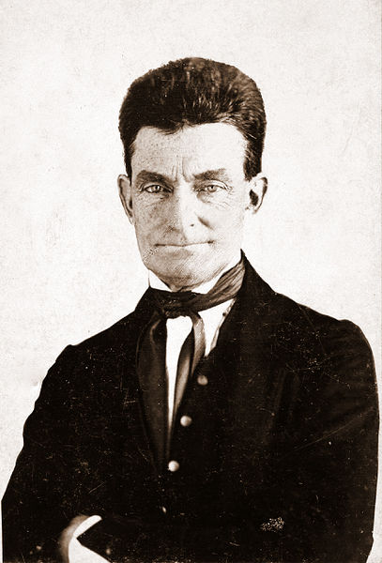
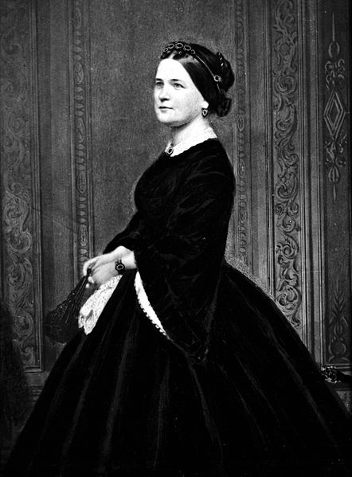
Abraham Lincoln and the Republican Triumph, 1858 - 1860
Lincoln’s early life:
Married Mary Todd – from Lexington, KY – knew Henry Clay!
Shared beliefs with the American Colonization Society
Lincoln-Douglas Debates:
7 debates for the Senate seat in Illinois
Douglas (D) wins, but alienates the South in the process
Lincoln emerges on a national level
“Freeport Doctrine”: if a territory wanted to, it could keep slavery out – split Democratic Party
John Brown and Harpers Ferry:
Hoped to incite a slave rebellion
Many southerners felt that North and Republican Party was filled with “John Browns”
Election of 1860:
Lincoln wins without receiving a single electoral vote from the South
Secession begins

Slide 7
Quick Review (Videos in Description)
Manifest Destiny
Mexican-American War
Free Soil Platform
Compromise of 1850
Kansas-Nebraska Act and “Bleeding Kansas”
Dred Scott
Election of 1860

Slide 8
Thanks for watching!
Good luck on your tests
Check out videos matching the new curriculum
Spread the word
Subscribe
I hope you’ve enjoyed learning about me…

