Slide 1
America’s History, 8th Edition, Chapter 14 Review Video
www.Apushreview.com
Two Societies at War: 1861 - 1865
Check out the description for videos that match up with the new curriculum.

Slide 2
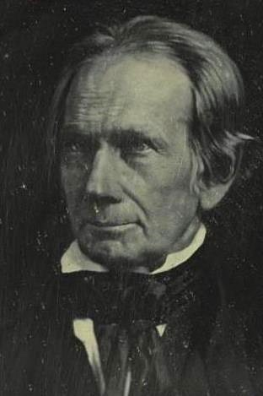
Secession and Military Stalemate, 1861 - 1862
This is the worst birthday ever……
The Secession Crisis:
SC was first to secede in December 20, 1860
The Lower South Secedes:
MS, FL, AL, GA, and LA soon followed
Jefferson Davis named President, Alexander Stephens named VP of CSA
Buchanan did not stop secession
The Crittenden Compromise: (2 Parts)
Proposed Constitutional amendment to protect slavery where it existed
36°30’ line would extend permanently to current and future territory
Lincoln did NOT support it – platform was the non-extension of slavery
The Upper South Chooses Sides:
April 12, 1862 – Fort Sumter attacked by the South
Ironically, Robert E. Lee was recommended to lead the Union army
Border states (MD, MO, KY, DE, and later, WV)
Geographically important (middle of South and North, rivers), industry
Lincoln had Southern sympathizers arrested in MD

Slide 3
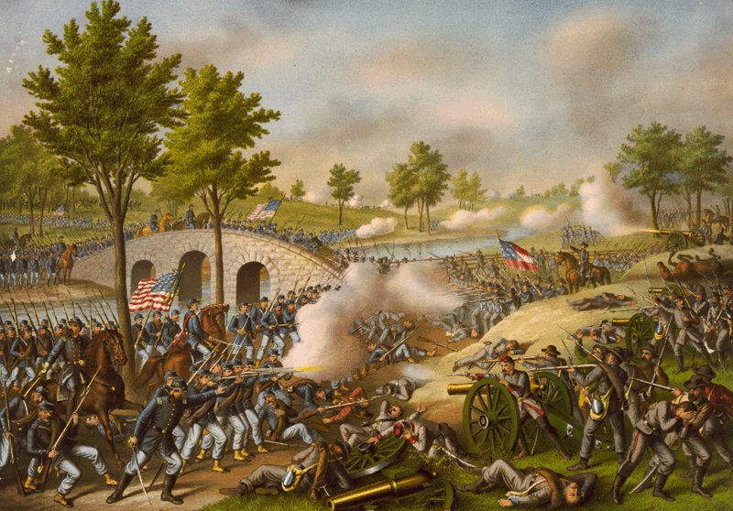
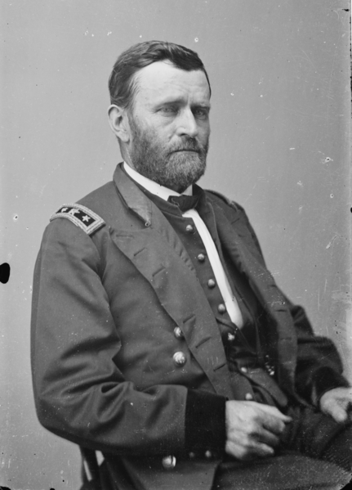
Secession and Military Stalemate, 1861 - 1862
Setting War Objectives and Devising Strategies:
Confederate Constitution forbid emancipation
Union Thrusts Toward Richmond:
The South won the 1st Battle of Bull Run – demonstrated strength
Lincoln replaced McDowell with McClellan
Lee Moves North: Antietam:
Antietam – bloodiest day in US history
North won – led to Emancipation Proclamation
McClellan was dismissed
The War in the Mississippi Valley:
Ulysses S. Grant captured forts on the TN river
Union captured the port city of New Orleans

Slide 4
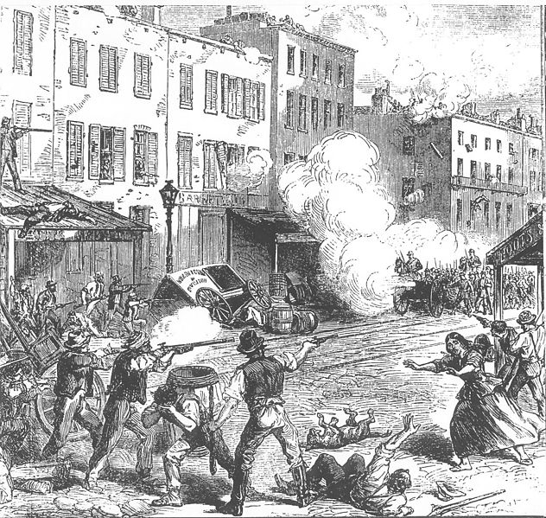
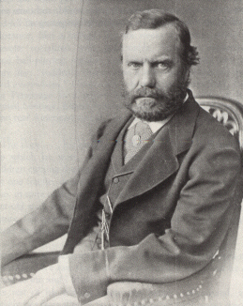
Toward Total War
Total War – using all of a nations resources in the war effort (used by the North, and later, the South)
Mobilizing Armies and Civilians:
South succeeded in raising volunteers – honor and duty
The Military Draft:
Conscription (draft) – first used by the South, later the North
Both sides allowed substitutes to be hired
Lincoln suspended habeas corpus (allowed people to be arrested and held without trial)
NYC Draft Riots (1863) (“Rich man’s war, but poor man’s fight”)
100s of people were killed
Women in Wartime:
Civil War had tremendous social and economic impacts on women:
Widows forced to work, women became nurses
Many women took jobs in factories

Slide 5
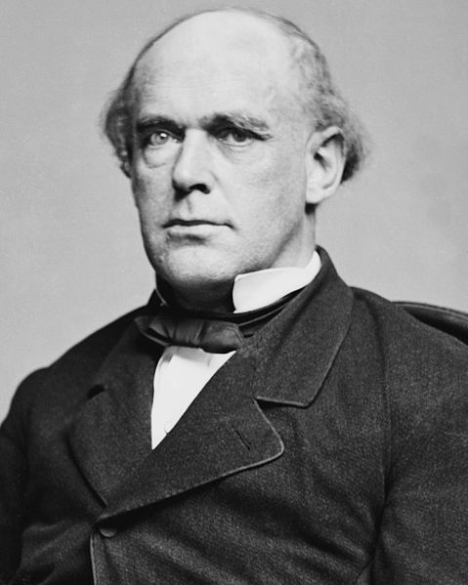
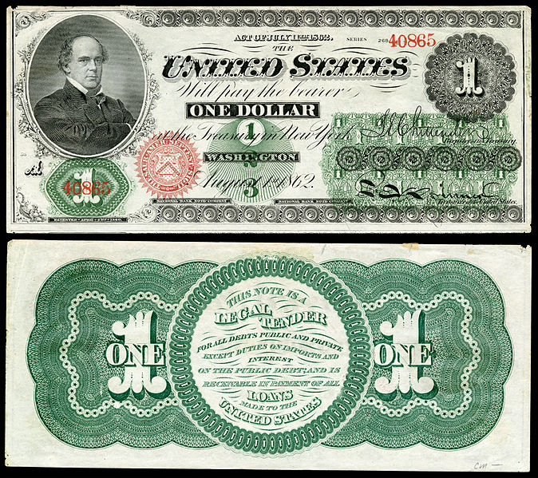
Toward Total War Cont.
Mobilizing Resources:
North had great advantages
2/3 of population and RRs
90% of industry
Southern advantages:
Few, powerful factories
“King Cotton” – powerful trading partner with Europe (England)
Republican Economic and Fiscal Policies:
Congress improved the infrastructure of the US
Encouraged expansion via Homestead Act and subsidies to RRs
How did the North pay for the war?
Higher tariffs – Republicans raise…., Bonds, printing greenbacks
The South Resorts to Coercion and Inflation:
South resisted taxes to raise $, issued paper $ - severe inflation

Slide 6
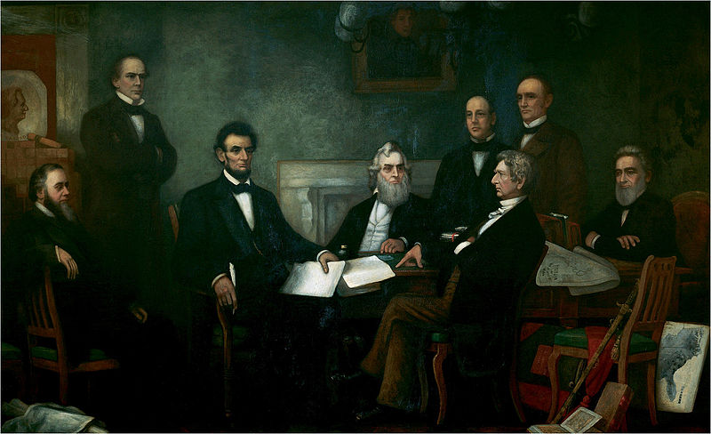
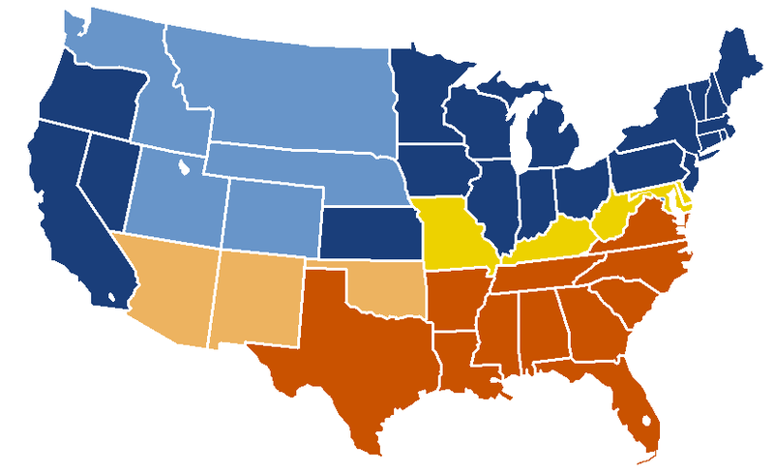
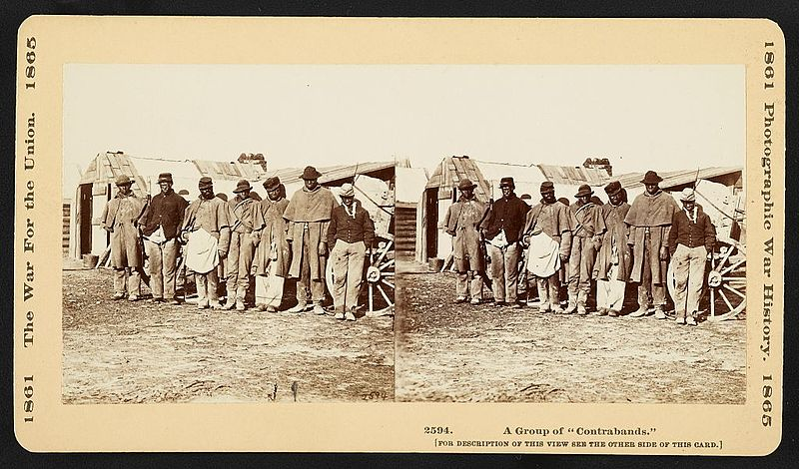
The Turning Point: 1863
Emancipation:
Contraband:
Escaped slaves that crossed over into the Union
Worked at camps and fought in the war
Slavery ended in DC and territories in 1862
The Emancipation Proclamation:
Issues on September 22, 1862, would take effect on January 1, 1863
Freed all slaves in areas of rebellion in the Confederacy
Slavery not touched in areas in control by North – border states especially
Helped keep Europe out of the war
Changed the aim of the war effort
Vicksburg and Gettysburg:
The Battle for the Mississippi:
Vicksburg, MS surrendered to Grant on July 4, 1863
Many escaped slaves were re-enslaved or killed by the South
Lee’s Advance and Defeat:
Gettysburg – 3 day battle, North won, but suffered heavy losses
Republicans were elected into office
King Cotton failed the South

Slide 7
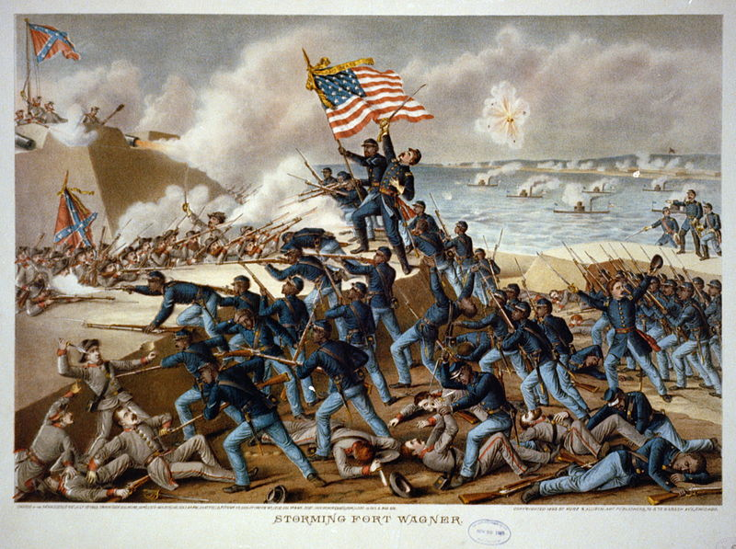
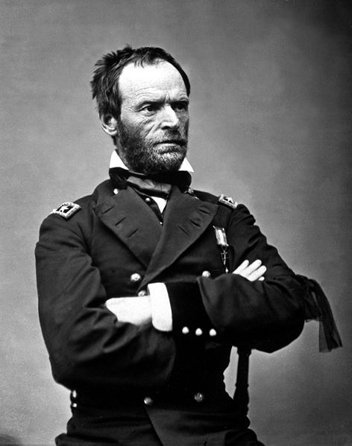
The Union Victorious, 1864 – 1865
Soldiers and Strategy:
The Impact of Black Troops:
200,000 black troops were recruited by 1865
54th Massachusetts Infantry
Black soldiers were paid less than whites
Capable Generals Take Command:
Grant became head of Union army in 1864
Heavy casualties under Grant’s leadership
William T. Sherman –invaded Atlanta
Stalemate:
Trench system was used
Scorched-earth – Shenandoah Valley was destroyed due to farmers’ support of Confederates

Slide 8
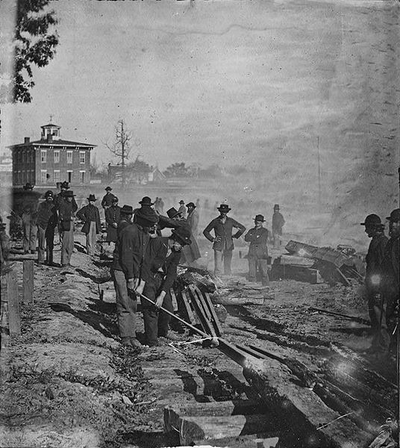
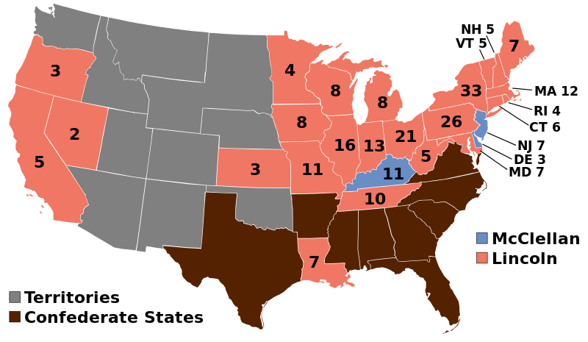
The Union Victorious, 1864 – 1865
The Election of 1864 and Sherman’s March
The National Union Party…..
Andrew Johnson (D from TN) named as Lincoln’s running mate
General McClellan ran for the Democrats
Some Democrats called for peace with the South
The Fall of Atlanta and Lincoln’s Victory:
Sherman’s army destroyed RRs
“Copperheads” - Democrats that spoke out against the war
Lincoln won with 55% of the popular vote, large electoral majority
13th amendment was approved in 1865
William T. Sherman: “Hard War” Warrior:
Sherman did not differentiate between civilians and soldiers
March to the Sea – 300 mile march from Atlanta in which everything was destroyed by Sherman and his men
Sherman set some land aside for freed slaves in GA
The Confederate Collapse:
Southerners resisted the draft
Blacks were used by the South, but too late in the war effort
April 9, 1865 – Lee surrendered at Appomattox Court House
Over 600,000 soldiers (North and South) died in the war

Slide 9
Quick Review
Election of 1860
Border South
Total War
How the North paid for the war
Emancipation Proclamation

Slide 10
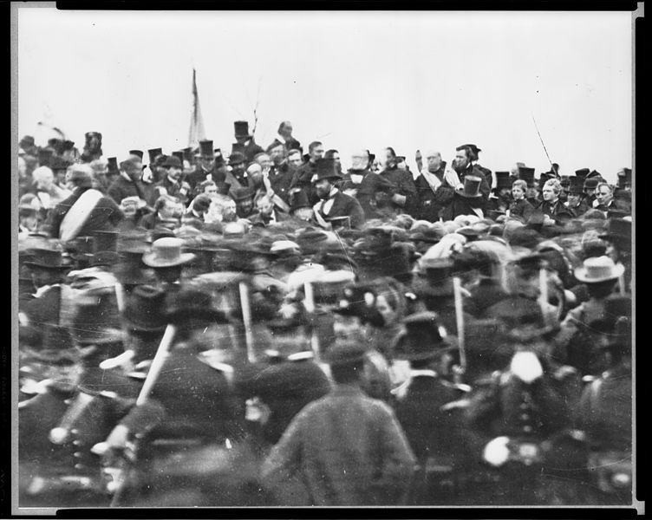
Thanks for watching!
Good luck on your tests
Check out videos matching the new curriculum
Spread the word
Subscribe

