Slide 1
America’s History, 8th Edition, Chapter 15 Review Video
www.Apushreview.com
Reconstruction: 1865 – 1877
Check out the description for videos that match up with the new curriculum.

Slide 2
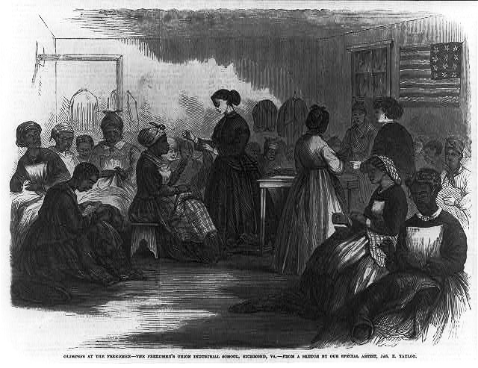
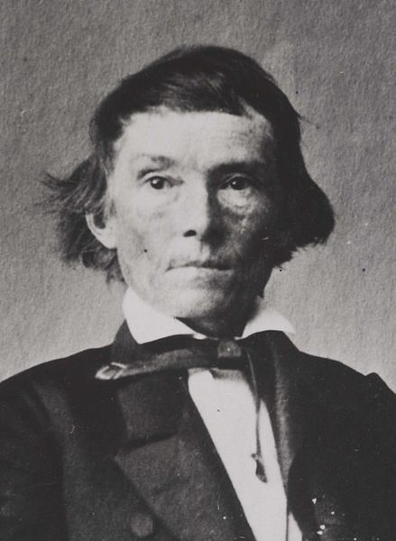
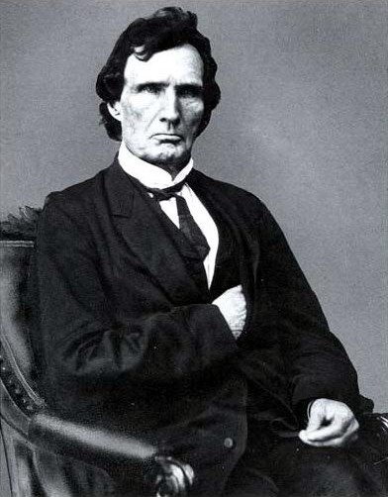
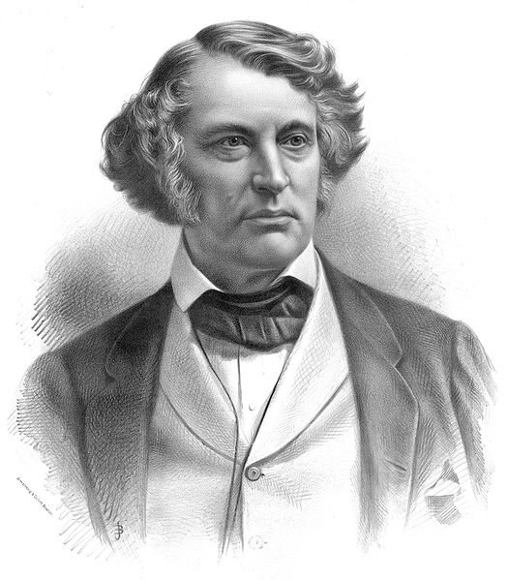
The Struggle for National Reconstruction
Reconstruction questions:
How should the South be readmitted?
Should leaders be punished?
Presidential Approaches: From Lincoln to Johnson
Lincoln and Johnson had similar plans
Amnesty (pardon) to most Confederates
States could be readmitted once 10% of voters in 1860 pledged loyalty and ratified 13th amendment
Wade-Davis Bill – Congressional bill calling for a more strict 50% of loyalty
Pocket-vetoed by Lincoln
Congress stepped in to take control of Reconstruction when:
South passed black codes - laws that restricted rights of free blacks
Georgia elected Alexander Stephens as their senator
Congress vs. the President:
Freedmen’s Bureau - Provided food, education, and assistance to former slaves and poor whites
Its biggest success was in EDUCATION!
Civil Rights Act of 1866 – granted citizenship to blacks and equal protection
Fourteenth Amendment – citizenship to all those born in US (made the Act of 1866 permanent)
Radical Republicans – Charles Sumner in the Senate, Thaddeus Stevens in the House

Slide 3
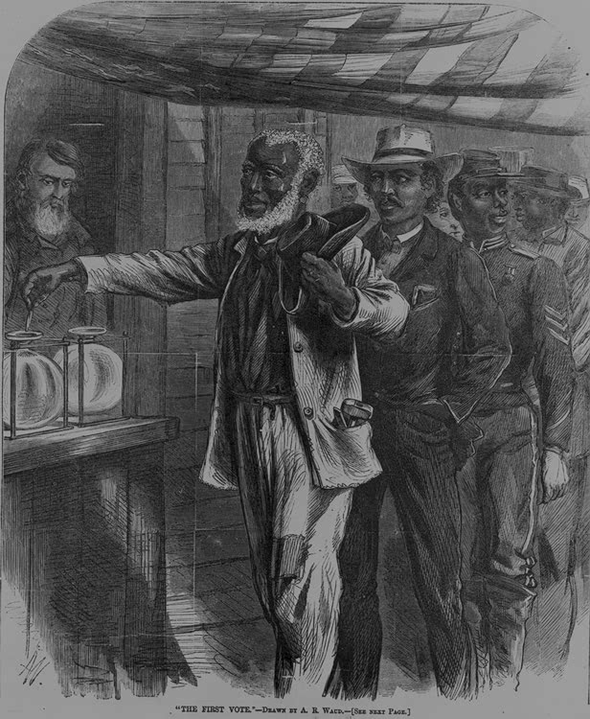
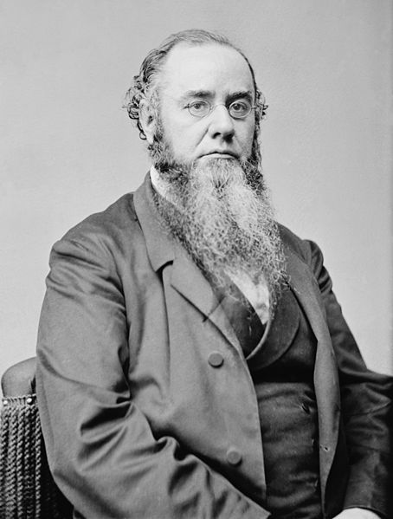
The Struggle for National Reconstruction Cont.
Radical Reconstruction:
Reconstruction Act of 1867 – divided the South into 5 districts
States must provide suffrage for blacks and deny it to ex-Confederates
The Impeachment of Andrew Johnson:
Violated the Tenure of Office Act:
President must get consent of Senate before removing cabinet members
Johnson is impeached, however, he is NOT removed from office
Election of 1868 and the Fifteenth Amendment:
15th – Suffrage could not be denied based on “race, color, or previous condition of servitude”
This would help ensure Republican support in the South
Woman Suffrage Denied:
Most men opposed women’s suffrage – “separate spheres”
The women’s rights group was split:
Lucy Stone and the American Women Suffrage Association hoped to achieve suffrage after Reconstruction
Stanton feared suffrage was not likely near, National Woman Suffrage Association advocated an amendment for women’s suffrage

Slide 4
The Meaning of Freedom
The Quest for Land:
Many former Confederates gained their land back via Johnson’s amnesty plan
Freed Slaves and Northerners: Conflicting Goals:
Most Congressmen believed former slaves would work plantations, not owning their own land
Without land, former slaves were left susceptible to rich land owners
Wage Labor and Sharecropping:
Many former slaves had to work for former slave owners since they had no land
**Sharecropping**
Renting land and paying via crops
If a drought or poor farming hit, tenants would be in trouble
Crop-Lien:
Receiving credit from a local store, usually at a HIGH rate (50-60%)
Usually led to debt for borrowers (former slaves)

Slide 5
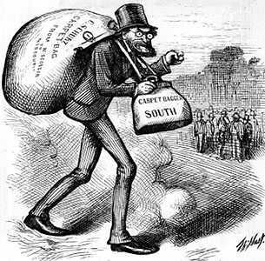
The Meaning of Freedom Cont.
Republican Governments in the South:
Union League – organization for blacks and white Republicans to share political news and voting procedures for blacks
Scalawags: Southerners that favored Reconstruction (mostly for economic reasons)
Carpetbaggers: Northerners that moved South during Reconstruction:
Doctors, lawyers, teachers
Political opportunities for African Americans increased during Reconstruction:
Robert Smalls – former slave, and Civil War hero, became a Congressman
Hiram Revels – 1st African American in the Senate (Jefferson Davis’ seat)
Building Black Communities:
Black churches doubled as schools and meeting places
Civil Rights Act of 1875 – “full and equal” access to political accommodations

Slide 6
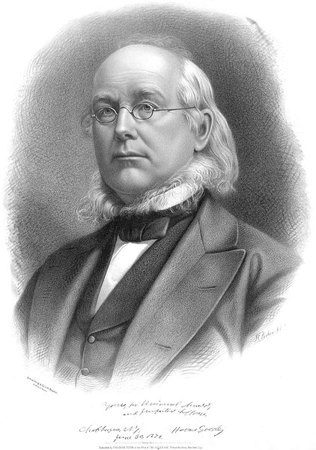
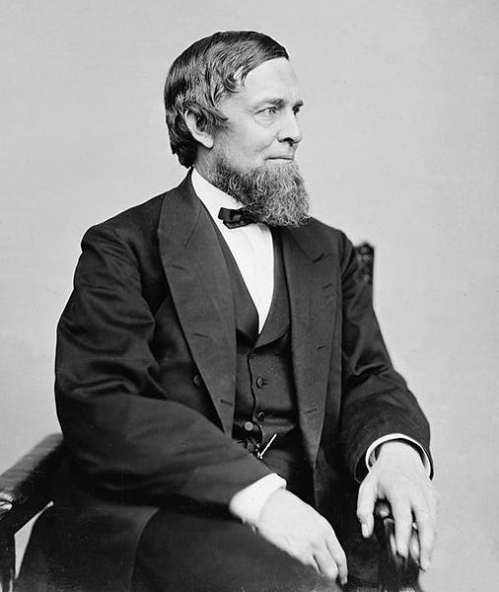
The Undoing of Reconstruction
Waning – to decrease, become weaker (Reconstruction efforts waned in the 1870s)
The Republicans Unravel:
Panic of 1873 hurt the country financially, and Republican goals in the South – cost $
Stories of corruption hurt the Republican Party
The Disillusioned Liberals:
Republican Party split into different factions – Liberal Republicans (Horace Greeley) advocated laissez-faire and smaller government
Credit Mobilier - Union Pacific RR company created bogus contracts to make $
Members of Congress, and Grant’s VP accepted bribes
Whiskey Ring - Government officials were creating false tax reports
Secretary of War accepted bribes

Slide 7
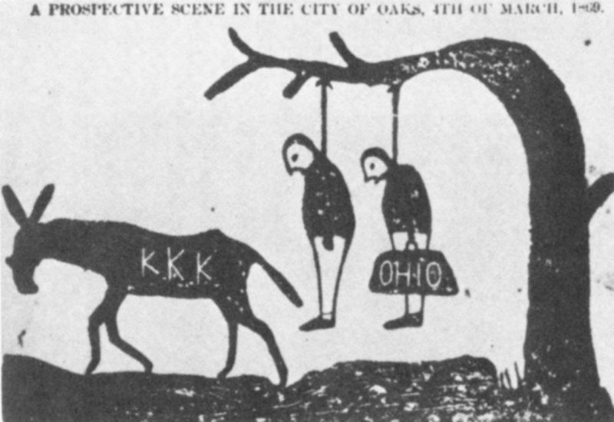
The Undoing of Reconstruction Cont.
Counterrevolution in the South:
Redeemer” governments:
Local and state governments that ousted Republican governments
Often done through violence and intimidation
KKK terrorized blacks and Republicans
Enforcement Acts: 1870-1871
Response to the KKK
Federal government could now prosecute criminals of federal law
President could use the military to protect individual rights

Slide 8
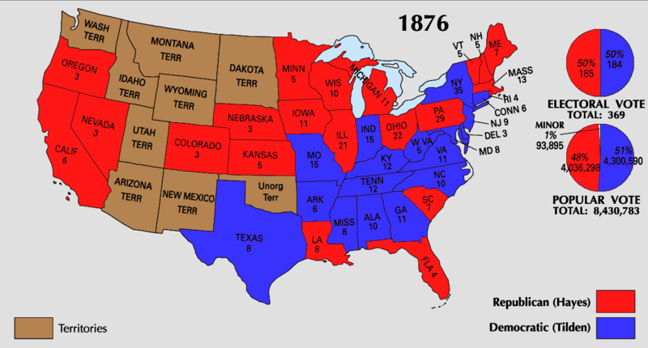
The Undoing of Reconstruction Cont.
Reconstruction Rolled Back
Democrats gained control of the House in 1874
Most of the country (including the Grant administration) was no longer concerned with the South
The Supreme Court Rejects Equal Rights:
US v. Cruikshank – court ruled that only state violations of individual rights were a concern, not individual rights
Civil Rights Cases - 14th Amendment did not prevent private discrimination, only government discrimination
The Political Crisis of 1877:
Hayes (Republican) v. Tilden (Democrat)
Tilden received 184 electoral votes to Hays 165; 185 needed to win
20 votes were in dispute
Eventually, all 20 were given to Hayes
Importance of the Compromise of 1877?
RECONSTRUCTION ENDS!, The military is withdrawn from the South

Slide 9
The Undoing of Reconstruction Cont.
Lasting Legacies
Although blacks still faced unbelievably harsh conditions, life was mostly better than the Antebellum Era
Right to marry, be educated, and travel
Although the 13 – 15 amendments were restricted in the short term, they later would be used to uphold civil rights:
1950s – 1960s Civil Rights Movement – Brown v. Board

Slide 10
Quick Review
Presidential vs. Congressional Reconstruction
Reconstruction Act of 1867
13 – 15 amendments
Split in women’s rights movement over the 15th amendment
Freedmen’s Bureau
Sharecropping
Redemption Governments

Slide 11
Thanks for watching!
Good luck on your tests
Check out videos matching the new curriculum
Spread the word
Subscribe
On a scale of 1 – 10, how sweet is my beard?

