Slide 1
APUSH Review: America’s History, Chapter 17 (8th Edition)
Check out the description for a link to this PowerPoint, as well as videos for the new curriculum.

Slide 2
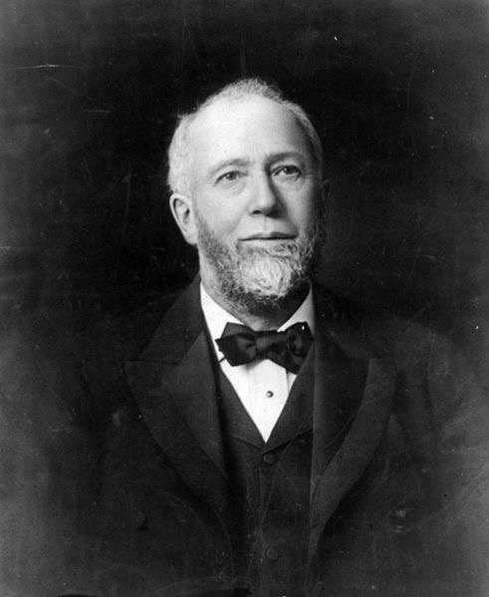
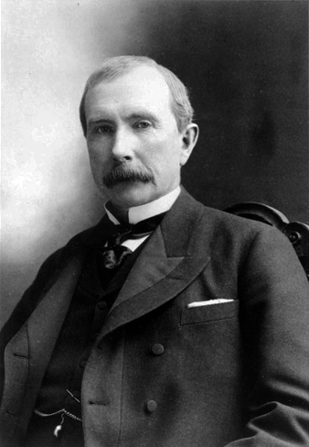
The Rise of Big Business
Key Concept 6.1, I, C. Business leaders consolidated corporations into trusts and holding companies and defended their resulting status and privilege through theories such as Social Darwinism.
Innovators in Enterprise:
Production and Sales:
Gustavus Swift - assembly line
Vertical integration - company controls all aspects of production from beginning to end
Predatory pricing - lowering prices to eliminate competitors
Standard Oil and the Rise of Trusts:
Rockefeller used vertical integration
Horizontal integration - merge competitor companies with his own to gain a market advantage
Trust - small group of individuals would hold stock from competing firms, thus controlling all of them
JP Morgan eventually bought Carnegie’s Steel Company, created 1st $1 billion company

Slide 3
The Rise of Big Business Cont.
Innovators in Enterprise:
Assessing the Industrialists:
Robber Barons v. Industrial Statesmen
Depending on the economy, views often change
A National Consumer Culture:
Department stores were able to cut prices significantly
Macy’s
Home-order catalogs helped those living in rural areas
Sears and Montgomery Ward
Advertisements appeared all over the nation, including outdoors on billboards

Slide 4
The Rise of Big Business Cont.
The Corporate Workplace
White-collar workers - professional positions; Blue-collar workers - manual labor
Managers and Salesment
New middle managers emerged - in charge of goods and labor
Sales positions increased throughout the US with opportunity for $
Women in the Corporate Office
By the end of the 1800s, 77% of stenographers were women
Clerking and secretarial opportunities for women increased and paid better than other domestic jobs
4 million women worked by 1900

Slide 5
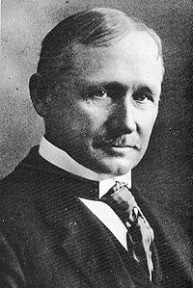
The Rise of Big Business Cont.
On the Shop Floor:
Deskilling of labor - instituting remote tasks that requires less autonomy of the worker (assembly line and mass production)
Scientific Management - Frederick Taylor (Taylorism)
Using strict rules to govern worker behavior - timed tasks, same tasks over and over
Health Hazards and Pollution
Dangerous conditions were in many industries - RR 1 in 20 deaths or disabilities, 2,000 coalminers died per year
Why did people work? Needed $
Unskilled Labor and Discrimination
Men and unions discriminated against women - should stay at home
1 in 5 children under 16 worked outside the home
African Americans were often paid the least amount, women worked in mostly domestic service roles

Slide 6
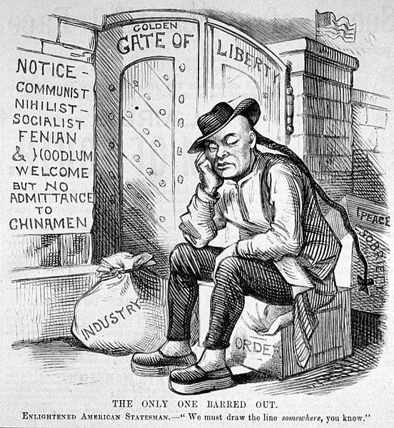
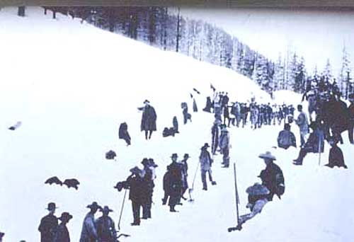
Immigrants, East and West
Key Concept 6.1, II, A. The industrial workforce expanded through migration across national borders and internal migration, leading to a more diverse workforce, lower wages, and an increase in child labor.
Immigrants were the ideal labor supply - abundant, worked for little $, hard to unionize - language barriers
Newcomers from Europe
Post-1892, many immigrants came through Ellis Island
“New Immigrants” were mostly from Southern and Eastern Europe (Italy, Greece, Russia, etc.) - 3 million were Jews
Many of these immigrants took low-paying jobs
Asian Americans and Exclusion
Chinese immigrants faced extreme prejudice and violence out West
Worked in restaurants and laundries, as they were the only jobs available
Chinese Exclusion Act (1882) - barred Chinese from coming to US, repealed in 1943

Slide 7
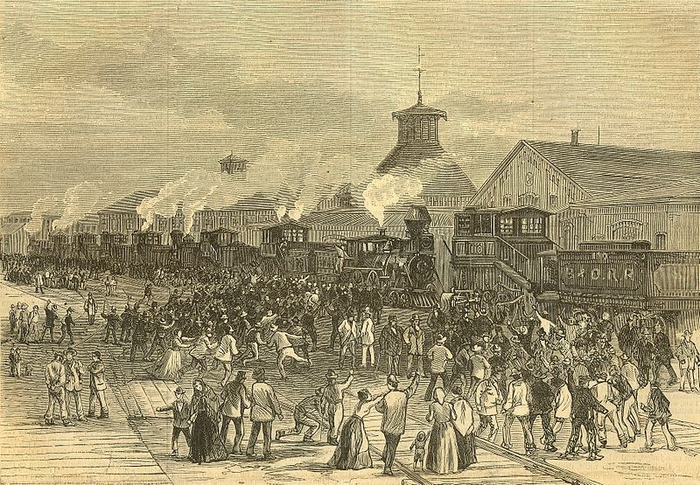
Labor Gets Organized
The Emergence of a Labor Movement
Great RR Strike of 1877 - reaction to wage cuts, protests erupted in many cities across the country
More than 50 people died
Many workers were blacklisted - prevented from being hired in the future
Farmers’ plight:
Despised tariffs, argued RRs exploited them - high rates for shipping
National Grange (The Grange) - brought farmers together to discuss their situation
Greenback Labor Party - national movement that sought an 8-hour work day and better working conditions
Granger Laws - state laws that regulated RRs, many later were overturned

Slide 8
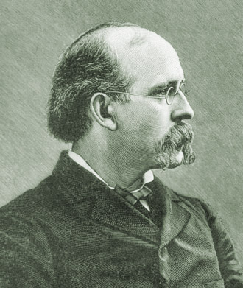
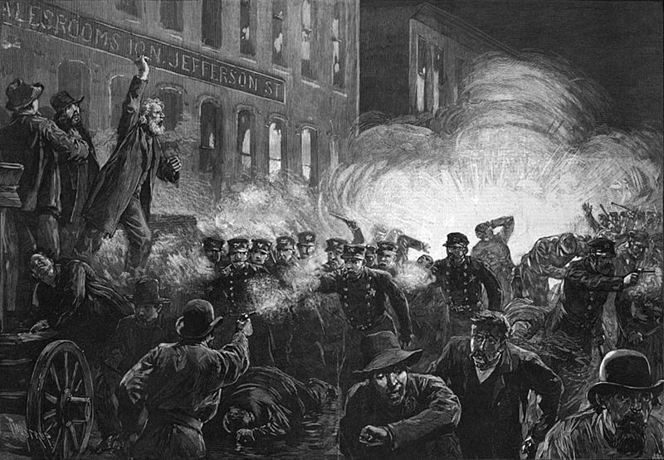
Labor Gets Organized Cont.
Key Concept 6.1, II., B. Labor and managements battled for control over wages and working conditions,
with workers organizing local and national unions and/or directly confronting corporate power.
The Knights of Labor
Founded in 1869, advocated employees should own shops
Characteristics of the Knights:
Open membership - skilled and unskilled workers, women and blacks were welcomed
Goals of the Knights?
Workplace safety laws, elimination of child labor, income tax for wealthy, public ownership of RRs
At its height, the Knights had 750,000 members
Haymarket Square Riot - Meeting of workers to gain 8-hour workday
At the meeting, someone threw a bomb, killing and injuring many
Many anarchists were found guilty and sentenced to death
The Knights of Labor were associated with the Haymarket Square Riot, leading to their downfall

Slide 9
Labor Gets Organized Cont.
Farmers and Workers: The Cooperative Alliance:
Farmers’ Alliance - sought to establish cooperative stores - eliminate the middlemen
A separate, Colored Farmers’ Alliance was established as well
Eventually, they morph into the **Populist Party** (Chapter 20)
Interstate Commerce Act - created the ICC, allowed the government to investigate RRs, mostly symbolic at first

Slide 10
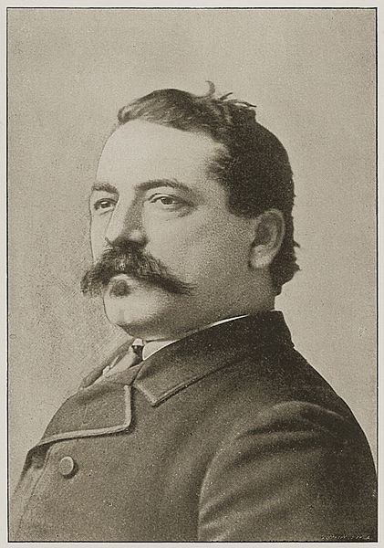
Labor Gets Organized Cont.
Another Path: The American Federation of Labor
Unlike the Knights, the AFL was comprised of skilled workers only
Led by Samuel Gompers, the AFL sought:
“Bread and butter” issues, or “pure-and-simple unionism”
Higher wages, shorter hours, and better working conditions
Membership increased to over 2 million at one point

Slide 11
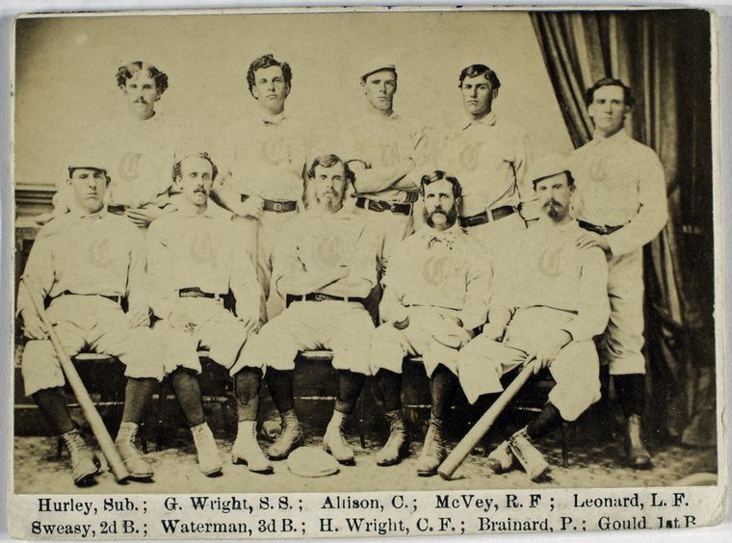
Good Luck!
Thanks for Watching
Please subscribe, share with others
Check out all my videos related to the new curriculum
Best of luck on all your tests!

