Slide 1
APUSH Review: America’s History, Chapter 18 (8th Edition)

Slide 2
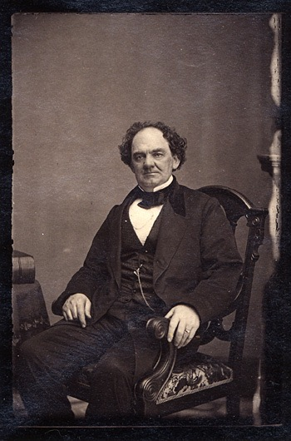
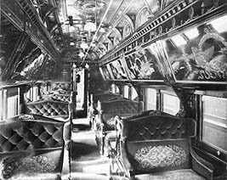
Commerce and Culture
Consumer Spaces
Businesses sought to attract middle-class women
P.T. Barnum’s Circus - appealed to families
Department stores and store credit
Electricity paved the way for new appliances:
Washing machines, vacuum cleaners, etc.
Pullman Palace Cars
Luxurious train cars

Slide 3
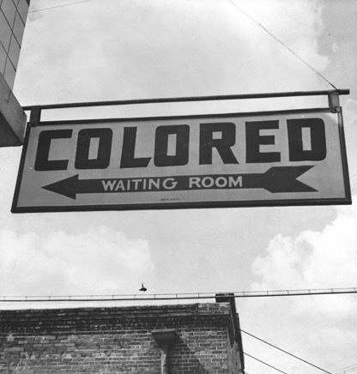
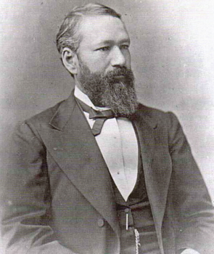
Commerce and Culture
Consumer Spaces
Plessy v. Ferguson (1896) upheld segregation in accommodations, as long as they were “equal”
Upheld the constitutionality of Jim Crow Laws
“Separate but equal” facilities appeared all over the South
In 1954, the case was overturned via Brown v. Board of Education

Slide 4
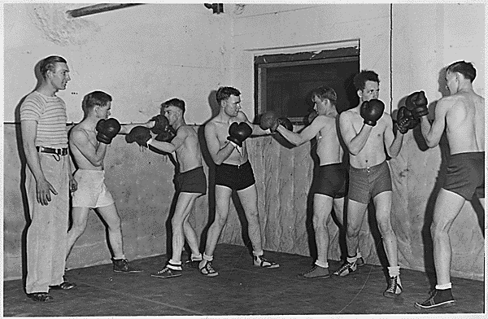
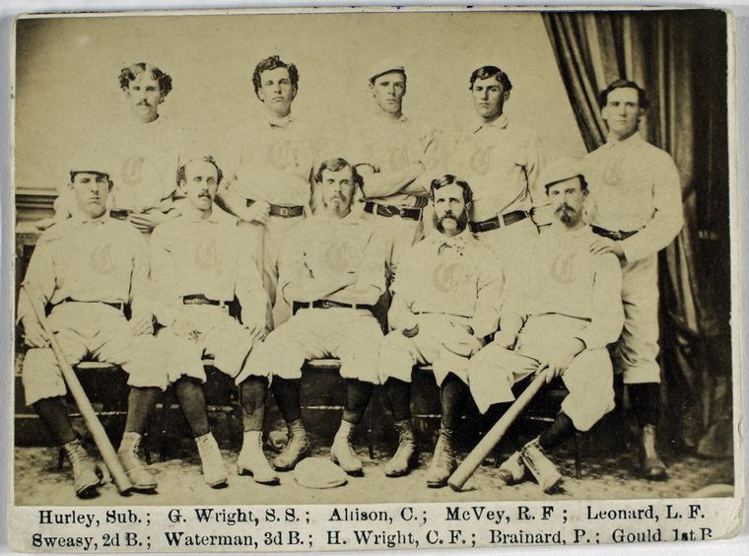
Commerce and Culture
Masculinity and the Rise of Sports
“Muscular Christianity”
YMCA - appealed to both professionals and working-class men
Promoted Christianity and fitness
America’s Game
Baseball became popular in the 1870s
Provided Americans with new leisure activity
First professional baseball team?
Cincinnati Red Stockings!!!

Slide 5
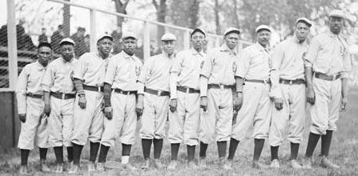
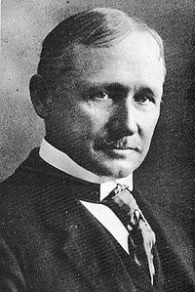
Commerce and Culture
Masculinity and the Rise of Sports
Rise of the Negro Leagues
Blacks were excluded from baseball, Negro Leagues were established
American Football
Collegiate football became popular under Yale’s Walter Camp, who utilized Scientific Management
Quick: Who created scientific management? What did it call for?

Slide 6
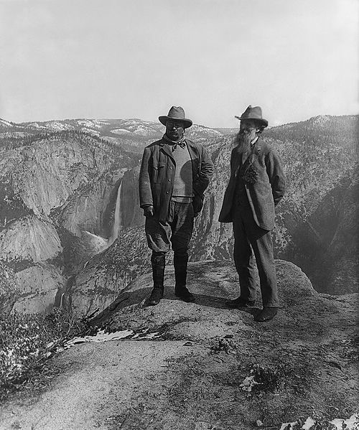
Commerce and Culture
Key Concept 6.1, III, A. Government agencies and conservationist organizations contended with corporate interests about the extension of public control over natural resources, including land and water.
The Great Outdoors
Sierra Club - sought to preserve America’s mountains
1872 - creation of Yellowstone in Wyoming
National Park Service (1916)
Antiquities Act (1906) - the president could set aside objects as national monuments
**Business interests hoped lands would be declared monuments as opposed to parks, because there was weaker protection.**
Many states passed laws regulating hunting and fishing to help preserve wildlife

Slide 7
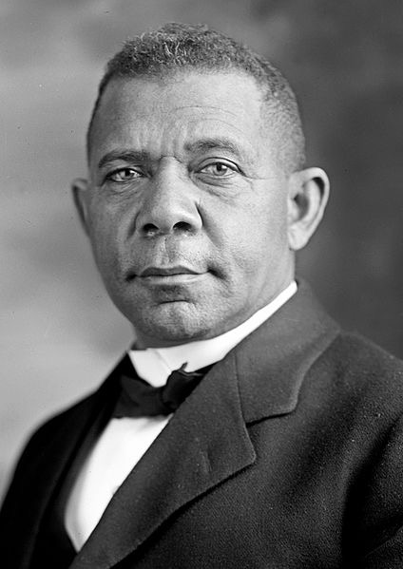
Women, Men, and the Solitude Self
Key Concept 6.3, II, C: Challenging their prescribed “place,” women and African American activists articulated alternative visions of political, social, and economic equality.
Changes in Family Life
Childbearing decreased drastically:
People married later in life, contraceptives became more widespread
Comstock Act (1873) - prohibited distribution of information about sex and birth control
Education:
By 1900, over 70% of Americans between 5 and 18 attended school
Tuskegee Institute:
Founded by Booker T. Washington, a former slave
Advocated that blacks learn industrial education, or vocational training
Atlanta Compromise:
Washington argued for equal economic opportunities for blacks
“In all things that are purely social we can be as separate as the fingers, yet one as the hand in all things essential to mutual progress.”
Women’s education opportunities increased post-Civil War
Many women attended black colleges created during Reconstruction

Slide 8
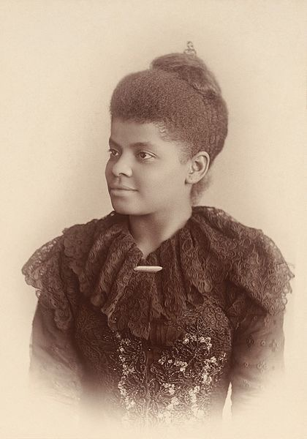
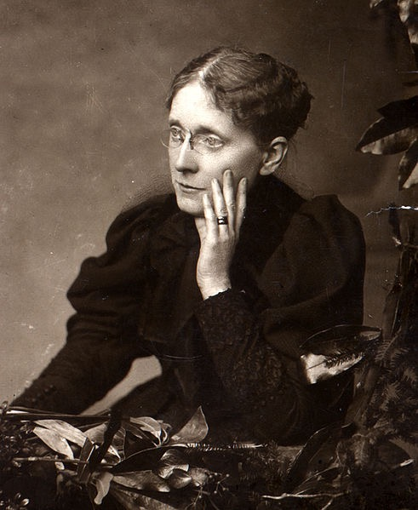
Women, Men, and the Solitude Self
Key Concept 6.3, II, C: Challenging their prescribed “place,” women and African American activists articulated alternative visions of political, social, and economic equality.
From Domesticity to Women’s Rights
Maternalism - helped justify women’s involvement in reform movements
The Woman’s Christian Temperance Union
1874, Frances Willard
Sought to challenge alcohol and domestic violence
Key frontrunner in the Prohibition movement
Movement was divided along religious, ethnic, and class lines
Women, Race, and Patriotism
United Daughters of the Confederacy (UDC)
Created monuments, gave out Confederate flags, and helped reshape the image of the Civil War
National Association of Colored Women:
Reform organization that focused on orphans, elderly in need of homes, and advocated temperance
Ida B. Wells - journalist that wrote about the horrors of lynching
Demonstrated lynchings were often result of labor and economic disputes, relationships between black men and white women

Slide 9
Women, Men, and the Solitude Self
Key Concept 6.2, I, D: In an urban atmosphere where the access to power was unequally distributed, political machines provided social services in exchange for political support, settlement houses helped immigrants adapt to the new language and customs, and women’s clubs and self-help groups targeted intellectual development and social and political reform.
From Domesticity to Women’s Rights
Women’s Rights
National American Woman Suffrage Association (NAWSA) (1890):
Many western states provided suffrage for women (WY, CO, ID, UT)
By 1913, many women west of MS River were granted suffrage
Feminism:
Advocate political, economic, and social equality for women

Slide 10
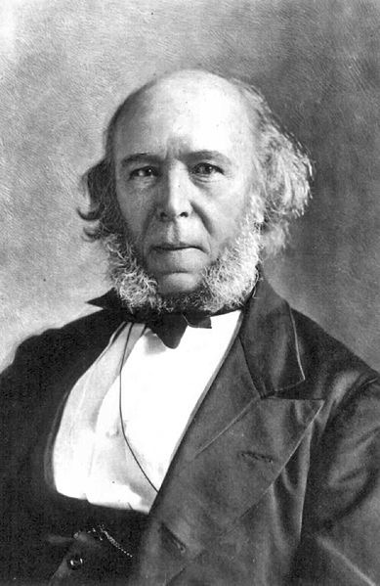
Science and Faith
Key Concept 6.3, I, C: Business leaders consolidated corporations into trusts and holding companies and defended their resulting status and privilege through theories such as Social Darwinism.
Darwinism and Its Critics
Herbert Spencer and “Social Darwinism” - “survival of the fittest”
Used by wealthy to justify their wealth
Success and wealth showed wealthy were “naturally selected”
Eugenics:
Practice of preventing certain individuals from reproducing

Slide 11
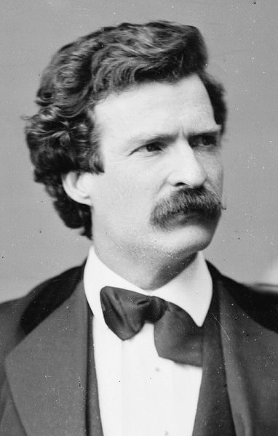
Science and Faith
Realism in the Arts
Realism:
Representing life in realistic terms
Mark Twain:
Coined the term, “Gilded Age”
Anti-imperialist, critic of American progress
Many realism and modernism artists were men

Slide 12
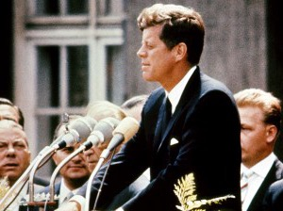
Science and Faith
Key Concept 6.2, I, C: Immigrants sought both to “Americanize” and to maintain their unique identities; along with others, such as some African Americans and women, they were able to take advantage of new career opportunities even in the face of widespread social prejudices.
APA, Why Are You Hating On Catholics, Bros?
Religion: Diversity and Innovation
Immigrant Faiths
Catholic and Jewish immigrants struggled to keep their traditions vs. becoming “American”
Italians and Poles often established their own parishes and schools
Protestant Innovations:
American Protective Association (APA)
Similar to the Know-Nothing Party of the 1840s and 1850s
Sought to ban Catholics from holding office
Key Concept 6.3, I, B: Increasingly prominent racist and nativist theories, along with Supreme Court decisions such as Plessy v. Ferguson, were used to justify violence as well as local and national policies of discrimination and segregation.

Slide 13
Science and Faith
Key Concept 6.3, II, B: A number of critics challenged the dominant corporate ethic in the United States and sometimes capitalism itself, offering alternate visions of the good society through utopianism and the Social Gospel.
Religion: Diversity and Innovation
Protestant Innovations:
**Social Gospel**
Protestant Church movement that sought to improve society by helping to end injustice and improve social welfare
Reading rooms, nurseries, and other services were provided to the needy
Salvation Army:
Helped establish soup kitchens and shelters
Fundamentalism:
Focused on the strict, literal interpretation of the Bible
Would play an important role in the 1920s

Slide 14
Quick Recap of Chapter 18
Plessy v. Ferguson and “separate but equal”
Later Overturned by Brown v. Board
Conflict between businesses and government over land and resources
Booker T. Washington
Women’s Christian Temperance Union
Ida B. Wells
Social Darwinism
American Protective Association (APA)
Social Gospel

Slide 15
Good Luck!
Thanks for Watching
Please subscribe, share with others
Check out all my videos related to the new curriculum
Best of luck on all your tests!
Go Reds!

