Slide 1
America’s History, 8th Edition, Chapter 2 Review Video
www.Apushreview.com
American Experiments
(1521 - 1700)

Slide 2
Chattel Slavery
Virginia and Maryland – 1660s
Legally defined chattel slavery
The status of the child would be determined based on the MOTHER and not the FATHER
Ran contradictory to English law
Children born to slave owners and slave mothers were automatically slaves

Slide 3
Spain’s Tribute Colonies
A New American World:
Encomienda System – Spanish conquistadors received land from the crown
Based almost entirely on Indian slave labor
Very harsh, yet profitable
Spanish social classes:
Mestizos, Mulattos, and Zambos emerged
Many Spanish priests sought to convert Indians
The Columbian Exchange
Exchange of goods, people, disease, and ideas between Europe, Africa, and Americas
New crops were introduced to Europe – potato, maize
Horse had large impact on Indian life
In some areas, 90% of Indian population decreased
The Protestant Challenge to Spain
England began to build up its navy in the 16th century
Mercantilism – purpose was to benefit the Mother Country (England) by exporting more goods than importing

Slide 4
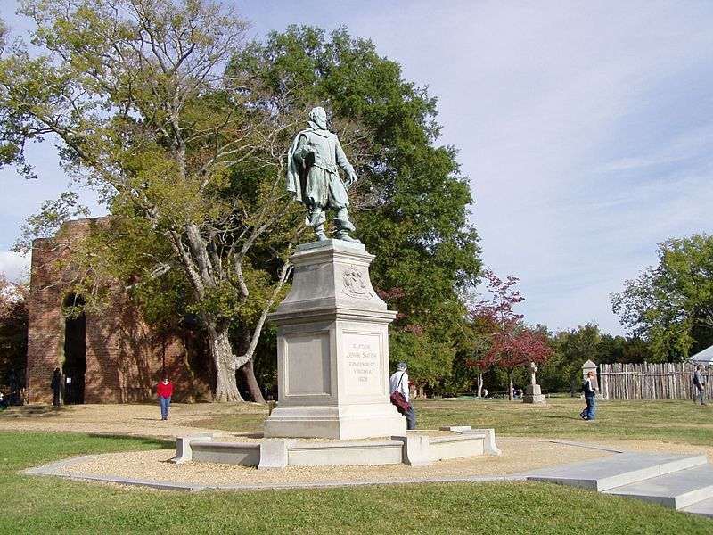
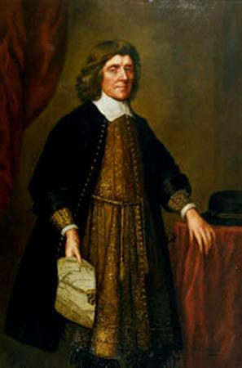
Plantation Colonies
Plantations in the Americas grew as a result of increased demand for sugar and tobacco
Brazil’s Sugar Plantations:
Very arduous labor, milling was done on site
As Indian populations declined, African slave labor was introduced
England’s Tobacco Colonies:
Jamestown: (1607)
Joint Stock Company (investors shared in profits and losses of colony)
Originally all men, hoped to gain gold
Eventually, tobacco became a major cash crop, but exhausted the land -> encroach on Indian land
House of Burgesses – first representative government in US (1619)
The Indian War of 1622:
1/3 of Jamestown population was killed by Indian attacks, English retaliated
Jamestown became a royal colony in 1624 – colonists had to pay taxes to support the Church of England
Lord Baltimore Settles Catholics in Maryland:
Proprietor colony – royal grant of land granted by the King
Maryland Acts of Toleration (1649) – granted religious freedom to CHRISTIANS only, particularly Catholics
Maryland relied heavily on tobacco, like the other Chesapeake colony, Virginia

Slide 5
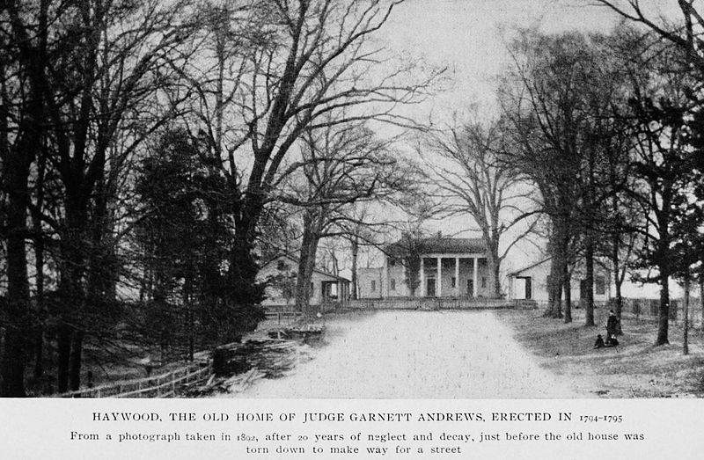
Plantation Colonies Cont.
The Caribbean Islands:
Like Brazil, these colonies focused on sugar production
Plantation Life:
Planation's grew in part, due to the Headright System:
Gave 50 acres of land to someone who paid for an immigrant’s passage – benefited the rich
Indentured Servitude:
In return for passage, individuals would work 4-5 years, then could be free
½ of all servants died before they became free
Used extensively in the Chesapeake colonies in 17th century
African Laborers:
Used more heavily in the Caribbean originally (sugar)
Used more in the Chesapeake due to Bacon’s Rebellion and it was cheaper than indentured servants
Strict laws developed that promoted racism and regulated behavior of blacks

Slide 6
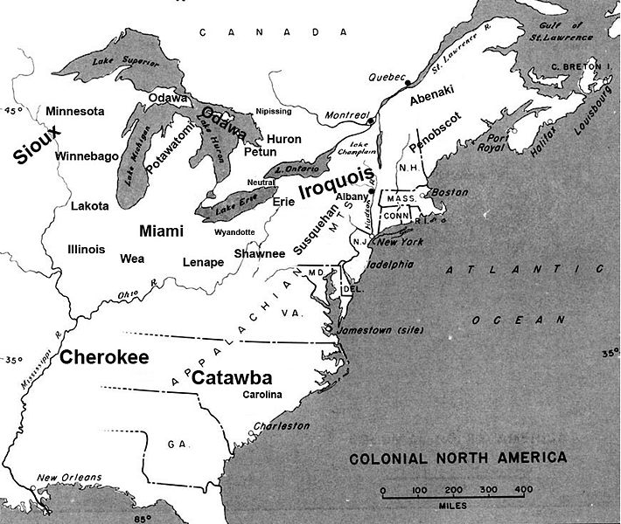
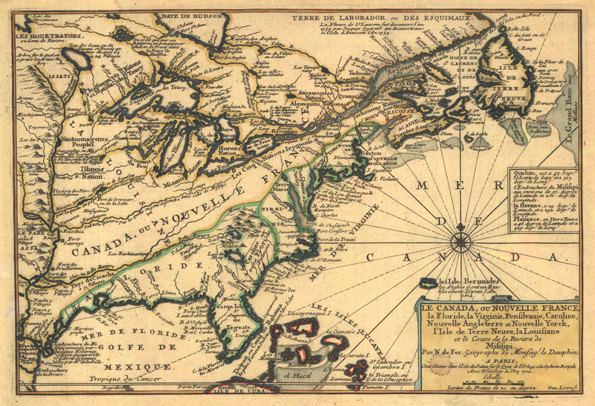
New-European Colonies
New France:
Expanded into the North American interior (Canada)
Quebec was established as a trading post (fur)
Established Jesuit priests sought to convert Indians
Coureurs de bois – French fur traders
New Netherland:
New Amsterdam (Manhattan) was a small colony, but engaged in significant commerce
Like the French, the Dutch traded furs
The Rise of the Iroquois:
Located in central and Western NY
Treaded weapons and goods with the Dutch and French
Remained a strong force in NY

Slide 7
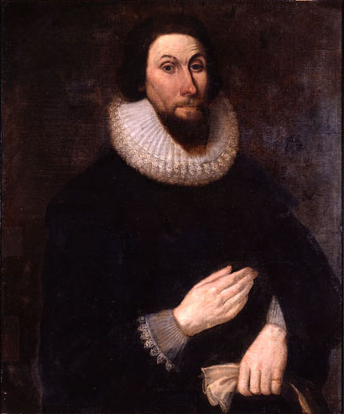
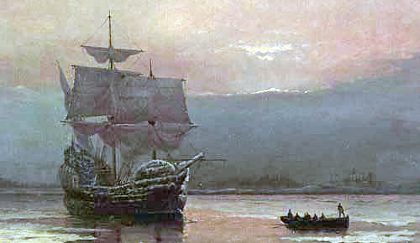
New-European Colonies Cont.
New England:
The Pilgrims
Separatists that wanted to break away from the Church of England
Plymouth’s climate was not as harsh as the Chesapeake
Representative self-government was established
Puritans – wanted to purify the English Church, NOT separate from it
John Winthrop and Massachusetts Bay:
Sought to establish a “City Upon a Hill”
Believed in predestination
Church members had tremendous power – only ones that could vote; not religiously tolerant
Roger Williams and Rhode Island:
Advocated separation of church and state, religious toleration, and friendly relations with Indians
Banished to Rhode Island by Winthrop
No legally established church in RI

Slide 8
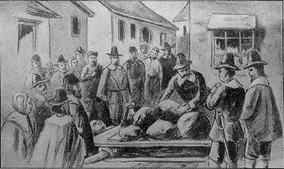
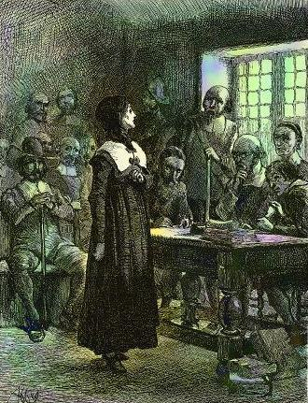
New-European Colonies Cont.
Anne Hutchinson:
Seen as a major threat to Puritans
Challenged gender roles in Church
Claimed to have direct revelations with God
Banished from MBC
Puritanism and Witchcraft:
Salem Witch Trials:
Hysteria throughout MA in late 17th century
Accused tended to be wealthier, widowed, and middle-ages
Reflected religious and social tensions
Most of the accused were “independent” which challenged Puritan society
After the hysteria ended, prosecution for witchcraft declined
Many colonists started to embrace ideas of the Enlightenment

Slide 9
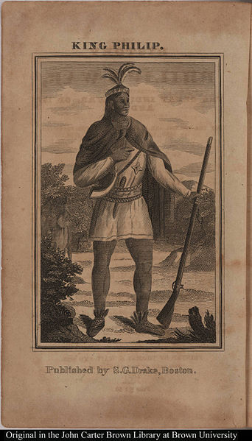
Instability, War, and Rebellion
New England’s Indian Wars:
Puritan-Pequot War:
Pequots were allied with the Dutch, had conflicts with English settlers
500 men, women, and children were massacred by Indians, New England retaliated harshly and gained land
Some settlers saw smallpox and other diseases that decimated Indians as doing “God’s work” (John Winthrop)
Metacom’s War, 1675 – 1676:
Metacom (King Philip) was a leader of the Wampanoags
Metacom was eventually killed and Natives were rarely a threat in New England after

Slide 10
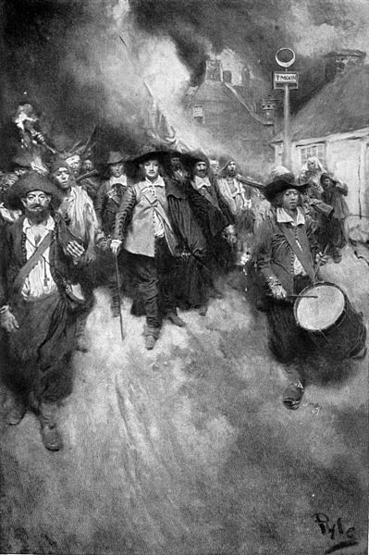
Instability, War, and Rebellion Cont.
Bacon’s Rebellion:
Gov. Berkeley did not allow settlement past a line
In the “west” many famers were underrepresented in the House of Burgesses
Conflict between Natives and “westerners” like Bacon
Bacon almost took control, died suddenly
Significance?
Movement towards slaves for labor
Shows tensions between rich and poor, East and West

Slide 11
Quick Recap
Columbian Exchange included diseases as well as goods (potatoes, maize, horses)
MD Acts of Toleration applied to ONLY Christians
Headright System and indentured servants
Chesapeake focused on indentured servants and tobacco -> expansion on Indian land
New France traded and had friendly relations with Indians
No religious toleration in MBC: Roger Williams and Anne Hutchinson
Bacon’s Rebellion showed tensions between “east and west” or “rich v. poor” and led to an increase in slavery

Slide 12
Thanks for watching!
Subscribe to my channel
Press the “Like” button
Questions? Comments?
Follow me on Twitter @APUSH_Review
Subscribe
Down here!

