Slide 1
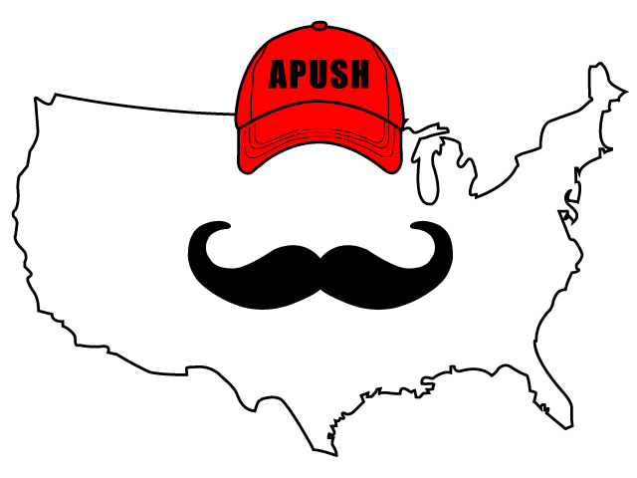
APUSH Review: America’s History, Chapter 20 (8th Edition)

Slide 2
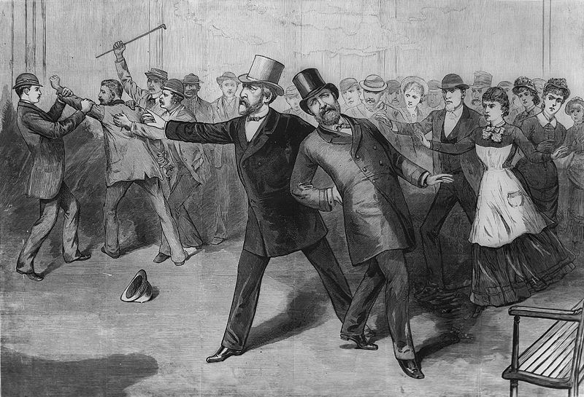
Reform Visions, 1880 - 1892
Electoral Politics After Reconstruction:
Control of Congress changed between Rs and Ds often
Republicans wanted to Raise tariffs
Gilded Age - saw political corruption, large gap between rich and poor
New Initiatives
James Garfield - died 6 months into office
Pendleton Act - required many government jobs to be filled by a civil service test (helped limit Spoils System)
Mugwumps - Liberal Republicans that did not support James Blaine in 1884
Grover Cleveland:
2 nonconsecutive terms, vetoed more bills than any president
Signed the Interstate Commerce Act - sought to limit power of corporations (RRs)

Slide 3
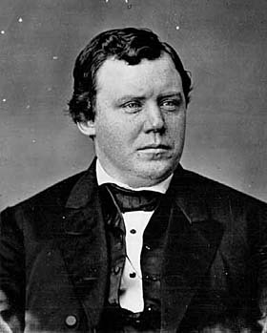
Reform Visions, 1880 - 1892
Electoral Politics After Reconstruction:
Republican Activism
Sherman Antitrust Act (1890):
Sought to limit corporations, forbid combinations “in the form of trust or otherwise”
Ironically, the act was often used to curb the power of unions, not corporations
Lodge Bill - would allow citizens to ask for government intervention in elections, did not pass
***The Populist Program*** (Specifically mentioned in new curriculum)
Made up of predominantly farmers
Omaha Platform - argued people should have more say in government:
Public ownership of RRs and telegraphs
Federal income tax for wealthy
Loosen the money supply (help borrowers and those in debt)
Ignatius Donnelly
Key Concept 6.1, III, C:The growth of corporate power in agriculture and economic instability in the farming sector inspired activists to create the People’s (Populist) Party, which called for political reform and a stronger governmental role in the American economic system.

Slide 4
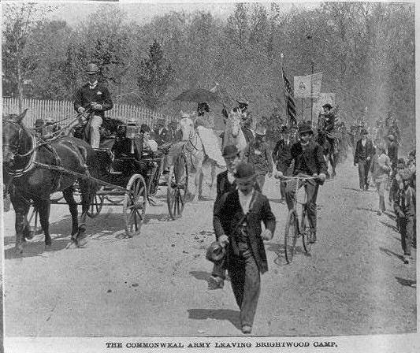
The Political Earthquakes of the 1890s
Depression and Reaction:
Panic of 1893 - high unemployment and bank failures
Coxey’s Army - marched to D.C.
Advocated the federal government to hire unemployed Americans to fix roads
Not successful, many saw Coxey as too extreme
Free Silver - advocates favor a looser monetary supply
Instead of just gold, the money supply would be backed up by silver 16:1 ratio
Help borrowers
Democrats and the “Solid South”
What is the “Solid South?”
Overwhelmingly voting for the Democratic Party by white southerners and had tremendous power
Although the grandfather clause was struck down, literacy tests and poll taxes were upheld in the South
African American voter turnout plummeted in many southern states
Public lynchings, arrests for “vagrancy,” chain gang labor

Slide 5
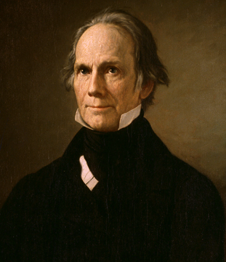
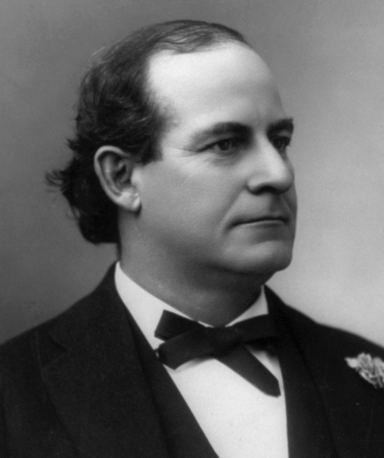
The Political Earthquakes of the 1890s
New National Realities:
William Jennings Bryan:
Populist and Democratic Candidate in 1896
3-time presidential candidate (lost all 3)
Cross of Gold - called for free silver platform
Election of 1896:
McKinley (R), pro-business, defeated Bryan
Ds and Rs increased direct primaries in states
17th amendment - direct election of senators, rather than legislatures
Lochner v. NY - overturned a NY law limiting bakers’ workday to 10 hours

Slide 6
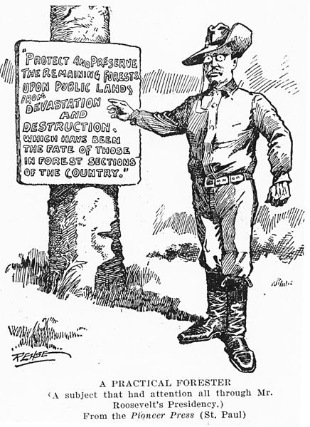
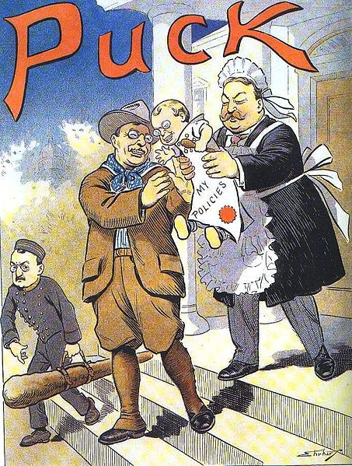
Reform Reshaped, 1901 - 1912
Theodore Roosevelt as President
Chosen as VP to McKinley by Republicans to quiet his career
Became youngest president in US history after assassination of McKinley in September, 1901
Antirust Legislation
1902 Anthracite Coal Strike - TR threatened to seize the mines if owners did not negotiate
Elkins Act (1903) - RRs could no longer offer cheaper rates to big companies (rebates)
Northern Securities Decision - powerful RR trust broken up and upheld by the Supreme Court
Hepburn Act - ICC could set shipping rates; gave ICC “teeth”
Environmental Conservation
TR set aside land for wildlife refugees
Newlands Reclamation Act (1902)
Government sold land to raise $ for improved irrigation in dry, arid lands
Roosevelt’s Legacy
Roosevelt handpicked Taft to be his successor

Slide 7
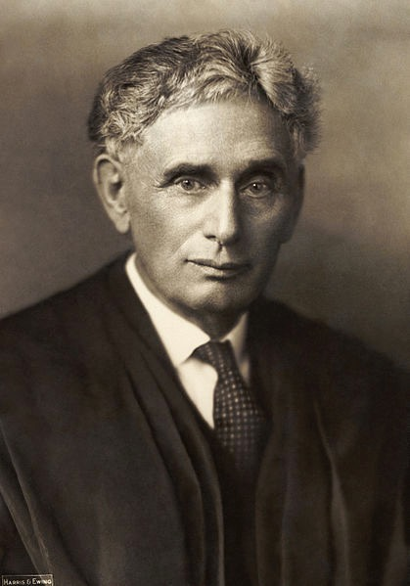
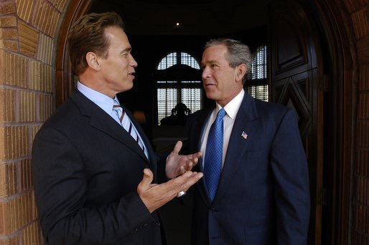
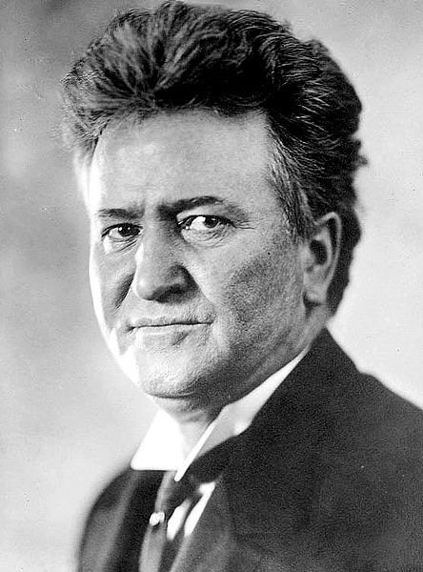
Reform Reshaped, 1901 - 1912
Diverse Progressive Goals
“Wisconsin Idea” - Robert La Follette
Increase government involvement in economy, increased voter participation
Recall - can remove elected officials
Referendum - citizens can vote on laws
Initiative - citizens can propose laws
Protecting the Poor
Poverty, Robert Hunter - argued poverty was not due to laziness, but rather social problems
National Child Labor Committee - helped lead to the Children’s Bureau
Muller v. Oregon - Supreme Court upheld a Oregon law limiting women to 10-hour work days
Argued by Louis Brandeis - future Supreme Court Justice
“Brandeis Brief” - supporting arguments by using scientific research
Many states and individuals resisted laws limiting child labor
Lower-income families often relied on income
Key Concept 6.3, I, A: Corruption in government — especially as it related to big business — energized the public to demand increased popular control and reform of local, state, and national governments, ranging from minor changes to major overhauls of the capitalist system.

Slide 8
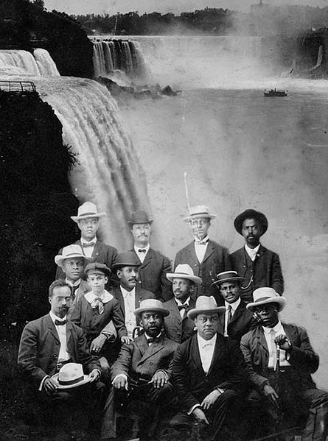
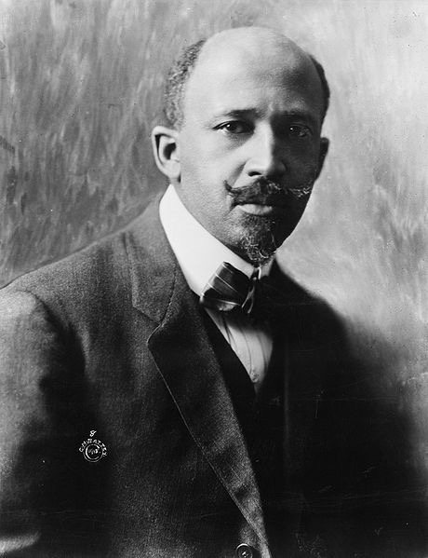
Reform Reshaped, 1901 - 1912
Diverse Progressive Goals
The Birth of Modern Civil Rights
W.E.B. Du Bois - Ph.D. from Harvard
“Talented Tenth” - argued for education of blacks (not just vocational training)
Niagara Movement (Niagara Falls, Canada why?)
Advocated end to segregation, increased voter rights, equal economic opportunities, etc.
National Association for the Advancement of Colored People (NAACP)
Civil Rights organization
Instrumental in many court cases (Brown v. Board)
The Problem of Labor
Industrial Workers of the World (IWW) - nicknamed Wobblies, or “I won’t work”
Used strikes to achieve their goals - overthrow of capitalism
They declined after WWI

Slide 9
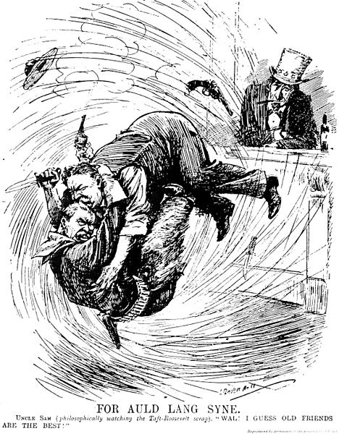
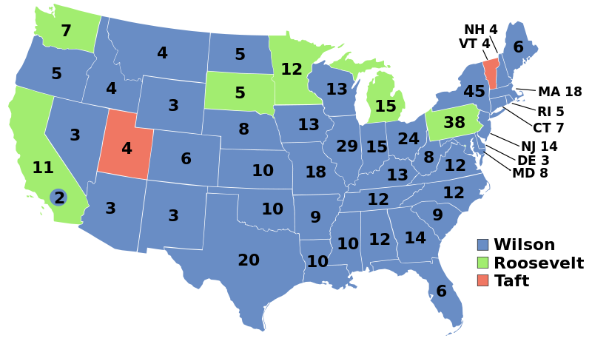
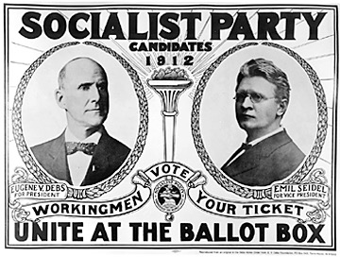
Reform Reshaped, 1901 - 1912
The Election of 1912
Roosevelt’s New Nationalism:
Advocated increased government control
Favored women’s suffrage
Teddy did not receive the nomination, ran on the Progressive, or “Bull Moose” Party
Two “Republicans” against each other all but guaranteed a victory for Wilson
Eugene V. Debs (person not a court case)
Ran as a socialist
Wilson - former governor of NJ, president of Princeton, won with just over 40% of the popular vote

Slide 10
Wilson and the New Freedom, 1913 - 1917
Economic Reforms
Progressive Income Tax (Populist idea) - 16th amendment
The higher an individual’s income, the more taxes paid
Taxes - income and inheritance, shifted the government source of revenue away from tariffs
Federal Reserve Act:
Created a new central banking system
Controls the supply of $
Set interest rates
Clayton Antitrust Act (1914):
Strengthened the Sherman Antitrust Act
Unions were exempt from prosecution
Labor Bills:
Adamson Act:
Created an 8-hour workday for RR workers

Slide 11
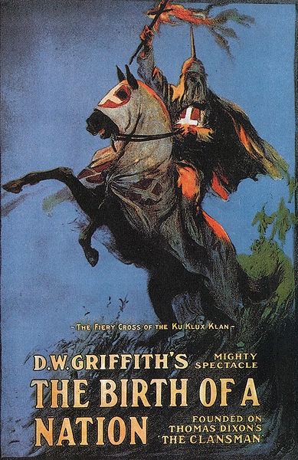
Wilson and the New Freedom, 1913 - 1917
Progressive Legacies
African Americans were left out of Progressive reforms
Wilson screened Birth of a Nation at the White House

Slide 12
Quick Recap For Chapter 20
Pendleton Act
Sherman Antitrust Act
Populist Party and the Omaha Platform
Coxey’s Army
Cross of Gold and Free Silver
Roosevelt - Antitrust Legislation and Conservation
Wisconsin Idea and La Follette
Election of 1912
Wilson’s Economic Reforms - Federal Reserve Act, Taxes, Clayton, etc.

Slide 13
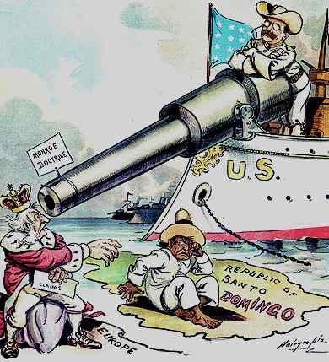
See You Back Here for chapter 21!
Thanks for Watching
Please subscribe, share with others
Check out all my videos related to the new curriculum
Best of luck on all your tests!

