Slide 1
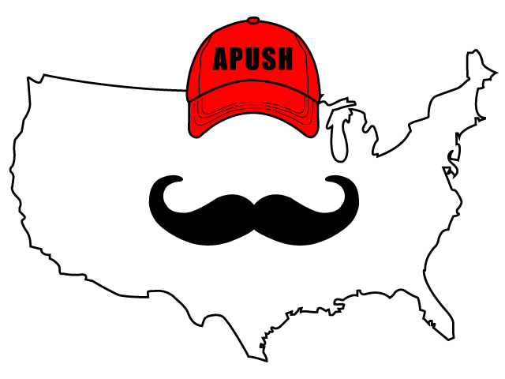
APUSH Review: America’s History, Chapter 21 (8th Edition)
Shout Out to Alex and the Milton APUSH class from Vermont. Thanks for your support, you ROCK!

Slide 2
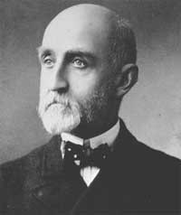
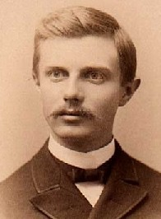
From Expansion to Imperialism
Key Concept 7.3, I, A: The perception in the 1890s that the western frontier was “closed,” economic motives, competition with other European imperialist ventures at the time, and racial theories all furthered the arguments that Americans were destined to expand their culture and norms to others, especially the nonwhite nations of the globe.
Foundations of Empire
Many sought overseas markets to improve the US economy
Two books to know (use them in any essay about imperialism)
Our Country - Josiah Strong
Advocated the spread of Christianity overseas
The Influence of Sea Power upon History - Alfred T. Mahan
Believed that naval power was a key to strong empires
Helped encourage the US to build a new, steel, Navy
Other arguments for expansion?
American exceptionalism - belief that the US should help spread democracy and spread its civilization
Belief that the frontier was “closed” - 1890 census - Frederick Jackson Turner’s Frontier Thesis

Slide 3
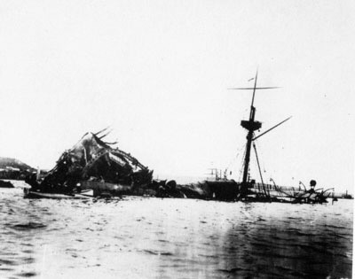
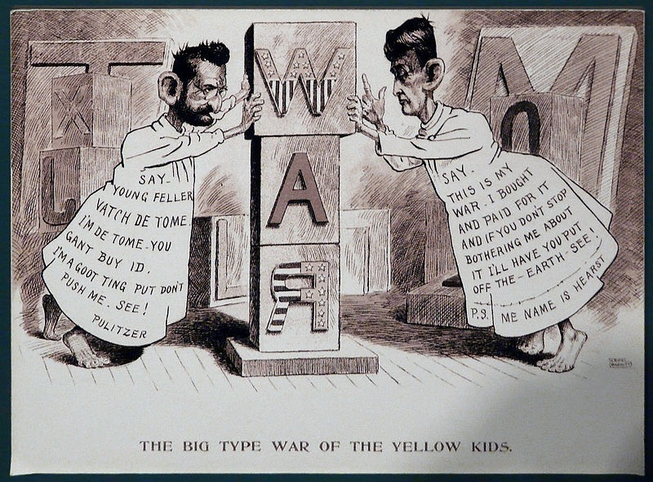
From Expansion to Imperialism
Key Concept 7.3, I, B: The American victory in the Spanish-American War led to the U.S. acquisition of island territories, an expanded economic and military presence in the Caribbean and Latin America,engagement in a protracted insurrection in the Philippines, and increased involvement in Asia.
The War of 1898
Causes:
Spanish placed Cubans in concentration camps, General “Butcher” Weyler
Yellow Journalism - exaggeration of stories to sell newspapers
“Remember the Maine” - US ship mysteriously exploded in Havana, the Spanish were blamed
DeLome Letter - Spanish minister trash talked President McKinley
Effects:
US wins the war in 4 months
Teller Amendment - US promised independence to Cuba after the war
US gained Guam, Cuba, Puerto Rico, and the Philippines

Slide 4
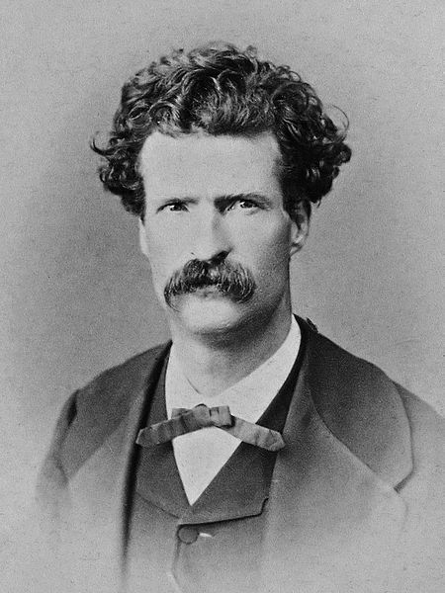
From Expansion to Imperialism
Spoils of War
Debates over the Philippines:
McKinley annexed the Philippines
Anti-Imperialist League:
Mark Twain, Jane Addams, Samuel Gompers and others spoke out against the acquisition of territories
Emilio Aguinaldo:
Led a rebellion in the Philippines against the US
Eventually, on July 4, 1946, the Philippines gained independence

Slide 5
A Power Among Powers
The Open Door in Asia
Secretary of State John Hay:
“Open Door Notes” - sought opportunity for all countries to have access to trade in China
Russo-Japanese War (1905)
Mediated by T. Roosevelt
Japan became an emerging world power
Root-Takahira Agreement:
US recognized Japan’s jurisdiction in Manchuria

Slide 6
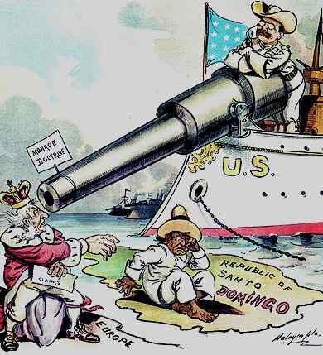
A Power Among Powers
The United States and Latin America
“Speak Softly and Carry a Big Stick” - Under Roosevelt, the US would use its new navy if necessary
Panama Canal - US gained authorization to build the canal and controlled it for the 20th century
Roosevelt Corollary:
Extension to the Monroe Doctrine
US could intervene in Latin American affairs
US became a police power in Latin America
Revolutions in Mexico:
Beginning in 1911, Mexico went through a series of leaders
Wilson became caught in the middle through his support and opposition of various leaders

Slide 7
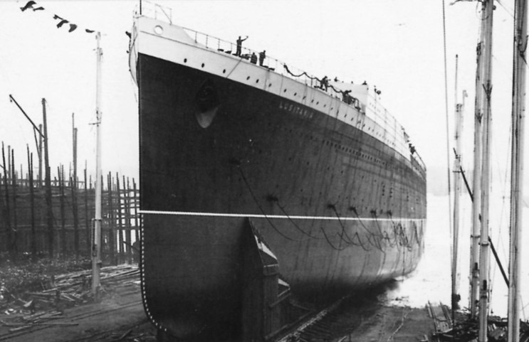
The United States in World War I
From Neutrality to War
MAIN causes of World War I - militarism, alliances, imperialism, nationalism
US sought neutrality at first - “neutral in fact as well as in name”
The Struggle to Remain Neutral:
US traded more with Allies than Central powers
Germany’s Unrestricted Submarine Warfare:
Lusitania - sunk on May 7, 1915
Sussex Pledge - Germany promised not to sink merchant and passenger ships without a warning
America Enters the War:
Zimmermann Telegram:
Germany encouraged Mexico to attack the US
Promised Mexico it would regain land lost to US in Mexican-American War

Slide 8
The United States in World War I
“Over There”
Americans Join the War
Congress instituted conscription (draft)
American Expeditionary Force (AEF)
US joined fighting in 1917
Bolshevik Revolution (1917)
Russia became communist, withdrew from WWI
11/11/18 - armistice to end fighting
The American Fighting Force
4 million men were in the military during WWI - 10% were African American
Fought in segregated units, excluded from victory parade in Paris
Influenza killed as many as 50 million after WWI worldwide

Slide 9
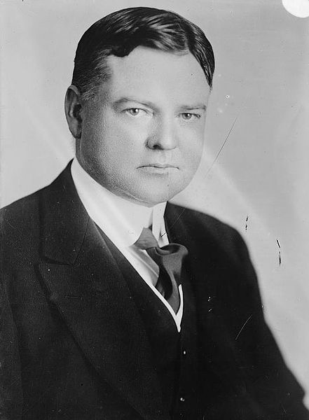
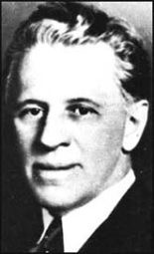
The United States in World War I
War on the Home Front
Mobilizing the Economy
War Industries Board:
Helped direct production for the military
National War Labor Board:
8-hour workday for war workers and overtime
Many unions promised not to strike
Food Administration:
Herbert Hoover - relied on volunteerism to promote war effort
Promoting National Unity
Committee on Public Information (Creel Committee):
Led by George Creel and “Four Minute Men”
Promoted the war effort on the home front
Sedition Act of 1918:
Made it illegal to criticize the war effort
Upheld by Schenck v. US (1918)

Slide 10
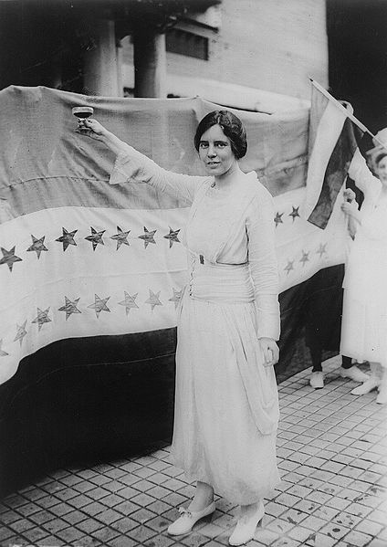
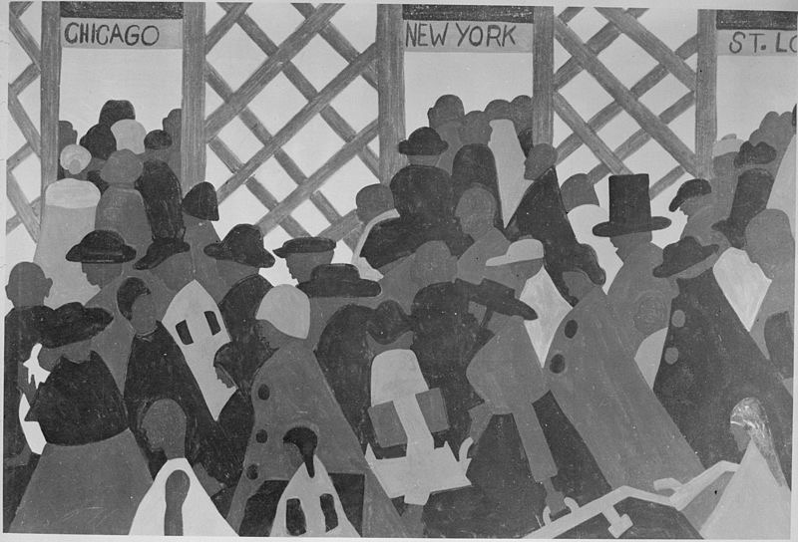
The United States in World War I
War on the Home Front
Great Migrations
Large movement of African Americans from the South to Northern cities (NYC, Chicago, St. Louis)
Red Summer of 1919 - race riots in many northern cities
Although they faced discrimination, many blacks benefitted from jobs that helped out in the war effort
Mexican Americans moved from farms to cities to work in factories
100,000 Mexicans came to the US between 1917 and 1920
Women’s Voting Rights
National American WomanSuffrage Association (NAWSA):
Carrie Chapman Catt - supported the war effort in the hopes to gain suffrage
National Woman’s Party (NWP):
Alice Paul - picketed the White House, went on a hunger strike
Wilson supported female suffrage, and in 1920, the 19th amendment was ratified
Key Concept 7.2, III, A: Although most African Americans remained in the South despite legalized segregation and racial violence, some began a “Great Migration” out of the South to pursue new economic opportunities offered by World War I.

Slide 11
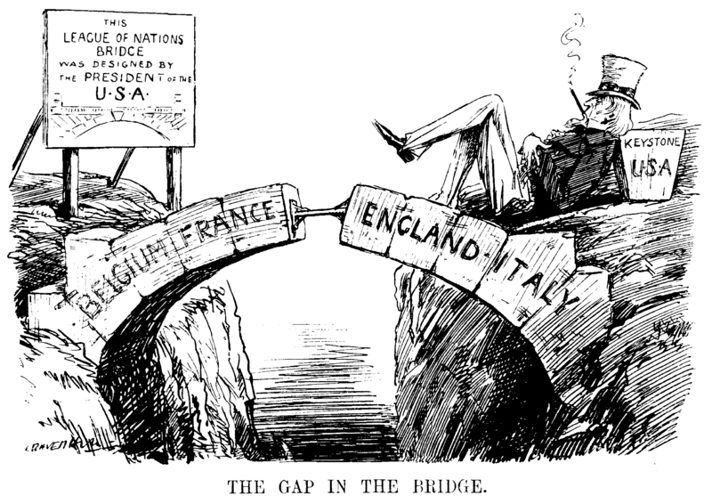
Catastrophe at Versailles
Key Concept 7.3, II, B: Although the American Expeditionary Force played a relatively limited roll in the war, Wilson was heavily involved in postwar negotiations, resulting in the Treaty Versailles and the League of Nations, both of which generated substantial debate within the United States.
Wilson’s 14 Points:
Wilson’s plans for post World War I
Called for: open diplomacy, arms reduction, free trade, sovereignty, etc
Article X - called for the creation of the League of Nations
Drastically different than Washington’s Farewell Address
The Fate of Wilson’s Ideas:
Russia and Germany were excluded from the peace conference at Versailles
Germany was punished severely ($33 billion in reparations)
Congress Rejects the Treaty:
“Irreconcilables” - opposed the treaty due to foreign affairs
Henry Cabot Lodge - despised Article X - would limit Congress’ war making powers
Ultimately, the US did not ratify the Treaty of Versailles

Slide 12
Quick Recap
Arguments for overseas expansion - Alfred T. Mahan
Debates over Philippines and expansion
Roosevelt Corollary
Reasons for US entrance into WWI
Creel Committee
Great Migration
Schenck v. US (1919)
***14 Points, Treaty of Versailles***

Slide 13
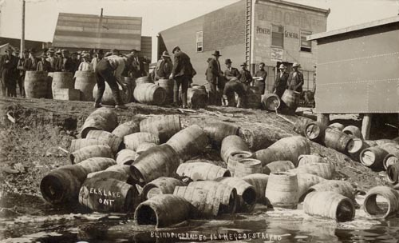
See You Back Here for chapter 22!
Thanks for Watching
Please subscribe, share with others
Check out all my videos related to the new curriculum
Best of luck on all your tests!

