Slide 1
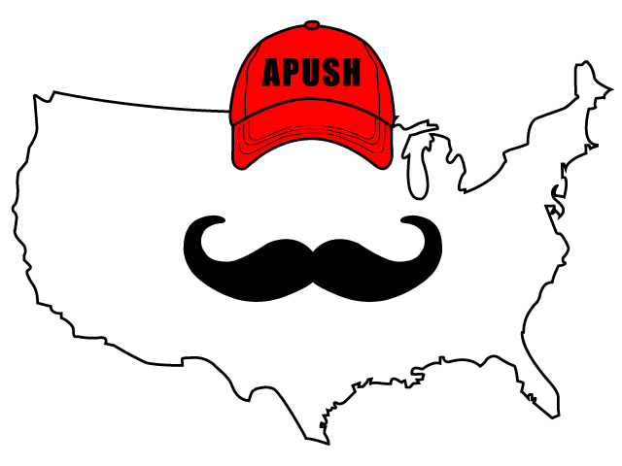
APUSH Review: America’s History, Chapter 22 (8th Edition)

Slide 2
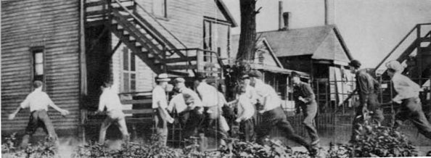
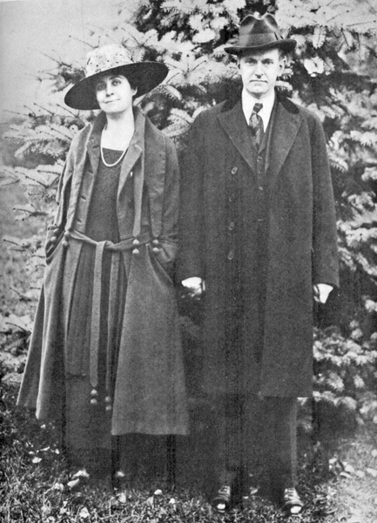
Conflicted Legacies of World War I
The Red Scare
Great Migration - mass movement of African Americans from the South to Northern cities
“Red Summer” of 1919 - race riots in many northern cities
120 died in race riots by September, 1919
Blacks competed with northern whites for jobs and housing
In the South, lynching rose from 1917 - 1919
Erosion of Labor Rights
AFL grew during WWI
1 in 5 workers went on strike in 1919
MA Governor Calvin Coolidge won support for opposing strikes
Some companies, notably Ford, practiced welfare capitalism during the booming economic times of the 1920s

Slide 3
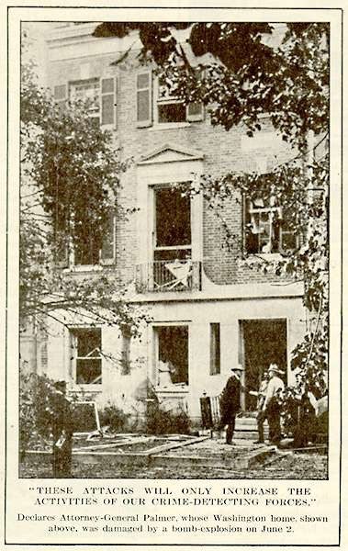
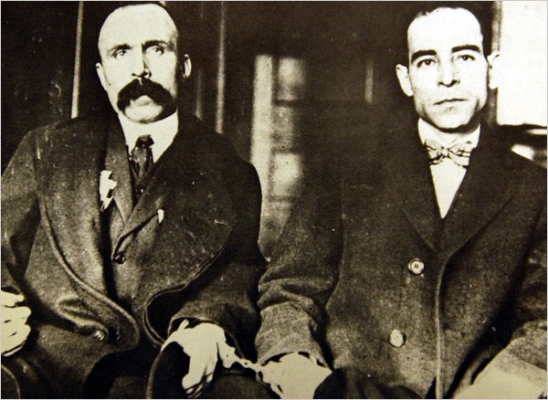
Conflicted Legacies of World War I
The Red Scare
Unions were often associated with radicalism and socialism
Many new immigrants had socialist views
The Bolshevik Revolution in Russia frightened many Americans
A. Mitchell Palmer and the first “Red Scare”:
After a bomb explosion at his house, Palmer cracked down radical organizations
Palmer Raids - over 6,000 people arrested
Sacco and Vanzetti:
Two Italian immigrants accused of murder
Eventually, they were sentenced to death in 1927
Guilty? Innocent? It’s heavily debated, although most agree they did not get a fair trial

Slide 4
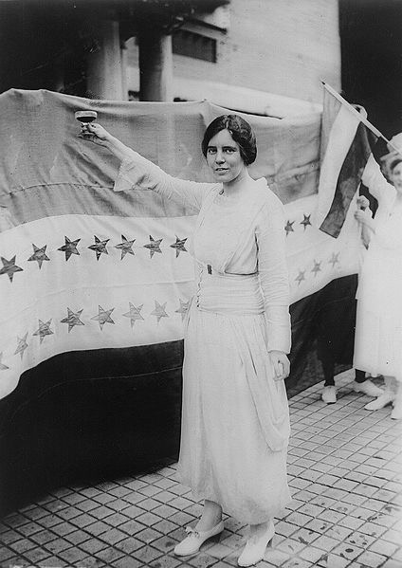
Politics in the 1920s
The 1920s called for a “Return to Normalcy”
Limited government (as opposed to the Progressive Era) and staying out of European affairs (Rejection of the Treaty of Versailles)
Women in Politics
Sheppard-Towner Federal Maternity and Infancy Act:
Provided federal funds for education programs and clinics
Helped improve healthcare for poor
1st time Congress allotted $ to states for social welfare programs
Theme during the 1930s forward
Equal Rights Amendment (ERA)
Proposed by Alice Paul in the 1920s
Not ratified by Congress until the 1970s
Never ratified by the necessary number of states
Women’s International League for Peace and Freedom:
Led by Jane Addams and others
Criticized imperialism and militarism

Slide 5
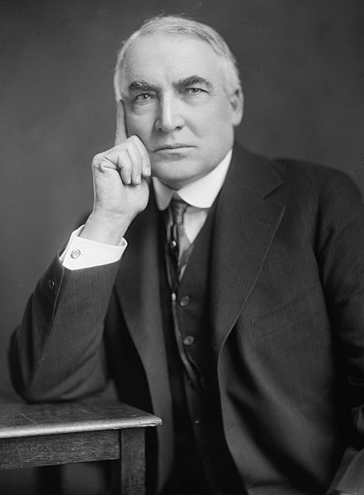
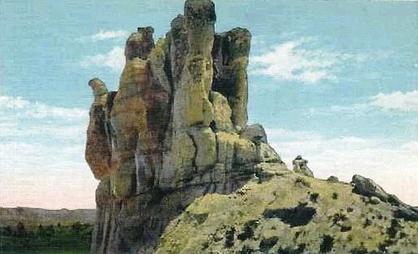
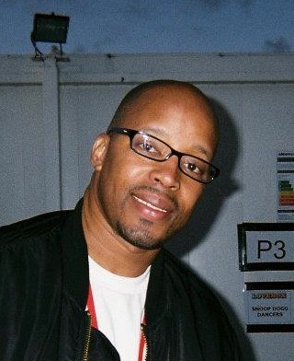
Politics in the 1920s
Republicans and Business
Warren G…….. wins the presidency in 1920
Appoints Herbert Hoover as Commerce Secretary
Associated state - cooperation between the government and business leaders to achieve economic stability
Teapot Dome Scandal:
Secretary of Interior Alber Fall leased government land to private companies in exchange for $300,000 in bribes
Calvin Coolidge:
Warren G……’s VP, became president upon Warren’s death
He and Secretary of the Treasury Andrew Mellon advocated tax cuts for businesses (similar to Reagan’s “Trickle-down” economics)

Slide 6
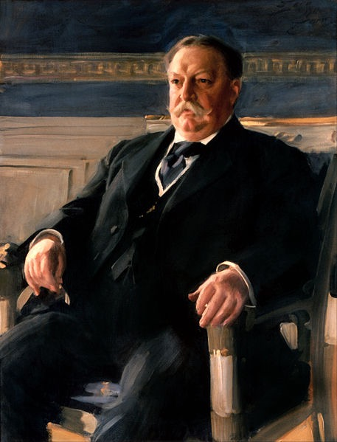
Politics in the 1920s
Dollar Diplomacy
Began under Taft’s administration
Advocated US banks providing loans to foreign countries
In some cases, the US military intervened to ensure repayment of loans:
Nicaragua from 1912 - 1933
Dominican Republic from 1916 - 1924
Haiti from 1915 - 1934

Slide 7
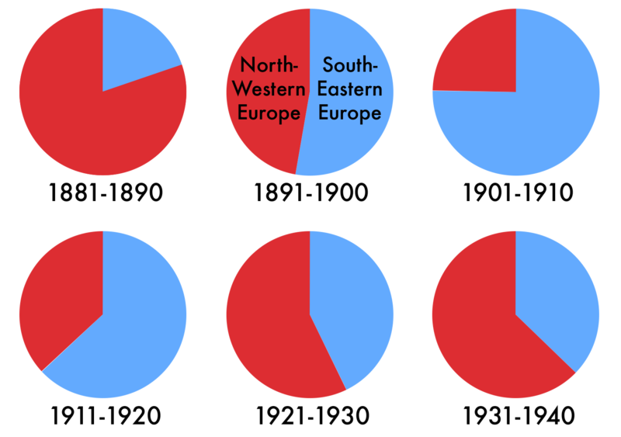
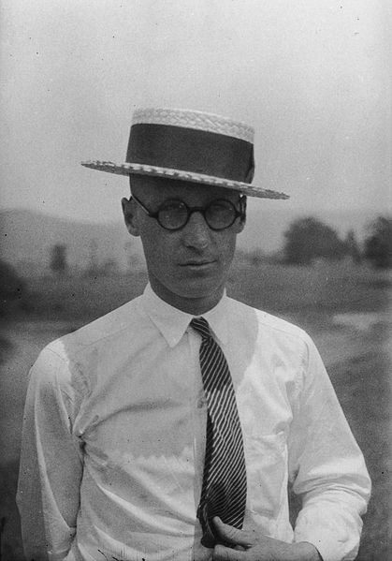
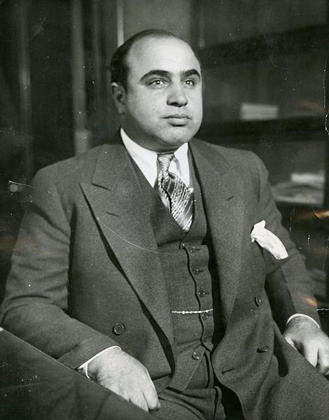
Politics in the 1920s
***Culture Wars***
Prohibition:
18th amendment, passed in part due to:
Anti-German sentiments during WWI
The law was often broken (speakeasies) and not adequately enforced
Organized crime grew as a result
Evolution in the Schools:
The Scopes “Monkey” Trial:
Conflict between science and religious fundamentalism
Scopes was supported by the ACLU and defended by Clarence Darrow
Nativism:
“New” Immigrants were often Catholic and Jewish, from Southern and Eastern Europe
Gentlemen’s Agreement - Teddy Roosevelt and Japan agreed to limit Japanese immigration
Emergency Quota Act (1921) - restricted European immigration
National Origins Act (1924) - Restricted European immigration even further
There were no restrictions on immigrants from Latin America

Slide 8
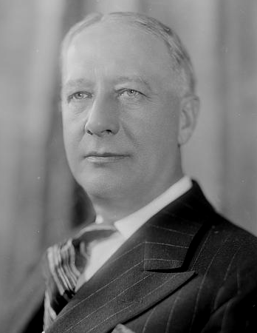
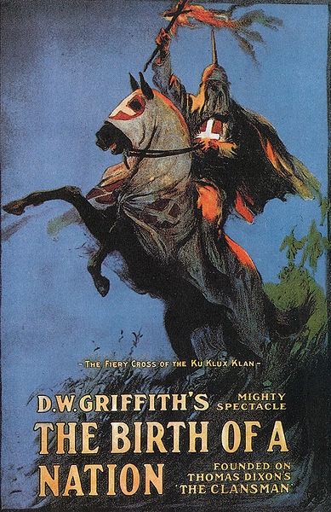
Politics in the 1920s
***Culture Wars***
The National Klan:
Birth of a Nation (1915) glorified the KKK and it resurged in the 1920s
In addition to targeting blacks, the new klan targeted Catholics, Jews, and immigrants (Non “WASPs”)
The Election of 1928
Democrats nominated NY governor Al Smith
First candidate to run for office that was Catholic
Republicans nominated Herbert Hoover, who won overwhelmingly

Slide 9
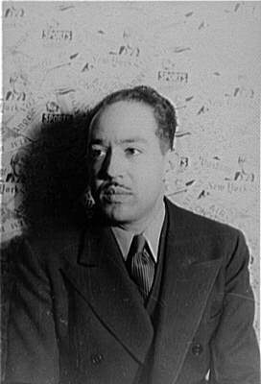
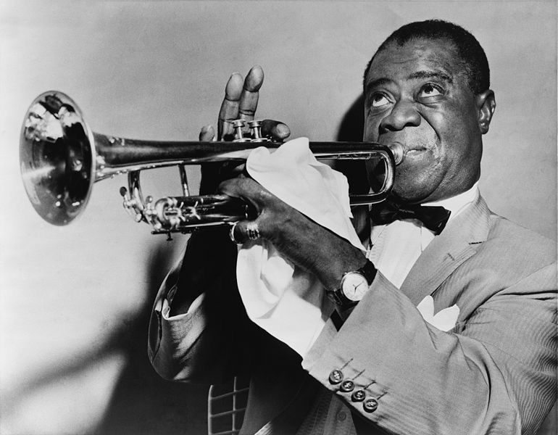
Intellectual Modernism
***Harlem in Vogue***
Black Writers and Artists:
***Harlem Renaissance*** (Post-WWI - 1930s)
Cultural, social, and artistic movement in Harlem that expressed pride in being black
“I am a Negro - and beautiful” - Langston Hughes
Zora Neale Hurston:
Focused on the impact of white oppression on blacks
Jazz:
Began in New Orleans
Louis Armstrong helped spread jazz when he moved to Chicago from NOLA
Duke Ellington - prominent jazz player in Harlem

Slide 10
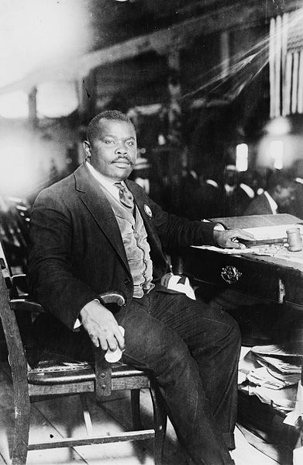
Intellectual Modernism
***Harlem in Vogue***
Marcus Garvey and the UNIA
United Negro Improvement Association - advocated black separatism (ideas would be influential in the 1960s Civil Rights Movement)
Promoted a back to Africa movement
Pan-Africanism - hoped to unite all individuals of African descent
Critiquing American Life
The Lost Generation:
Writers of the 1920s that criticized consumerism and American culture (Similar to the Beat Generation of the 1950s)
Examples:
Hemingway’s A Farewell to Arms
Sinclair Lewis’ Babbitt
F. Scott Fitzgerald’s The Great Gatsby

Slide 11
From Boom to Bust
The Postwar Economy:
Rampant inflation in 1919
Many big businesses merged
Farmers were left out of much of the economic prosperity of the 1920s
Competition from European farmers drove the price of crops down
Farmers produced more in the hopes of making $, helped reduce prices of goods
Consumer Culture
New consumer products - vacuum cleaners, refrigerators
Advertising industry began to sell “hope”
Goods were purchased more on credit - “buy now, pay later”

Slide 12
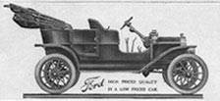
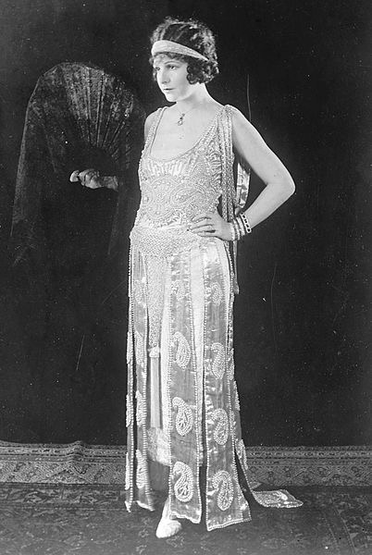
From Boom to Bust
Consumer Culture
The Automobile
1 car for every 6 Americans
Highway construction increased drastically
Hotels, restaurants, and gas stations increased
Railroads were hurt
More Americans travelled by car on vacation - 1/3 of Americans by 1929
Hollywood
Southern California provided land, good weather, and nice scenery
Flapper:
More of an image than reality
Short(er) dresses and short hair
Smoked, drank, and (gasp!) danced

Slide 13
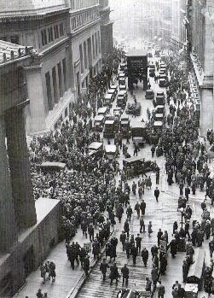
From Boom to Bust
The Coming of the Great Depression
More Americans bought stock in the 1920s
Buying on margin:
Putting little money down to purchase a stock
(sometimes 5 - 20%)
Stock Market Crash in October, 1929
Farming, construction, and industries saw their production and/or prices plummet
Unemployment would soon reach almost 25%
Banks closed - savings were not guaranteed
Charities had a difficult time keeping pace with those in need

Slide 14
Quick Recap
Red Summer
Red Scare
Return to Normalcy
Equal Rights Amendment
Teapot Dome Scandal
Dollar Diplomacy
National Origins Act of 1924
Harlem Renaissance
Marcus Garvey
The Lost Generation
Impacts of the automobile

Slide 15
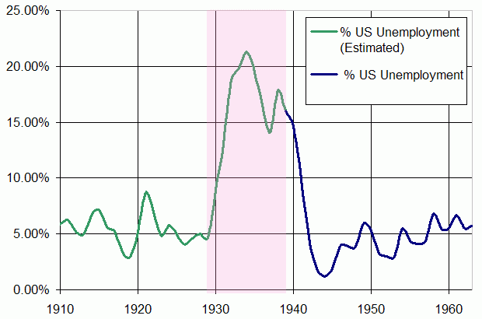
See You Back Here For Chapter 23!
Thanks for Watching
Please subscribe, share with others
Check out all my videos related to the new curriculum
Best of luck on all your tests!

