Slide 1
America’s History, Chapter 24
8th Edition

Slide 2
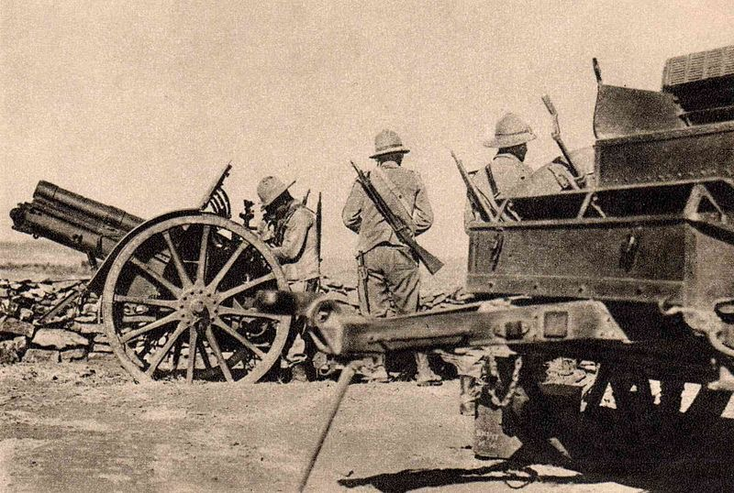
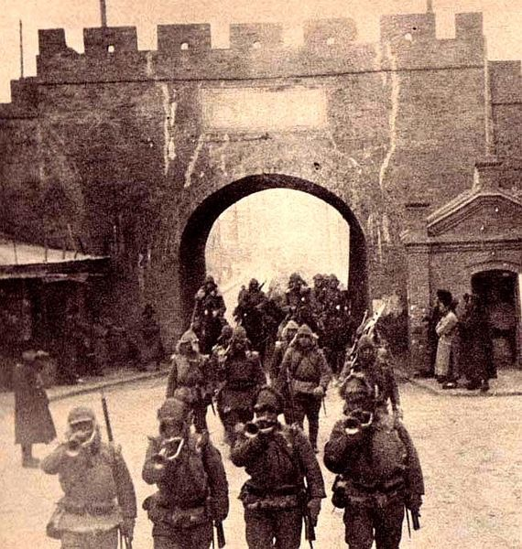
The Road To War
The Rise of Fascism
Authoritarian government with nationalism and militarism
Japan and Italy:
Japan expanded due to a need for raw materials and markets
Invasion of Manchuria in 1931
Italy invaded Ethiopia
League of Nations did not intervene in either case
Hitler’s Germany:
Hitler was granted dictator powers
Sought to expand (lebensraum) and
Began to persecute Jews
Rome-Berlin Axis - alliance between Italy and Germany

Slide 3
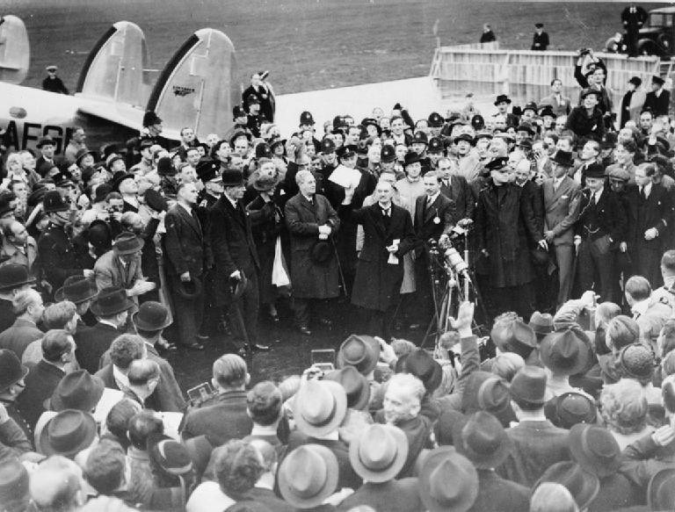
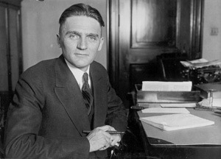
The Road To War
War Approaches
Nye Committee (1934) - alleged that the US became involved in WWI to make $ for munition companies
Inspired the Neutrality Act of 1935 - US could not sell weapons to belligerent (warring) countries
The Popular Front:
Advocated European intervention
Supported the Loyalists in the Spanish Civil War
The Failure of Appeasement:
Munich Conference - Germany was given the Sudetenland
PM Chamberlain proclaimed “Peace for our time”
Hitler knew Europeans would NOT stand up to him
September 1, 1939 - Germany invaded Poland
A significant majority of Americans supported Britain and France

Slide 4
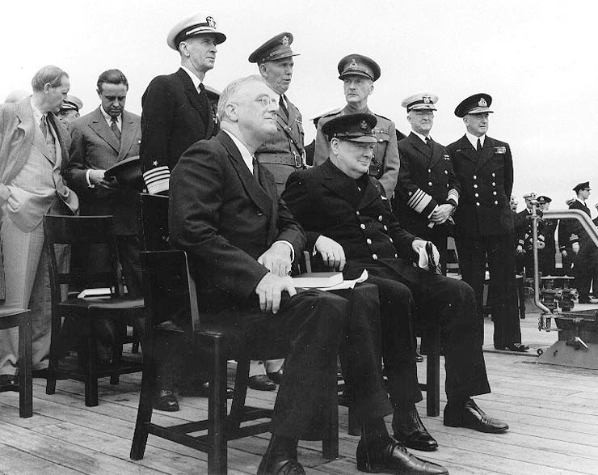
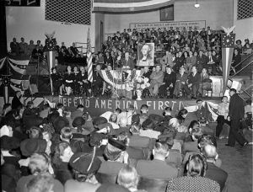
The Road To War
Isolationism and Internationalism:
Committee to Defend America:
Advocated that the US aided allies
America First Committee:
Isolationists - Charles Lindbergh
FDR traded destroyers with Great Britain for military bases
1st peacetime draft in history occurred in 1940
4 Freedoms Speech:
Freedoms that everyone should enjoy
Linked the war with democracy
Lend-Lease Act:
US could lend military supplies to countries deemed vital to US security (Britain)
Atlantic Charter:
FDR and Winston Churchill - focused on post WWII goals - economic cooperation, self-determination, and political stability

Slide 5
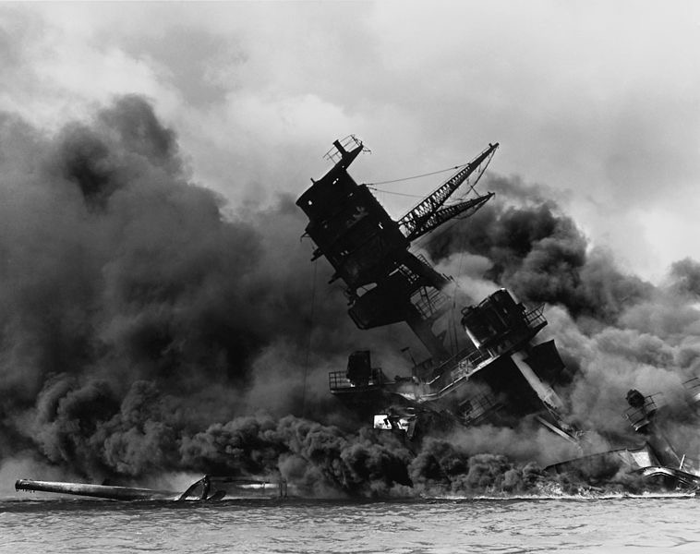
The Road To War
The Attack on Pearl Harbor
1937 “Quarantine” Speech:
FDR encouraged economic sanctions against Japan in response to invasion of China
US froze Japanese assets in US and placed an embargo in 1941
December 7, 1941 - Japan attacked Pearl Harbor

Slide 6
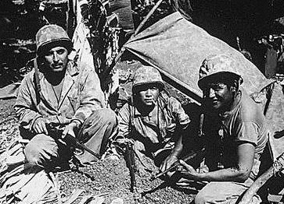
Organizing for Victory
Financing the War
Revenue Act of 1942 - increased number of Americans paying taxes
In addition to taxes, the government borrowed $ to pay for the war
War Productions Board:
Encouraged businesses to begin military production (GM and Ford)
Henry Kaiser - contractor, applied Ford’s mass production techniques to ship construction
Mobilizing the American Fighting Force
15 million Americans joined the armed forces
African Americans remained segregated
Native Americans played an instrumental role - “code talkers”
Women predominantly did clerical, communications, and health care work
Key Concept 7.3, III, A. The mass mobilization of American society to supply troops for the war effort and a workforce on the home front ended the Great Depression and provided opportunities for women and minorities to improve their socioeconomic positions.

Slide 7
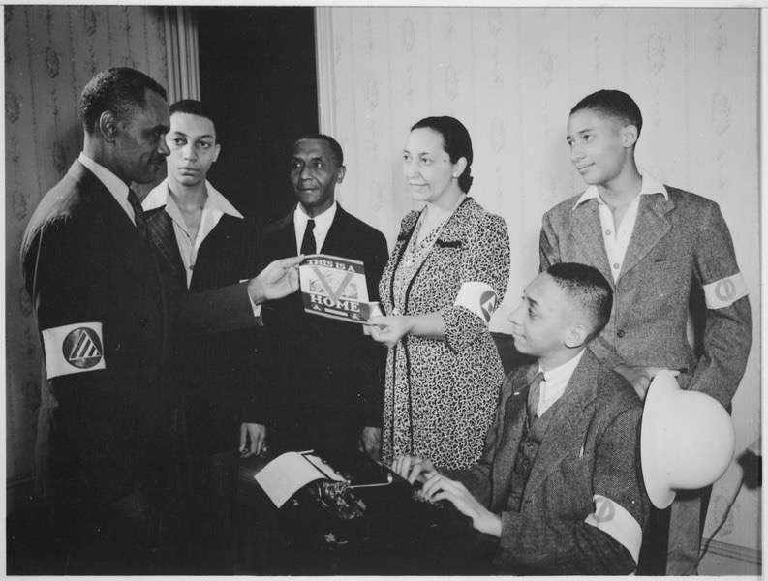
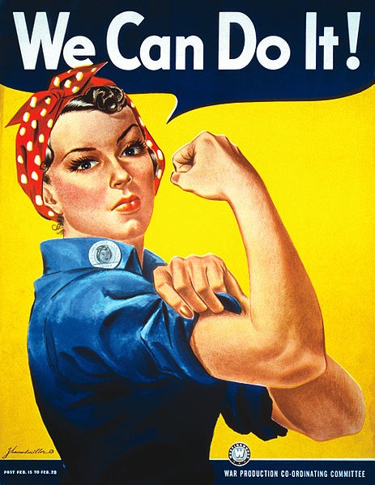
Organizing for Victory
Key Concept 7.3, III, B. Wartime experiences, such as the internment of Japanese Americans, challenges to civil liberties, debates over race and segregation, and the decision to drop the atomic bomb raised questions about American values.
Workers and the War Effort
Rosie the Riveter:
Women were encouraged to help in the war effort
Often paid less than men
Post-WWII women were encouraged to go back to the home
Wartime Civil Rights:
Double V campaign:
Victory abroad against Fascism, Victory at home over racism
A. Philip Randolph:
Planned a march on Washington, led to Executive Order 8802:
Forbid discrimination in defense industries based on race
Congress of Racial Equality - created in 1942, would become influential in the 1960s
Organized Labor:
National War Labor Board - established pay, hours, and working conditions
Smith-Connally Act - prohibited strikes in defense industries

Slide 8
Organizing for Victory
Politics in Wartime
Servicemen’s Readjustment Act (G.I. Bill)
Provided education, loans, mortgages, etc. for returning soldiers

Slide 9
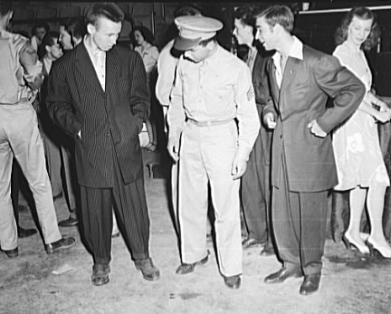
Life on the Home Front
“For the Duration”
Americans helped out by recycling, building “victory gardens,” rationing, etc.
Shortage of consumer goods encouraged savings
Migration and the Wartime City
15 million Americans moved during the war
Took jobs in factories
California benefitted more than any other state
Racial Conflict:
Zoot Suit - popular clothing worn by Mexican American teenagers
Zoot Suit Riot - Conflict in Southern California between servicemen and Mexican Americans
Gay and Lesbian Communities:
Strong gay communities emerged in large cities (significant in the 1960s and 70s)

Slide 10
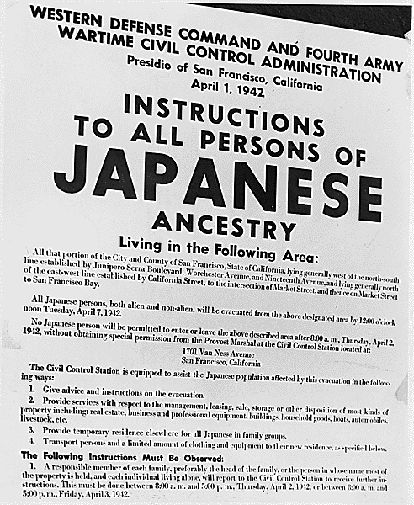
Life on the Home Front
Japanese Removal
Executive Order 9066:
Forced removal of Japanese Americans on west coast to relocation camps during the war
2/3 of those affected were Nisei - American born Japanese citizens
Upheld via Korematsu v. US (1944)

Slide 11
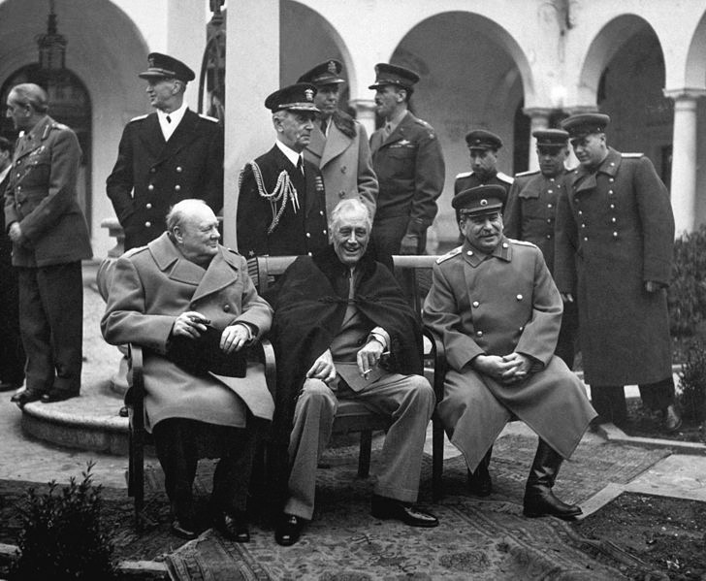
Fighting and Winning the War
Wartime Aims and Tensions
Big 3 - FDR, Churchill, and Stalin
Tehran Conference - Churchill and FDR agreed to open a 2nd front in France
The War in Europe
Soviet Union pushed Germany out in 1944
D-Day:
June 6, 1944 - invasion of Normandy by allies
Turning point in the war
The Holocaust:
6 million Jews were killed
SS St. Louis - US turned away a German ship with 1,000 Jewish refugees
Only 21,000 Jewish refugees were allowed to enter the US during the war

Slide 12
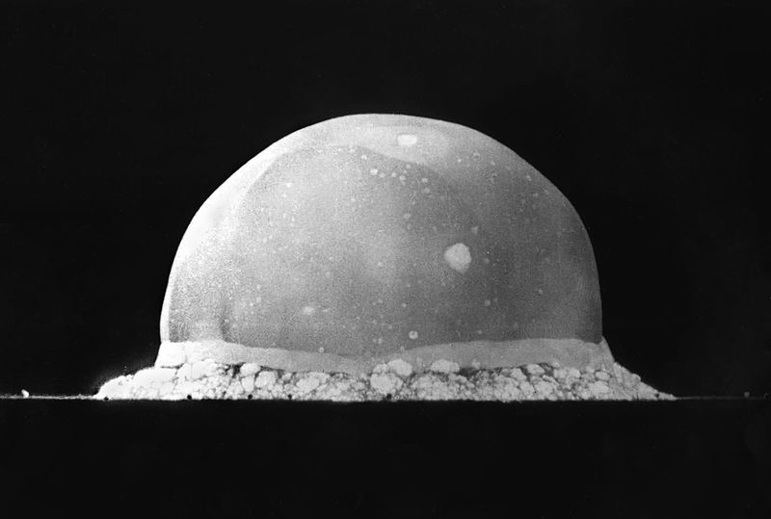
Fighting and Winning the War
Key Concept 7.3, III, C. The United States and its allies achieved victory over the Axis powers through a combination of factors, including allied political and military cooperation, industrial production, technological and scientific advances, and popular commitment to advancing democratic ideals.
The War in the Pacific
Battle of Midway - turning point in the Pacific War
Yalta Conference - last meeting of the Big 3
The Atomic Bomb and the End of the War
Manhattan Project - $2 billion project to build the atomic bomb - J. Robert Oppenheimer
July 16, 1945 - Trinity Test in NM
Hiroshima (August 6) and Nagasaki (August 9)
Many believed a Japanese invasion would cost up to a million Allied lives
Potsdam Conference (July, 1945) - Allies called for unconditional surrender of Japan
The Toll of the War
50 million people were killed worldwide
100 million were wounded

Slide 13
Quick Recap
Appeasement - Munich Conference
Isolationists vs. Interventionists
Atlantic Charter
Opportunities for women and minorities in the war
Double V Campaign
Zoot Suit Riots
Internment of Japanese Americans
Dropping of the atomic bomb

Slide 14
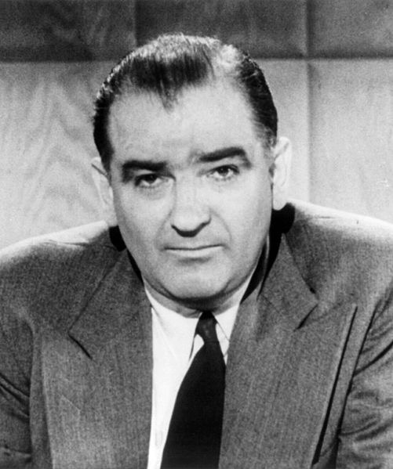
See You Back Here For Chapter 25!
Thanks for watching!
Please subscribe and share
Check out videos in the description
Good luck on all your tests!

