Slide 1
APUSH Review, America’s History, 8th Edition
Chapter 26
Shoutout to Daquian and Mr. Dempsey’s class, Egnor’s class in Miramar, FL, and Mr. Martel from Cal-Mum HS. Thanks for watching!

Slide 2
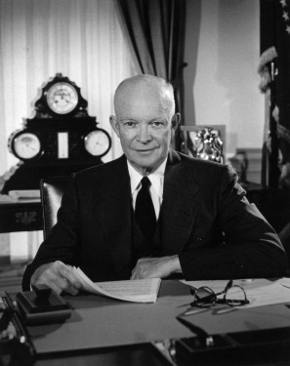
Postwar Prosperity and the Affluent Society
Economy: From Recovery to Dominance
The Bretton Woods System:
Creation of the World Bank - gave loans to countries in the 3rd world and those destroyed by war
International Monetary Fund (IMF) - established to stabilize currencies around the world
The Military-Industrial Complex
Industries that benefitted from government contracts for military supplies
Boeing, General Electric, etc.
Eisenhower warned of the dangers of this in his Farewell Address
Military spending increasingly consumed more of the nation’s GDP
Soviet launch of Sputnik - led to the Space Race
US passed the National Defense Education Act - increased funding for education, especially in science and math

Slide 3
Postwar Prosperity and the Affluent Society
Economy: From Recovery to Dominance
Corporate Power:
Corporations grew in power and had a large share of their markets
Mechanization replaced factory workers (Continuity - mechanization replaced farmers in the late 19th century)
The Economic Record:
The Affluent Society - argued that the poor were not the focus of politicians and economists
The Other America - Michael Harrington - focused on the poor in America
Helped influence LBJ’s Great Society in the 1960

Slide 4
Postwar Prosperity and the Affluent Society
A Nation of Consumers
The 1950s could be compared to the 1920s - new consumer products, media (tv), and mass consumption
The G.I. Bill:
Provided education opportunities for returning soldiers
Over 7 million veterans attended college or trade schools in the 1950s -> higher paying workforce
Veterans Administration (VA):
Provided home loans for veterans
Trade Unions:
Union membership increased in the 1940s
Income rose for many workers in the 1950s
Health insurance and pensions were provided through many contracts

Slide 5
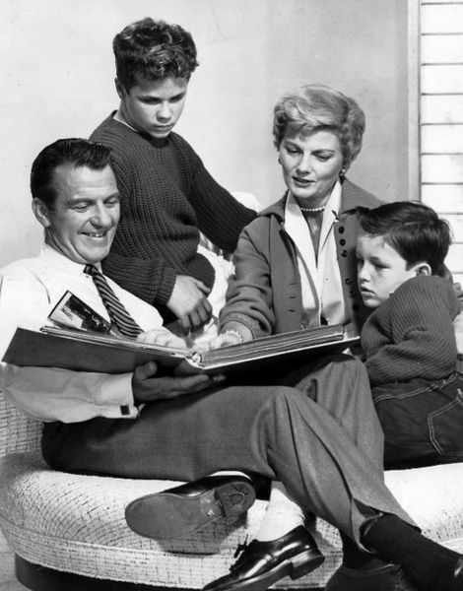
Postwar Prosperity and the Affluent Society
A Nation of Consumers
Houses, Cars, and Children:
Many families purchased homes and cars in the 1950s
25 million homes between 1945 and 1970!
Most homes had TVs, which promoted consumer products
Television:
TV shows focused predominantly on:
White, middle-class, suburban families, where mothers were housewives
Leave it to Beaver, Father Knows Best

Slide 6
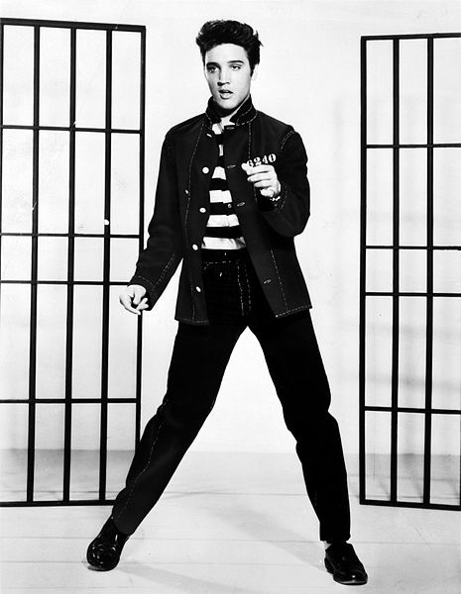
Postwar Prosperity and the Affluent Society
Youth Culture
Teenagers were often targeted by advertisers to buy products
Movies glorified young, rebellious men - Rebel Without a Cause
Rock n’ Roll
Alan Freed played “race” records over Cleveland airways
Some of Elvis Presley’s songs were covers of black artists
Cultural Dissenters:
Beats (Beatniks, Beat Generation)
Writers that criticized middle-class values and culture
Similar to the Lost Generation of the 1920s (F. Scott Fitzgerald)
Jack Kerouac - On The Road

Slide 7
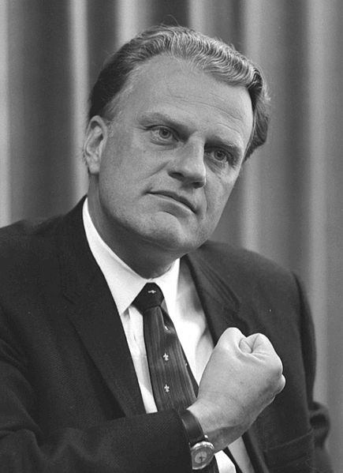
Postwar Prosperity and the Affluent Society
Religion and the Middle Class
Billy Graham - influential evangelical preacher of the1950s
Argued that materialism was not incompatible with living a moral life
In 1954, “Under God was added to the Pledge of Allegiance

Slide 8
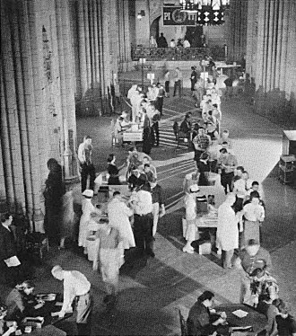
The American Family in the Era of Containment
The Baby Boom
1945 - 1964 (Birth control pill)
Drop in divorces
Impact of baby boom?
Tighter job market in the 1970s
Health care and Social Security issues today
Improving Health and Education
New medical advancements reduced mortality rates (and for children)
Polio vaccine - Dr. Jonas Salk - gave it away for free!
Dr. Benjamin Spock:
Common Sense Book of Baby Child Care
Argued that mothers be available for their children

Slide 9
The American Family in the Era of Containment
Women, Work, and Family
Expectation of middle-class women in the 1950s?
Raise children, clean the house, cook - “Cult of Domesticity”
More women began working to help provide for families - most jobs included: nurses, receptionists, etc.
Women were paid less than men
Challenging Middle-Class Morality
Alfred Kinsey:
Researched sexual practices of Americans
Americans were much more sexually active than most believed
The Homophile Movement:
Kinsey revealed that homosexuality was more common than believed, especially among men
Homosexuals faced discrimination throughout the 1950s and 1960s
1969 - Stonewall Riots - Gay Rights Movement began
Media to Morality:
Fear that comic books encouraged crime among youth
Playboy was founded in 1953 - challenged societal norms

Slide 10
A Suburban Nation
The Postwar Housing Boom
1 out of 3 Americans lived in suburbs by 1960
Aided by cars, and highways
William Levitt and the FHA
Introduced mass-production of houses (Levittown)
Cheap houses, similar styles, excluded African Americans
Federal Housing Administration (FHA)
Provided mortgages with little $ down
Helped increase home ownership drastically
Despite the Supreme Court’s ruling, racial discrimination in housing persisted

Slide 11
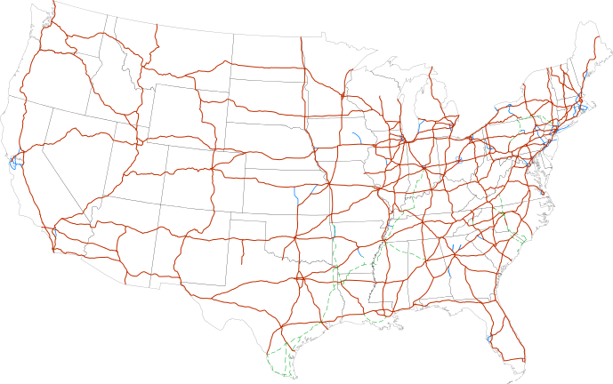
A Suburban Nation
The Postwar Housing Boom
Interstate Highways
National Interstate and Defense Highways Act
Created under Eisenhower’s administration
Over 42,000 miles of highways - would aid in a nuclear attack
Led to the growth of hotel and food industries throughout the US
Fast Food and Shopping Malls
Ray Kroc - purchased McDonald’s - used Taylorism techniques to mass produce hamburgers

Slide 12
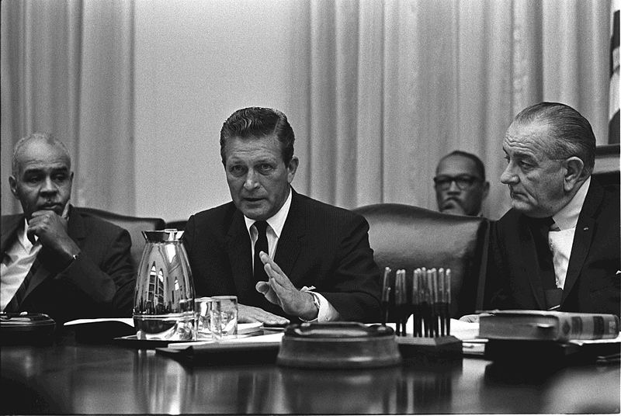
A Suburban Nation
Rise of the Sunbelt
What is the Sunbelt?
States located in the South and Southwest portion of the US
Industries blossomed (especially military bases) - warm weather and low taxes
A trend since WWII is an increase in population in Sunbelt states
Two Societies: Urban and Suburban
As many whites moved to the suburbs (often referred to as “white-flight), African Americans moved to cities in large numbers
Kerner Commission - government commission that stated the country is “moving towards two societies, one black, one white, separate and unequal.”

Slide 13
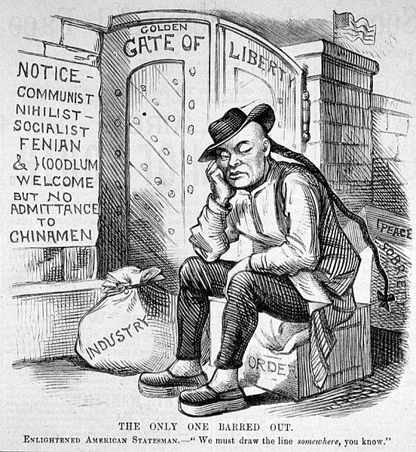
A Suburban Nation
The Urban Crisis:
Many African Americans that lived in cities lived in old apartment buildings and received low paying jobs
Urban renewal - push to destroy old buildings
Urban Immigrants:
Chinese Exclusion Act was repealed in 1943
Many Mexicans from the Bracero program remained in the US after it ended in 1964
Puerto Ricans migrated to the US in large numbers
Higher population in NYC than San Juan
After Fidel Castro gained power in Cuba in 1959, many Cubans fled to the US, especially in Miami

Slide 14
Quick Recap
Military-Industrial Complex - IT’S SPECIFICALLY MENTIONED IN THE NEW CURRICULUM!
The Affluent America
The GI Bill
Beatniks - similar to the Lost Generation
Short-term and long-term impacts of the Baby Boom Generation
The 1950s “family” and the role of women
Levittown and the FHA
Interstate Highways
Growth of the Sunbelt
White-flight and its impacts on cities

Slide 15
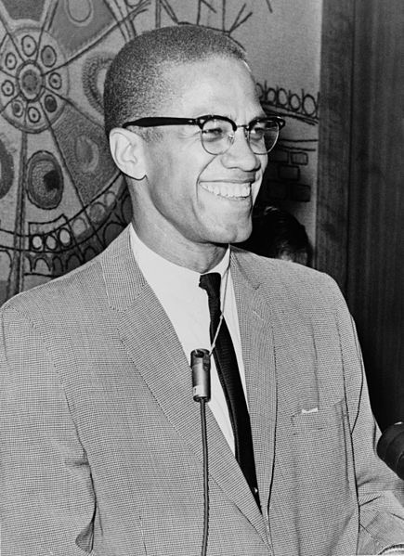
See You Back Here For Chapter 27!
Thanks for watching!
Subscribe and spread the word
Good luck on all your tests
You are brilliant!

