Slide 1
America’s History, 8th Edition
Chapter 27
Shoutouts to: Ms. Willet’s class from NC - teacher of the year, Ms. McFarland’s class in Washington, and Mrs. Smith’s class from McKinney, TX

Slide 2
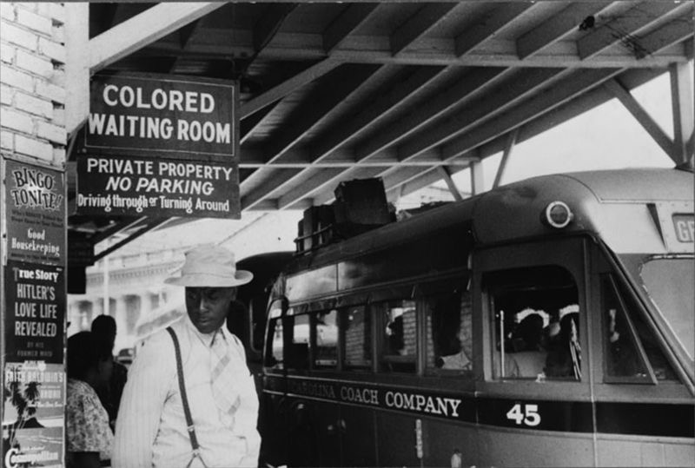
The Emerging Civil Rights Struggle, 1941 - 1957
Rights Liberalism: belief that the government must protect people from discrimination
Life Under Jim Crow
Jim Crow laws were prevalent in the South
Poll taxes, literacy tests, and “white primaries” discouraged African Americans from voting
Housing in the North was heavily segregated
Violence used to discourage blacks from living in white neighborhoods
Origins of the Civil Rights Movement
Nazi racism was attacked during WWII
The Cold War aided the Civil Rights Movement
US claimed democracy was better than communism
African American college students played a large role in the movement in the 1960s
TV showed demonstrations and violence against blacks

Slide 3
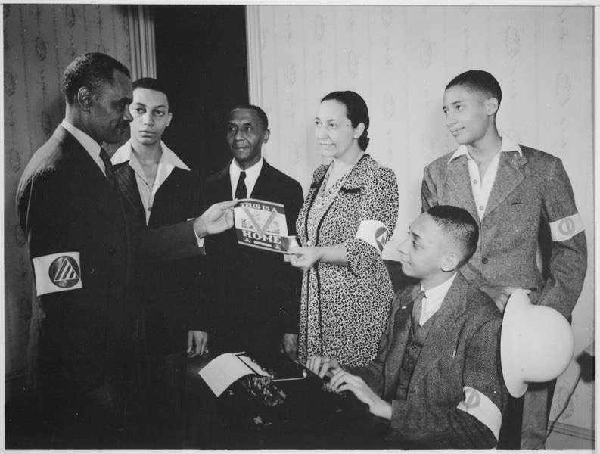
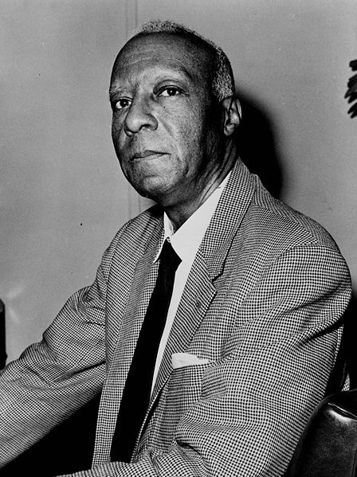
The Emerging Civil Rights Struggle, 1941 - 1957
World War II: The Beginnings
Executive Order 8802:
A. Philip Randolph proposed a March on Washington
FDR barred discrimination in defense industries
The Double V Campaign:
Victory over fascism and victory over racism at home
James Farmer - founding member of the Congress of Racial Equality (CORE)
Play an instrumental role in the 1960s
Many African American veterans benefitted from the GI Bill

Slide 4
The Emerging Civil Rights Struggle, 1941 - 1957
Cold War Civil Rights
Civil Rights and the New Deal Coalition:
“To Secure These Rights” government report under Truman’s administration that advocated government involvement to ensure equality for blacks
Executive Order # 9981 - desegregated US military
Korean War was the first war fought with desegregated units
States’ Rights Democratic Party (Dixiecrats)
Southern Democrats led by Strom Thurmond, who ran for president in 1948
Race and Anticommunism:
Racism in the US aided the Soviet Union in the Cold War

Slide 5
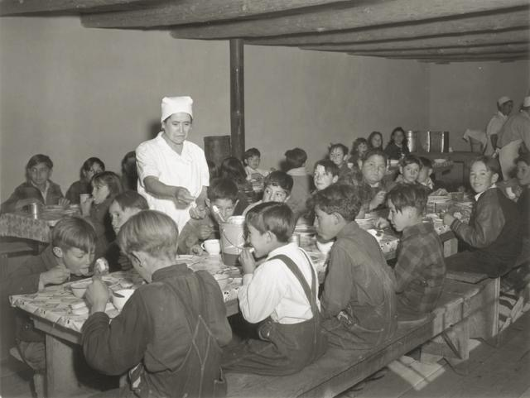
The Emerging Civil Rights Struggle, 1941 - 1957
Mexican Americans and Japanese Americans
Mexican Americans faced similar discrimination - poll taxes and poor, rundown neighborhoods
Cesar Chavez - United Farm Workers (UFW)
Mendez v. Westminster (1947):
Segregated Mexican schools were not allowed
California’s Alien Land Law was overturned
Forbade Japanese immigrants from owning land

Slide 6
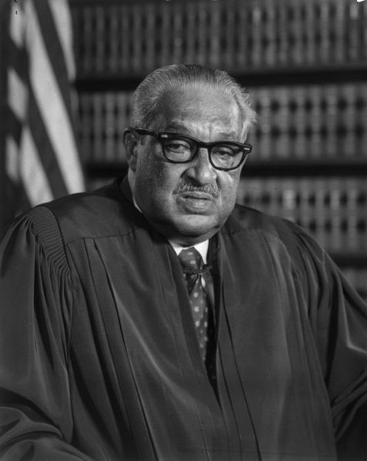
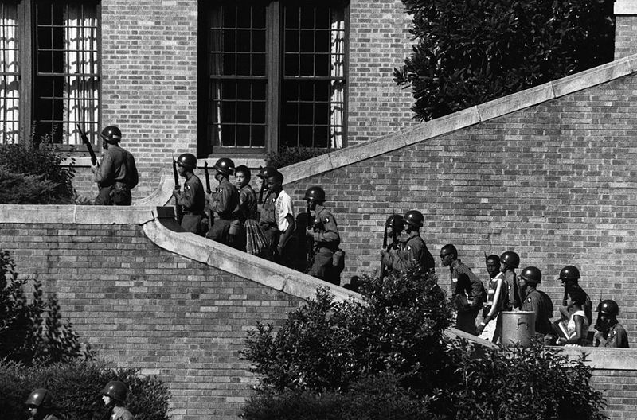
The Emerging Civil Rights Struggle, 1941 - 1957
Fighting For Equality Before the Law
Thurgood Marshall
NAACP lawyer, future justice of the Supreme Court
Smith v. Allwright (1944) - white primaries were unconstitutional
Lead attorney in Brown v. Board
***Brown v. Board of Education***:
Overturned “separate but equal” established by Plessy
Led to resistance by Southerners:
Massive Resistance - schools would shut down, rather than desegregate
The Southern Manifesto - Southern Congressmen argued the Supreme Court overstepped its power
Little Rock Nine:
Eisenhower used troops to protect 9 black students at Little Rock High School

Slide 7
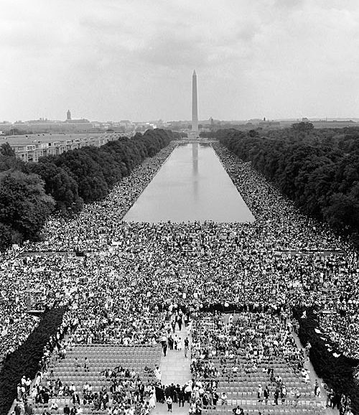
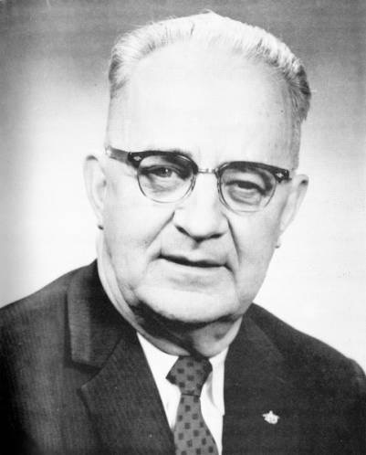
Forging a Protest Movement, 1955 - 1965
Legislating Civil Rights, 1963 - 1965
The Battle for Birmingham:
Eugene “Call me Bull” Connor - ordered the police to use force against protestors
Images appeared in newspapers and tv
Letter from a Birmingham Jail
MLK justified his approach - inspired by Gandhi and Jesus
George Wallace tried to prevent black students from the University of Alabama
The March on Washington and the Civil Rights Act:
August, 1963 - King, one of many speakers, delivered his famous “I Have a Dream” speech
250,000 in attendance
***Civil Rights Act of 1964 - Specifically mentioned in the new curriculum***
Outlawed discrimination based on race, sex, origin, and religion
Government could cut off $ where discrimination occurred

Slide 8
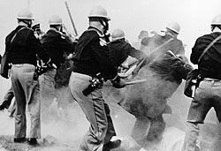
Forging a Protest Movement, 1955 - 1965
Legislating Civil Rights, 1963 - 1965
Freedom Summer
SNCC, CORE, NAACP, and SCLC helped register voters in 1964
Mississippi Freedom Democratic Party - sought to attend the Democratic National Convention in Atlantic City
The convention did not recognize the party and they were left out
Selma and the Voting Rights Act
“Bloody Sunday” - attack of marchers from Selma to Montgomery by state troopers
Voting Rights Act of 1965:
Barred literacy tests
Federal government could register voters
24th Amendment - barred poll taxes
Many Southern whites switched from the Democratic Party to the Republican Party

Slide 9
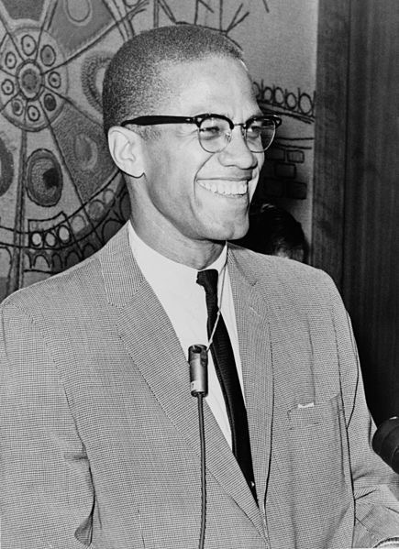
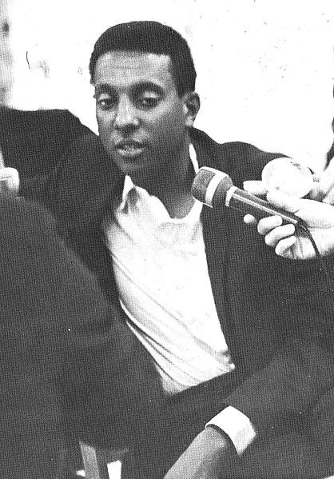
Beyond Civil Rights, 1966 - 1973
Black Nationalism
Many meanings - pride, separatism, supporting black businesses, etc.
Nation of Islam
Popular among African Americans in cities
Malcolm X
Urged violence for self-defense
Eventually he split from the NOI, and was murdered on February 21, 1965
Black Power
Stokely Carmichael - became leader of SNCC, advocated Black Power
Focused on black pride and strengthening black communities

Slide 10
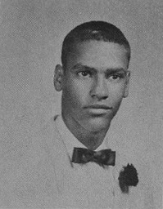
Beyond Civil Rights, 1966 - 1973
Black Nationalism
Black Panther Party
Founded in 1966 by Bobby Seale and Huey Newton
Urged arming African Americans in pursuit of self-defense
Popular in urban areas
Focused on community programs - free breakfast for children
Young Lords
Inspired by Black Panthers
Hoped for self-determination for Puerto Ricans in the US and the country
Sought to improve conditions in neighborhood cities, particularly East Harlem
The New Urban Politics
Gary, Indiana and Cleveland, Ohio elected black mayors
National Black Political Convention:
Toyed with the idea of creating a third party, eventually continued to support the Democrats
Sought national health insurance and elimination of the death penalty

Slide 11
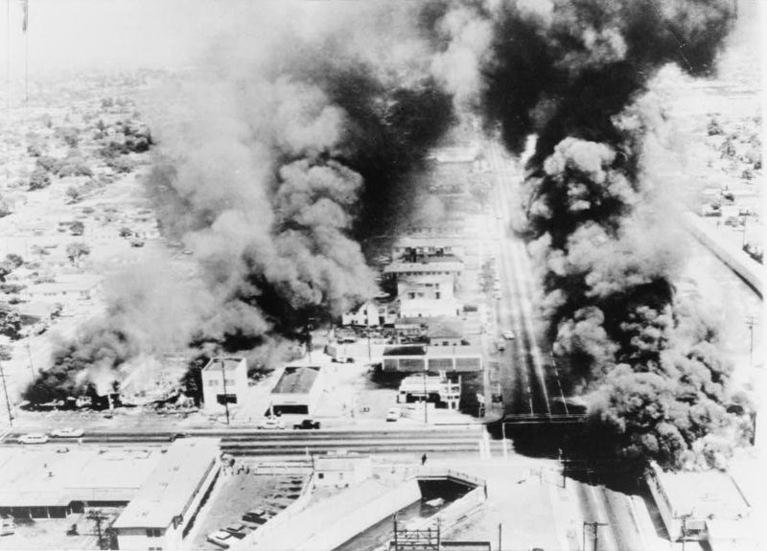
Beyond Civil Rights, 1966 - 1973
Poverty and Urban Violence
Watts Riots of 1965:
Weeklong riot in which 34 people were killed
After more riots in 1967, the Kerner Commission investigated origins of violence
“Our nation is moving toward two societies, one black, one white - separate and unequal.”
MLK spoke out against the war in Vietnam - LBJ focused on the war more than poverty and issues at home
On April 4, 1968, MLK was assassinated by James Earl Ray

Slide 12
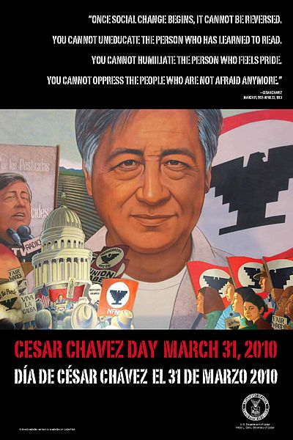
Beyond Civil Rights, 1966 - 1973
Rise of the Chicano Movement
Cesar Chavez - helped create the United Farm Workers (UFW)
Led a grape pickers’ strike to bring attention to the plight of Mexican-American workers
1968 - 28 day hunger strike, met with Presidential Candidate and Attorney General, RFK

Slide 13
Beyond Civil Rights, 1966 - 1973
The American Indian Movement
Faced the most challenges of any minority group:
Stunningly high unemployment, poor housing and schools
Indians of All Tribes (IAT) and American Indian Movement (AIM):
Used protests to bring attention to their plight
1969 - IAT took over Alcatraz Island
Trail of Broken Treaties - protest across the country by many Native American groups
Media attention was widespread of various Native takeovers

Slide 14
Quick Review
Role of tv and the Cold War in the Civil Rights Movement
Executive Order 8802 - FDR - desegregated defense industries
Double V Campaign
Executive Order 9981 - desegregated the military
Dixiecrats
Thurgood Marshall
Brown v. Board
Civil Rights Act of 1964
Voting Rights Act of 1965
24th Amendment
March on Washington
Black Power, Malcolm X, and the Black Panthers
Kerner Commission
Chicano Movement and Native Americans

Slide 15
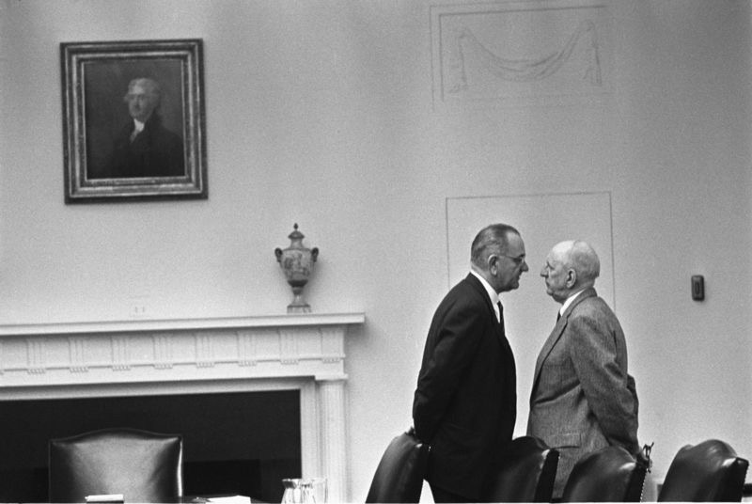
See You Back Here For Chapter 28!
Thanks for watching
Subscribe and share
Check out other videos
Good luck in May!

