Slide 1
America’s History, 8th Edition, Chapter 3 Review Video
www.Apushreview.com
The British Atlantic World
(1660 - 1750)

Slide 2
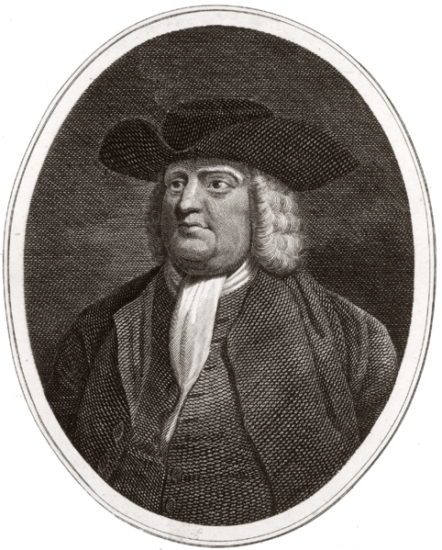
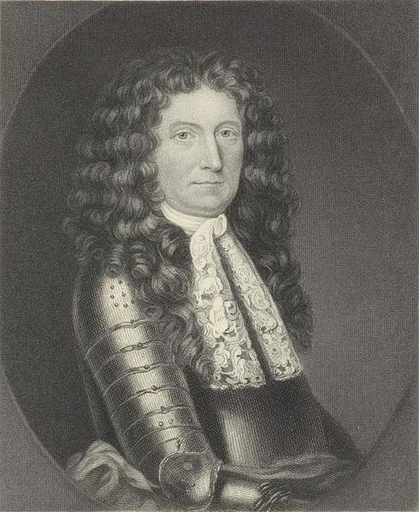
Colonies to Empire, 1660 - 1713
The Restoration Colonies and Imperial Expansion:
Proprietorship – royal grant of land given to an individual by the English Crown; Could rule as wished, as long as it was within English laws
The Carolinas:
South Carolina established a strict racial hierarchy
Focused on growing rice
William Penn and Pennsylvania:
Believed in an “inner light,” Pacifists, no paid clergy
Paid Native Americans for their land
“Holy experiment” – toleration of many religious groups
All could attain salvation, did not favor predestination
Women had many rights in church – could become preachers, speak publicly
From Mercantilism to Imperial Dominion:
The Navigation Acts:
Laws passed by England that required all goods to be carried on English or colonial ships
Colonists could NOT trade with other countries – colonists began SMUGGLING!
The Dominion of New England - combined Massachusetts with the rest of New England, and later New Jersey and New York
Assemblies were eliminated and a new governor was appointed – Sir Edmund Andros who was very unpopular
The Dominion was met with resistance and ended with “The Glorious Revolution” in England

Slide 3
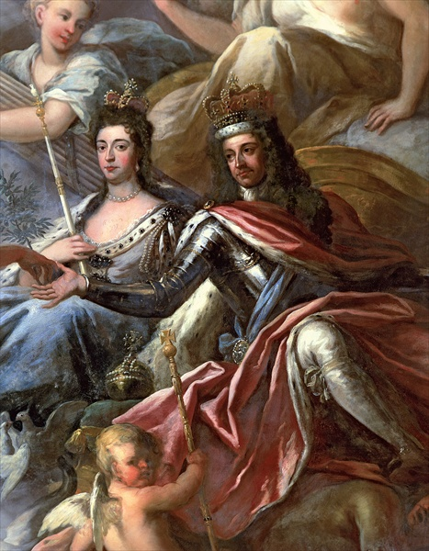
Colonies to Empire, 1660 - 1713
The Glorious Revolution in England and America
James II is overthrown, William and Mary installed as joint rulers
Declaration of Rights established a constitutional monarchy that limited the power of the monarchy
Rebellions in America:
Leisler’s Rebellion:
Rebelled against the Dominion of New England
Was eventually hanged and decapitated
Demonstrated tensions between lower class and wealthy

Slide 4
Imperial Wars and Native Peoples
Tribalization:
Native Americans were forced to demands of Europeans
Iroquois Indians used the French and English against each other
Iroquois sought to remain neutral in conflicts between the two powers

Slide 5
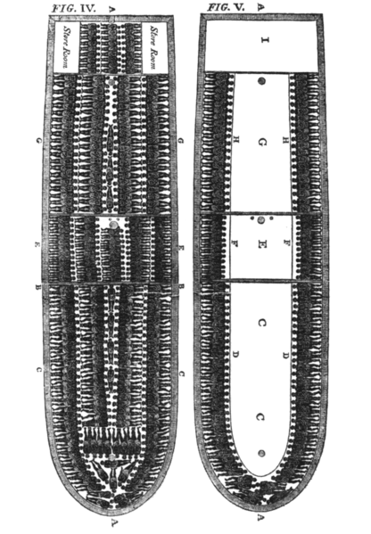
The Imperial Slave Economy
The South Atlantic System:
Trade between the Caribbean, Brazil, and Africa
England and the West Indies:
Barbados became a major sugar producer using slave labor
Fear was a significant force in slave labor
Sugar was the most profitable crop
The Impact on Britain:
England gained tremendous wealth through the South Atlantic System and Navigation Acts
Africa, Africans, and the Slave Trade:
Africans and the Slave Trade:
West Africa became a major player in the slave trade
2/3 of slaves were men
Many African men practiced polygamy
The Middle Passage and Beyond:
Middle Passage – Slave voyage from Africa to the Americas
Horrific conditions
Many died on the ship
Slaves regularly worked 10 hour days in brutal heat
Suffered mental and physical abuse, as well as sexual exploitation

Slide 6
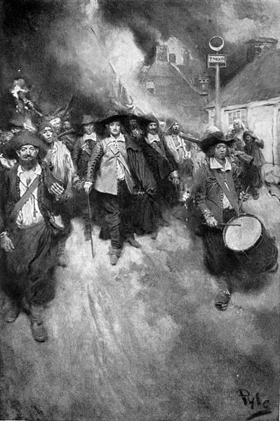
The Imperial Slave Economy
Slavery in the Chesapeake and South Carolina:
1740, slaves made up 40% of the population in the Chesapeake
What caused this increase after 1676?
Slaves were defined by race; slave owners could not be charged with a crime if they killed their slaves
Slavery was more arduous in the Caribbean raising sugar
Diseases were more frequent in the West Indies
South Carolina raised mostly rice, similar conditions to sugar plantations

Slide 7
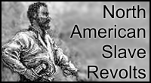
The Imperial Slave Economy Cont.
An African American Community Emerges:
Plantation owners purposely bought slaves from different areas of Africa that did not speak the same language
Building Community:
Africans developed a unique blend of both African and American cultures
Religion, music, etc.
Resistance and Accommodation:
Slave resistance mostly took the form of working slowly, faking illness, breaking tools, and running away
The Stono Rebellion (1739):
Many slaves revolted and killed whites and tried to flee to Spanish Florida
After this and other Rebellions, slave laws became more strict
The Rise of the Southern Gentry (high social class):
Wealthy plantation owners had tremendous power
Hoped to prevent another Bacon’s Rebellion by lowering taxes and encouraging small farmers to own slaves
Some small farmers were given the right to vote

Slide 8
The Northern Maritime Economy
Trade increased contact and reliance between New England and West Indies
The Urban Economy:
Molasses from the West Indies was turned into rum in New England
The New England fishing industry sold fish to Europe
A major shipbuilding industry emerged in New England – 1/3 of British fleet by 1770s
Urban Society:
Merchant elites controlled a sizeable portion of trade in New England
Artisans made up 50% of society
Indentured servants and slaves worked on docks
Children were often forced to work to help provide for their families

Slide 9
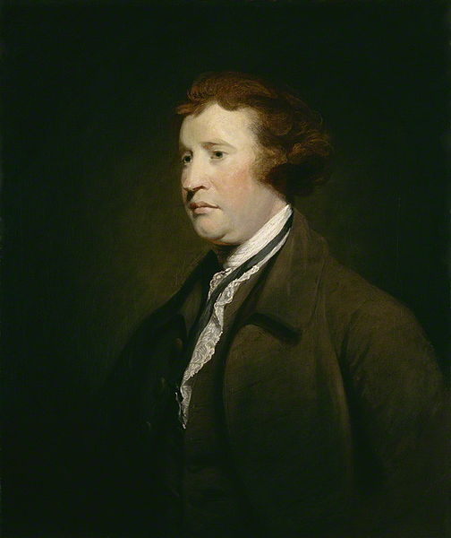
The New Politics of Empire, 1713 - 1750
The Rise of Colonial Assemblies:
Only white, property-owning males could vote
Many assemblies limited the power of the royally appointed governor
Elite families dominated politics; many members of one family would serve on legislatures
Crowds would often protest colonial acts deemed unpopular
Salutary Neglect:
Coined by philosopher Edmund Burke
Essentially, England left the colonies alone, as long as they were profitable
Ends in 1763 with the end of the 7 Years War (Britain needed $ to pay for its debt)

Slide 10
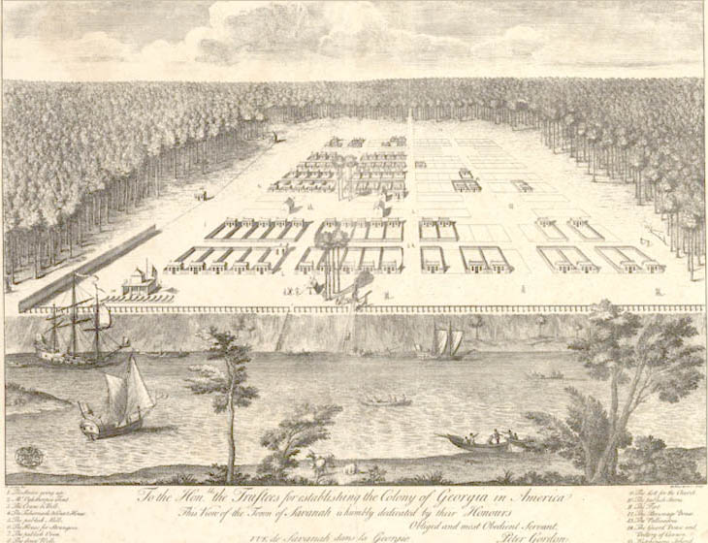
The New Politics of Empire, 1713 - 1750
Protecting the Mercantile System:
Georgia was established as a “buffer” colony between South Carolina and the Spanish in Florida
War of Jenkin’s Ear – fought over land disputes between the Spanish and British
Mercantilism and the American Colonies:
American colonists began to control more and more of the Atlantic trade – large increase in wealth for colonies
Molasses Act (1733) – placed a high tariff on French molasses
Although Britain discouraged trade with other countries, colonists routinely smuggled goods
Currency Act (1751) – first of two currency acts
Prohibited the colonies from issuing paper money

Slide 11
Quick Recap
Pennsylvania and the “Holy Experiment”
Navigation Acts
Transatlantic trade increased demand for sugar and slaves
Comparing slavery in the Chesapeake with South Carolina and West Indies
Stono Rebellion led to more harsh slave laws
Salutary Neglect
Most conflict between countries was over LAND!
Colonists avoided British acts (Navigation) by smuggling

Slide 12
Thanks for watching!
Subscribe to my channel
Press the “Like” button
Questions? Comments?
Follow me on Twitter @APUSH_Review
Subscribe
Down here!

