Slide 1
America’s History, 8th Edition, Chapter 5 Review Video
www.Apushreview.com
The Problems of Empire
(1763 - 1776)
Check out the description for videos that match up with the new curriculum.

Slide 2
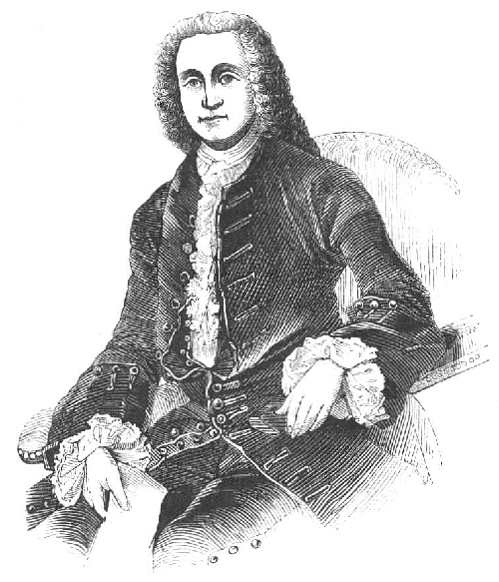
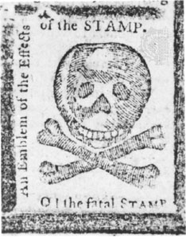
An Empire Transformed
The Costs of Empire:
Britain’s debt increased drastically after the 7 Years’ War
Increased taxes for British citizens and colonists
Smugglers faced harsh punishments – some became indentured servants
Increase of British military in America post 7 Years’ War – prevent Native American rebellions – Pontiac’s and Proclamation of 1763
George Greenville and the Reform Impulse:
Currency Act (1764): prohibited colonies from using paper money
The Sugar Act (1764): increased tax that replaced the Molasses Act
Many colonists got around it by………..
SMUGGLING!
The End of Salutary Neglect:
Ended in 1763
Smugglers would be tried in vice-admirality courts; guilty until proven innocent
Many colonists resisted the increase in British control
An Open Challenge: The Stamp Act (1765):
Tax on 50 commonly used goods, affected most colonists
Violators would be tried in vice-admirality courts
Quartering Act – colonists were required to feed and house British troops

Slide 3
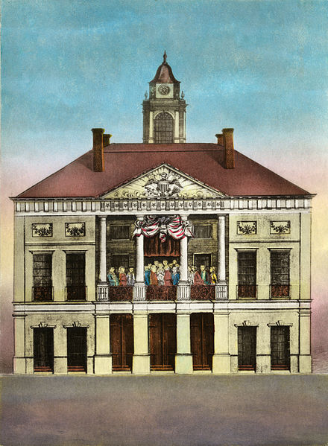
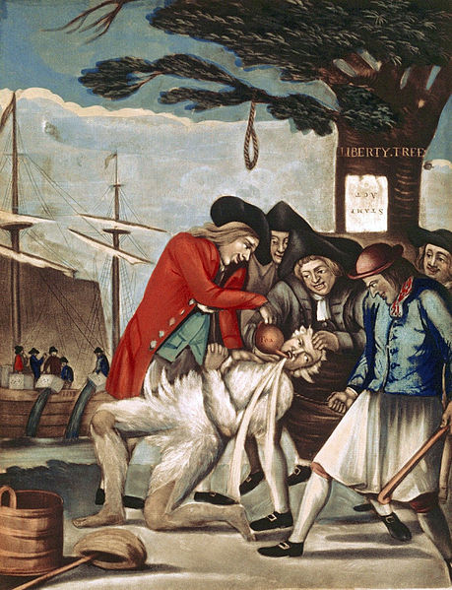
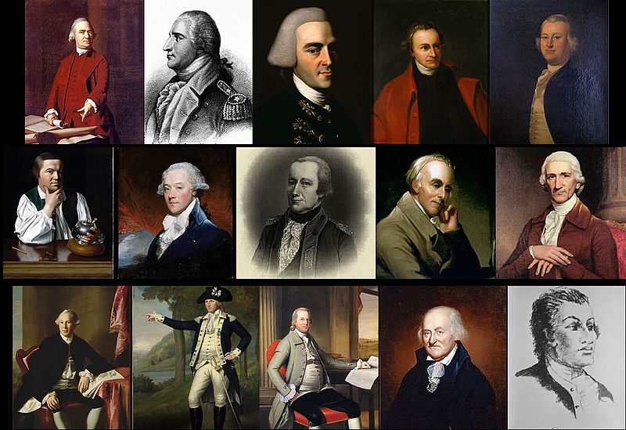
The Dynamics of Rebellion (1765 – 1770)
Formal Protests and the Politics of the Crowd:
House of Burgesses protested the Stamp Act – Patrick Henry
The Stamp Act Congress:
Met to protest the Stamp Act
Believed only colonial representatives could tax the colonists NOT Parliament
Sons of Liberty – protested the Act, attacked royal officials, boycotted British goods, tarring and feathering
The Motives of the Crowd:
Large protests led to many British officials resigning their positions
The Ideological Roots of Resistance:
Justification for Colonial Resistance:
English Common Law – argued that as subjects of the British Monarchy, colonists deserved certain rights
Enlightenment – ideas such as “natural rights,” and “separation of powers”
Whigs in Parliament were favorable to colonists
Many of these ideas spread rapidly in newspapers and pamphlets (Print Revolution from chapter 4)

Slide 4
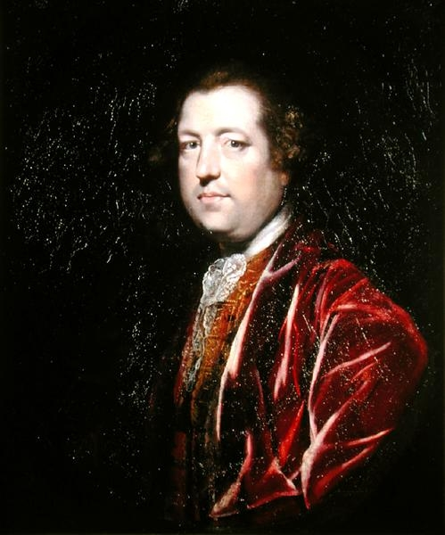
The Dynamics of Rebellion (1765 – 1770) (Continued)
Another Kind of Freedom:
Many colonists compared themselves to slaves since they did not give consent to British laws
A few colonists challenged slavery (Franklin, James Otis)
Parliament and Patriots Square Off Again:
Britain repealed the Stamp Act in 1766, passed the Declaratory Act:
Parliament could pass any law in the future
Charles Townshend Steps In:
Townshend was not sympathetic to the colonists
Townshend Acts:
Tax on paper, paint, glass, and tea
Taxes would pay salaries of imperial officials
Colonists resisted these taxes as well….
A Second Boycott and the Daughters of Liberty:
Nonimportation agreements – refusing to buy British goods
Women played a large role – homespun clothing
Ben Franklin advocated returning to pre-1763 policies
Troops to Boston:
Both the colonists and British dug-in with their beliefs
British troops were sent to Boston (hotbed of resistance)

Slide 5
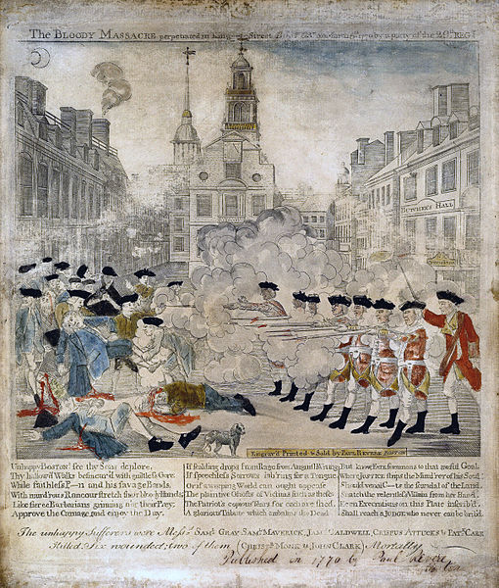
The Dynamics of Rebellion (1765 – 1770) (Continued)
The Problem of the West:
Many colonists favored westward expansion (land speculators, traders, squatters)
Britain began to view the Proclamation Line as permanent
Parliament Wavers:
Prime Minister Lord North convinced Parliament to repeal the Townshend Acts (tax on tea remained)
The Boston Massacre:
British soldiers in Boston worked jobs that colonists wanted
March 5, 1770 – conflict in which Boston troops killed 4 colonists
Colonists used this as propaganda to spread their message
Sovereignty Debated:
Most colonists were loyal and DID NOT WANT INDEPENDENCE
Rather, they wanted to go back to the days of SALUTARY NEGLECT

Slide 6
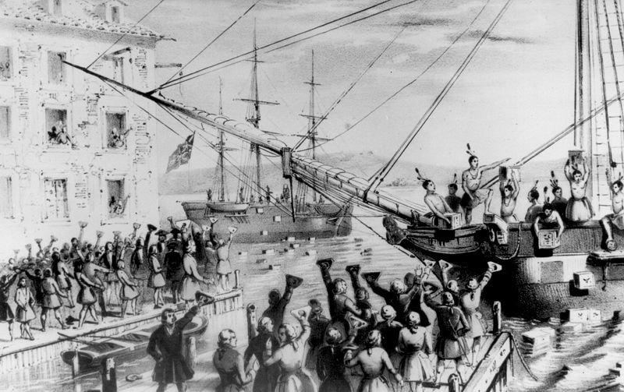
The Road to Independence (1771 – 1776)
A Compromise Repudiated:
Committees of Correspondence – assemblies that were created for colonial leaders to communicate with one another. Another form of colonial unity
The East India Company and the Tea Act:
Tea Act (1773) bailed out the East India Company by creating a tax; even though the tea was cheaper than smuggled tea, the colonists were still against it….. Why?
The Tea Party and the Coercive Act:
Led by the Sons of Liberty, 342 chests of tea were dumped into the Boston Harbor
In response, Britain passed the Coercive (Intolerable) Acts:
Massachusetts must pay for the tea, port of Boston was closed, MA charter was voided, and town hall meetings were outlawed
The Continental Congress Responds:
Formed in response to the Coercive Acts
12 colonies (not GA) sent representatives to have grievances redressed and favored a boycott
Most did NOT WANT INDEPENDENCE, rather the days of Salutary Neglect

Slide 7
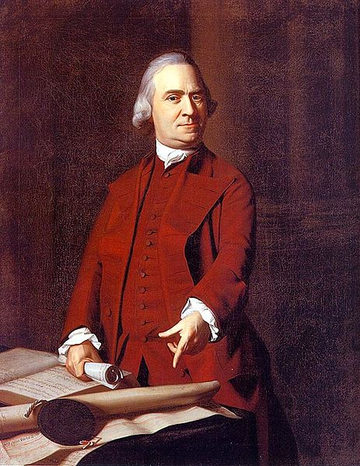
The Road to Independence (1771 – 1776)
The Continental Association:
Encouraged a third boycott against British goods
Southern Planters Fear Dependency:
Many VA farmers were in debt to British merchants
VA feared that Britain could punish them like MA
Loyalists and Neutrals:
Some Patriot leaders (Sam Adams) were accused of serving their own interests
Loyalists (those loyal to Britain) numbered around 20 percent

Slide 8
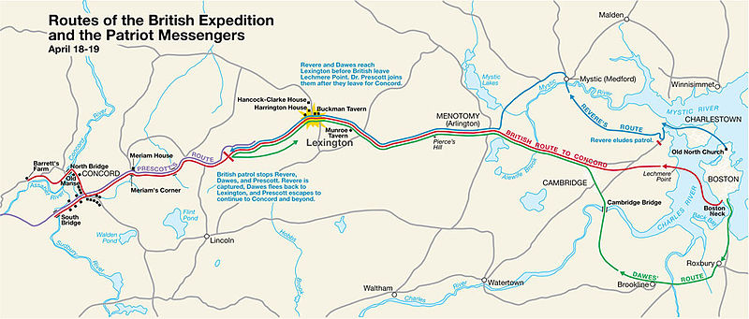
Violence East and West
Armed Resistance in MA:
Minutemen – Patriots that would warn of conflict with the British
Lexington and Concord (1775)
1st battles against the British, “shot heard around the world”
The Second Continental Congress Organizes for War:
2nd C.C. – met in May 1775, appointed George Washington as head of the colonial army
Congress Versus King George:
Olive Branch Petition was rejected by KG3, deemed the colonies to be in a state of rebellion
Fighting in the South:
Britain promised to free slaves that were loyalists; angered many slave owners and strengthened the Patriot cause in the South
Occupying Kentucky:
Daniel Boone occupied newly independent areas of KY

Slide 9
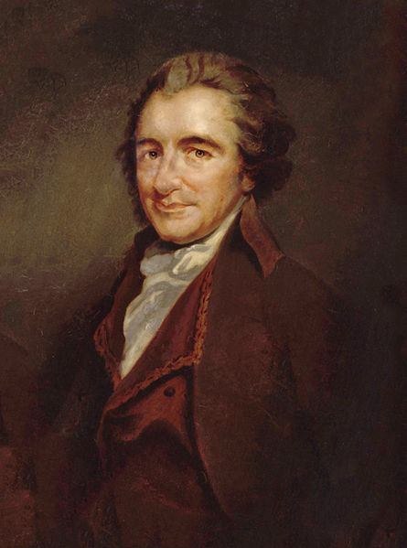
Violence East and West Cont.
***Thomas Paine’s Common Sense:***
Written in January 1776
Accused KG3 of several wrongdoings
Urged America to declare independence
“A government of our own is our natural right, ‘tis time to part.”
This is specifically mentioned in the new curriculum
Check out my video in the description
Independence Declared:
Declaration of Independence – inspired by Common Sense and the Enlightenment
Jefferson and other writers wrote about popular sovereignty – the power rests with the people, not the government

Slide 10
Quick Recap
End of F&I War = Debt = Increased Taxes = End of Salutary Neglect
Stamp Act -> Stamp Act Congress -> Stamp Act overturned -> Colonists’ resolve increases
Smuggling and Boycotting
Print Revolution, Committees of Correspondence helped spread ideas
Tea Act -> Tea Party -> Coercive (Intolerable) Acts -> 1st Continental Congress
Most colonists in the first half of the 1770s did NOT want independence, they longed for Salutary Neglect
Common Sense appeals to many colonists

Slide 11
Thanks for watching!
Subscribe to my channel
Press the “Like” button
Questions? Comments?
We all subscribed!
Subscribe
Down here!

