Slide 1
America’s History, 8th Edition, Chapter 6 Review Video
www.Apushreview.com
Making War and Republican Governments
1776 – 1789
Check out the description for videos that match up with the new curriculum.

Slide 2
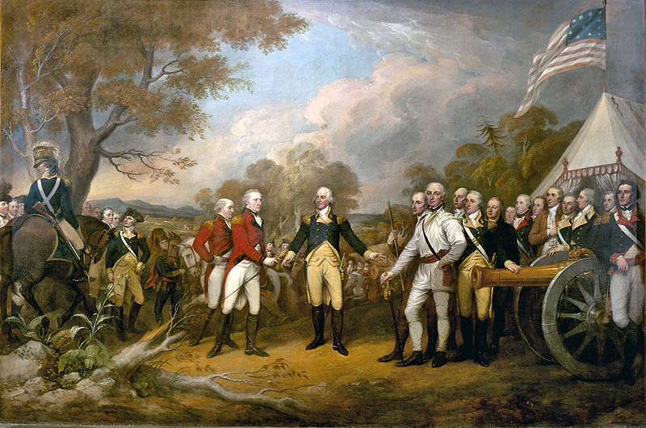
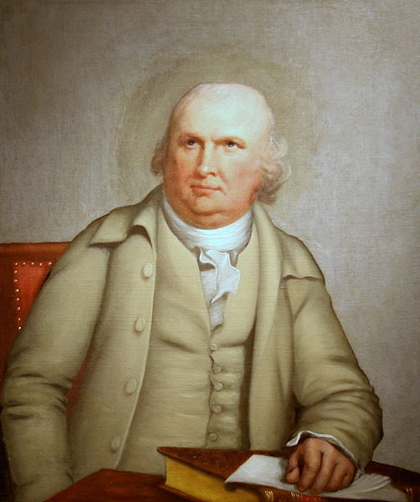
The Trials of War, 1776 - 1778
War in the North:
  Britain’s military vastly outnumbered the Patriots
  Some Natives sided with the British
Victories at Saratoga:
  The Battle of Saratoga was a turning point
  The Patriots won; France provided aid to the US (financial and military)
The Perils of War:
  Women played an important role – created clothing, ran farms
  Some women hoped to gain more rights (Abigail Adams)
Financial Crisis:
  State currencies were highly inflated
  Robert Morris (Chief Treasury) secured valuable aid from Holland and France
Valley Forge:
  Baron von Steuben – former Prussian military officer, helped train the American army

Slide 3
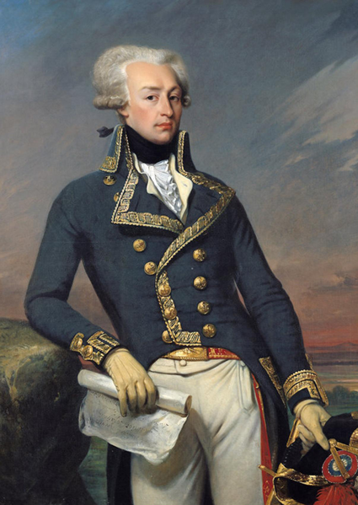
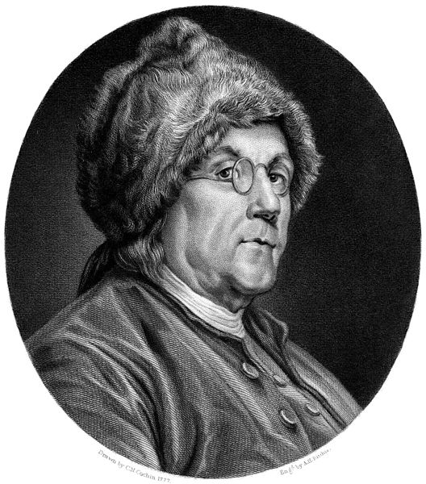
The Path to Victory, 1778 - 1783
The French Alliance:
  France and US made an unusual alliance (Catholic monarchy)
  Ben Franklin played an important role in the Treaty of Alliance
    America and France would ensure the independence of the US
War in the South:
  Spain fought against Britain in 1779
  Britain’s Southern Strategy:
    The South contributed fewer individuals to war effort – fear of leaving slaves unattended
    Philipsburg Proclamation – slaves that rebelled would gain protection and freedom from Great Britain
    5,000 African Americans (free and slave) fought for Patriot Cause
    The Marquis de Lafayette – instrumental in gaining French troops to America
  Guerrilla Warfare in the Carolinas:
    Battle of Saratoga (1781) – last major battle of the war, Cornwallis surrenders

Slide 4
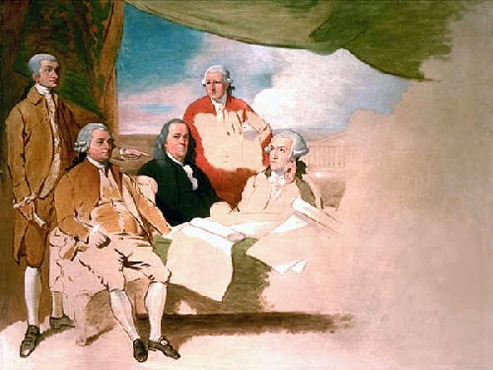
The Path to Victory, 1778 – 1783 (Cont.)
The Patriot Advantage:
  French aid
  “Home-field advantage”
  Leadership – George Washington
Diplomatic Triumph:
  Treaty of Paris (1783)
    Britain recognized US independence
    US gained all land east of Mississippi River
    US fishing rights off Newfoundland
    Britain could pursue debts
Spain and France gained very little
  France becomes severely in debt

Slide 5
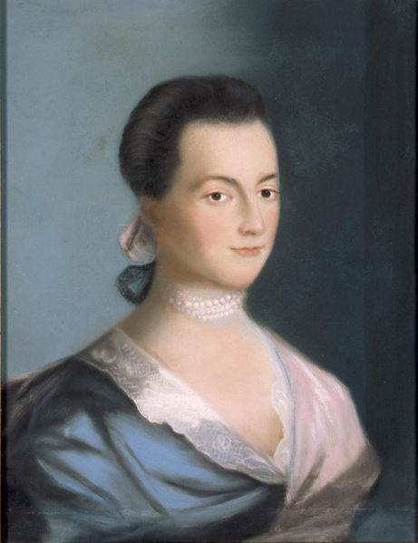
Creating Republican Institutions (1776 – 1787)
Don’t forget about us John….
The State Constitutions: How Much Democracy?
  Pennsylvania’s Controversial Constitution:
    Unicameral legislature was created with total power (no governor)
  Tempering Democracy:
    Other states created bicameral legislatures
    Most states were not truly democratic – only PA and VT
Women Seek a Public Voice:
  Abigail Adams’ “Remember the Ladies”
    Hoped to end customs and laws that oppressed women (married women could not own property, have contracts, etc.)
  Only white men were full citizens in new government
The War’s Losers: Loyalists, Native Americans, and Slaves:
  Many loyalists suffered economically, others fled
  Native Americans were pushed further west off their lands
  Slaves did not gain freedom after the war

Slide 6
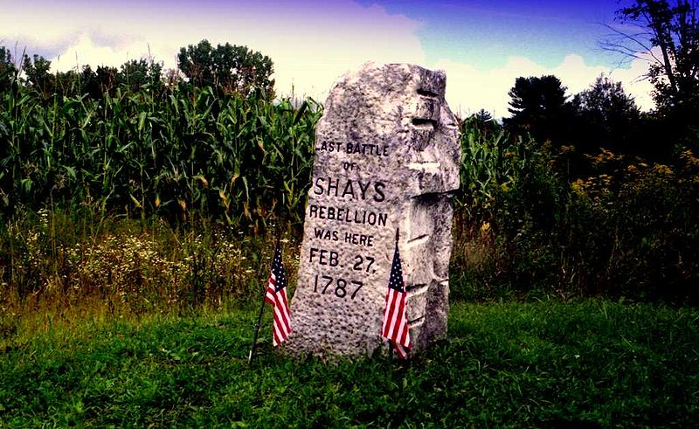
Creating Republican Institutions (1776 – 1787)
The Articles of Confederation:
  Created a weak central government, states had a lot of power
  Each state had one equal vote in the national government
  In order to amend the Articles, unanimous approval was required
  The federal government could: make treaties, borrow money, ask for tax $
Continuing Fiscal Crisis:
  The US was in debt, began to sell western land
The Northwest Ordinance:
  Slavery was banned in the Northwest Territory
  $ from 1 out of 36 square miles that were sold would go towards education
  Territories could apply for statehood when they reached 60,000 people
Shays’ Rebellion:
  MA state legislature increased taxes
  Many farms were foreclosed
  Former Rev. War vet, Daniel Shays’ led a rebellion
    Demonstrated the weakness of the Articles
    Helped many recognize the need for a new government

Slide 7
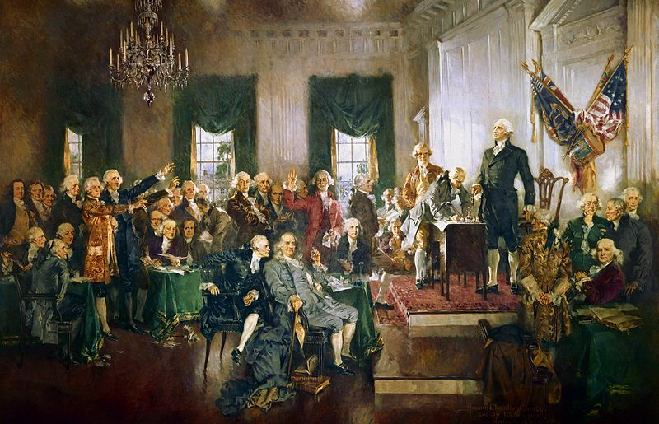
The Constitution of 1787
The Rise of a Nationalist Faction:
  Sectional differences slowly emerged: northerners tended to favor tariffs, southerners did not
The Philadelphia Convention:
  55 delegates, mostly wealthy and upper-class
  Thomas Jefferson and John Adams were NOT in attendance
  The VA and NJ Plans:
    VA Plan – proposed a bicameral legislature where representation in Congress was to be based on population
    NJ Plan – favored smaller states, representation would be equal for each state
  The Great Compromise:
    Combined elements of both VA and NJ plans
    Created bicameral legislature: lower house (Representatives) would be based on population and elected by the people, upper house (Senate) would have 2 per state and elected by state legislatures
  Negotiations over Slavery:
    3/5 Compromise – 60% of slaves would count towards population for representation in Congress, advantage for the South
  National Authority:
    Constitution is the “Supreme Law of the Land”
    “Necessary and Proper” (Elastic) clause increases power of Congress

Slide 8
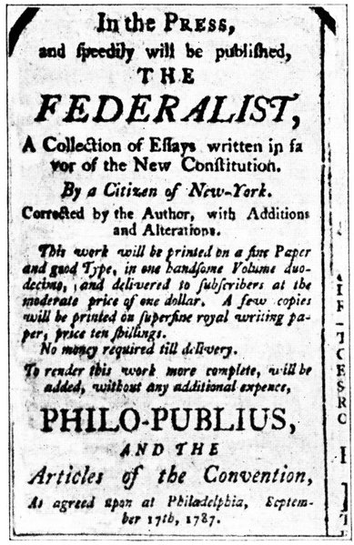
The Constitution of 1787 (Cont.)
The People Debate Ratification:
  Constitution would take effect when 9 out of 13 states ratified it
  Emergence of two groups:
    Federalists – favored ratification
    Anti-federalists – weary of ratification
  The Antifederalists:
    Feared centralized power at states’ expense
    Criticized the lack of a bill of rights
  Federalists Respond:
    The Federalist Papers (Jay, Madison, and Hamilton)
    85 essays written to promote the Constitution
    Federalist 10 discussed factions
  The Constitution Ratified:
    Typically, people in the backcountry were Antifederalists, easterners were Federalists
    With the promise of the Bill of Rights, many Antifederalists ratified the Constitution

Slide 9
Quick Recap
Battle of Saratoga
Foreign assistance (Spain, Holland, France)
Women, Natives, and African Americans did not gain rights after the Rev. War
Shays’ Rebellion
Articles of Confederation - +’s and –’s
Northwest Land Ordinance
NJ and VA Plans, and the Great and 3/5 Compromises
Federalists and Antifederalists

Slide 10
Thanks for watching!
  Subscribe to my channel
  Press the “Like” button
Questions? Comments?
Remember to subscribe…..
Subscribe
Down here!

