Slide 1
America’s History, 8th Edition, Chapter 7 Review Video
www.Apushreview.com
Hammering Out a Federal Republic (1787 – 1820)
Check out the description for videos that match up with the new curriculum.

Slide 2
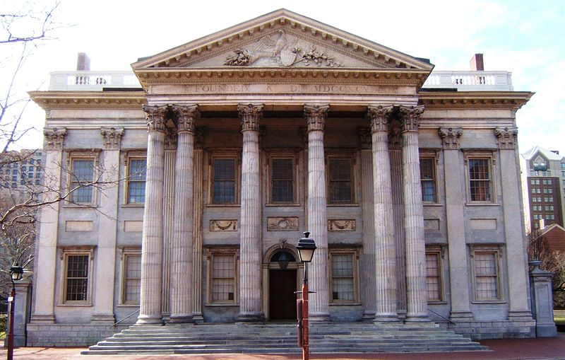
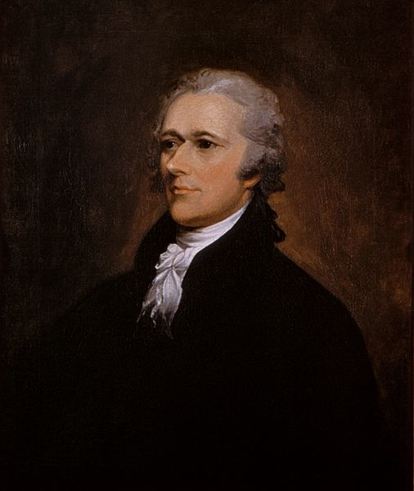
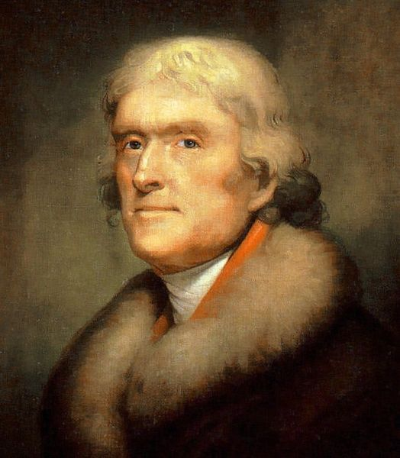
The Political Crisis of the 1790s
The Federalists Implement the Constitution
  Devising the new Government:
    Washington’s Cabinet: State – Jefferson, Treasury – Hamilton, War – Knox
    Judiciary Act of 1789 – created the Supreme Court with 6 justices, and lower courts
  The Bill of Rights:
    Safeguard against government power; protection of personal powers
    Added to mollify the Antifederalists to ratify the Constitution
Hamilton’s Financial Program
  Public Credit: Redemption and Assumption
    Hamilton advocated buying back all loans plus interest (funding at par)
    Controversial plan – some speculators bought up bonds at cheap prices
    Hamilton proposed assuming all state debts
    Only after D.C. would be located in the South did his plan pass
    Hamilton favored the national debt – thought it was a blessing
  Creating a National Bank:
    Bank of the US (BUS) – cornerstone of his financial plan; would provide loans to businesses and help the economy
    Strict v. Loose interpretation
  Raising Revenue Through Tariffs:
    Excise tax – tax on domestic goods
    Tariff – tax on imported goods (revenue for the government)

Slide 3
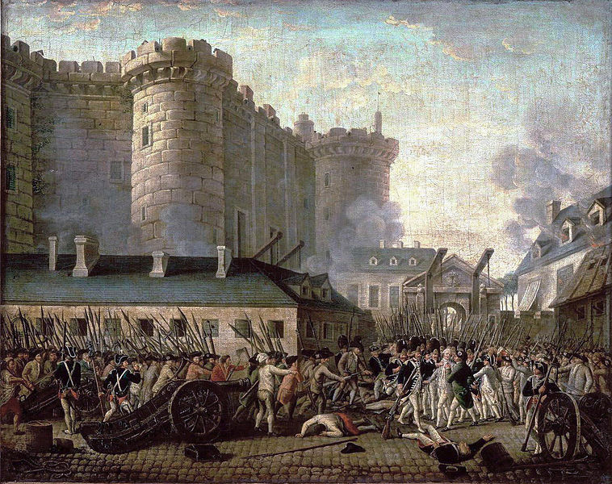
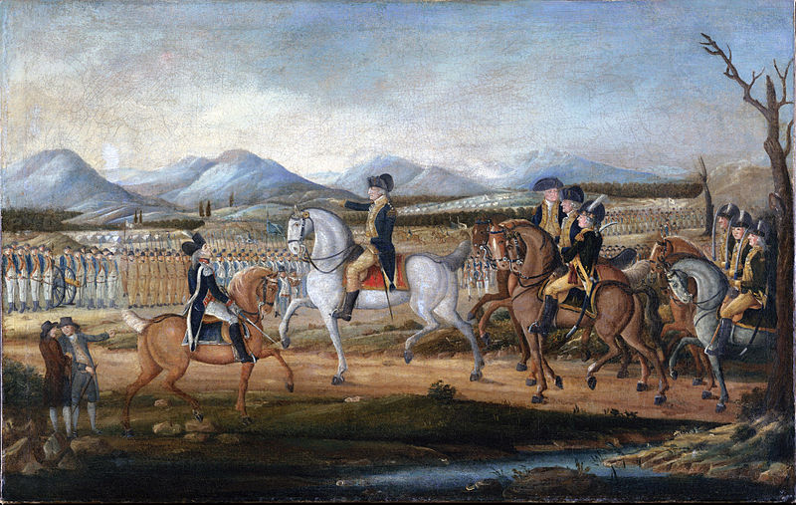
The Political Crisis of the 1790s
Jefferson’s Agrarian Vision:
  First party system (Hamiltonians/Federalists and Jeffersonians/Republicans)
  Jefferson believed farmers were the backbone of the economy
The French Revolution Divides Americans:
  Proclamation Neutrality:
    Washington issued to remain neutral in conflict between Britain and France
  Ideological Politics:
    French Revolution – Jeffersonians saw it as an extension of the American Revolution
    Whiskey Rebellion – PA farmers rebelled against the excise tax; crushed by the national government
  Jay’s Treaty:
    Britain seized American ships, Jay hoped to protect ships
    Treaty did little to fix problems
  The Haitian Revolution:
    Toussaint L’Ouverture helped Haiti gain independence
    Many US slaveholders feared the impact of the revolution on their slaves

Slide 4
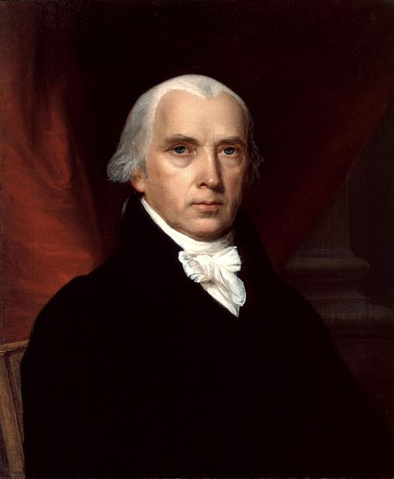
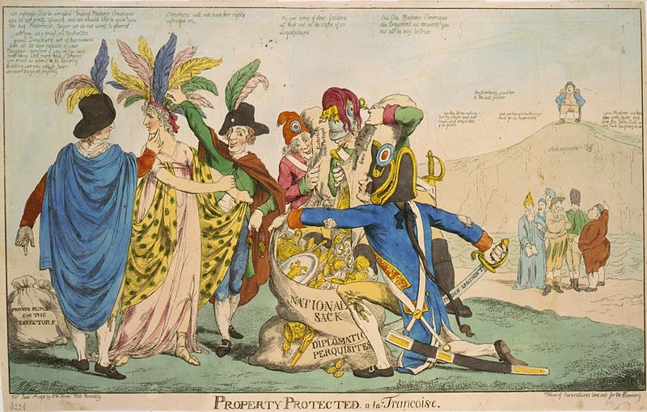
The Political Crisis of the 1790s
The Rise of Political Parties:
  Republicans tended to be:
    farmers (west and south), immigrants, and subsistence farmers in the north
    Pro-French ad power to the states
  XYZ Affair – French diplomats demanded a bribe from 3 US ambassadors, war hysteria ensued
  The Naturalization, Alien, and Sedition Acts:
    Meant to silence opposition to Federalists or President Adams
    Naturalization – increased residency requirement from 5 – 14 years
    Alien Act – president could deport foreigners
    Sedition Act – illegal to criticize the government
    VA and KY Resolutions – urged states to nullify the Alien and Sedition Acts (Compact Theory)
  The “Revolution of 1800”
    Jefferson becomes President, peaceful transition of power between political parties
    “We are all Republicans, we are all Federalists”

Slide 5
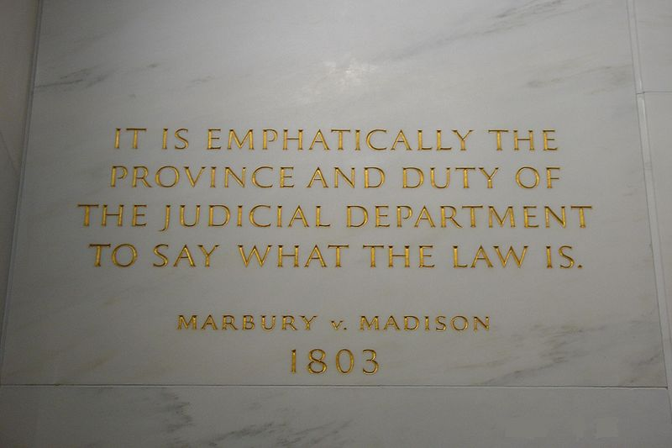
A Republican Empire Is Born
Sham Treaties and Indian Lands:
  After the Rev. War, Natives were pushed further and further west
  The Treaty of Greenville:
    Western Confederacy gave up most of Ohio to Americans
  Assimilation Rejected:
    Natives were encouraged to assimilate (act America)
    Most Natives resisted this – it ran contrary to their ways of life
Migration and the Changing Farm Economy
  Southern Migrants:
    A few, wealthy individuals owned significant land
    ½ of white men owned no land in KY
    Cotton! – King Cotton; cotton gin -> expansion into MI and AL
The Jefferson Presidency:
  “Virginia Dynasty” – TJ, JM, JM
  Jefferson had to deal with a Federalist judiciary branch – “midnight judges”
  ***Marbury v. Madison*** - S.C. rules a law unconstitutional
  Jefferson’s administration eliminated the excise tax, kept the BUS

Slide 6
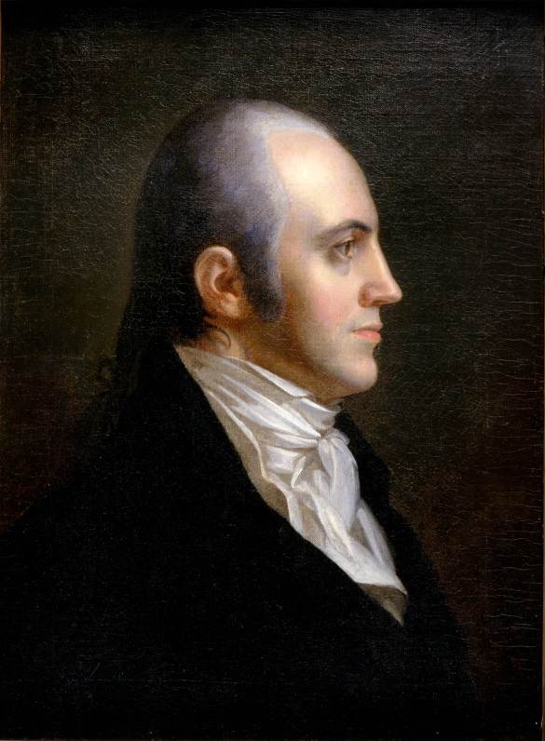
A Republican Empire Is Born
Jefferson and the West:
  Pinckney’s Treaty – US and Spain, US could navigate the Mississippi, store goods in NO
  The Louisiana Purchase:
    Napoleon gained by the LA territory in 1803; US feared they would be cut out of the Mississippi River, so……
    Jefferson wants to by NO
    Impact of LA Purchase? Doubles the size of the US, Jefferson switches from strict to loose interpretation
  Secessionist Schemes:
    Aaron Burr (Jefferson’s VP) flees to the SW, tries to create a new country
  Lewis and Clark Meet the Mandans and Sioux:
    Sent to explore the newly acquired territory, many interactions with Natives along the way

Slide 7
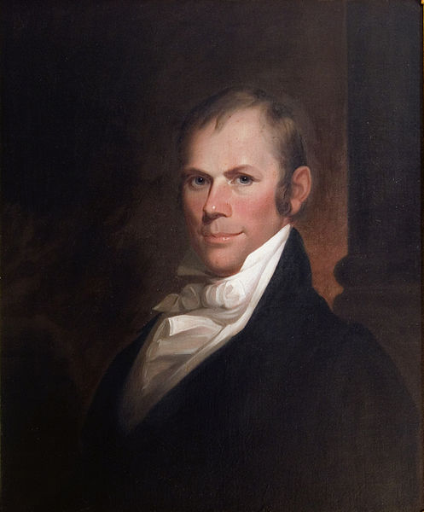
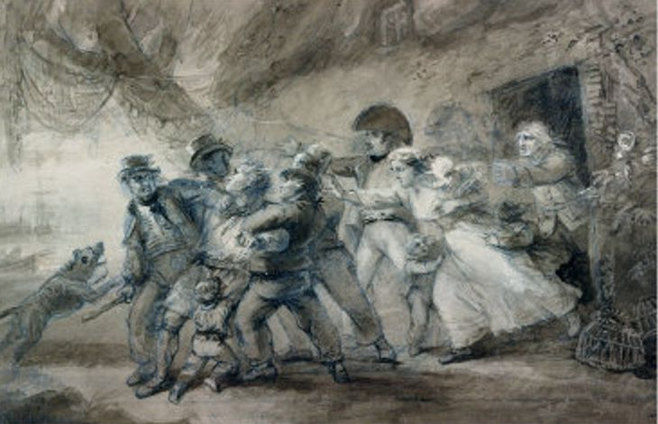
The War of 1812 and the Transformation of Politics
Conflict in the Atlantic and the West
  Impressment – British practice of seizing ships and forcing sailors (many Americans) into the British Navy
  The Embargo of 1807:
    Response to the Chesapeake incident
    US cut off ALL trade with ALL countries – huge disaster
    Other embargoes follow (Non-intercourse Act, Macon’s Bill #2)
  Western War Hawks (Henry Clay!)
    Tecumseh and Natives were provided guns by the British – eventually defeated by William Henry Harrison (future President) at the Battle of Tippecanoe
    Henry Clay! was elected Speaker of the House on his first day of office
    He and other Southern and Western Congressmen (John C. Calhoun) pushed for war
    Most Federalists were against the war, why?

Slide 8
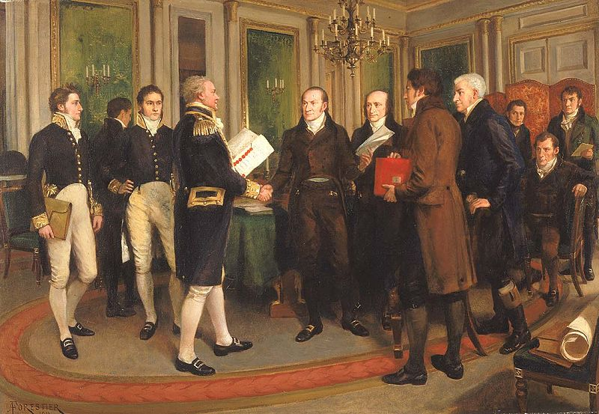
The War of 1812 and the Transformation of Politics
The War of 1812
  Not very successful
  Washington D.C. and Buffalo were burned
  Federalist Oppose the War:
    Hartford Convention – meeting of Federalists to address grievances
      Propose some amendments
      Some urge secession
      Huge blow to the Federalist Party
  Peace Overtures and a Final Victory:
    Treaty of Ghent (Henry Clay!)
      No land was gained or lost
      2 weeks later, Battle of New Orleans (Andrew Jackson)

Slide 9
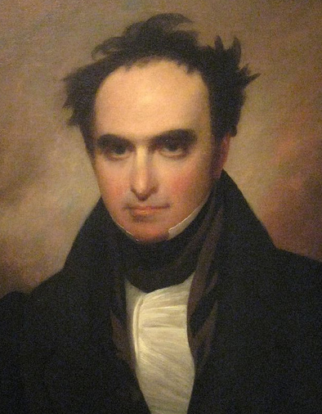
The War of 1812 and the Transformation of Politics
The Federalist Legacy:
  Nationalist-Republicans pursued policies similar to the Federalists (Henry Clay!)
  Marshall’s Federalist View:
    Strengthened the power of the federal government AND the Supreme Court
  Asserting National Supremacy:
    McCulloch v. Maryland – BUS was declared constitutional; states cannot tax a federal government agency
    Gibbons v. Ogden – Only Congress, NOT states, can control INTERstate commerce
  Upholding Vested Property Rights:
    Dartmouth College v. Woodward – contracts cannot be impaired by the government
  The Diplomacy of John Q. Adams (Secretary of State – stepping stone)
    Adams-Onis Treaty (1819) – US gained Florida, gave up claims to TX
    Monroe Doctrine – Europe must stay out of the Western Hemisphere, America will not get involved in European affairs

Slide 10
Quick Recap
Hamilton’s Financial Plan – BUS
Jeffersonians/Federalists – supporters
French Revolution
Neutrality Proclamation
Whiskey Rebellion
Haitian Revolution – scared slave owners
XYZ Affair
The “Revolution of 1800”
John Marshall Court Cases – Marbury, Gibbons, McCulloch, Dartmouth
LA Purchase and Constitutional interpretation
Henry Clay!

Slide 11
Thanks for watching!
  Subscribe to my channel
  Press the “Like” button
Questions? Comments?
Thanks for watching. Good luck!
Subscribe
Down here!

