Slide 1
America’s History, 8th Edition, Chapter 8 Review Video
www.Apushreview.com
Creating A Republican Culture(1790 – 1820)
Check out the description for videos that match up with the new curriculum.

Slide 2
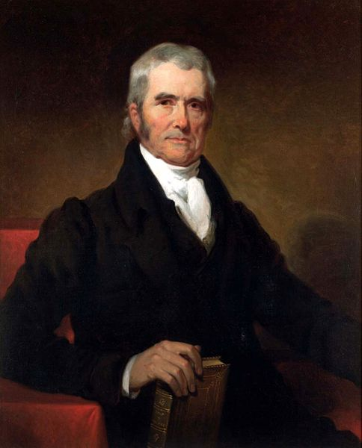
The Capitalist Commonwealth
Banks, Manufacturing, and Markets
Banking and Credit:
2nd BUS was Chartered in 1816 for 20 years
Panic of 1819: state banks over-issued notes, overspeculation on Western land
Growing distrust of banks (2nd BUS) emerged
Rural Manufacturing:
Merchants were especially hard hit from the Panic
More and more of manufacturing moved from homes to factories
New England and the West focused on livestock – Cincinnati
Forests were removed in many areas of the North
Textile mills were built around water
The Transportation System:
Turnpikes – toll roads increased (Lancaster Turnpike)
Connected interior to coasts – increased trade
Public Enterprise: The Commonwealth System:
Under John Marshall, the Supreme Court ruled in favor of expanding business (eminent domain); state legislatures followed
Commonwealth System – providing government aid to private businesses

Slide 3
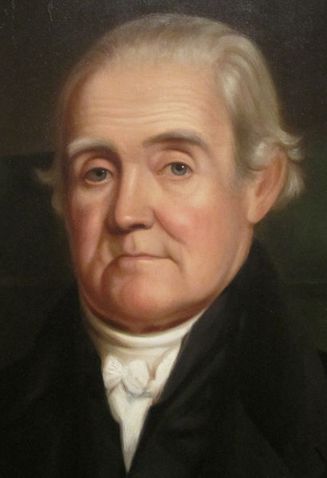
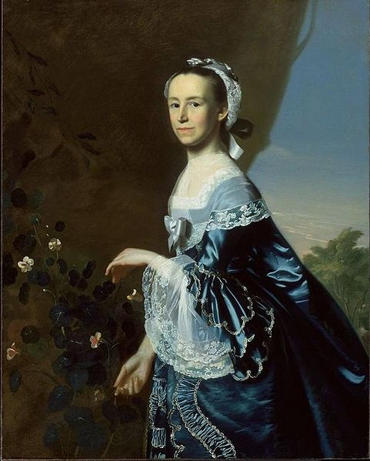
Toward a Democratic Republican Culture
Opportunity and Equality – for White Men:
US was unique in the world – no aristocratic families
However, there were numerous laws that restricted rights based on race and gender
Toward Republican Families:
Mercy Otis Warren – argued against patriarchy
Republican Marriages:
More marriages were based on love, fewer arraigned marriages
Husbands still had more power than wives - property
***Republican Motherhood***:
Mothers would raise their children to be good citizens
Mothers took a more active role in education
Raising Republican Children:
Two Modes of Parenting:
Encouraging independence v. authoritarianism
Debates Over Education:
Jefferson advocated education for Americans
More schools were located in the North – why?
1820s – increase in funding for education
Promoting Cultural Independence:
Noah Webster – helped standardize the English language

Slide 4
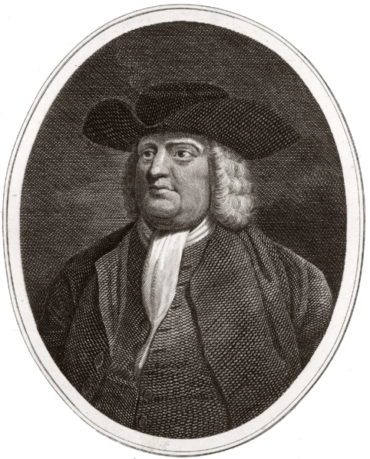
Aristocratic Republicanism and Slavery
The Revolution and Slavery, 1776 – 1800
1,000s of slaves gained freedom via the British during the Rev. War
Manumission and Gradual Emancipation:
Manumission – freeing of slaves by owners (1782)
Quakers and Enlightenment thought challenged slavery
Free blacks still faced significant discrimination
Slavery Defended:
VA legislature passed new manumission law in 1792
Slavery viewed as a “necessary evil”
Gabriel Prosser – planned rebellion, he and 30 others were hanged
As with all slave rebellions, slave laws were more harsh after a rebellion

Slide 5
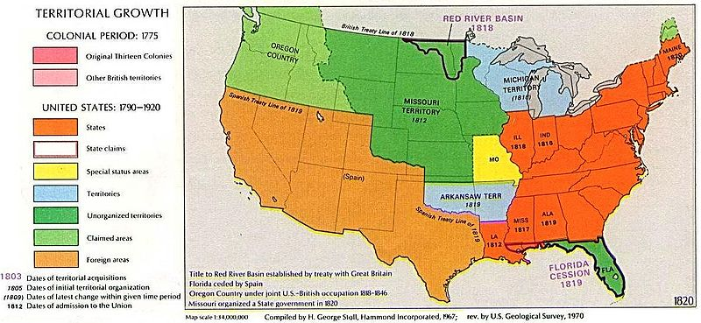
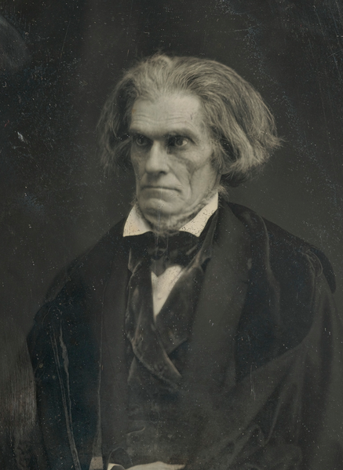
Aristocratic Republicanism and Slavery
The North and South Grow Apart:
Education was much better in the North – higher literacy rates
Slavery and National Politics:
Transition in South from “necessary evil” to “positive good”
Southern dominance in the federal government protected slavery
African Americans Speak Out:
With the cotton boom (cotton gin), slavery increased
American Colonization Society – proposed free slaves would be sent to Africa (Liberia); many African Americans rejected the idea
New black churches developed
The Missouri Crisis (Must know for new curriculum)
MO (part of LA Purchase) applies for statehood as a slave state
This would make 12 slave states and 11 free
Tallmadge Amendment:
Proposed for gradual emancipation of slaves in MO
South hated it, seen as a step towards ending ALL slavery
The Solution?
MO added as a slave state
ME (from Massachusetts) added as a free state
Balance stays equal at 12 states free, 12 slave
Slavery prohibited above 36°30’ line in the future

Slide 6
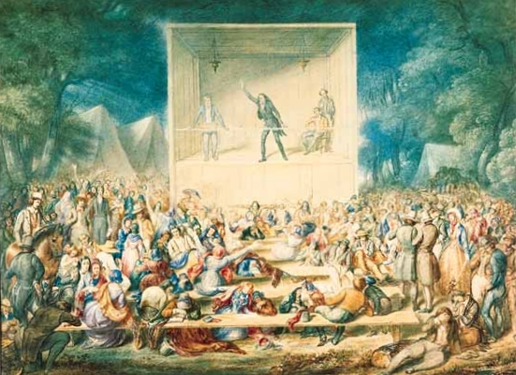
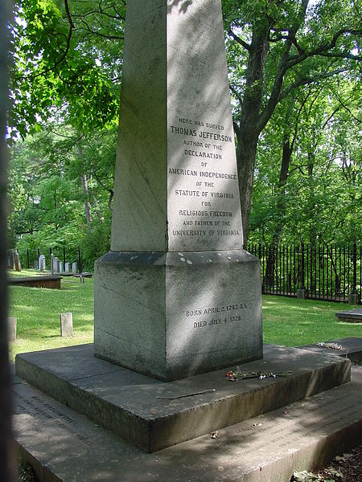
Protestant Christianity as a Social Force
A Republican Religious Order:
Religious Freedom:
Jefferson’s bill for Establishing Religious Freedom (inspired 1st amendment)
Increase in number of denominations helped guarantee there would not be an established church
Church-State Relations:
VA outlawed religious requirements for office
“Voluntarism” – funding of churches came from members
Republican Church Institutions:
Evangelical Methodist and Baptist churches gained a large number of members
***The Second Great Awakening***
Spread of Christianity throughout the US
Emotional meetings (Cane Ridge, KY; burned over district in NY)
A New Religious Landscape:
Inspired by Whitefield, preachers increased conversions
Black Christianity:
Many saw slavery as similar to the plight of Israelites

Slide 7
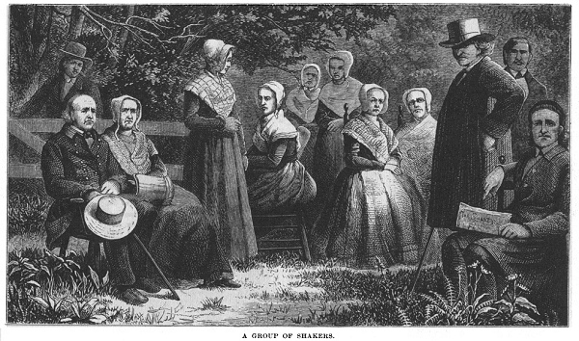
Protestant Christianity as a Social Force
Religion and Reform:
Unitarians – believed in rational thought
Many churches rejected predestination
2nd Great Awakening encouraged people to better the world (Humane Society)
Women’s New Religious Roles:
Shakers – Mother Ann Lee:
Promoted celibacy and women’s rights
A Growing Public Presence:
Women gained some rights in churches – gender-segregated prayer meetings ended
Mother’s Magazine – taught Christian women how to raise children
Emma Willard – outspoken advocate of education for women

Slide 8
Quick Recap
Republican Motherhood
Slavery as a “necessary evil” and a “positive good”
Tallmadge Amendment and the MO Compromise
2nd Great Awakening
Increased denominations
More rights for women
Inspired people to improve other areas of life

Slide 9
Thanks for watching!
Subscribe to my channel
Press the “Like” button
Questions? Comments?
Subscriber to Adam Norris
Subscribe
Down here!

