Slide 1
America’s History, 8th Edition, Chapter 9 Review Video
www.Apushreview.com
Transforming the Economy, 1800 - 1860
Check out the description for videos that match up with the new curriculum.

Slide 2
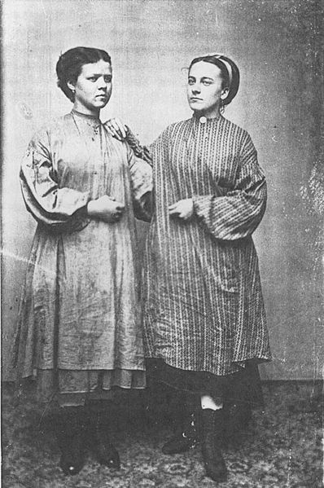
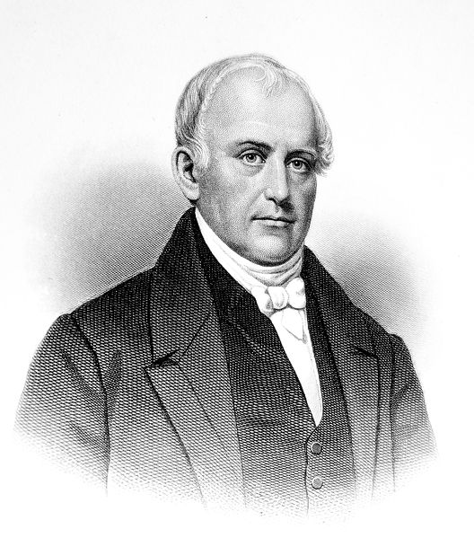
The American Industrial Revolution
The Division of Labor and the Factory:
Whether at home, or a factory, work became more rote and efficient by doing specific tasks (assembly line)
Seen in slaughterhouses – PORKOPOLIS! – and shoe factories
The Textile Industry and British Competition:
The British government forbid mechanics and machines to leave Britain
Samuel Slater – emigrated to America in disguise
American and British Advantages:
US had a tremendous amount of natural resources
US instituted tariffs on foreign goods
Britain had a large population (cheap labor)
Better Machines, Cheaper Workers
US improved on British machines
Lowell System – farmers’ daughters that worked in factories
Lived in housing provided by employers – curfews, no alcohol
Many saw greater independence

Slide 3
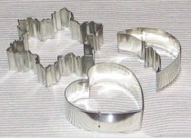
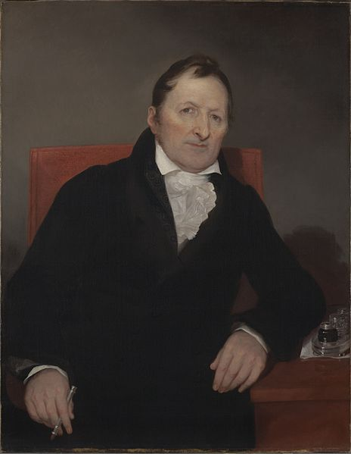
The American Industrial Revolution
American Mechanics and Technological Innovation:
US patents increased drastically between 1820 and 1860
Eli Whitney:
Cotton gin (1793) – separated cotton from its seeds
Interchangeable parts – used for guns, applied to other areas
Products became more abundant and cheaper
Wageworkers and the Labor Movement:
Free Workers Form Unions:
Unions formed to bargain with employers
Early American law viewed unions as illegal
Labor Ideology:
Commonwealth v. Hunt (1837) Massachusetts State Supreme Court decision that declared unions legal
More symbolic at the time

Slide 4
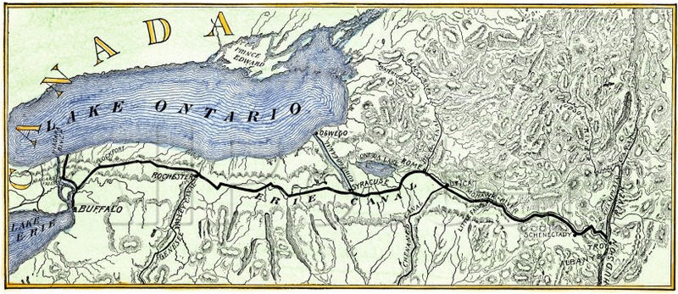
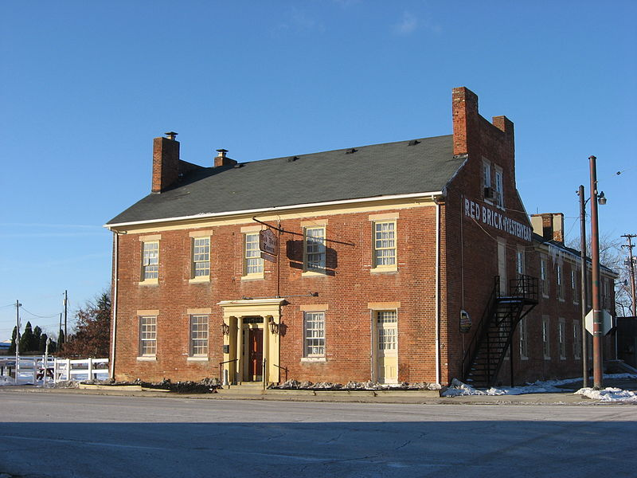
***The Market Revolution***
What is it?
Change in labor systems, population, and transportation
Greatly affected the Northeast and Midwest
The Transportation Revolution Forges Regional Ties:
Germans and Irish made up large portion of immigrants
National Road (Cumberland, MD – Vandalia, Il) was funded by the federal government
Canals and Steamboats Shrink Distance:
Erie Canal – Albany to Buffalo – and beyond via Great Lakes and rivers
Canals and roads changed the environmental landscape of US
Other canals emerged connecting more of America together
State governments subsidized canals
Railroads Link the North and Midwest:
Livestock and wheat were transported between the two regions
Inventions that helped farmers – McCormick Reaper and Deere’s steel plow
The South did not invest in manufacturing, relied on agriculture (cotton)
The Growth of Cities and Towns:
The Market Revolution increased the number of cities and towns
Cities emerged as trading and manufacturing centers:
Cincinnati, Buffalo, Pittsburgh, Chicago, etc.

Slide 5
New Social Classes and Cultures
Impacts of the Market and Industrial Revolutions?
Larger houses, better clothes, cheaper products, distinct social classes
The Business Elite:
Prior to the Revolutions, social classes regularly interacted and dressed similar
After, the wealthy dressed in finer clothing, had carriages and servants
Employers and employees worked alongside each other less
The Middle Class:
Farmers, merchants, lawyers, etc. made up this emerging group
30% of the population in the 1840s in the northeast
Wives bought books, pianos, etc.
Middle-class children received a high school education
Republican Motherhood

Slide 6
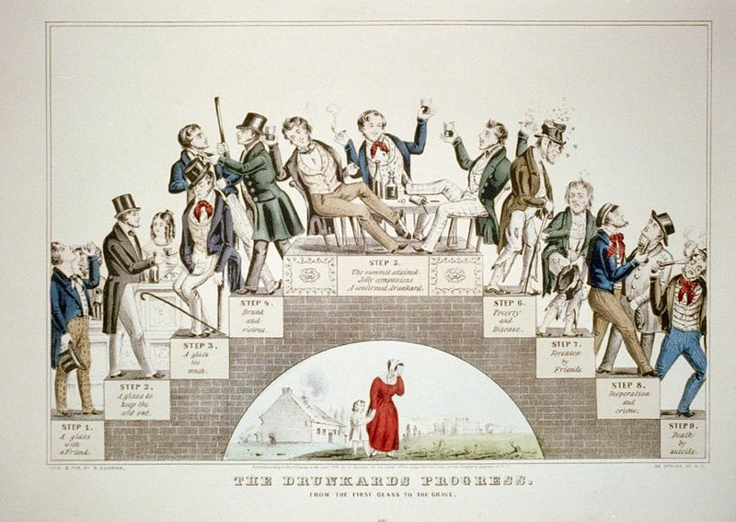
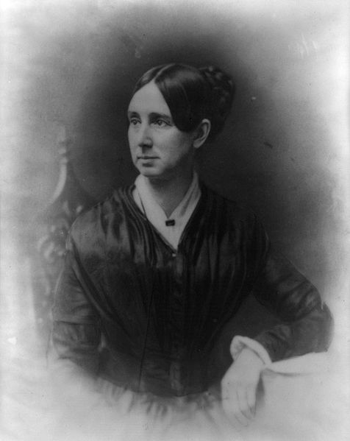
New Social Classes and Cultures
Urban Workers and the Poor:
Poor workers were especially hit hard during economic downturns
Children would often work to help provide for families
The Benevolent Empire:
Religious movement to reduce alcohol and vices
Encouraged governments to ban carnivals
Improved society by creating homes for orphans and asylums for those with mental illnesses
Women played a large role in this movement
Many laborers resisted this movement, especially laws restricting activities on Sundays

Slide 7
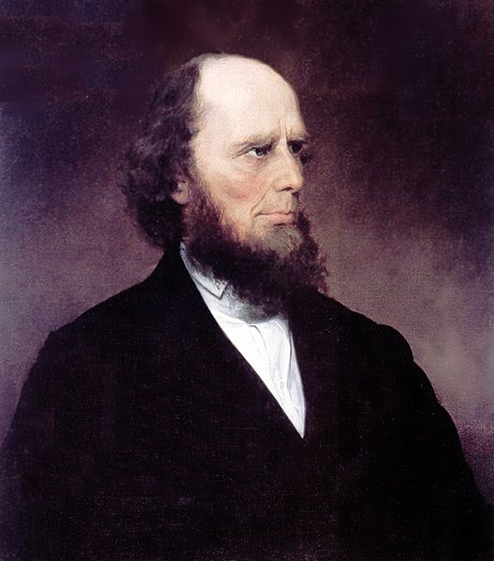
New Social Classes and Cultures
Charles Grandison Finney: Revivalism and Reform:
Played an instrumental role in the 2nd G.A.
Evangelical Beliefs:
Preached individuals had free will – anyone could be saved
Resonated with wealthy individuals in WNY
Poor and immigrants were not as affected
Temperance:
American Temperance Society – 200,000 members
People promised to abstain from alcohol
Very influential
Immigration and Cultural Conflict:
“Old Immigration” – Germans and Irish
Irish Poverty:
Irish Potato Famine – settled in cities in Northeast, Catholics, tended to vote Democrat
Nativism:
Dislike/distrust of immigrants
Many Protestants feared the power of the Pope

Slide 8
Quick Review
Lowell Girls
Eli Whitney
Impact of canals – Erie
Impacts of the Market Revolution
Connected NE and Midwest
2nd Great Awakening
Charles Grandison Finney
Temperance
Nativism

Slide 9
Thanks for watching!
Good luck on your tests
Check out videos matching the new curriculum
Spread the word
Subscribe
Comment

