Slide 1
American History: Chapter 1 Review Video
www.Apushreview.com
Colliding Worlds (1450 – 1600)

Slide 2
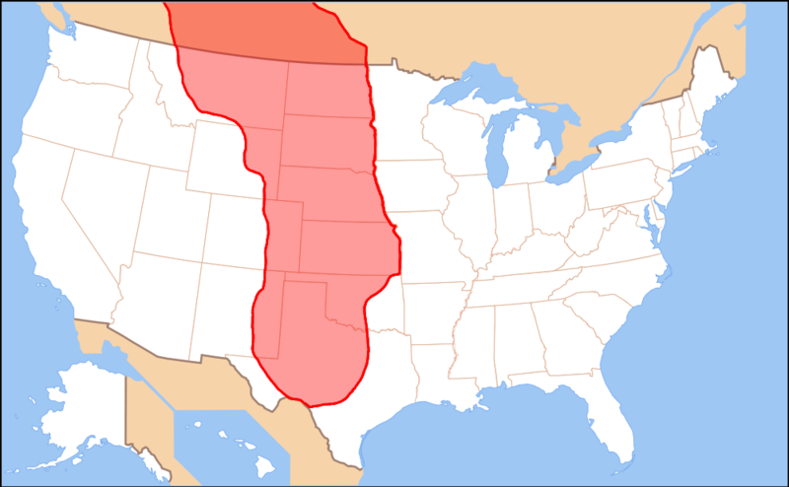
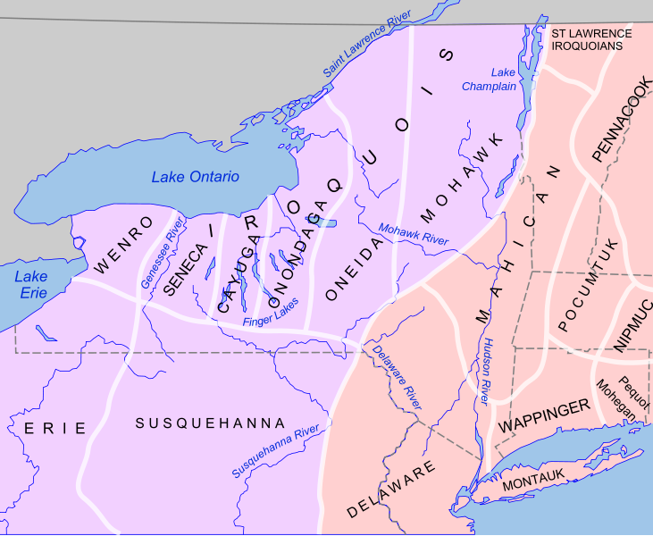
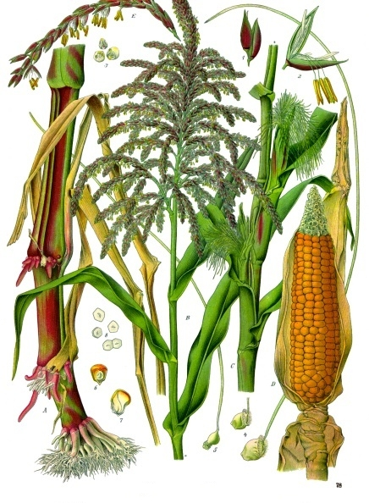
The Native American Experience
The First Americans:
Many people came to the Americas via the Bering Straight
6000 B.C.E. – Indians began raising crops – maize
Helped encourage population growth, especially in present-day Mexico
American Empires:
Aztec Empire – Tenochtitlán was the capital
Established trading routes throughout the empire
Used tribute – payment (taxes)
Chiefdoms and Confederacies:
Maize became a major crop throughout Central and North America
Mississippi Valley
Eastern Woodlands – villages were built around maize fields; also hunted and gathered
Women were in charge of crops and played instrumental roles in community affairs
Iroquois were a matriarchal society – power based on female families
Great Plains and Rockies - hunted Buffalo; lack of natural resources made many Indians nomadic
The horse (introduced by Europe) drastically changed life of Plains Indians
Arid Southwest – based on agriculture (maize) and built elaborate irrigation systems (Pueblo Indians – see video in description)
Pacific Coast – Chinooks were strong warriors, relied heavily on fishing; built elaborate canoes

Slide 3
The Native American Experience Cont.
Patterns of Trade:
Many Indians traded with each other throughout the Americas
Trade fairs between nomadic Navajos and Pueblos in the Southwest
Maize would be traded for meat, furs, and other supplies
Sacred Power:
Animism – religion associated with nature
Indians respected animals they hunted by performing rituals

Slide 4
Western Europe: The Edge of the Old World
Hierarchy and Authority:
European families were patriarchal – property and wealth was based on male families
Females gave up many rights when married – name, property, expected to submit to husband
Primogeniture – eldest son inheriting most of wealth
Later encouraged immigration to colonies
Peasant Society:
Poor individuals, mostly farmers; made up most of the immigrants to Americas
Half of the children died before 21!
Expanding Trade Networks:
Merchant cities began to grow drastically
Guilds helped regulate trade

Slide 5
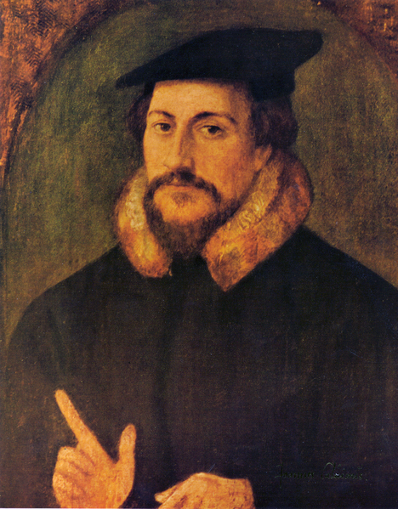
Western Europe: The Edge of the Old World Cont.
Myths, Religions, and Holy Warriors
Roman Catholic Church had tremendous power in Western Europe
Individuals involved in heresies (ideas inconsistent with Christianity) were persecuted
Reformation:
Martin Luther and his 95 Theses – protested the sale of indulgences
John Calvin and Predestination
England became a Protestant nation
The Reformation weakened the strength of Catholicism in Europe

Slide 6
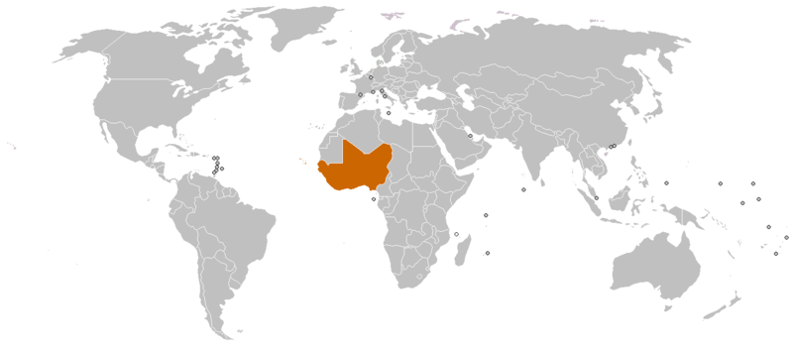
West and Central Africa: Origins of the Atlantic Slave Trade
Empires, Kingdoms, and Ministates:
Most of the African Slave Trade was based out of West Africa
Kings and Princes were regarded as divine
Ghana, Mali, and Songhai Empires – used extensive trade routes
Used the military to control trade routes – GOLD!
The Spirit World:
Islam spread over trade routes in Africa
Many Africans still practiced versions of Animism and were polytheistic

Slide 7
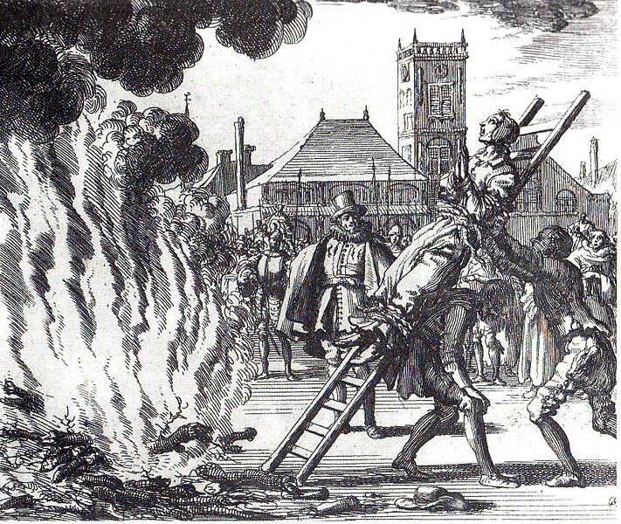
Exploration and Conquest
Portuguese Expansion:
Portugal had an extensive role in exploration and African Slave Trade
Trading posts were established in West Africa
Europeans had little luck exploring the interior of the African Continent:
Disease – malaria, the interior was well defended
The African Slave Trade:
Slavery was widespread throughout Europe and Africa
Slaves were used on sugar plantations
In the mid-16th century, the African Slave Trade expanded drastically and used in South America
Sixteenth-Century Incursions:
Reconquista – Spanish Catholics tried to get rid of Muslims in Europe
Inquisition against alleged Christian heretics

Slide 8
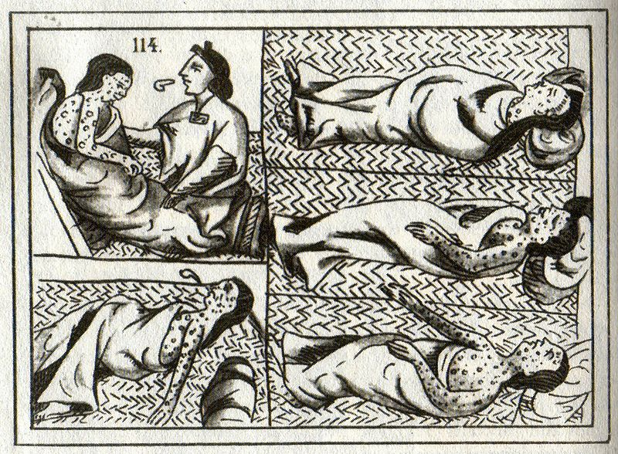
Exploration and Conquest Cont.
Spain in the Western Hemisphere:
Conquistadores – Spanish conquerors
Hernán Cortés: led 600 men to defeat the Aztecs at Tenochtitlán
Many of the Aztecs were defeated due to disease, especially smallpox
Francisco Pizarro: defeated the Incas in Peru
Effects of the Spanish Invasions:
Disease and war killed many Indians
20 million Indians in 1500 -> 3 million in 1650
Portugal focused on conquering Brazil

Slide 9
Thanks for watching!
Subscribe to my channel
Press the “Like” button
Questions? Comments?
Follow me on Twitter @APUSH_Review
Subscribe
Down here!

