Slide 1
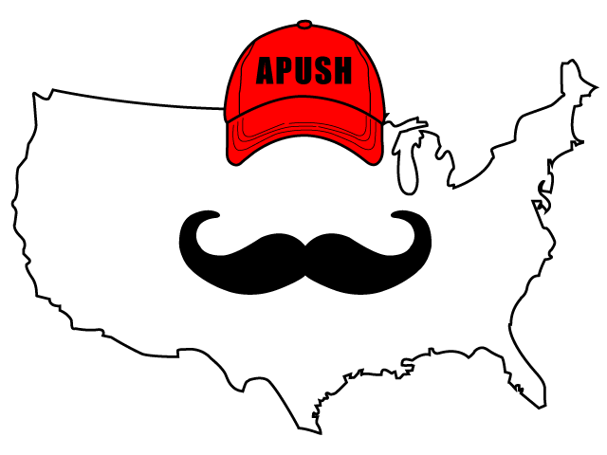
America’s History, 8th Edition
Chapter 31 - The LAST One!

Slide 2

America in the Global Economy
2 terms to know:
  Globalization: Interdependence, connection between countries and businesses -> increase in trade
  World Trade Organization: Organization that regulates trade between nations (inter)
The Rise of the European Union and China
  European Union - made up of dozens of countries from Europe - common currency
  The Chinese economy has grown significantly since 2000
    Elements of capitalism within the Communist Party
    Outsourcing of jobs to China - 2016 election

Slide 3
America in the Global Economy
An Era of Globalization
International Organizations and Corporations
  G8 (Group of 8) - control most financial organizations - IMF
  North American Free Trade Agreement (NAFTA):
    No tariffs on trade between US, Canada, and Mexico
  Multinational Corporations - businesses that operate in many countries - Walmart
Financial Deregulation
  Many banks and other financial institutions saw their industries significantly deregulated

Slide 4
America in the Global Economy
Revolutions in Technology
  1990s - growth of PCs and Internet
  Rise of e-commerce - Amazon

Slide 5

Politics and Partisanship in a New Era
An Increasingly Plural Society
  2040 - 2050 the US will become a “majority-minority” nation
New Immigrants
  28 million immigrants between 1970 and 2000
  Immigration and Nationality Act of 1965:
    Eliminated quota system from the 1920s
    Immigrants with skills in high demand could more easily come to US
    Immediate family members of legal immigrants could come to America more easily
  Many immigrants send $ to families back home
QUOTAS

Slide 6
Politics and Partisanship in a New Era
Multiculturalism and Its Critics
  Immigration Reform and Control Act of 1986
    Granted citizenship to many illegal immigrants that arrived prior to 1982
    Illegal for companies to knowingly hire illegal immigrants
  Multiculturalism:
    Americans were made up of many ethnic and racial groups
  Proposition 209:
    California referendum that outlawed affirmative action in state employment and education

Slide 7
Politics and Partisanship in a New Era
Clashes over “Family Values”
  The New Right focus on marriage between a man and woman
Abortion
  Major distinction between Democrats and Republicans
    Democrats tend to be pro-choice
    Republicans tend to be pro-life
  Organized protests outside abortion clinics have occurred since Roe v. Wade

Slide 8
Politics and Partisanship in a New Era
Gay Rights
  Defense of Marriage Act - allowed states to not recognize same sex marriage - later overturned by the Supreme Court (2013)
Culture Wars and the Supreme Court
  Webster v. Reproductive Health Services (1989):
    States could limit funds for abortion
  Planned Parenthood v. Casey (1992):
    States could require 24 hour waiting period before an abortion

Slide 9
Politics and Partisanship in a New Era
The Clinton Presidency, 1993 - 2001
  Political parties have become more polarized since the 1990s
  Growth of cable news began in the 90s
  Clinton defeated Bush and Perot in 1992
New Democrats and Public Policy
  Clinton pushed for universal healthcare
  1998: Balanced budget
The Republican Resurgence
  Newt Gingrich - Speaker of the House
    Contract with America - called for tax cuts, reduction in welfare and government regulations

Slide 10
Politics and Partisanship in a New Era
Clinton’s Impeachment
  Clinton was charged with perjury and obstruction of justice
  Most Americans opposed impeachment - 58%, while 38% favored
  Clinton, like Andrew Johnson before him, was not removed from office
Post-Cold War Foreign Policy
  NATO expanded in the 1990s
    Former Soviet controlled countries such as Poland

Slide 11
Politics and Partisanship in a New Era
The Breakup of Yugoslavia
  Bosnia-Herzegovina declared independence in 1992
  Slobodan Milosevic committed genocide, “ethnic cleansing”
  NATO bombing campaign against Milosevic
  2008 - 7 countries from former Yugoslavia
America and the Middle East
  US troops in Saudi Arabia after the Persian Gulf War has upset many in the Middle East
  1993 World Trade Center bombing:
    Killed 6, injured 1,000+
  US embassies in Kenya and Tanzania were bombed in 1998
  Bombing of the USS Cole in 2000
    Attacks were committed by Al Qaeda

Slide 12
Into a New Century
The Ascendence of George W. Bush
  Election of 2000 - Bush v. Gore
    Gore won the popular vote, Bush won the electoral vote
    Supreme Court intervened in recount efforts in Florida
Tax Cuts
  Economic Growth and Tax Relief Act
    Decreased income and estate taxes
  Federal spending increased
    Medicare and Medicaid - uncontrollable spending

Slide 13
Into a New Century
September 11, 2001
  19 terrorists hijacked 4 planes
    2 crashed into the World Trade Center
    1 crashed into the Pentagon
    1 crashed in a field in Pennsylvania
  October 2001 - US fought the Taliban in Afghanistan for hiding bin Laden

Slide 14
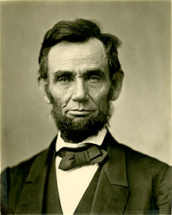
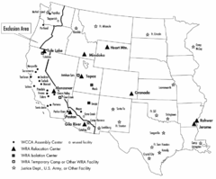
Into a New Century
The Invasion of Iraq
  Patriot Act - increased the government’s power to monitor Americans
  Remember, during times of war, personal liberties decrease (suspension of habeas corpus during Civil War, Japanese Internment during WWII)
  US invaded Iraq in 2003 without a UN resolution
    Claimed Hussein had ties to terrorism and WMDs
  Abu Ghraib Prison Scandal (2004):
    Pictures and videos showed American guards torturing and abusing suspected terrorists

Slide 15
Into a New Century
The 2004 Election
  Bush v. Kerry
    Kerry was portrayed as a “flip-flopper” for his positions on the Iraq War
  11 states passed bans on same sex marriage
Violence Abroad and Economic Collapse at Home
  Hurricane Katrina - devastated New Orleans, killing more than 2,000
  2008 - stock market tumbled, unemployment reached 10%!
  Great Recession - also saw housing prices plummet

Slide 16
Into a New Century
The Obama Presidency
“Remaking America”
  Obama focused on an economic stimulus package, healthcare, and Wall Street regulation early presidency
  American Recovery and Reinvestment Act:
    $787 billion to states for projects
  Tea (Taxed Enough Already) Party:
    Right wing group that was critical of large government and Obama’s health care plans
  2011 - Obama repealled the military’s “Don’t Ask, Don’t Tell” policy, which allowed gays to openly serve in the military
  Sonia Sotomayor - first Latina on the Supreme Court

Slide 17
Into a New Century
War and Instability in the Middle East
  Arab Spring - protests that led to the downfall of several regimes in the Middle East
  May 2011 - Seal Team 6 killed Osama bin Laden
Climate Change
  Impacts of higher temperatures - higher sea levels, agricultural difficulties, etc.
  Kyoto Protocol - treaty to limit carbon emissions - US is not a signee
Electoral Shifts
  Obama’s victories were based on an electorate that was multiracial, young, and many females

Slide 18
Quick Recap
Globalization
NAFTA
Impacts of new technology - computers
NATO
Immigration Laws of 1965 and 1986
Supreme Court and abortion
Gay rights
“Contract with America”
Terrorism since 1993
Tax cuts under Bush
9/11 and war in Afghanistan
Iraq War
Tea Party

Slide 19
I Will NOT See You Back For Another Chapter…. Congratulations!
You should be proud of yourself
Best of luck on the exam
You are more than a test score - always

