Slide 1
America’s History, Chapter 23
8th Edition

Slide 2
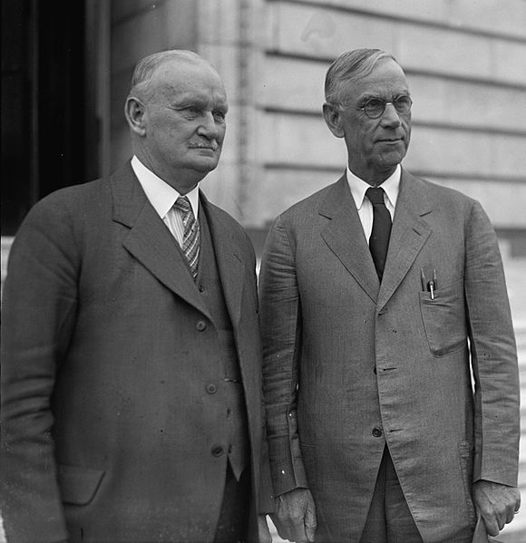

Early Responses to the Depression, 1929 - 1932
Enter Herbert Hoover:
  Hoover believed volunteerism and hard work would alleviate the depression
  Hoover did not take the US off the gold standard
  Smoot-Hawley Tariff - significantly raised tariff rates - retaliatory rates from other countries
  Reconstruction Finance Corporation (RFC):
    Federal loans to businesses
    Spent too little $ too cautiously

Slide 3
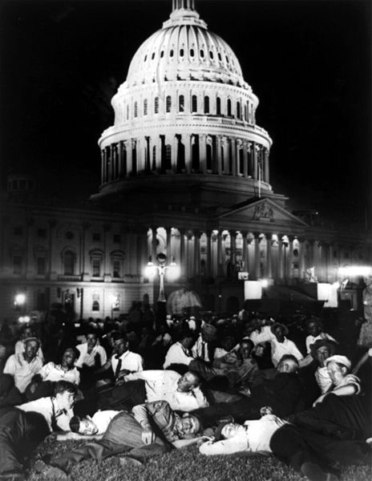
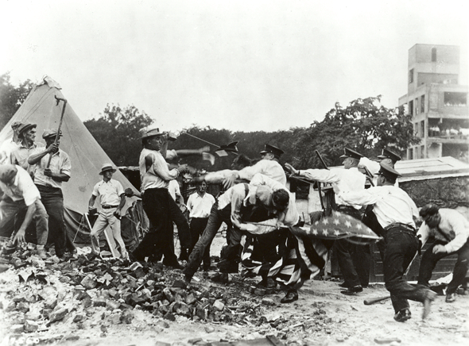
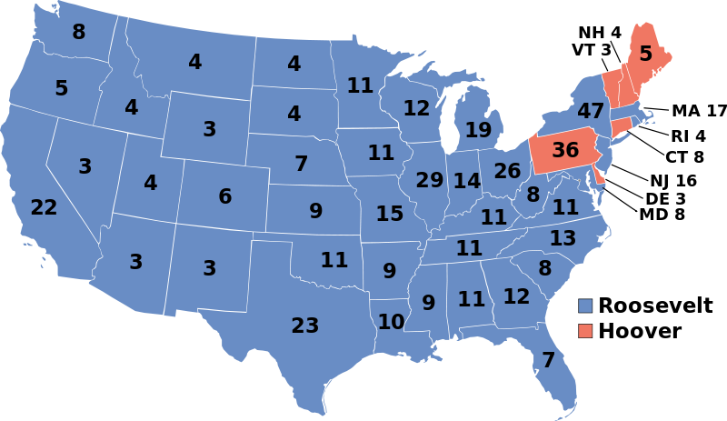
Early Responses to the Depression, 1929 - 1932
Rising Discontent:
  Hoovervilles and Hoover blankets
  Bonus Army:
    15,000 WWI veterans demanded earlier bonus payment
    Hoover ordered the army disperse the Bonus Army - popularity decreased significantly
The 1932 Election
  Hoover v. FDR
  FDR defeated Hoover 472 - 59
  Unemployment and bank failures continued throughout late 1932 and early 1933

Slide 4
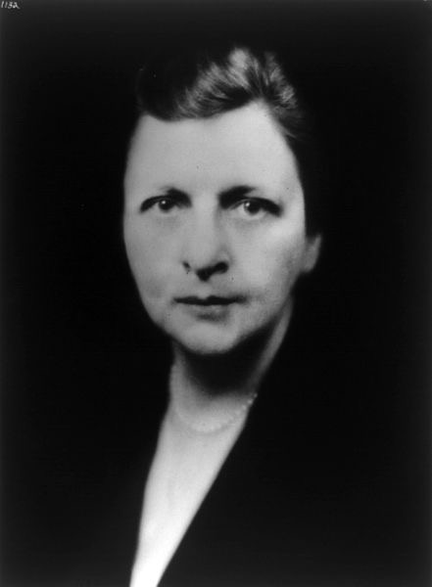
The New Deal Arrives, 1933 - 1935
Roosevelt and the First 100 Days:
  Fireside chats - Presidential addresses via radio
  “Brains Trust” - group of unofficial advisers that helped draft legislation
  Frances Perkins - 1st female cabinet member
  100 Days - legislation that focused on 4 major areas: banks, agriculture, businesses, and unemployment

Slide 5
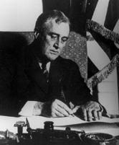
The New Deal Arrives, 1933 - 1935
Banking Reform:
  Bank Holiday - closing of banks, could not reopen until they proved to be sound (Emergency Banking Act)
  Glass-Steagall Act: created FDIC, insured bank deposits up to $2,500
Agriculture and Manufacturing:
  Agricultural Adjustment Act (AAA):
    Sought to rectify overproduction of farm goods
    Paid farmers not to grow crops (benefitted large land owners, not sharecroppers)
  National Recovery Administration (NRA):
    Industries agreed on prices and production quotas
Both the AAA and NRA were declared unconstitutional by the Supreme Court….
Key Concept 7.1, III, A. The liberalism of President Franklin Roosevelt’s New Deal drew on earlier progressive ideas and represented a multifaceted approach to both the causes and effects of the Great Depression, using government power to provide relief to the poor, stimulate recovery, and reform the American economy.

Slide 6
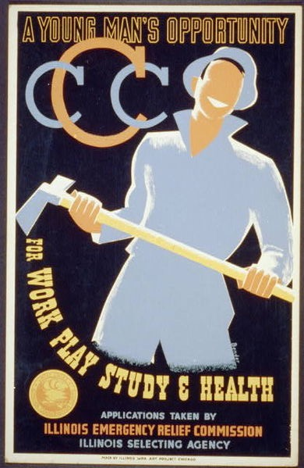
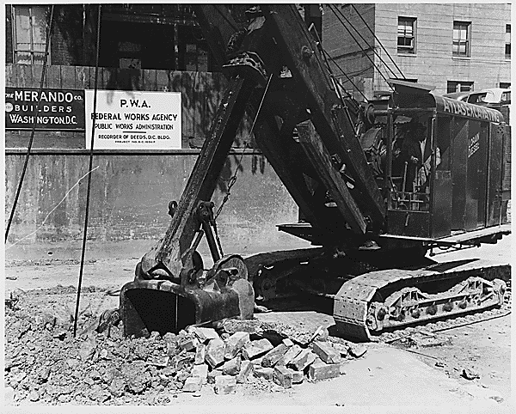
The New Deal Arrives, 1933 - 1935
Unemployment Relief:
  Federal Emergency Relief Administration (FERA) - provided federal $ to give to states for relief programs
  Public Works Administration (PWA):
    Construction projects
  Civil Works Administration (CWA):
    Provided4 million jobs to Americans in the winter of 1933 - 1934
      Construction projects - bridges, roads, etc.)
  Civilian Conservation Corps (CCC):
    Outdoor work, conservation, planting trees, etc.
    Mostly young men, 18 - 24, sent $ back home to families
Housing Crisis:
  500,000 families lost their homes
  Federal Housing Administration (FHA)
    Helped regulate interest rates for mortgages

Slide 7
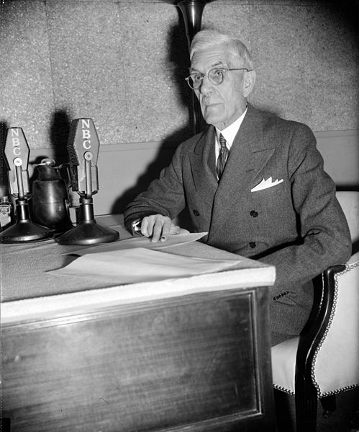
The New Deal Arrives, 1933 - 1935
Key Concept 7.1, III, B. Radical, union, and populist movements pushed Roosevelt toward more extensive reforms, even as conservatives in Congress and the Supreme Court sought to limit the New Deal’s scope.
The New Deal Under Attack:
  Securities and Exchange Commission (SEC)
    Regulated the stock market, sought to prevent abuses
  Critics on the Right:
    Liberty League - criticized government spending
    National Association of Manufacturers:
      Used radio and other media to promote their anti-Roosevelt message
    Schechter Poultry v. US, and Butler v. US declared the NRA and AAA unconstitutional by the Supreme Court
  Critics on the Populist Left:
    Francis Townsend:
      Proposed giving $200 a month to seniors over 60 - helped influence Social Security
    Huey Long:
      “Share our Wealth”

Slide 8
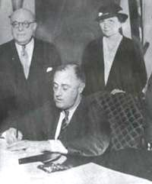
The 2nd New Deal……….
The Welfare State Comes into Being
  1st New Deal - economic recovery, 2nd New Deal - social justice and safety net
  The Wagner Act and Social Security:
    Since the NRA was declared unconstitutional, unions lost many rights
    Wagner Act - workers had the right to join unions, couldn’t be fired for joining union
    Social Security Act - provided pensions for retired workers, compensation for unemployed and disabled workers
  New Deal Liberalism:
    Classical liberalism - associated with free markets

Slide 9
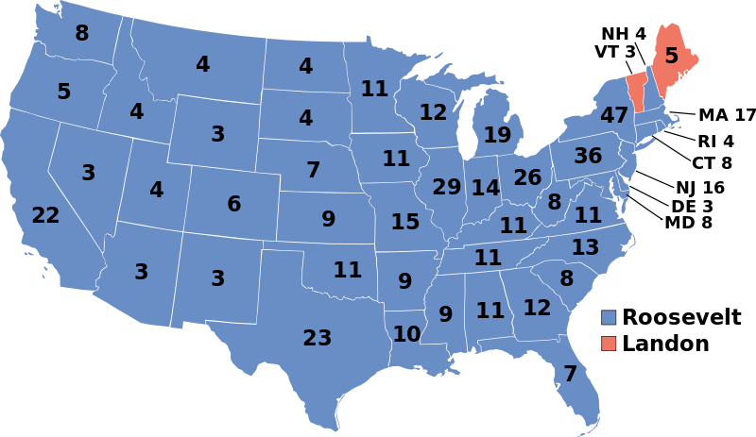
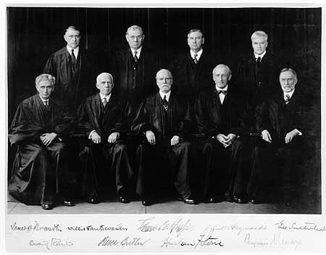
The 2nd New Deal……….
From Reform to Stalemate
  The 1936 Election:
    Works Progress Administration (WPA)
      Employed over 8 million workers
      Construction on roads, bridges, etc.
    Republican Alfred Landon challenged FDR, lost election
  Court Battle and Economic Recession:
    In reaction to the S.C. declaring New Deal Programs unconstitutional, FDR sought to:
      Appoint a new justice for every judge over 70 (could appoint 6)
    This “court packing plan” was overwhelmingly rejected
    “Roosevelt Recession” - FDR cut back on spending due to an improved economy
      Keynesian economics - Government must spend $ in a depression to “prime the pump” and stimulate the economy

Slide 10
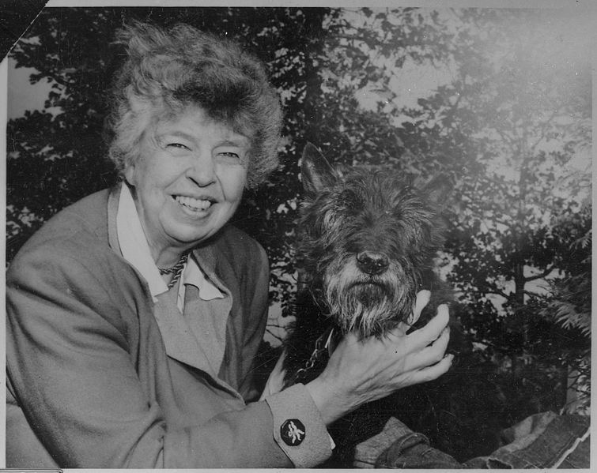
The New Deal’s Impact on Society
A People’s Democracy
  Organized Labor:
    Union membership increased to 23%
    Congress of Industrial Organization (CIO) - organized all workers within an industry regardless of skill level
  Women and the New Deal:
    Gender inequities persisted
    Elanor Roosevelt:
      “Eyes and ears” of FDR, transformed the image of the First Lady
    Women were often paid less than men for same jobs
    CCC did not allow women to join

Slide 11
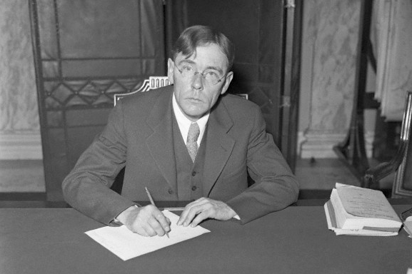
The New Deal’s Impact on Society
  African Americans Under the New Deal:
    Resettlement Administration - helped small farmers buy land
    African Americans began to overwhelmingly vote Democratic
    CCC segregated blacks
    Lynching persisted throughout the 1900s
    Scottsboro Boys - 9 African Americans charged with raping 2 white women on a train, 8 sentenced to death, eventually death sentences were overturned
    AAA did not help sharecroppers (checks were given to land owners)
  Indian Policy:
    John Collier - commissioner of Bureau of Indian Affairs (BIA)
    Indian Reorganization Act (Indian New Deal):
      Reversed the assimilation policy of the Dawes Act
      Many Natives were given religious freedom and semi sovereign nation status

Slide 12
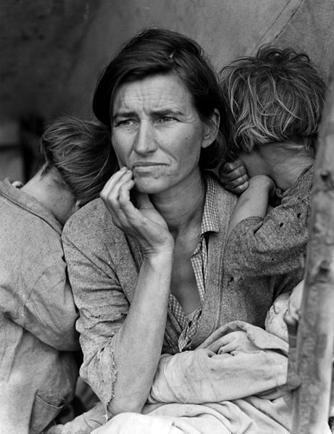
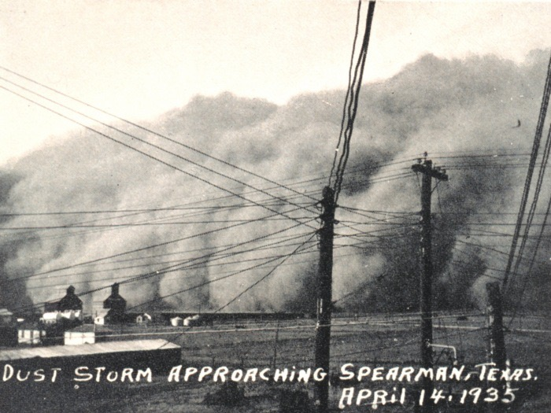
The New Deal’s Impact on Society
  Struggles in the West:
    Mexican Americans benefitted from the WPA and CCC
    Most Chinese were excluded from New Deal Programs
Reshaping the Environment
  FDR sought to have land benefit the needs of humans
    The Dust Bowl
      Impacted mostly the Great Plains region
      Over-cultivation affected farmland
      “Okies” fled to California - The Grapes of Wrath
      Dorothea Lange

Slide 13
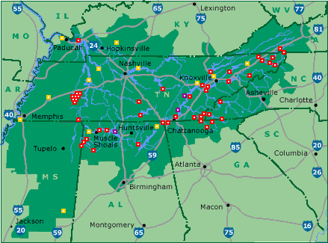
The New Deal’s Impact on Society
  Tennessee Valley Authority:
    Focused on flood control, electricity development, etc.
    Provided a significant amount of electricity to farms, homes, and factories
    Rural Electrification Administration:
      Provided electricity to rural areas
  Grand Coulee
    Columbia River, Washington
    Largest electricity producer in the world
The New Deal and the Arts
  Over 20,000 Artists, musicians, and writers were employed

Slide 14
The New Deal’s Impact on Society
Key Concept 7.1, III, C. Although the New Deal did not completely overcome the Depression, it left a legacy of reforms and agencies that endeavored to make society and individuals more secure, and it helped foster a long-term political realignment in which many ethnic groups, African Americans, and working-class communities identified with the Democratic Party.
Legacies of the New Deal
  Millions paid taxes into Social Security
  1/3 of the population received government assistance
  New Deal was criticized by both the Right and Left
  **Change in voting patterns**:
    Unions, blacks, and many immigrants predominantly voted Democratic

Slide 15
Quick Recap
Bonus Army
Hoover’s vs. FDR’s response to the Depression
New Deal Programs
Critics of the Great Depression (Right, Left, Supreme Court)
New Deal’s impact on women, African Americans, and Native Americans
TVA
Voting Patterns

Slide 16
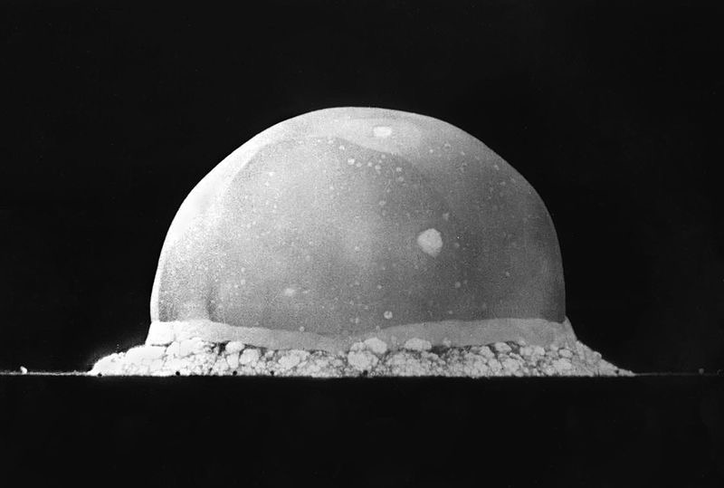
See You Back Here For Chapter 24!
Thanks for Watching
Please subscribe, share with others
Check out all my videos related to the new curriculum
Best of luck on all your tests!

