Slide 1
APUSH Review: The New Curriculum – Multiple-Choice Questions
www.Apushreview.com
Everything You Need To Know About The Multiple-Choice Section To Succeed In APUSH

Slide 2
The New Test
Part I of the exam will consist of 55 multiple-choice questions (55 minutes suggested time) and 4 short answer questions (SAQs) (45 minutes suggested time)
You will have 100 minutes to complete this
There will be a break
Part II will consist of 1 DBQ essay (60 minutes suggested time – including reading the documents) and a long essay (35 minutes suggested time )
That’s it!

Slide 3
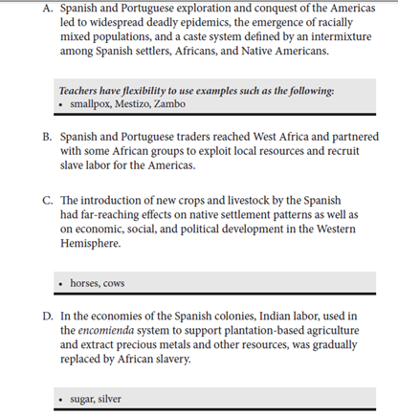
Understanding The New Curriculum
If you have not already, download and look at the new curriculum!
You will be assessed on time periods (9), historical thinking sills, and themes
I have videos on periods 1 – 3 done, more to come each week
You MUST be familiar with the “white” area of the new curriculum
These could be answers to multiple-choice questions
White are “big ideas” – know the basics, be able to explain things in the……
The “grey” area is NOT required to know, but you should be familiar with one of the examples for answering short answer questions or writing an essay
Ex: Explain the impact of a new crop or livestock by the Spanish
You are not required to use horses, but you must be able to explain the impact of at least one
Page 32 of the Curriculum Framework

Slide 4
Tips for the Multiple-Choice
All questions will have a prompt (map, quote, etc.)
This prompt will be used for 3 – 5 questions
Look at the SOURCE/AUTHOR
Ex. George Washington’s Farwell Address
You should already know what the message is
If you are familiar with the document, jump to the questions first to answer, then go back if needed
There are many terms listed in the “white” area you MUST KNOW
Common Sense, Encomienda System, Pueblo Revolt, etc.
I have, or will have videos on most, if not, ALL of them

Slide 5
Types of Question Stems…..
The impact of the ______ mentioned in the above excerpt was…….. (what was the effect?)
Which of the following was the effect of the above event?
What contributed to (whatever is described in the document)? (What caused this? Historical Causation)
Which group (or person) would support/disagree with the position described above? (Point of view)
The above description is most similar to what other event/time period in US History? (Comparison, Continuity and Change Over Time)

Slide 6
Thanks for watching!
Subscribe to my channel
Help spread the word
Questions? Comments?
Leave in comments
Subscribe
Down here!

