Slide 1
APUSH Review: The New Curriculum – Short Answer Questions (SAQs)
www.Apushreview.com
Everything You Need To Know About The Short Answer Question Section To Succeed In APUSH

Slide 2
The New Test
Part I of the exam will consist of 55 multiple-choice questions (55 minutes suggested time) and 4 short answer questions (SAQs) (45 minutes suggested time)
You will have 100 minutes to complete this
  There will be a break
Part II will consist of 1 DBQ essay (60 minutes suggested time – including reading the documents) and a long essay (35 minutes suggested time )
That’s it!

Slide 3
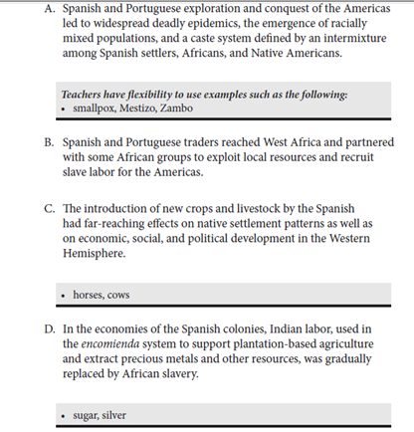
Understanding The New Curriculum
If you have not already, download and look at the new curriculum!
You will be assessed on time periods (9), historical thinking sills, and themes
  I have videos on periods 1 – 3 done, more to come each week
You MUST be familiar with the “white” area of the new curriculum
  These could be answers to multiple-choice questions
  White are “big ideas” – know the basics, be able to explain things in the……
The “grey” area is NOT required to know, but you should be familiar with one of the examples for answering short answer questions or writing an essay
  Ex: Explain the impact of a new crop or livestock by the Spanish
  You are not required to use horses, but you must be able to explain the impact of at least one
Page 32 of the Curriculum Framework

Slide 4
Description Of Short Answer Questions
These will test not only your content knowledge, but your knowledge of historical thinking skills (HTS)
  Historical Argumentation, Use of Relevant Historical Evidence, Historical Causation, Patterns of Continuity and Change Over Time, Periodization, Compare and Contrast, Contextualization, Interpretation, Synthesis
Some may have a source (reading, map, etc.), some will just explain requirements
All answer MUST be in complete sentences

Slide 5
Tips For Short Answer Questions
You must answer within the boxes only
  Essentially, 1 page with lines to answer all the parts (A, B, C)
Keep it pithy, space (and time) is limited
Make sure you answer what the question is asking
All 4 questions must be answered

Slide 6
Types of Question Stems…..
Questions with sources (photos, maps, excerpts, etc.):
  Explain the meaning of document 1, 2, why are there differences? What other info would support a view of one of the documents? (Comparison, Appropriate use of historical evidence)
Questions without sources:
  Explain a cause (or two) of the American Revolution. What was a result of the American Revolution? (Historical Causation)
  Of the following 3 events, which could mark the beginning of ______ (American identity, Sectional conflict, etc.) Support your choice, state why another is not as good (Periodization)
  The Great Awakenings of Red Scares: Explain one similarity for why they occurred, Similarities between the two, how did Americans respond? (Comparison)

Slide 7
Thanks for watching!
  Subscribe to my channel
  Help spread the word
Questions? Comments?
  Leave in comments
Subscribe
Down here!

