Slide 1
APUSH Review: “Old Immigration” and Nativism
www.Apushreview.com
Everything You Need To Know About Old Immigration and Nativism To Succeed In APUSH

Slide 2

What is “Old Immigration?”
What is it?
  Immigrants that came from Northern and Western Europe
Specific countries?
  Ireland, Germany, England
When did it occur?
  1820s – 1870s
What group made up the largest prior to the Civil War?
  Irish

Slide 3
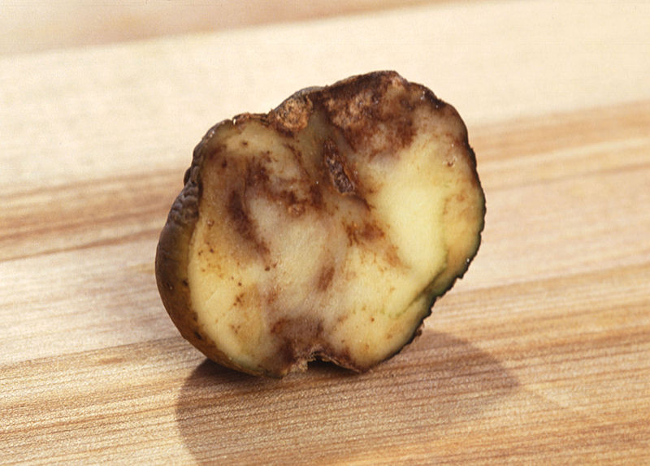
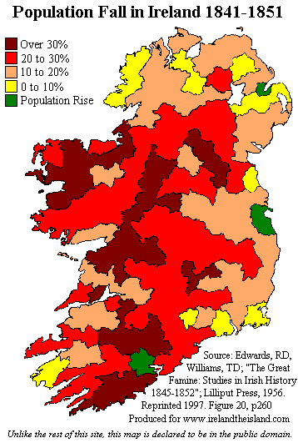
Why did they come here? Where did they settle?
Why they came here?
  Germans – farmers looking for land
  Irish – Potato Famine (1840s) “Black Forties”
  Settled in large cities in the Northeast
    Boston and New York
Where did they settle?
  Germans – on the frontier and the Midwest and Northwest
    Ohio, Wisconsin, etc.
    Kindergarten

Slide 4
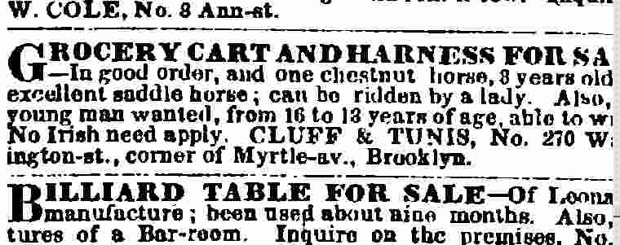

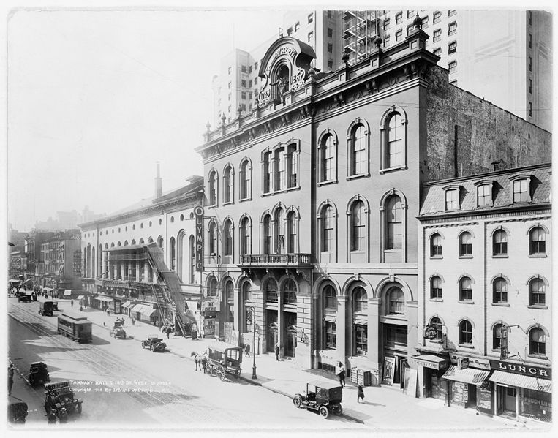
Nativism
What is it?
  Fear, distrust, and hatred of foreigners
Reasons for nativism:
  Different cultures
  Different languages
  Religion
  Irish and Germans “stole” elections
    Tended to vote Democratic
    Tammany Hall – NYC
  Immigrants “took” jobs
    Work for less money
    Would not unionize

Slide 5
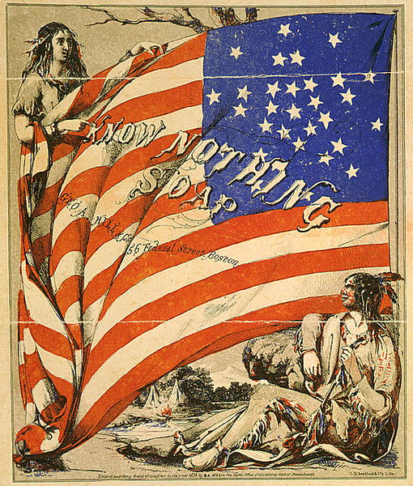
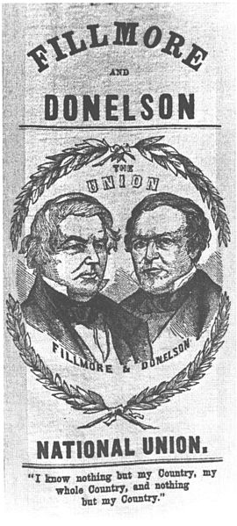
The “Know-Nothing” Party
What is it?
  Political party formed due to nativism
Originated as the Supreme Order of the Star-Spangled Banner
  Wanted to ban Catholics from holding offices
  Called for tougher immigration and naturalization laws
In 1856, Ex-President Millard Fillmore ran for President the Know-Nothing Party
  Won 21% of the popular vote
By 1860, they were no longer a political threat

Slide 6
Thanks for watching!
  Subscribe to my channel
  Help spread the word
Questions? Comments? Ideas for videos?
  Leave in comments
Don’t be a Know-Nothing when it comes to APUSH knowledge, Subscribe!
Subscribe
Down here!

