Slide 1
APUSH Review: The People’s (Populist) Party
Everything You Need To Know About The People’s Party To Succeed In APUSH

Slide 2
The New Curriculum
Key Concept 6.1, III, C
“Economic instability inspired agrarian activists to create the People’s (Populist) Party, which called for a stronger governmental role in regulating the American economic system.” - page 62.
Since it’s mentioned, anything about the party is fair game for the test
Focus on it being an agrarian movement (and other groups) and advocating for government intervention

Slide 3
What Is The Populist Party?
Political party from the late 19th century, made up of mostly farmers
They sought increased government involvement in the economy:
Railroads, banks, and government reform
Critical of the economic system (capitalism)
Originated in CINCINNATI!

Slide 4
What Groups of People Supported the Populist Party?
Farmers!
The Grange - sought to connect farmers and share techniques
Hoped to elect state legislatures that supported their programs
Farmers’ Alliances - mainly local organizations - established stores and banks
Industrial Workers
Knights of Labor - Labor union of skilled AND unskilled workers
Terrance Powderly
Economic reformers

Slide 5
What Led to the Creation of the Populist Party?
Economic Issues:
Growth of corporate power:
RRs - high shipping rates hurt farmers
RRs often owned grain elevators and charged high rates to store goods
Panics of 1873 and 1893:
Significantly hurt farmers - crop prices plummeted
Emerged from previous agrarian groups:
Grange
Farmers’ Alliances

Slide 6
Goals of the Populists
Sought economic relief, as well as government intervention:
Omaha Platform:
Direct election of senators
Graduated income tax
Australian (secret) ballot
Government control of railroads, telegraphs, and telephones
Free Coinage of Silver at a ratio of 16:1 with gold (Bimetalism)
16 ounces of silver would equal 1 ounce of goal
Would increase money supply -> farmers to pay off their debts more easily
Supported by farmers and debtors, opposed by Industrialists and lenders
Civil Service Reform
8-hour workday

Slide 7
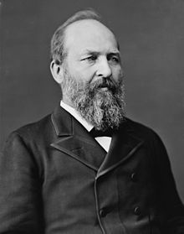
Election of 1892
Grover Cleveland (Democrat) vs. Benjamin Harrison (Republican) vs. James Weaver (Populist)
Weaver campaigned on the Omaha Platform
He received 22 electoral votes, and 8.5% of the popular vote

Slide 8
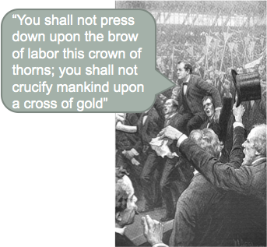
Election of 1896
William Jennings Bryan (Democrat AND Populist) vs. William McKinley (Republican)
The Populist Party supported Bryan due to his support for Free Silver
***“Cross of Gold” Speech***

Slide 9
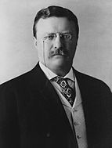
Impact of the Populists
Many of the ideas and goals of the Populist Party later came to fruition
16th amendment - income tax
17th amendment - direct election of senators
Secret ballots
All during the Progressive Era - Connection to another time period!

Slide 10
Test Tips
Multiple-Choice And Short Answer:
Reasons for the development of the Populist Party
Populists’ ideas are most similar to……. (PROGRESSIVES)
Who would support the Populist Party? (FARMERS!)
Who would oppose? (INDUSTRIALISTS!)
Cross of Gold
Essays:
Comparing farmers and industrial workers responses to industrialization

Slide 11
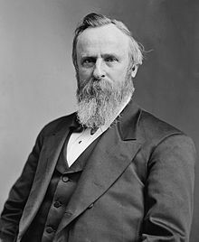
Thanks For Watching!
Best of luck in May!

