Slide 1

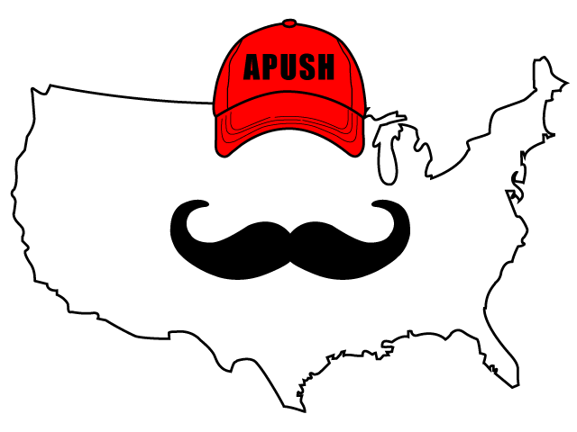
APUSH Review: Conservation And Preservation During The Progressive Era
Shoutout time: Mr. Burns’s class in Warwick, NY. Thanks for the support, best of luck!
Everything You Need To Know About Conservation And Preservation During The Progressive Era To Succeed In APUSH

Slide 2
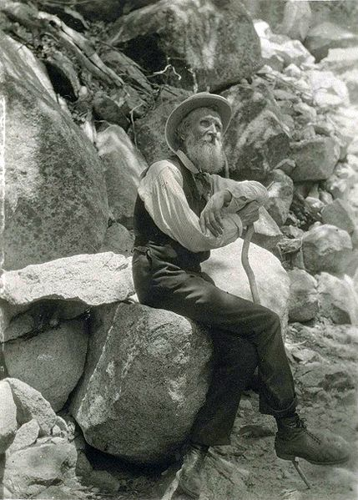
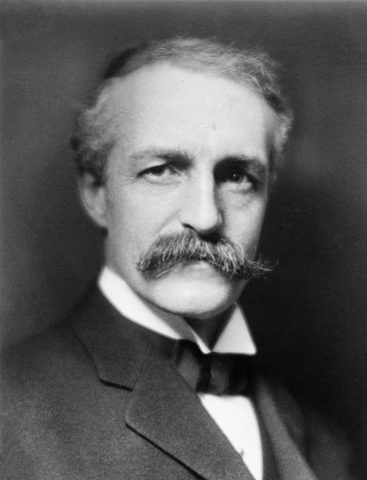
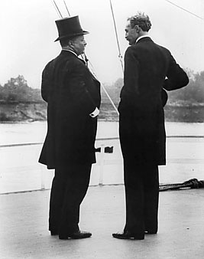
Background Info
What is conservation?
  Advocating the proper use of nature and resources
  Example - Teddy Roosevelt
  Gifford Pinchot - Roosevelt’s chief forester
What is preservation?
  Advocating the protection of nature and land from humans
  Example - John Muir and the Sierra Club

Slide 3
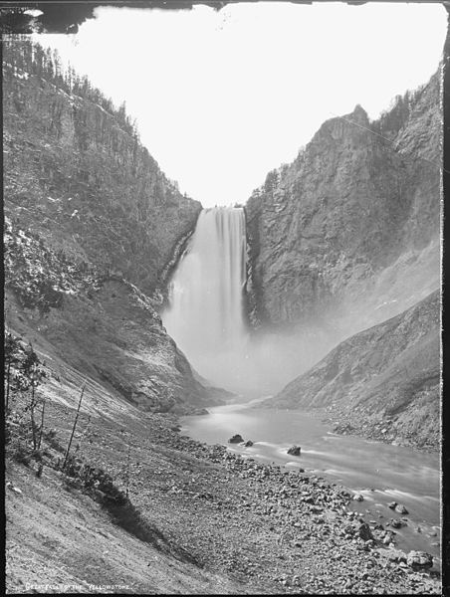
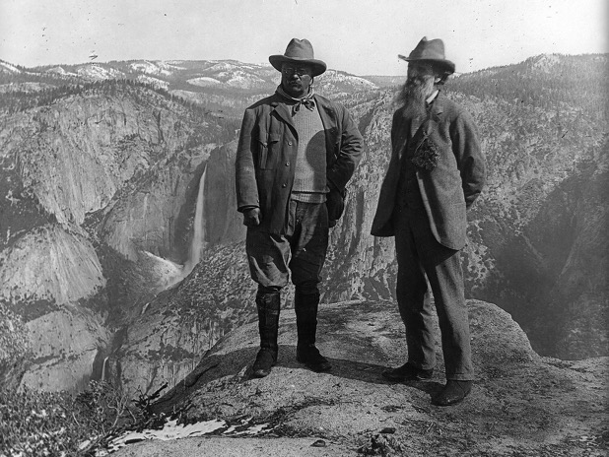
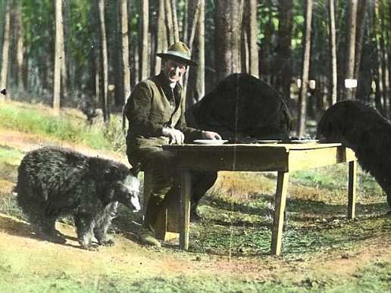
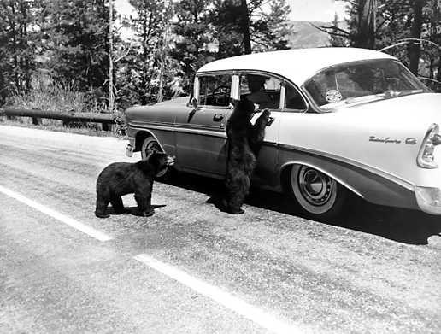
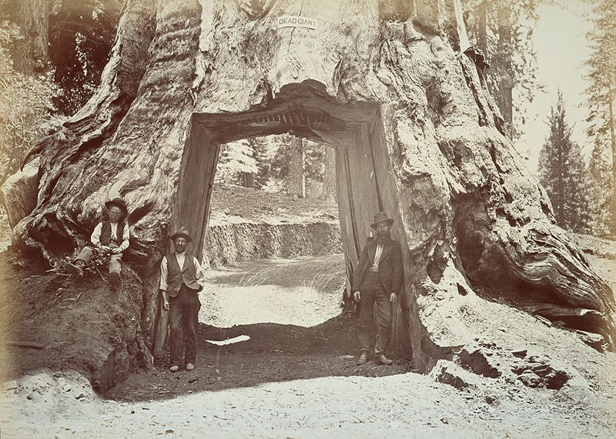
Similarities Between the Two Groups
Both conservationists and Preservationists advocated establishing national parks
  Yellowstone in 1872 - 1st national park
  Yosemite in 1890

Slide 4
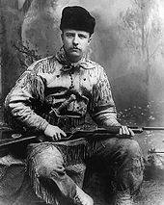
Differences Between the Two Groups
Conservationists support USING nature
Preservationists wanted to PROTECT nature from human interaction

Slide 5

The Hetch Hetchy Controversy
Hetch Hetchy is in Yosemite National Park
San Francisco sought a stable water supply - proposed a dam
John Muir (Sierra Club and preservationist) opposed the dam
Pinchot (and Roosevelt) approved construction of the dam
  85% of water usage today in San Fran comes from Hetch Hetchy, 167 miles away
The needs of the people outrank preservation…..

Slide 6
Test Tips
Multiple-Choice and Short Answer:
  Comparing and Contrasting preservation and conservation
  Excerpt about Hetch Hetchy, debates over preservation and conservation
Long Essay and DBQ:
  Part of an essay on the Progressive Era
  Connecting this time to Environmental movement in the 1960s and 1970s

Slide 7
Thanks For Watching!
Best of luck this year!

