Slide 1
APUSH Review: Key Concept 7.1, Revised Edition
Everything You Need To Know About Key Concept 7.1 To Succeed In APUSH

Slide 2
Key Concept 7.1
“Growth expanded opportunity, while economic instability led to new efforts to reform U.S. society and its economic system.” Page 68
Big Idea Questions:
Why did the US transform from a rural to industrial society? How did this affect the lives of women and other Americans?
Why did citizens and government officials call for increased intervention in the economy?
How did the New Deal change the relationship between the government and the economy?

Slide 3
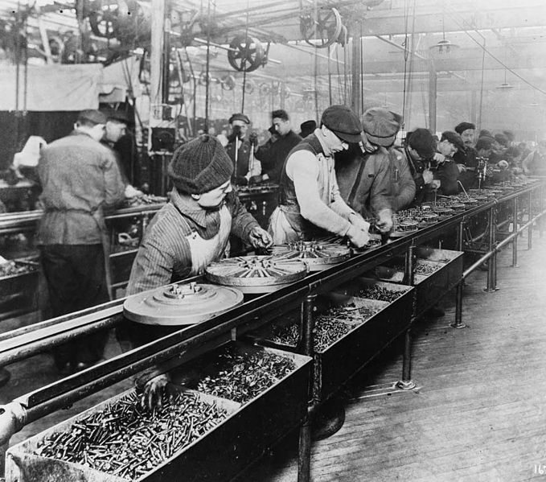
Key Concept 7.1, I
“The United States continued its transition from a rural, agricultural economy to an urban, industrial economy led by large corporations.” Page 68
A: New technologies and manufacturing techniques:
Assembly Line - Henry Ford - utilized Taylorism - timed tasks
Focused on production of consumer goods:
Radios, refrigerators, cars, etc.
Impact of new goods?
Improved standards of living
Greater personal mobility - cars - vacations, travel across the country
Better communications systems - phones and radios

Slide 4
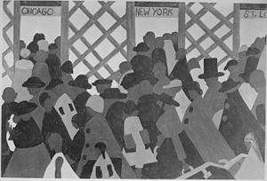
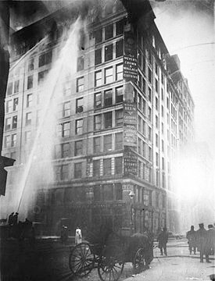
Key Concept 7.1, I
B: US transformation from rural to urban society:
By 1920, more Americans lived in cities than rural areas for the first time in the nation’s history
This transformation provided opportunities for:
Women:
Work in factories (textile - Shirtwaist factories)
International migrants:
“New” immigrants moved to cities to work in factories
Internal migrants:
African Americans moving north as well as farmers to cities - Great Migration

Slide 5
Key Concept 7.1, I
C: Economic downturns led to calls for government involvement and the creation of a stronger financial regulatory system:
Federal Deposit Insurance Corporation (FDIC)
Created to insure bank deposits
Drastically decreased the number of bank failures

Slide 6
Key Concept 7.1, II
“In the Progressive Era of the early 20th century, Progressives responded to political corruption, economic instability, and social concerns by calling for greater government action and other economic political and social measures.” Page 69
A: Progressive Era Journalists attacked:
Political Corruption: The Shame of Cities - exposed corruption between municipal government and businesses
Social injustice and Economic Inequality: Jacob Riis and How The Other Half Lives
Progressive Era Reformers (Middle-class and urban)
Sought social changes in cities and immigrant populations
Jane Addams and the Hull House

Slide 7
Key Concept 7.1, II
B: Progressives on the national level sought to:
Regulate the economy:
Clayton Antitrust Act - strengthened the Sherman Antitrust Act, exempted labor unions from prosecution
Federal Reserve Bank - Established to control the $ supply
Expand democracy:
17th amendment - direct election of senators
Generate moral reform, including the 18th amendment(1919) - Prohibition, banned alcohol
Other Progressive Era Constitutional amendments:
16th - income tax
19th (1920) - Women’s suffrage

Slide 8
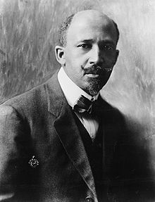
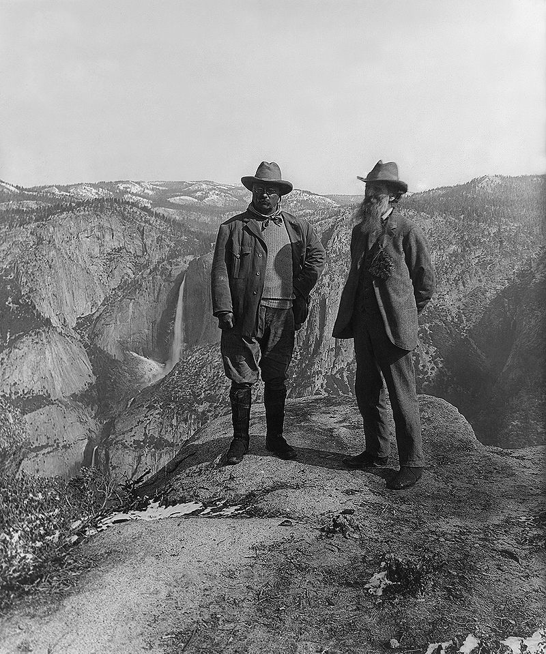
Key Concept 7.1, II
C: Preservationists and Conservationists advocated the establishment of national parks
Advocated different responses to overuse of natural resources
Conservationists - advocate the proper use of nature
Preservationists - advocate the protection of nature from use
D) Issues that divided Progressives
Segregation:
W.E.B. Du Bois and the Niagara Movement (NAACP) sought to end segregation
Booker T. Washington sought economic equality first
Expanding popular participation in government:
Some argued for professionals to make decisions, others advocated for broader political participation
Immigration:
Disagreements over restriction - restriction would not take place until the 1920s

Slide 9
Key Concept 7.1, III
“During the 1930s, policymakers responded to the mass unemployment and social upheavals of the Great Depression by transforming the U.S. into a limited welfare state, redefining the goals and ideas of modern American liberalism.” Page 70
A: FDR’s New Deal tried to end the Great Depression by:
Using the government to provide relief to the poor:
Social Security - provided income for elderly Americans
AAA - paid farmers to NOT overproduce goods
Stimulate recovery:
Provided jobs to the unemployed through the Civilian Conservation Corps (CCC), and Public Works Administration (PWA)
FDR embraced Keynesian deficit spending to “prime the pump”
Reform the American economy:
Securities and Exchange Commission (SEC) - established to regulate the stock market and prevent fraud
FDIC

Slide 10
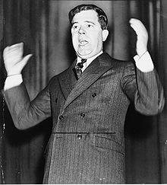
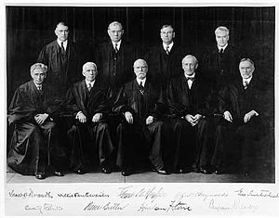
Key Concept 7.1, III
B. Movements that pushed for more reforms included:
Unions, populists, and radicals
Examples:
Huey Long - Governor and Senator from LA - Every Man A King” - proposed giving giving $5,000 to citizens by taxing wealthy
Father Charles Coughlin - Argued that the government should nationalize banks
Some in Congress and the Supreme Court hoped to limit the New Deal
Congress::
Robert Taft (William Howard’s son) and other conservatives sought to stop the New Deal
Viewed the New Deal as socialist
Supreme Court:
Schechter Poultry v. US - Overturned the NRA
US v. Butler - Overturned the AAA

Slide 11
Key Concept 7.1, III
C: Legacy of the New Deal?
Did not solely end the Great Depression
New reforms and agencies (still around today - Social Security, FHA, FDIC, etc)
**Change in voting patterns**:
African Americans switched from the Republican to Democratic Party in LARGE numbers
Many ethnic groups began to identify with Democrats
Working-class communities (labor unions) did as well (Wagner Act)

Slide 12
Test Tips
Multiple-Choice and Short Answer Questions:
Identify and explain opportunities for women, African Americans and immigrants in cities
Successes, failures, and critics of the New Deal
Government reforms during the Great Depression
Essay Questions:
Comparing and contrasting government response during Great Depression to other time periods
Causes and effects of various migrations (internal and international)

Slide 13
See You Back Here for Key Concept 7.2!
Thanks for Watching
Check out all my videos related to the new curriculum
Best of luck on all your tests!

