Slide 1

APUSH Review: Key Concept 7.2, Revised Edition
Shoutouts to: Mrs. Ferguson’s class at Weir High School, Central Valley Academy in NY, Mr. Dollar’s Class in TX, and Mr. Leiberknecht’s Class in CA. Thank you all for watching!
Everything You Need To Know About Key Concept 7.2 To Succeed In APUSH

Slide 2
Key Concept 7.2
“Innovations in communications and technology contributed to the growth of mass culture, while significant changes occurred in internal and international migration patters.”
Big Idea Questions:
  How did technology transform the standard of living in the Unite States?
  What factors led to immigration restrictions during the 1920s?
  What caused internal migration to increase drastically in the United States during the first half of the 20th century?

Slide 3
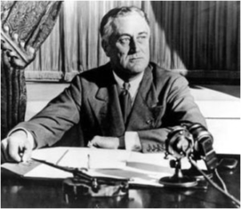
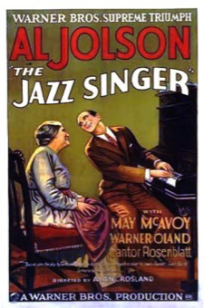
Key Concept 7.2, I
“Popular culture grew in influence in U.S. society, even as debates increased over the effects of culture on public values, morals, and American national identity.”
A. New mass media helped spread culture and awareness of regional cultures
  Radio:
    Large source of entertainment (War of the Worlds - 1938, “Fireside Chats,” Father Charles Coughlin)
  Cinema:
    “Nickelodeons”
    Movies entertained many during the Great Depression
    The Jazz Singer - 1927 - first movie with sound
  Regional cultures:
    Yiddish Theater - portrayed experiences of American Jews
      Influenced English-speaking theaters later in America
    Edward Hopper - focused on the loneliness of the modern city

Slide 4

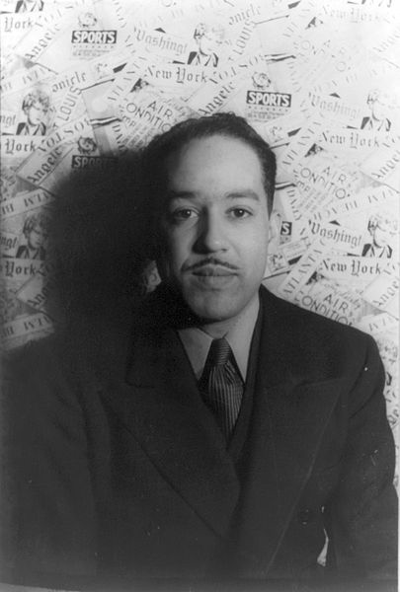
Key Concept 7.2, I
“The night is beautiful,
So the faces of my people.
The stars are beautiful,
So the eyes of my people.
Beautiful, also, is the sun.
Beautiful, also, are the souls of my people.”
B. Harlem Renaissance:
    Celebration of African American culture through writing, music, and art:
      Langston Hughes, Zora Neale Hurston
C. Restrictions on freedom of speech during WWI
  Espionage Act of 1917, Sedition Act of 1918
    Limited citizens ability to criticize the government/speak out against the war
    Upheld by Schenck v. US
  Red Scare - fears of radicalism, communism, and anarchism
    Impact - attacks on unions and immigrants
      Governor Calvin Coolidge stopped the Boston Police Strike in 1919

Slide 5
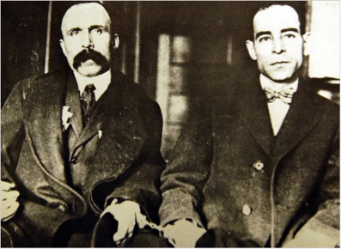
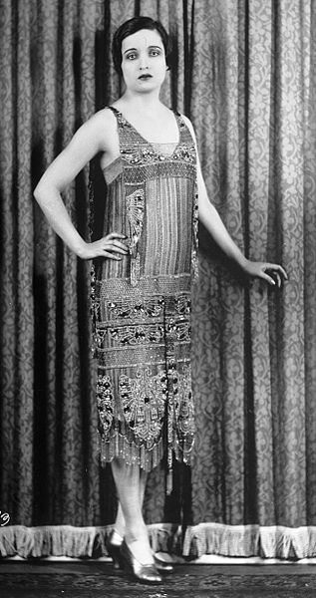
Key Concept 7.2, I
D. 1920 controversies and debates:
  Gender roles:
    “Flappers” challenged gender norms
      Women that drank, danced, smoked, and wore shorter dresses
    Margaret Sanger advocated birth control
  Modernism:
    1920 census - more Americans living in cities for 1st time
    Many workers lost autonomy - assembly line
  Science and Religion:
    Scopes Trial - literal interpretation of bible vs. evolution
  Race:
    “Red Summer” of 1919 - race riots in northern cities - Chicago
  Immigration:
    Rise of nativism in the 1920s - KKK
    Sacco and Vanzetti

Slide 6
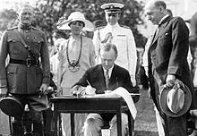
Key Concept 7.2, II
“Economic pressures, global events, and political developments caused sharp variations in the numbers, sources, and experiences, of both international and internal migrants.”
A. European immigration reached its zenith prior to WWI
  Nativism in the 1920s
    Restrictive immigration quotas
      1921:
        Restricted immigration to 3% of a country’s population in the US according to 1910 census
      1924:
        Further restricted immigration to 2% of a country’s population in the US, used 1890s census instead
        Excluded immigrants from Asia
  Targeted “New” Immigrants from Southern and Eastern Europe

Slide 7
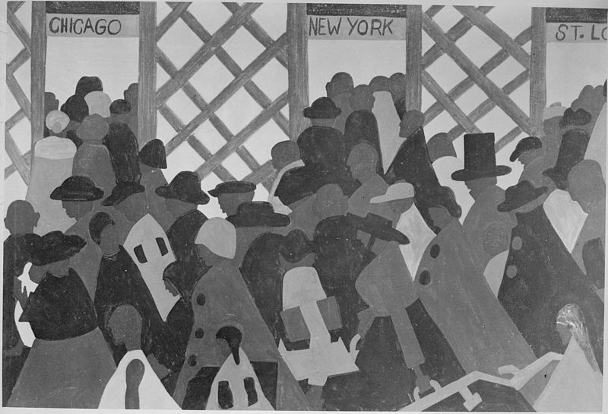
Key Concept 7.2, II
B. Reasons for internal migration to cities (urban centers)
  WWI and WWII economic opportunities in cities for war production and labor
  Great Depression (1930s) - “Okies” fled the “Dust Bowl” to California - Grapes of Wrath
C. Great Migration - during and after WWI
  Movement of African Americans from the South to the North and West
  Reasons for migration?
    Escaping:
      Segregation - Plessy v. Ferguson
      Racial Violence - KKK, Lynchings
      Limited economic opportunities - sharecropping
    African Americans still encountered discrimination in the North

Slide 8
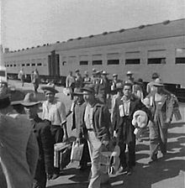
Key Concept 7.2, II
D. Many Mexicans came to the US for economic opportunities
  They faced ambivalent (contradictory) government policies in the 1930s and 1940s
    Many (500,000) were deported during the Great Depression
    Bracero Program:
      US encouraged Mexican immigration during WWII as a labor source
      Many worked as farmers

Slide 9
Test Tips
Multiple-Choice and Short Answer Questions:
  Changes in technology (1920s)
  Causes of cultural and political conflict
  Harlem Renaissance
  Red Scare - impacts
  Immigration Acts
  Great Migration - reasons for and impacts
Essay Questions:
  Migration opportunities (part of larger essay on WWI and/or WWII)
  Comparing 1920s to another decade (1950s)
  Cultural conflicts of the 1920s

Slide 10
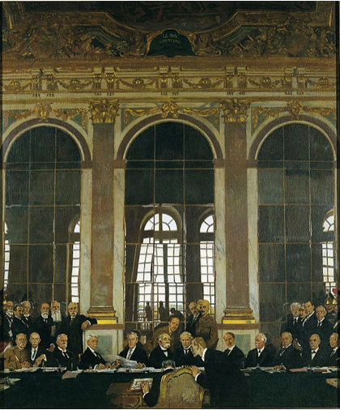
See You Back Here For 7.3!
Thanks for watching!
Check out other videos in the description
Best of luck on all your tests!

