Slide 1

APUSH Review: Key Concept 7.3, revised edition
Shoutout Time: Mr. Bare’s Class in Monroe, Mrs. Tremble’s Class in California, Mrs. Petersen’s Class in CA, and Mr. Porcelli’s Class in VA. Best of luck everyone!
Everything You Need To Know About Key Concept 7.3 To Succeed In APUSH

Slide 2
Key Concept 7.3
“Participation in a series of global conflicts propelled the United States into a position of international power while renewing domestic debates over the nation’s proper role in the world.” Page 73
Big Idea Questions:
  What were arguments for and against US expansion overseas in the late 19th/early 20th centuries?
  How did WWI and WWII challenge the US’ tradition of neutrality? What ways did the US change its views and remain the same?
  What impacts did WWII have on the home front, as well as the US position in the world?

Slide 3
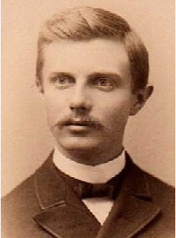
Key Concept 7.3, I
“In the late 19th century and early 20th century, new U.S. territorial ambitions and acquisitions in the Western Hemisphere and the Pacific accompanied heightened public debates over America’s role in the world.” Page 73
A. Imperialists arguments to expand overseas
  Economic opportunities:
    American companies sought markets overseas - US plantation owners in HI
  Racial Theories:
    Some sought to “civilize” nonwhite nations - “White Man’s Burden” - 1899
  Frontier was “closed”:
    1890 census - Frederick Jackson Turner argued the frontier was closed, many Americans believed opportunities dried up

Slide 4
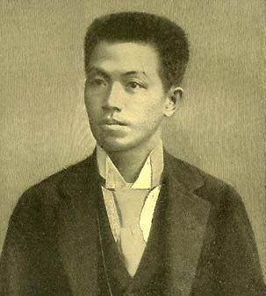
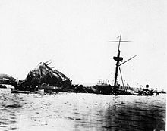
Key Concept 7.3, I
B. Arguments used by Anti-imperialists against overseas acquisition:
  Self-Determination:
    Didn’t Filipinos deserve the “consent of the governed”
  Tradition of Isolationism:
    George Washington’s Farewell Address
C. Spanish American War (1898)
  US defeated Spain in 4 months
  Causes - USS Maine, Yellow Journalism, De Lome Letter
  US gained many territories - Cuba, Guam, Puerto Rico, and the Philippines
  Effects of the war:
    US presence in the Caribbean and Latin America increased significantly (Roosevelt Corollary)
    Nationalist Movement in the Philippines - Emilio Aguinaldo
    See my video: The Spanish-American War As A Turning Point

Slide 5
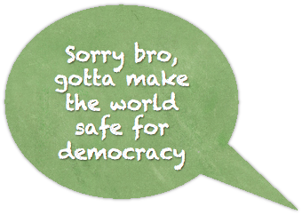
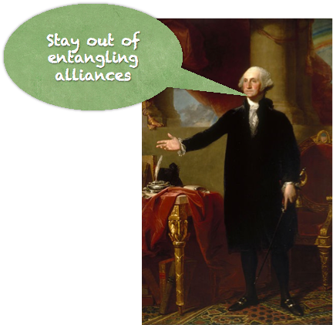
Key Concept 7.3, II
“World War I and its aftermath intensified ongoing debates about the nation’s role in the world and how best to achieve national security and pursue American interests.” Page 74
A.US was initially neutral in WWI
  Upon entry, the US departed from the tradition of noninvolvement in European affairs (Washington’s Farewell Address again)
  Wilson called for humanitarian and democratic principles
    To make the world safe for democracy
    14 Points
B. Role of the American Expeditionary Forces (Military)
  US entered war in 1917
  The US’ entrance tipped the balance in favor of the allies

Slide 6
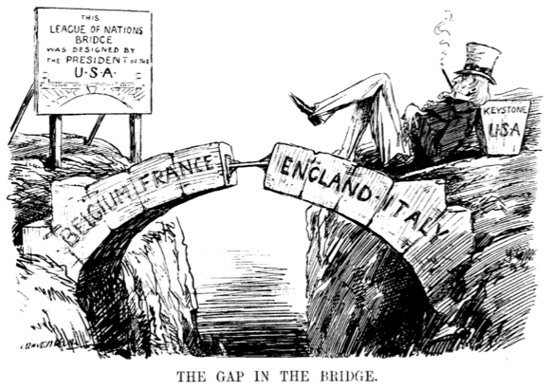
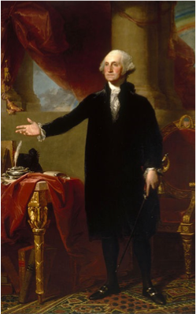
Key Concept 7.3, II
C. The Senate refused to ratify the Treaty of Versailles or join the League of Nations
  Even though Wilson was heavily involved in the postwar negotiations
  Treaty of Versailles:
    Ended WWI, punished Germany severely
  League of Nations:
    Major component of Wilson’s 14 Points, international organization
    Henry Cabot Lodge and the “Irreconcilables” - Congress could lose war making power if the US joined the League
      Washington’s ghost (again)

Slide 7
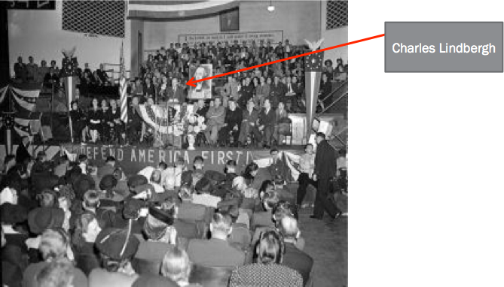
Key Concept 7.3, II
D. US foreign policy following WWI:
  Unilateral policy that:
    Used international investment:
      Continuing Dollar Diplomacy - US banks investing in foreign countries
    Peace Treaties:
      Washington Naval Conference (5 power and 9 power treaties) - determined the number of battleships the US, Britain, and Japan could build (5:5:3 ratio)
    Select military intervention:
      Mostly in Latin America - Nicaragua (1912 - 1933)
    Maintained isolationism:
      Neutrality Acts of 1930s forbid trading with warring (belligerent nations)
E. Many Americans opposed military action until Pearl Harbor
  America First Committee - AGAINST US intervention - Charles Lindbergh and Robert Taft

Slide 8
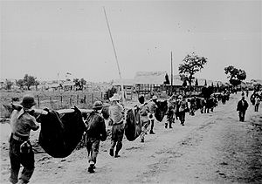
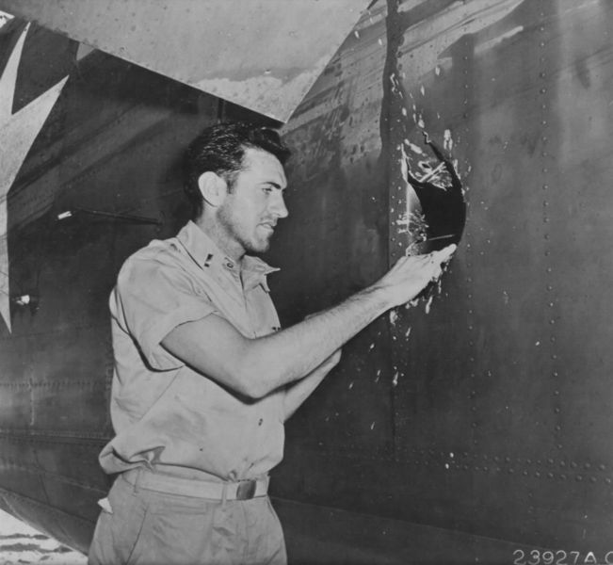
Key Concept 7.3, III
“U.S. participation in World War II transformed American society, while the victory of the United States and its allies over the Axis powers vaulted the U.S. into a position of global, political, and military leadership.” Page 75
A. How did Americans view the war?
  Fight for freedom and democracy
    Later reinforced by:
      Japanese wartime atrocities - Bataan Death March
        Unbroken
      Nazi Concentration Camps and the Holocaust
B. Mass Mobilization of American Society:
  Helped end the Great Depression
  Industrial base helped win the war by:
    Providing equipment, provisions, and troops for the war effort

Slide 9
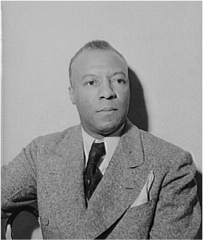
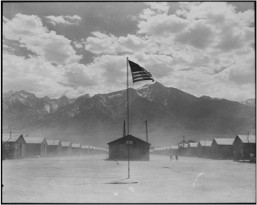

Key Concept 7.3, III
C. Mobilization provided opportunities for women and minorities:
    Women worked in factories - “Rosie the Riveter” and health care during the war
    African Americans served in the military (segregated units), worked in factories
Debates over racial segregation:
  A. Phillip Randolph helped lead to Executive Order 8802 - eliminated discrimination in defense industries
  Double V Campaign - victory over Fascism abroad, victory over racism at home
  Military remained segregated until the Korean War (E.O. 9981)
Challenges to civil liberties:
  Japanese Internment - forced movement of Japanese-Americans (2/3 Nisei) to camps during the war
  Upheld by Korematsu v. US

Slide 10
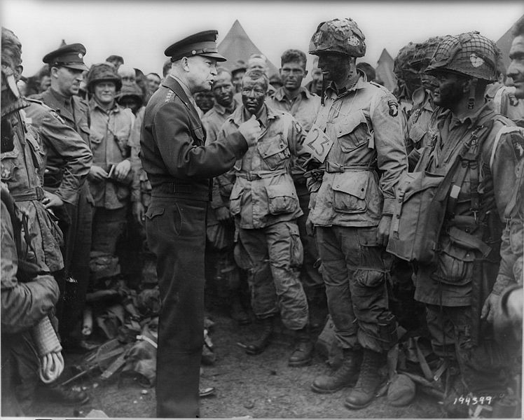
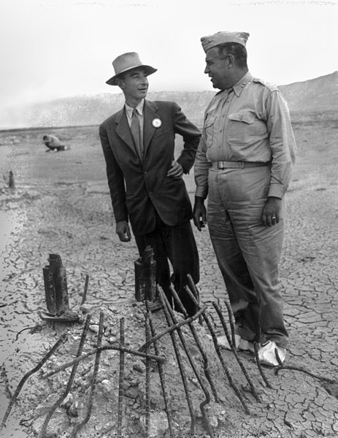
Key Concept 7.3, III
D. Reasons for US and Allied Victory:
  Allied cooperation:
    US, GB, France, and the Soviet Union
    Tehran Conference - “Big 3” meeting; agreed to invasion of Europe in 1944
  Technical and scientific advances:
    Manhattan Project - $2 billion to develop the atomic bomb
      Use of atomic bombs ended the war, but sparked debates
    Sonar - used against German submarines
  Servicemen and women:
    Millions of Americans fought in the war
  Campaigns such as:
    “Island-hopping” campaign:
      Conquering islands in the Pacific prior to attacking Japan
    D-Day Invasion:
      June 6, 1944 - led by Dwight Eisenhower

Slide 11
Key Concept 7.3, III
He’s Finally gone. Man, it’s like he was around in apush forever….
BYE APUSH, I’m finally gone for good
E. The US emerged as the most powerful nation on earth due to:
  War-ravaged conditions in Asia and Europe
  Dominant U.S. role in the Allied victory and postwar peace settlements:
    Creation of the United Nations
    US is a permanent member of the security council
    Departure from Washington’s Farewell Address

Slide 12
Test Tips
Multiple-Choice and Short Answer:
  Arguments for and against US expansion overseas
  Treaty of Versailles and the 14 Points
  Reasons for victories in WWI and WWII
  Domestic impact of WWII - minorities, economy, etc.
Essays:
  Comparing and Contrasting the US’ role in the world post-WWI and Post-WWII
  Social impacts of WWII (Japanese Americans, Women, African Americans”

Slide 13
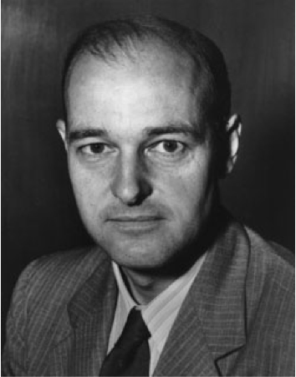
See You Back Here For Key Concept 8.1!
Thanks for watching!
Check out other videos in the description
Best of luck on all your tests, especially the one in May!

