Slide 1
APUSH Review: Period 8 In 10 Minutes! (1945 - 1980)
Everything You Need To Know About Period 8 In 10 Minutes
Shoutout Time: Ms. Son’s class in South Korea! Mr. Campbell’s APUSH and Gov’t classes, Adam S and the rest of Mr. King’s APUSH class, Mr. McGiny from the Elizabeth Learning Center, Mr. Angell’s class at Berkeley HS, Mrs. Pillar Saad in FL, and Ms. Greenswag and Mr. Malonoe at Libertyville HS. You will all do great!

Slide 2
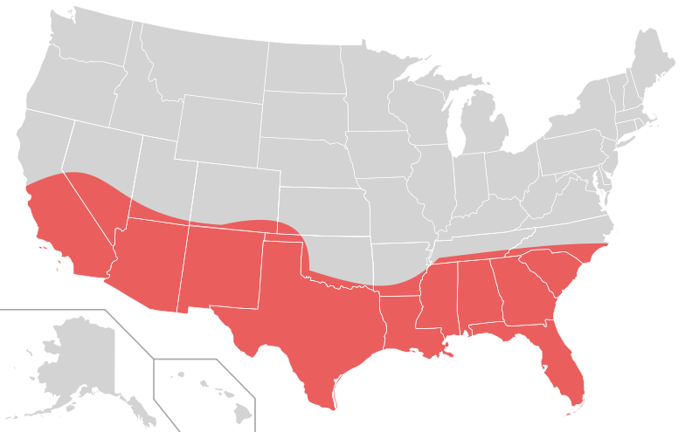
Post-WWII Economy
Prosperous economy caused by:
Federal spending, baby boom, technological developments
Impacts?
Improved higher education (G.I. Bill), “Sun Belt” - mentioned twice in the curriculum
Challenges to conformity by:
Artists (Beat Generation - similar to Lost Generation of 1920), Intellectuals (The Affluent Society) and youth

Slide 3
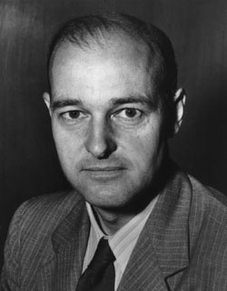
US Foreign Policy Post WWII
Containment - George Kennan
US sought to keep communism from spreading
Seen through:
Collective Security - NATO
Economic Frameworks - Truman Doctrine, Marshall Plan
Conflicts - Korea and Vietnam (North was communist in both)
Detente and indirect confrontation
SALT vs. Cuban Missile Crisis

Slide 4
US Foreign Policy Post WWII
Cold War impact on other countries/regions?
US and USSR sought allies among new, decolonized countries (India)
Latin America - US supported non-Communist governments, even if they weren’t the most democratic
US involvement in the Middle East - oil crises - 1973 oil embargo

Slide 5
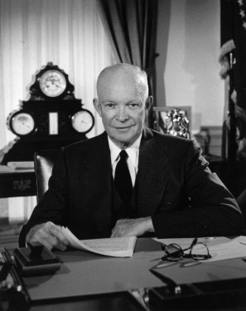
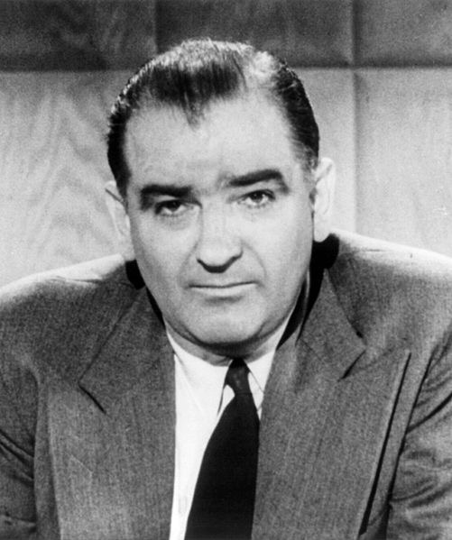
Cold War Domestic Issues
Both parties supported containing communism, however:
Debates emerged over how to root out Communists
McCarthyism, Red Scare, HUAC, Rosenbergs, etc.
Korean War - some domestic opposition
Vietnam War - large, sometimes violent protests - especially post 1968 (Tet Offensive) and 1970 (bombing of Cambodia)
Military-Industrial Complex - Eisenhower’s warning about military spending during peacetime
Debates about executive branch power (during Vietnam War - Gulf of Tonkin Resolution)

Slide 6
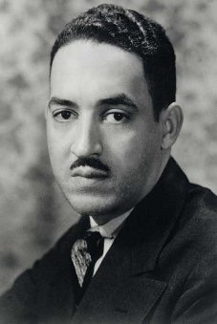
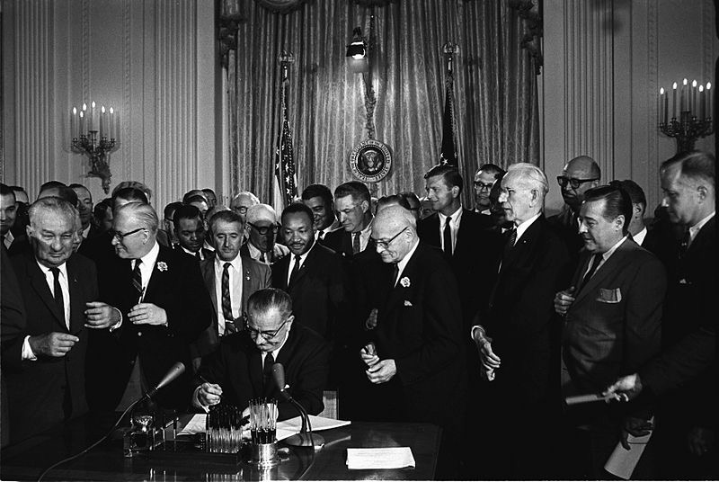
Civil Rights
Many strategies - legal challenges, direct action, and nonviolent protests
All 3 branches of government promoted civil rights:
Executive - E.O. 9981 - desegregated military (Truman)
Judicial - Brown v. Board
Legislative - Civil Rights Act of 1964
White resistance to desegregation:
Southern Manifesto, Massive Resistance, Little Rock 9
Debates emerged among activists post 1965:
Black power (Black Panthers)

Slide 7
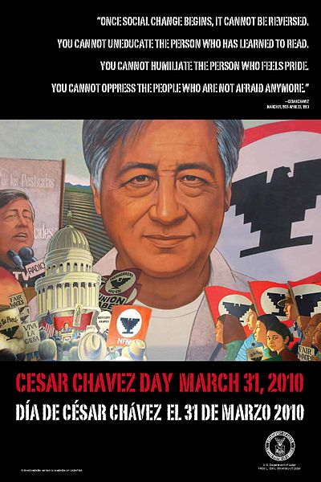
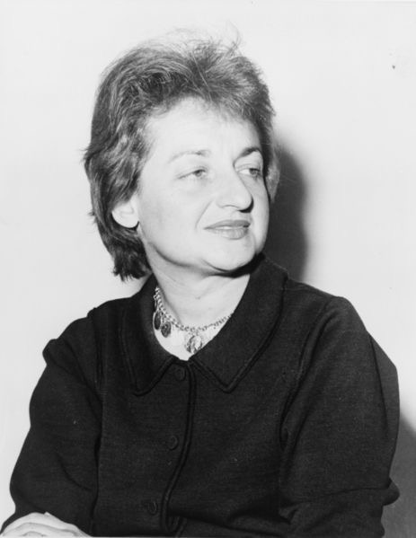
Rights For Other Groups and Other Social Issues
Women’s Rights:
Betty Friedan’s The Feminine Mystique - challenged the 1950s “cult of domesticity”
Gays and Lesbians:
Stonewall Riots: 1969
Latinos:
Cesar Chavez - grape pickers’ strike and hunger strike
American Indians:
Indians of All Tribes (IAT) and American Indian Movement (AIM) - used protests
Awareness of Poverty:
Michael Harrington’s The Other America - influenced LBJ’s Great Society

Slide 8
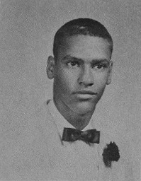
Great Society and the Supreme Court
Liberalism - using the government to promote social wellbeing
Reached its zenith under the Great Society
Sought to:
End discrimination (Civil Rights Act of ’64, V.R. Act of ’65)
Eliminate poverty - food stamps, Medicaid
Fix other social issues - education
Supreme Court in the 1960s - promoted individual freedoms
Griswold v. Connecticut - established “Right to Privacy”
Helped inspire a conservative movement (more in period 9)
People on the left felt liberals did NOT go far enough to change society racially and economically
Black Panthers, SDS

Slide 9
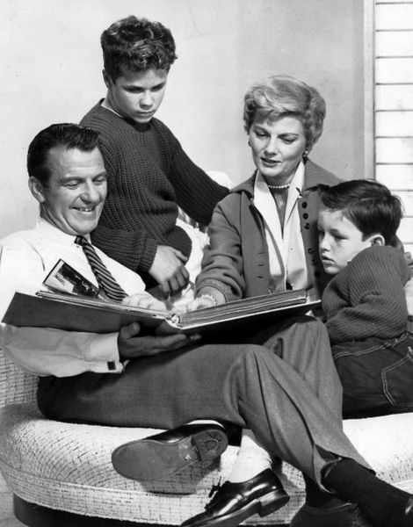
Demographics and Counterculture
1950s image of a nuclear family?
2 children, suburbs, stay at home mom
Reality?
Women worked more and more as time went on (1970s)
Counterculture - hippies:
Challenged their parents’ generation ideals
Used drugs and instituted a sexual revolution
Debates between conservatives and liberals:
Bakke v. University of California:
Overturned quotas for minority applicants

Slide 10
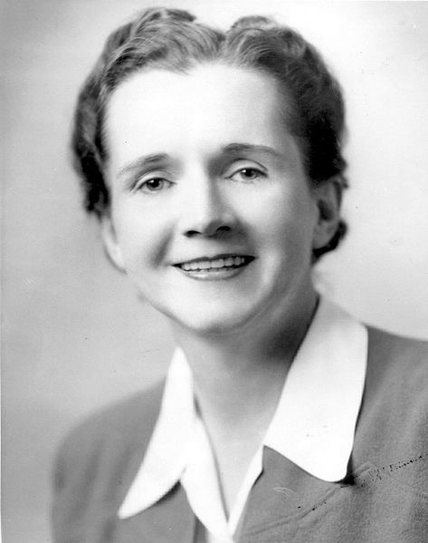
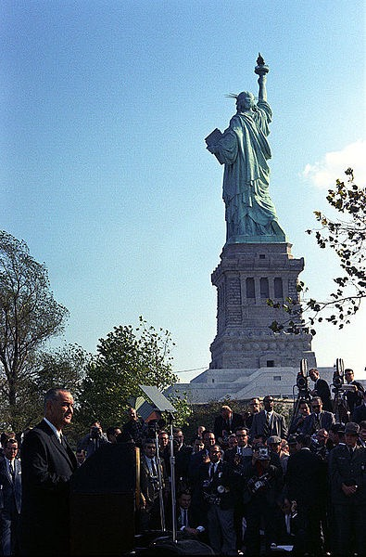
Immigration and Environmentalism
Immigration Act of 1965:
Reversed the quota system from the 1920s (1921 and 1924)
Favored immigration from Asia and Latin America (traditionally underrepresented groups)
Rachel Carson’s Silent Spring:
Brought awareness to environmental problems
Helped lead to the creation of the EPA, Clean Air Act, etc.

Slide 11
Quick Recap
Sunbelt
Containment
Truman Doctrine and Marshall Plan
NATO
Korea and Vietnam
Detente
Military-Industrial Complex
3 Branches and Civil Rights
Great Society
The Feminine Mystique
Silent Spring
Counterculture
Immigration Act of 1965

Slide 12
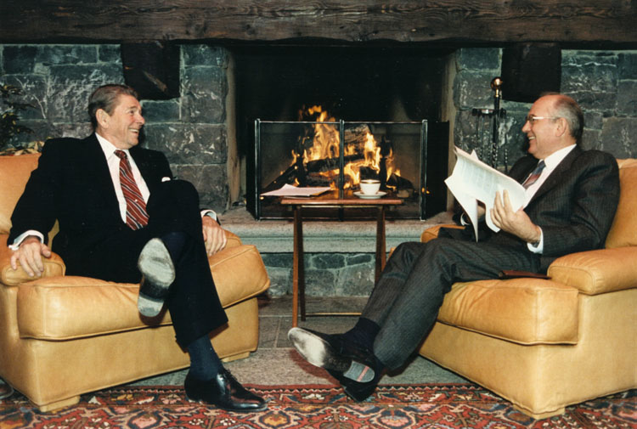
See You Back Here For Period 9 In 10 Minutes!
Thanks for watching!
Check out my playlist of 10 minute videos
Periods 1-5 and 6-9 Review Videos
Good luck, you are BRILLIANT!

