Slide 1
APUSH Review: Key Concept 8.3, Revised Edition
Shoutouts to: Mr. Schneider’s class, Mr. Wedan’s class in VA, Mr. Lance’s class at Dawson High School, Mr. Johnson’s and Mr. South’s classes in CA, and Mr. Amendola’s class in FL. Thanks for the support and good luck!
Everything You Need To Know About Key Concept 8.3 To Succeed In APUSH

Slide 2
Key Concept 8.3
“Postwar economic and demographic changes had a far-reaching impact on American society, politics, and culture.”
Big Idea Questions:
How did economic growth impact American society and American values?
How did new immigration laws in 1965 impact immigrants? (Change and continuity)
How did the counterculture impact American society?

Slide 3
Key Concept 8.3, I
“Rapid economic and social changes in American society fostered a sense of optimism in the postwar years.”
A: A burgeoning (increasing) private sector due to:
Federal spending
Baby boom generation
Technological developments
All of these contributed to economic growth
B: Impact of higher education opportunities and new technologies?
Migration of middle class to the suburbs
Growth of the “Sun Belt” gaining influence (at expense of the “Frost Belt”)

Slide 4
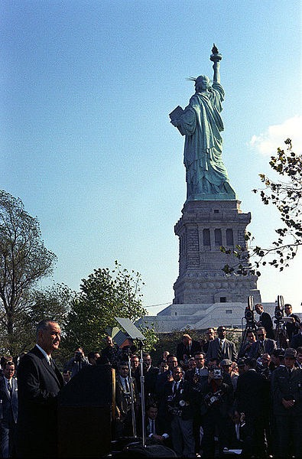
Key Concept 8.3, I
C.: Internal and International immigration increased -> economic opportunities
Immigration Law of 1965:
***Abolished the quota system from the 1920s***
Families of legal immigrants living in the US were given preferential treatment
Especially benefited immigrants from Latin America and Asia

Slide 5
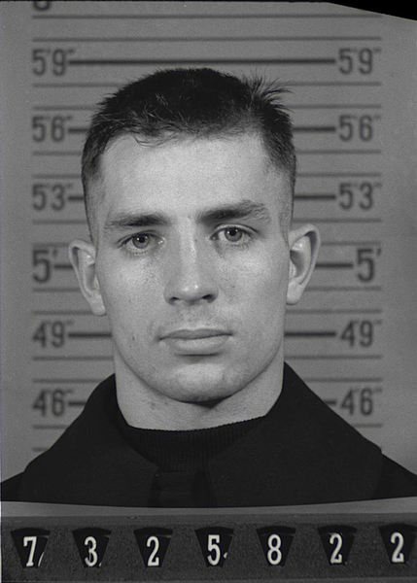
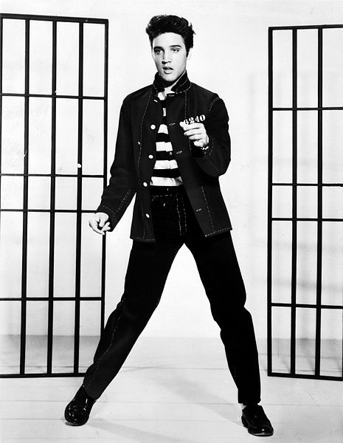
Key Concept 8.3, II
“New demographic and social developments, along with anxieties over the Cold War, changed U.S. culture and led to significant political and moral debates that sharply divided the nation.”
A: The rise of a homogeneous mass culture
Was caused by:
Economic and Social Changes
Anxiety over the Cold War
Was challenged by artists, intellectuals, and youth
Beat Movement - writers that challenged middle class conformity
The Affluent Society (1958) - brought attention to income disparity in post-WWII US
Rock and roll music - Elvis Presley, Beatles

Slide 6
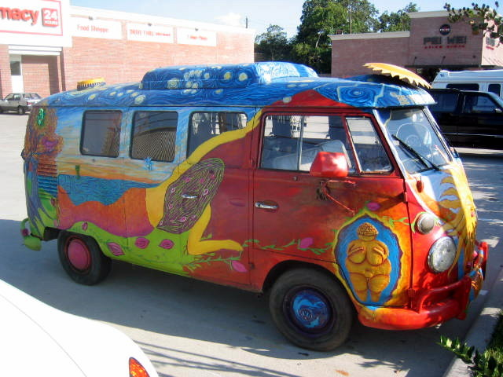
Key Concept 8.3, II
B: Feminists and the Counterculture of the 1960s (“Hippies”)
Rejected many of their parents generations’ values
Social - used marijuana; new music (Woodstock)
Economic - rejected materialism, sought to live a simpler life
Political - protested the Vietnam War; active in civil rights, promoted women’s rights
Initiated:
Changes in sexual norms
Greater informality into US Culture

Slide 7
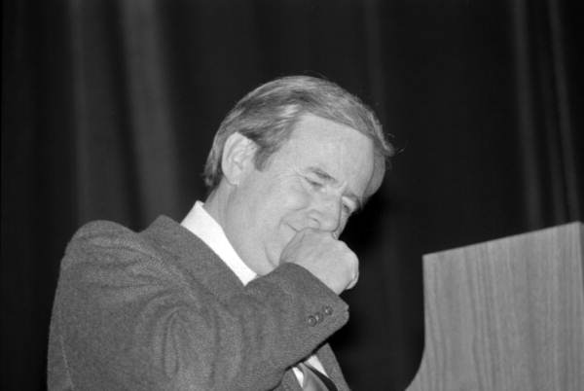
Key Concept 8.3, II
C: Rise of evangelical Christian churches and organizations - “Born-again” Christians - personal conversion
Was accompanied by:
Great political and social activism by religious conservatives
Response to Roe v. Wade
Jerry Falwell and the Moral Majority
Opposed the ERA, SALT, abortion, and homosexuals
Focus on the Family - Promoted abstinence, against same-sex marriage, and is pro-life

Slide 8
Test Tips
Multiple-Choice and Short Answer:
Rise of the conservative movement
Family structures and counterculture
Essays:
Immigration - comparing post 1965 with prior time periods (1920s immigration quotas)
Rise of the conservative movement (making connections to the 1960s under LBJ)

Slide 9
See You Back Here For 9.1!
Thanks for watching!
Subscribe and share
Check out my other videos (end of year reviews)
Good luck in May!

