Slide 1

APUSH Review: Key Concept 8.1, Revised Edition
Shoutout time! Mr. Cruz’s class in VA, Ms. Munoz’s Class in Chicago, Mr. Picardi’s Class in CA, Dr. Tyrrell’s Class in OH. Thank you all for your support!
Everything You Need To Know About Key Concept 8.1 To Succeed In APUSH

Slide 2
Key Concept 8.1
“The United States responded to an uncertain and unstable postwar world by asserting and working to maintain a position of global leadership, with far-reaching domestic and international consequences.”
  Page 77
Big Idea Questions:
  What were different ways the US sought to “contain” communism, both domestically and abroad?
  How did independence movements throughout the world affect the Cold War?
  How did the Vietnam War impact domestic life?

Slide 3
Key Concept 8.1, I
“United States policymakers engaged in a Cold War with the authoritarian Soviet Union, seeking to limit the growth of Communist military power and ideological influence, create a free-market global economy, and build an international security system.”
A: The wartime alliance between Soviet Union and Allies dissolved, US developed a foreign policy based on:
  Collective Security:
    North Atlantic Treaty Organization (NATO) - an attack on one country was an attack on all
  International aid:
    Marshall Plan - provided billions of $ to Europe to rebuild war-torn countries
    Truman Doctrine - $400 million in military aid to Greece and Turkey
  Economic institutions that bolstered non-Communist nations:
    International Monetary Fund (IMF)
      Created in 1944 - promotes trade and provided loans to countries in need

Slide 4
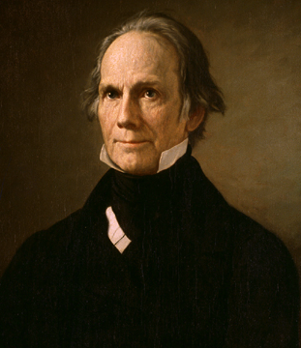
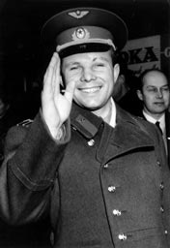
Key Concept 8.1, I
Happy Birthday Me!
B: US “contained” communism through:
  Military engagements in Korea and Vietnam:
    Domino theory - fear if one country became communist, then surrounding countries would
  Massive Retaliation:
    The US would respond with more force if attacked
    The Ron Burgundy, “That escalated quickly.”
  Space Race:
    Reaction to Sputnik and Yuri Gagarin
    US built up space program AND education in the US

Slide 5
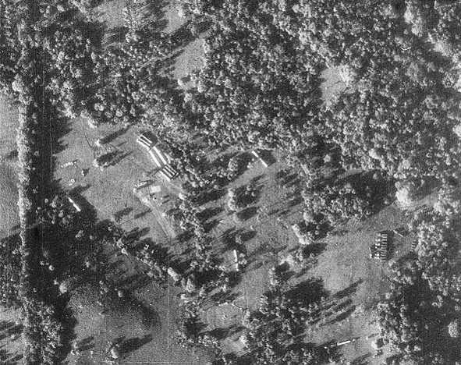
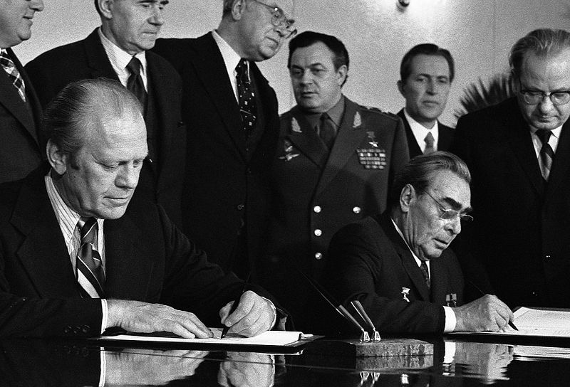
Key Concept 8.1, I
C: Cold War fluctuated between direct and indirect military confrontations:
  Cuban Missile Crisis:
    13 days in October, 1962
    Closest the US and Soviet Union came to war
  Detente: easing of tensions between superpowers
    SALT (Strategic Arms Limitation Talks) -> Treaties:
      Began with Nixon’s administration and continued through Carter’s
      Agreements to limit certain arms

Slide 6
Key Concept 8.1, I
D. Impacts of postwar decolonization movements in Asia, Africa, and the Middle East:
  US and USSR sought allies among the new nations, although many remained neutral
  The US immediately recognized Israel in 1948
  Many revolutions were seen as pawns of the Soviet Union
E.: Cold War in Latin America:
  “US supported non-communist regimes with varying levels of commitment to democracy.”
    1954 - overthrow of Arbenz in Guatemala
    He was democratically elected and nationalized land owned by the United Fruit Company
    He was replaced with a military dictator, Armas

Slide 7
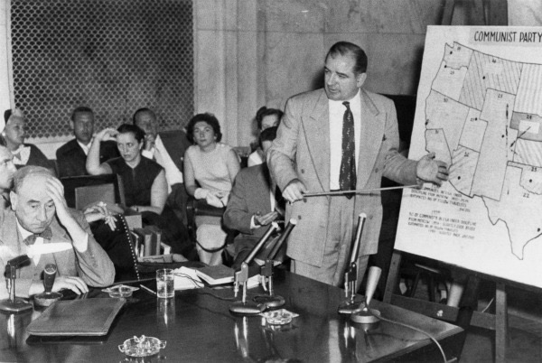
Key Concept 8.1, II
“Cold War policies led to public debates over the power of the federal government and acceptable means for pursuing international and domestic goals while protecting civil liberties.”
A: Debates over methods to root out domestic Communists:
  Truman’s Executive Order 9835 - “Loyalty Oath” for Federal employees
  2nd Red Scare:
    HUAC and the “Hollywood Ten”
    McCarthyism
Both political parties supported containing the threat of Communism
  Eisenhower (R) in Iran and Guatemala
  Truman in Korea (D) and LBJ (D) in Vietnam

Slide 8
Key Concept 8.1, II
B: Domestic opposition to wars:
  The Korean War produced only minor opposition
  Vietnam saw violent protests that increased as the war went on
    Especially after the Tet Offensive (January 1968)
    Students for a Democratic Society (SDS) - used violence as time went on to protest
    Kent-State Protests (May, 1970) - reaction to Cambodia Bombings

Slide 9
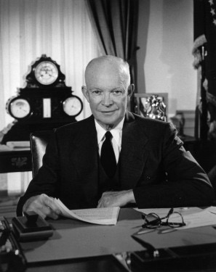
Key Concept 8.1, II
C: Americans began to debate:
  The merits of a large nuclear arsenal
  The “military-industrial complex”
    Buildup of military and industries throughout the US
    Eisenhower warned of this in his farewell address
  Power of executive branch in foreign and military policy
    Congress reversed the Gulf of Tonkin Resolution with the War Powers Act

Slide 10
Key Concept 8.1, II
D. US involvement in the Middle East was shaped by ideological, military, and economic concerns
  Suez Crisis (1956) - Nasser of Egypt nationalized the Suez Canal, Britain and France attacked
    The US helped end the conflict -> fear the Soviets would get involved
Oil crises helped initiate attempts at creating a national energy policy
  Organization of Petroleum Exporting Countries (OPEC):
    Cartel formed by mostly Middle Eastern countries to control the supply of oil
    After the US supported Israel in 1973 (Yom Kippur War), OPEC placed an oil embargo on the US, drastically raising gas prices

Slide 11
Test Tips
Multiple-Choice and Short Answer:
  Ways the US sought to “contain” communism -
    Korea and Vietnam; Marshall Plan and Truman Doctrine
  Detente
  Military industrial complex
Essay Questions:
  WWII as a Turning Point for US foreign policy
  Comparing and contrasting post-WWI with post-WWII

Slide 12
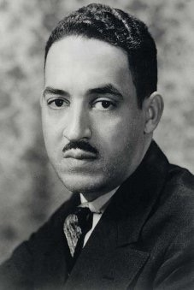
See You Back Here For 8.2!
Thanks for watching
Subscribe and Share
Best of luck
Good luck in May!

