Slide 1

APUSH Review: Key People To Know (Periods 1 - 5)
Shoutout time: Ms. Borges’ class in Puerto Rico!, Ms. Duggan’s class in Meridian, MS, Ms. Safstrom’s class, Mrs. Moore’s class in CA, Mr. Armstrong’s class at Cerritos High School, Mr. Haine’s class Lilly, Lexie, Sanam, Casey, and Suzie from Mr. King’s and Mr. Chrstopher’s classes at Pali High. Best of luck everyone, you got this!
Everything You Need To Know About Important People From Periods 1 - 5 To Succeed In APUSH

Slide 2
Period 1 Key People
Juan de Sepulveda:
  Advocated harsh treatment of Natives
  Claimed slavery for Natives was justified under Christianity
Bartolome de Las Casas:
  Argued Natives deserved same treatment as other men
  Helped end the Encomienda System

Slide 3
Period 2 Key People
New England Colonies
John Winthrop
  Governor of MBC - “City Upon a Hill”
Roger Williams
  Kicked out of MBC - established RI - religious toleration
Anne Hutchinson
  Challenged gender norms, banished to RI
Middle Colonies
William Penn - founded Pennsylvania - religiously and ethnically diverse

Slide 4
Period 2 Key People
Enlightenment
  John Locke - natural rights - inspired Declaration of Independence
1st Great Awakening
  Jonathan Edwards - Started the First Great Awakening
    “Sinners in the Hands of an Angry God”
  George Whitefield - great orator of the Awakening

Slide 5
Period 3 Key People
Chief Pontiac:
  Credited with Pontiac’s Rebellion - conflict between Natives and English colonists after the 7 Years’ War
  Natives resisted colonial encroachment
Benjamin Franklin:
  Co-author of the Declaration of Independence, helped gain support of France during the Rev. War
Mercy Otis Warren:
  Influential writer that urged independence
American colonists from all social classes and backgrounds argued for independence:
  Colonial leaders, grassroots movement

Slide 6
Period 3 Key People
Thomas Paine:
  Common Sense - argued America should break away from England
Marquis de la Fayette:
  From France, helped out in the Rev. War
  Washington’s right hand man
Abigail Adams:
  Wife of John, hoped he would “Remember the Ladies”
Daniel Shays:
  Revolutionary War veteran, led a rebellion against farm foreclosures, high state taxes
  Helped lead to calls for the Constitution

Slide 7
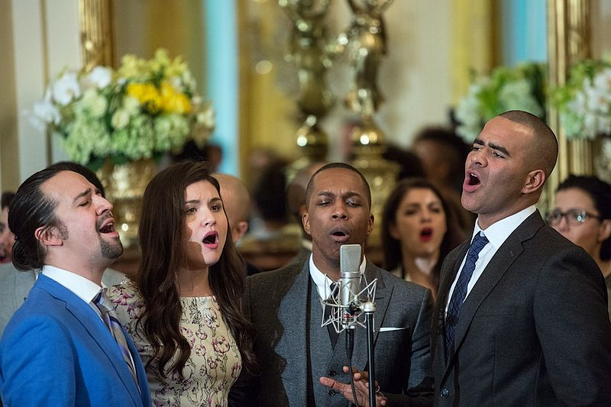
Period 3 Key People
John Jay, Alexander Hamilton, and James Madison
  Wrote the Federalist Papers
  Urged the ratification of the Constitution
George Washington:
  Farewell Address - warned of political parties and foreign alliances
Thomas Jefferson
  Secretary of State under Washington
  Leader of the Jeffersonians (1st Party System)
Alexander Hamilton
  Secretary of Treasury under Washington
  Leader of the Federalists (1st Party System)

Slide 8
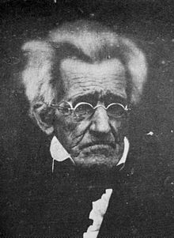
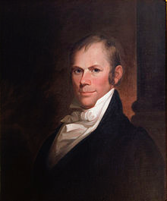
Period 4 Key People
John Marshall:
  Chief Justice of the Supreme Court (1801 - 1834)
  His decisions helped strengthen the federal government over the states
  Marbury v. Madison, Gibbons v. Ogden, McCulloch v. Maryland
Henry Clay!
  American System
  Leader of the Whigs
  3 time compromiser - 1820, 1833, 1850
Andrew Jackson:
  Leader of the Democrats
  Elimination of property requirements -> white, male, adults

Slide 9
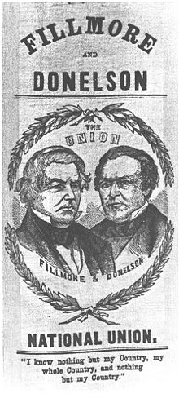
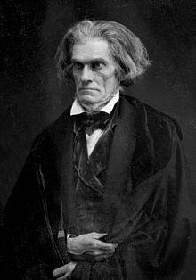
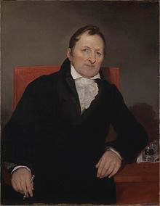
Period 4 Key People
Eli Whitney:
  Invented cotton gin and interchangeable parts
John C. Calhoun:
  Senator, South Carolina, “Great Triumvirate”
  “Slavery as a Positive Good”
Know-Nothing Party:
  Anti-Immigrant Party
  Sought to limit immigrants’ political power and influence

Slide 10
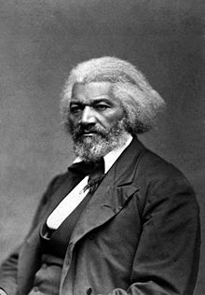
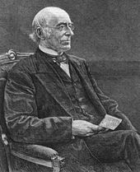
Period 4 Key People
Abolitionists
  Denmark Vesey:
    Planned largest ever slave rebellion in South Carolina
  Nat Turner:
    Led a slave revolt in Virginia in 1831
  Frederick Douglass:
    Former slave, great orator, women’s rights advocate
  William Lloyd Garrison:
    Creator of the Liberator
    Called for immediate and uncompensated end to slavery
  John Brown:
    “Bleeding Kansas” and Harpers Ferry
  Harriet Tubman:
    Underground RR

Slide 11
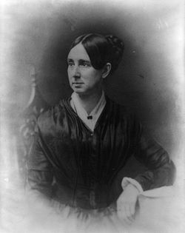
Period 4 Key People
Reform Movements:
  Dorothea Dix - treatment of mentally ill
  Horace Mann - Education
  Elizabeth Cady Stanton - Seneca Falls
Religion:
  Charles G. Finney - 2nd Great wakening
  Brigham Young - Moved Mormons out west to Utah

Slide 12
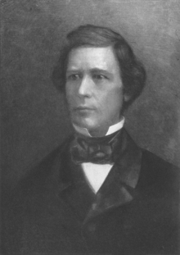
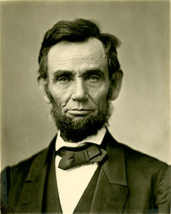
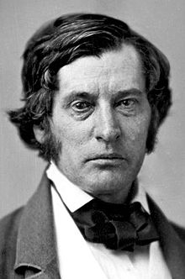
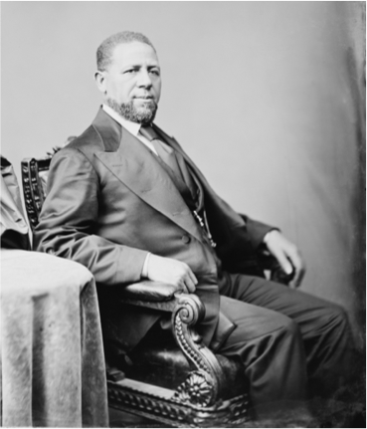
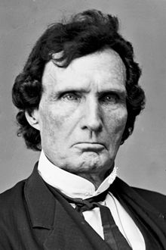
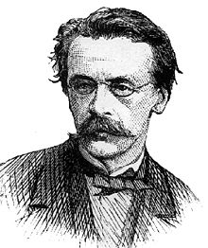
Period 5 Key People
John L. O’Sullivan - coined the term “Manifest Destiny”
David Wilmot - Wilmot Proviso
Abe Lincoln - “free-soil” platform
Charles Sumner and Thaddeus Stevens - Radical Republicans
Hiram Revels - 1st African American elected to Congress

Slide 13
See You Back Here For Periods 6 - 9
Please don’t forget me……
Thanks for watching
Check out other review videos in the description
Best of luck in May!

