Slide 1
APUSH Review: Key People To Know (Periods 6 - 9)
Shoutout time: Meg and Katie at UA NOLA, Mr. Torres’ class in Guadalajara, Mexico!, Mr. DeJoseph’s class in PA, Mrs. Rivera’s Brick Memorial APUSH class - celebrated Henry Clay’s B-day. You all will do great on the exam!
Everything You Need To Know About Important People From Periods 6 - 9 To Succeed In APUSH

Slide 2
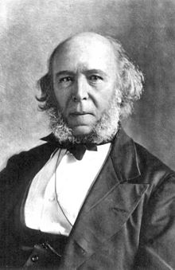
Period 6 Key People
Mark Twain - coined the term, “Gilded Age”
Herbert Spencer - advocated social darwinism - used by wealthy to justify their success
Industrialists:
Andrew Carnegie - steel, “***Gospel of Wealth***” - philanthropy or philanthropic contributions
John Rockefeller - oil
Cornelius Vanderbilt - RRs
J.P. Morgan - finance
Industrialists sought to consolidate corporations (form trusts/monopolies/etc.) to increase their wealth and power

Slide 3
Period 6 Key People
Unions:
Knights of Labor - led by Terrance Powderly
Skilled AND Unskilled workers
Women and African Americans
American Federation of Labor - Samuel Gompers
Skilled workers
Focused on “Bread and Butter” issues - 8-hour work day, high wages

Slide 4
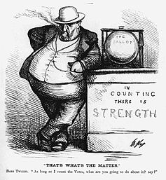
Period 6 Key People
Urbanization:
Political Machines - Tammany Hall (Boss Tweed)
Provided immigrants and poor with social services
Hull House - Jane Addams
Chicago - helped immigrants adapt to US culture (language and customs)

Slide 5
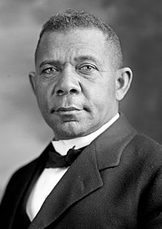
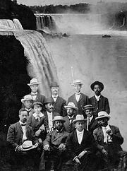
Period 6 Key People
Key Reformers:
Ida B. Wells - journalist that wrote about lynchings in the South
Booker T. Washington - sought economic opportunities for African Americans
W.E.B. Du Bois - Sought immediate equality, founder of the NAACP

Slide 6
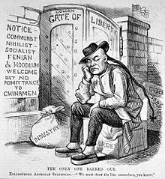
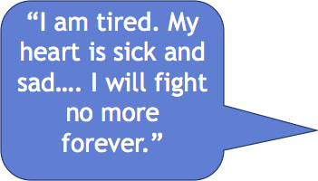
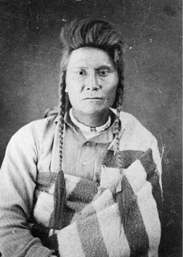
Period 6 Key People
Helen Hunt Jackson - A Century of Dishonor
Chief Joseph: leader of Nez Percé
Immigrants:
“New” Immigrants:
Southern and Eastern Europe - escape religious persecution, poverty, and limited social mobility
Often settled in cities - worked in factories
Asian immigrants settled on the West Coast
Immigrants faced nativism and discrimination (APA, Chinese Exclusion Act)

Slide 7
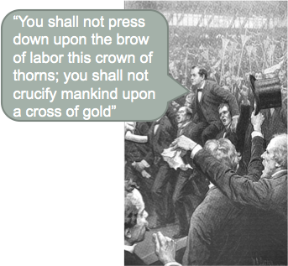
Period 6 Key People
Populist Party:
Advocated more government involvement in the economy
William Jennings Bryan - ran for president in 1896 as a Populist
“Cross of Gold” Speech

Slide 8
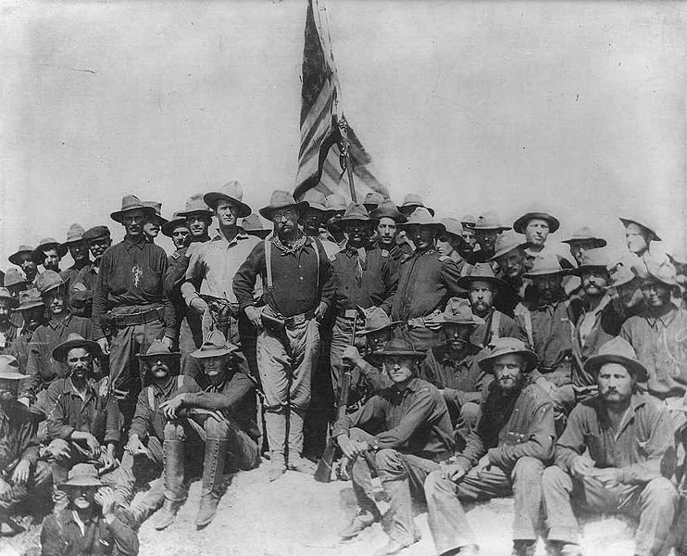
Period 7 Key People
Frederick Jackson Turner
Argued that the frontier was “closed” - led to overseas expansion
Alfred T. Mahan - Influence of Seapower Upon History:
Encouraged countries to build up their navies
Rudyard Kipling:
“White Man’s Burden” - justified imperialism
Spanish-American War
T. Roosevelt - resigned as Assistant Secretary of the Navy to fight in the war
William McKinley - President during the war
Emilio Aguinaldo - Filipino that fought against the US after the war for independence
Anti-Imperialist League - were against US acquiring land, especially the Philippines

Slide 9
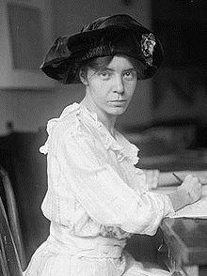
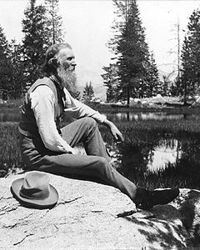
Period 7 Key People
Progressive Era
Writers to Know:
Upton Sinclair - The Jungle
Jacob Riis - How the Other Half Lives
Lincoln Steffens - Shame of Cities
Alice Paul - fought for women’s suffrage - 19th amendment
John Muir - founded the Sierra Club - preservationist organization

Slide 10
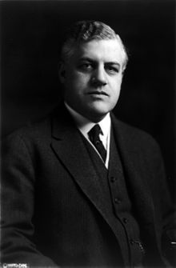
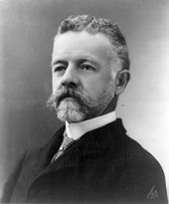
Period 7 Key People
WWI
Wilson campaigned on “He Kept Us Out Of War”
Entered the war for humanitarian and democratic principles
George Creel:
Journalist, 4 minute speeches to support the war
Charles Schenck:
Arrested and convicted of violating the Espionage Act of 1917
Upheld by Schenck v. US
Henry Cabot Lodge:
“Lodge Reservations” - against the Treaty of Versailles and League of Nations
A. Mitchell Palmer - Palmer Raids - 1919 - helped lead to the Red Scare

Slide 11
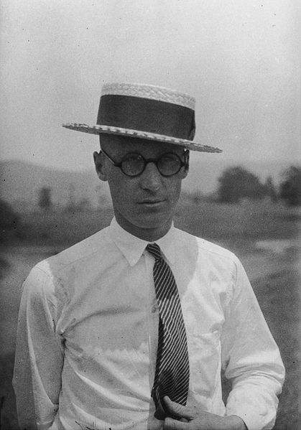
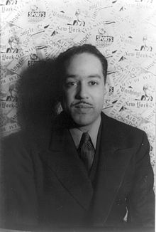
Period 7 Key People
1920s
Harlem Renaissance:
Celebration of African American Culture through music and literature
Langston Hughes, Zora Neale Hurston
Marcus Garvey:
Leader of the UNIA, promoted “Back to Africa” movement
Influenced Malcolm X
John T. Scopes - Science teacher convicted of teaching evolution in TN
Lost Generation - criticized middle class consumerism

Slide 12
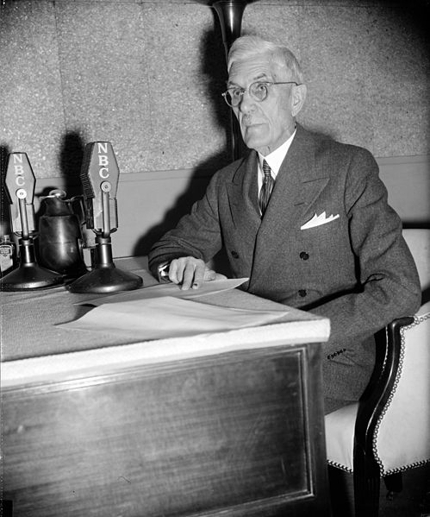
Period 7 Key People
Great Depression/New Deal
Bonus Army - WWI veterans went to Washington to receive their bonus payment early
FDR - New Deal, 3 Rs
Dr. Francis Townsend - advocated giving $200 per month to elderly
Political Realignment:
African Americans and the working class began to vote Democratic after the Great Depression

Slide 13
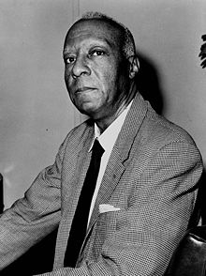
Period 7 Key People
WWII
A. Philip Randolph - proposed march on Washington -> led to FDR desegregating defense industries
Women - worked in factories - “Rosie the Riveter”
African-Americans - worked in factories, fought in the war - Double V Campaign
Japanese Americans - 100,000+ were put in Internment camps
Mexican-Americans - Bracero program, Zoot Suit Riots

Slide 14
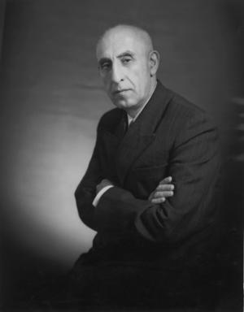
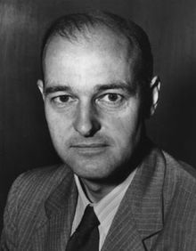
Period 8 Key People
Cold War:
George Kennan - father of containment
George Marshall - Secretary of State - Marshall Plan
Eisenhower’s Farewell Address - warned of “military-industrial complex”
Shah of Iran - leader after CIA overthrew Mohammad Mosaddegh
Ho Chi Minh - sought to unify Vietnam as a communist nation

Slide 15
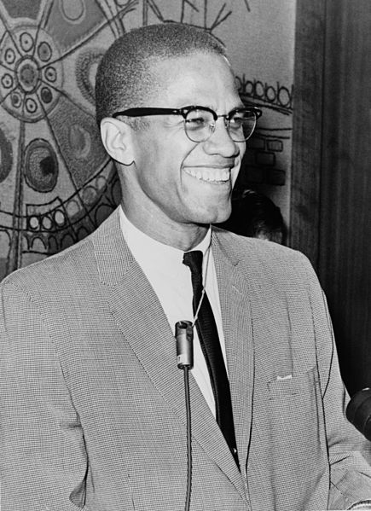
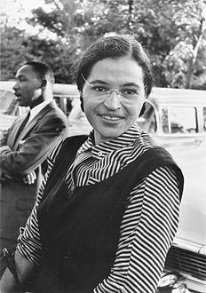
Period 8 Key People
Civil Rights:
Rosa Parks - Montgomery Bus Boycott
MLK, Jr. - Bus Boycott, March on Washington
Emmett Till - black teenager that was brutally murdered in the South
Little Rock Nine - 9 black students that went to Little Rock High School after it was desegregated
Malcolm X - advocated black nationalism

Slide 16
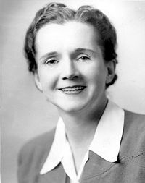
Period 8 Key People
Authors to Know:
Betty Friedan - The Feminine Mystique
Rachel Carson - Silent Spring
Misc. Period 8
Phyliss Schlafly - STOP E.R.A., sought to prevent the passage of the E.R.A.
Beat Generation (1950s) - criticized middle class consumerism
LBJ - Great Society, escalated the Vietnam War
Immigrants post-1965:
Overturned the quotas from 1920s; predominantly from Asia and Latin America

Slide 17
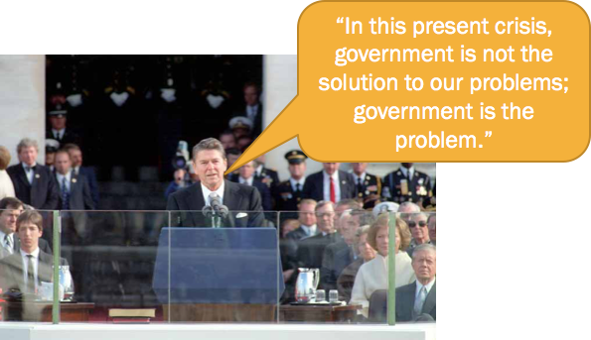
Period 9 Key People
Ronald Reagan:
Elected in 1980 - advocated a conservative government
Tax cuts, deregulation of industries, buildup of the military
Mikhail Gorbachev - Leader of the Soviet Union, instituted Glasnost and Perestroika
“Don’t Ask, Don’t Tell” - banned openly gay individuals from serving in the military, overturned by President Obama

Slide 18
Period 9 Key People
Osama bin Laden - leader of Al Qaeda - orchestrated the attacks on September 11, 2001
Led to the war in Afghanistan
Saddam Hussein - leader of Iraq
Suspected of having WMD’s - led to war in Iraq

Slide 19
That’s it. Thanks for watching!
Best of luck on your exams
Check out other videos in the description

