Slide 1

APUSH Review: Key Terms, People, and Events SPECIFICALLY Mentioned In The New Curriculum!
Shoutout time: Shoutout to YOU for watching. Thanks for the support!
Part 1: 1491 - 1877
Periods 1 - 5 (50% of the New Curriculum)
If it’s BOLD, KNOW it! Check out videos in the description

Slide 2
Period 1 Overview (1491 - 1607)
Test structure:
  Period 1 is roughly 5% of the exam:
  You will NOT see an essay exclusively on this period
    You could see a topic that incorporates this period as part of a broader idea
      For example - Experiences of European countries in America
Why was 1491 - 1607 chosen for the dates?
  1491 = 1 year prior to European contact
  1607 = first permanent English settlement - Jamestown
  Much of the focus of this period is on Native life PRIOR to contact, and interactions between Natives, Africans, and Europeans (Columbian Exchange)

Slide 3
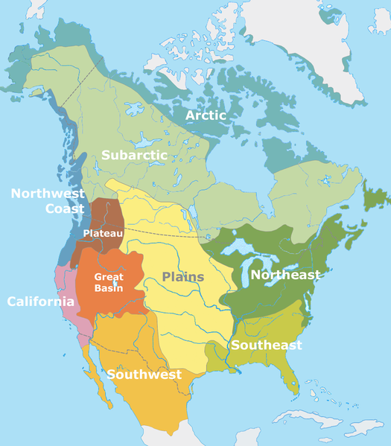

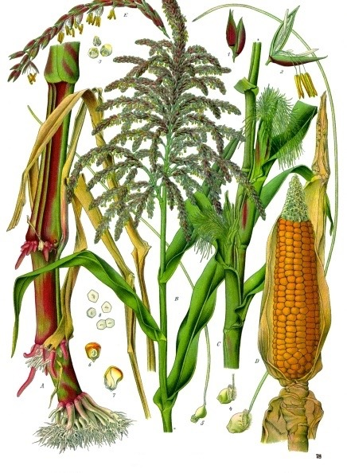
Period 1: 1491 - 1607
Maize - corn, grown by Natives in the SW US and Mexico
Great Plains and Great Basin - lack of resources, led to nomadic lifestyles
Columbian Exchange - exchange of goods, ideas, diseases, and people between Europe, Africa, and the Americas
  Impact on Americas - diseases impacted Natives, guns and horses transformed Native life, racially mixed populations (Mestizos)
  Impact on Europe - potatoes and maize led to large population growth, increase in capitalism
  Impact on Africa - Slave trade - Middle Passage (Spanish and Portuguese in West Africa)

Slide 4
Period 1: 1491 - 1607
Encomienda System - royal grants of land by the Spanish Crown to settlers
  Settlers promised to Christianize Natives
  Eventually was replaced with African slave labor
Autonomy - independence, self-rule
  Africans and Natives sought to preserve their autonomy after contact with Europeans

Slide 5
Period 2 Overview (1607 - 1754)
Test structure:
  Period 2 is roughly 10% of the exam:
  Essay topics could include:
    Comparing and Contrasting European powers
    Characteristics of British colonies
Why was 1607 - 1754 chosen for the dates?
  1607 = first permanent English settlement - Jamestown
  1754 = Beginning of the Seven Years War
  This time period continues to focus on European colonization, with England representing a significant amount of focus

Slide 6
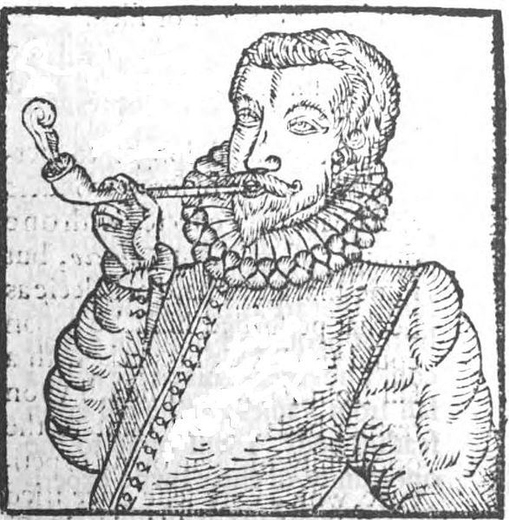
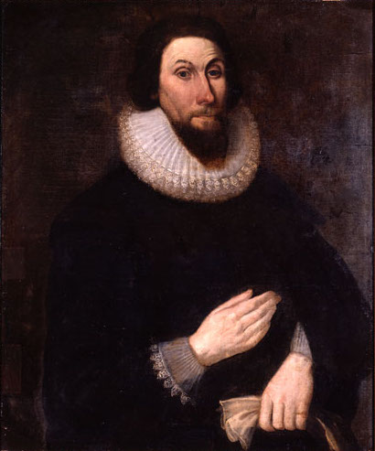
Period 2: 1607 - 1754
New England Colonies:
  Established by Puritans - like-minded community, mix of agriculture and commerce
Middle Colonies:
  Cereal crops - religiously, demographically, and ethnically diverse
Chesapeake Colonies: (Maryland and Virginia)
  Grew tobacco
  Relied on indentured servants, and later African slaves
Southern Colonies and West Indies:
  Grew staple crops (sugar), heavy use of slave labor
  Africans made up a majority of the population in some areas

Slide 7
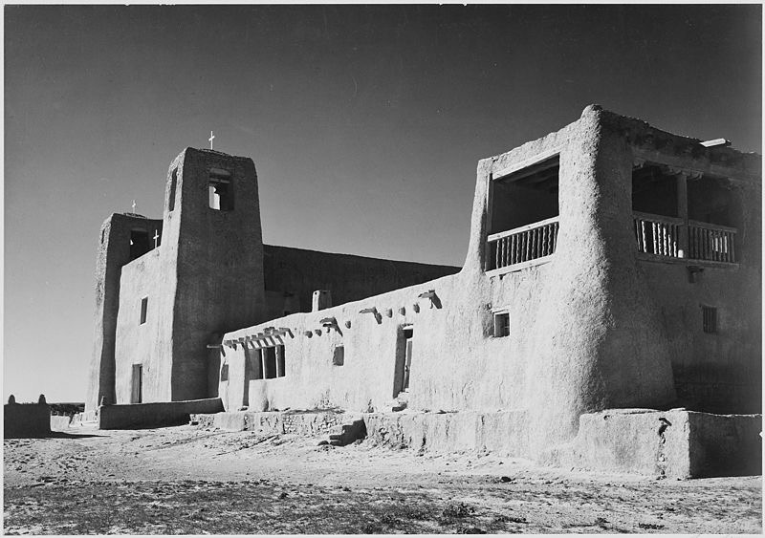
Period 2: 1607 - 1754
Pueblo Revolt:
  Native American rebellion in SW portion of US
  Spanish sought to end Native practices that were inconsistent with Christianity
  The Pueblos rebelled, expelled Spanish for over 10 years
  Eventually, the Spanish regained control, began to advocate the religious assimilation of Natives
Anglicization of the British Colonies:
  Process of colonies “becoming” or taking on British characteristics
  Seen through: trans-Atlantic print culture, commercial ties, etc.

Slide 8
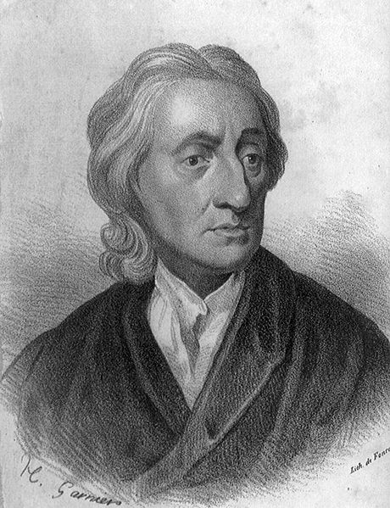
Period 2: 1607 - 1754
Enlightenment:
  Focus on reason and intelligence
  Individuals began to question forms of government
    Montesquieu - Separation or Powers, Locke - Consent of the Governed
Mercantilism:
  Goal is to make $ for the mother country
  Positive balance of trade that favors the mother country

Slide 9
Period 3 Overview (1754 - 1800)
Test structure:
  Period 3 is roughly 12% of the exam:
  Essays could be on The 7 Years War as a turning point, the American Revolution, Comparing and Contrasting the Articles and Constitution
Why was 1754 - 1800 chosen for the dates?
  1754 = Beginning of the Seven Years War
  1800 = Jefferson’s election
  This time period focuses on the shift in the relationship between the British and the Colonists, which culminates in the American Revolution
  Additionally, the structure of American government is a focus with the Articles of Confederation and Constitution

Slide 10
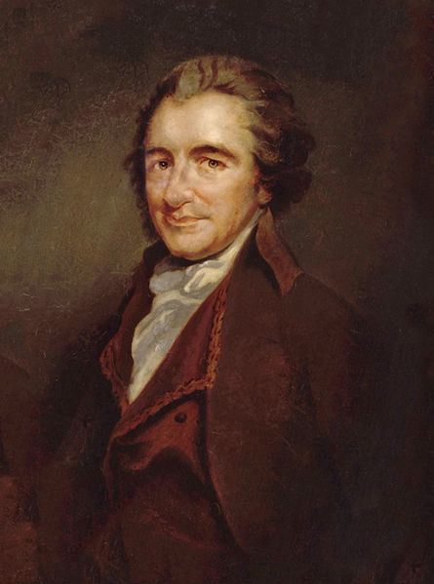
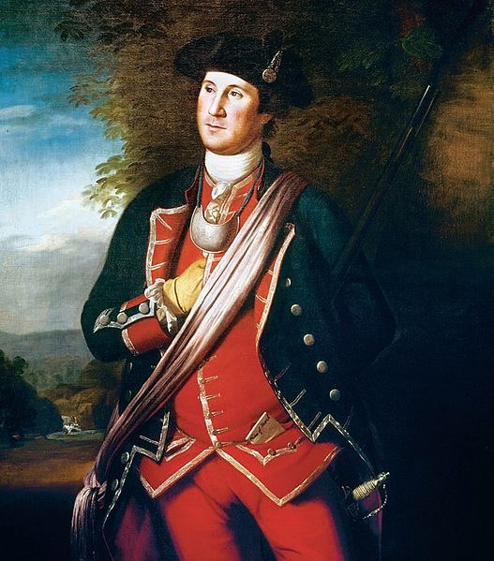
Period 3: 1754 - 1800
Seven Years’ War:
  Fought between the British/colonists and the French/Natives
  Britain won, France is removed from North America
  WATERSHED event - Britain ends salutary neglect, begins to tax colonies -> colonial resistance
    Be able to identify/explain two new taxes, and the colonists’ response
      Stamp Act -> Stamp Act Congress -> Repeal of Stamp Act -> Declaratory Act
T-Paine’s Common Sense:
  Enlightenment thinker, urged the colonists to break away from Great Britain

Slide 11
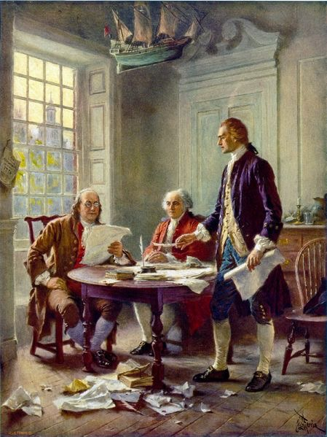
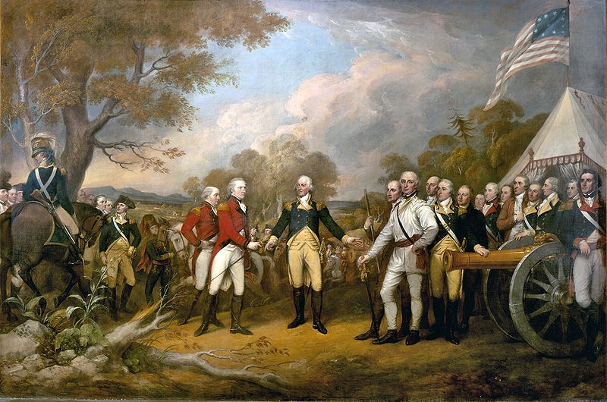
Period 3: 1754 - 1800
Declaration of Independence:
  Written by Jefferson, Adams, and Franklin, inspired by Common Sense and Enlightenment thinkers (Locke)
  List of grievances against KG3
Colonial War for Independence:
  US won in spite of: loyalist opposition, military and financial advantages by Great Britain; because of - support from Europe (France), ideological commitment

Slide 12
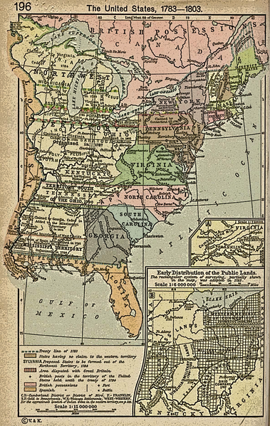
Period 3: 1754 - 1800
Articles of Confederation:
  Created a very weak central government:
    Could not tax, no national military, 9 out of 13 states to pass laws, all 13 required to amend Articles
Northwest Land Ordinance:
  Process for admitting states into the Union (60,000 inhabitants)
  Outlawed slavery in the Northwest Territory
  Established public education

Slide 13
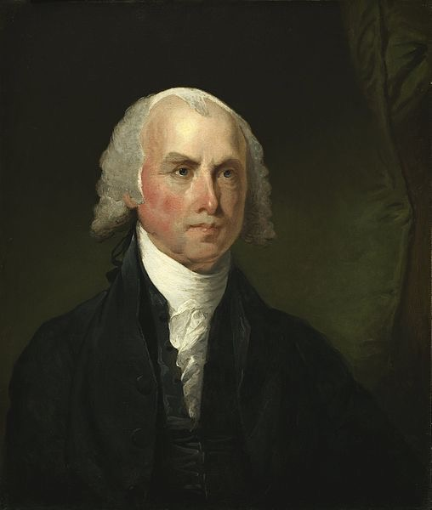
Period 3: 1754 - 1800
Constitution:
  Based on Federalism and Separation of Powers
    Prevents one branch/ level of government from abusing its power
  Series of Compromises with limits on national powers
    Great Compromise - established a bicameral legislature, one house based on population, one had equal representation per state (Senate)
    3/5 Compromise - 60% of slaves would count as population towards representation
    Slave Trade Compromise - outlawed the international slave trade after 1808
  The Constitution did not deal with slavery - postponed a solution to the problems of slavery
Bill of Rights:
  Added AFTER the Constitutional Convention
  Guarantees rights - satisfied the Anti-federalists to ratify the Constitution

Slide 14
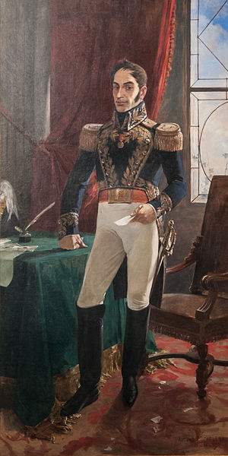
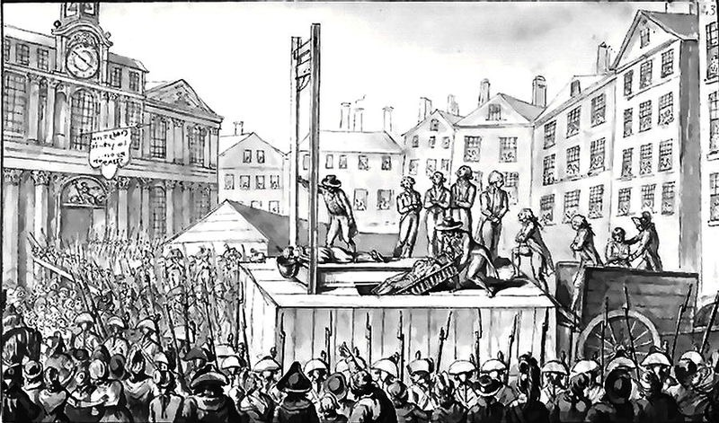
Period 3: 1754 - 1800
Impact of the ideals of the Declaration of Independence and American Revolution?
French Revolution:
  Inspired by Enlightenment ideas as well
  Helped lead to divisions between Jefferson and Hamilton
Haiti and Latin America experienced rebellions as well

Slide 15
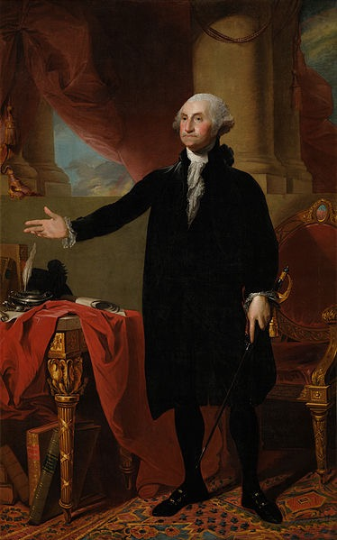
Period 3: 1754 - 1800
Thanks for listening to me America
George Washington’s Farewell Address warned against:
  Foreign Alliances
  Political Parties
Tensions with Britain and France helped lead to political parties
After WWII (Period 8), the US entered into peace time alliances

Slide 16
Period 3: 1754 - 1800
“Republican Motherhood”
  Encouraged women to raise children and instill republican values in their families
  Women gained more access to education

Slide 17
Period 4 Overview (1800 - 1848)
Test structure:
  Period 4 is roughly 10% of the exam:
  Essay topics could include:
    Reform movements inspired by the 2nd Great Awakening
    Westward Expansion and impact on slavery
    Impact of Market Revolution on regions of the US
Why was 1800 - 1848 chosen for the dates?
  1800 = Jefferson’s election
  1848 = Seneca Falls Convention - Women’s Rights Convention
  This time period focuses on the Market Revolution, the increase in democracy, and several reforms inspired by the Second Great Awakening

Slide 18
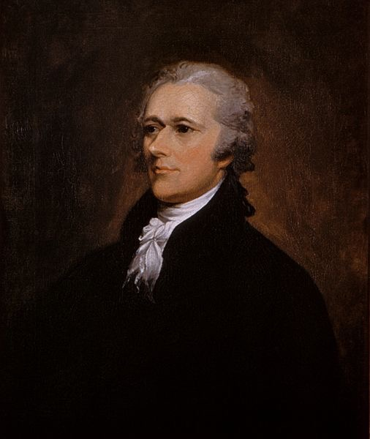
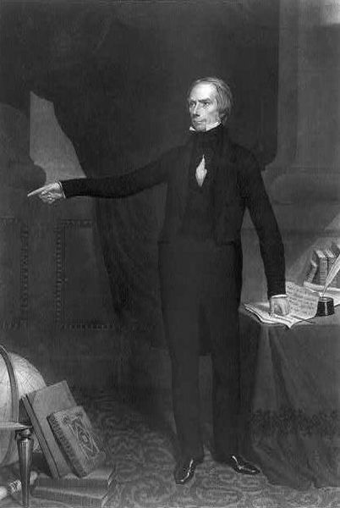
Period 4: 1800 - 1848
I Love
trading with Britain!
Federalists and Democratic-Republicans:
  First political parties, formed in response to Hamilton’s Financial Plan, French Revolution
  Federalists tended to be upper-class, advocate a loose interpretation of the Constitution, were pro-British (trade), favored merchants, and liked the BUS
  Democratic-Republicans tended to be commoners - middle-class, advocate a strict interpretation (pre LA Purchase), were pro-French (Rev. War), favored farmers, and disliked the BUS
Democrats and Whigs:
  2nd Party System - Whigs were formed in response to “King Andrew I”
  Democrats tended to be the party of the “Common Man”, favored universal, white male suffrage, Spoils System, wanted to lower tariffs
  Whigs tended to favor tariffs, a strong Congress, BUS, and internal improvements

Slide 19
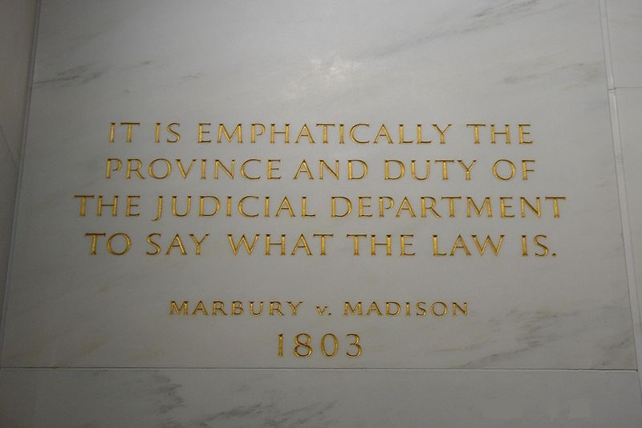
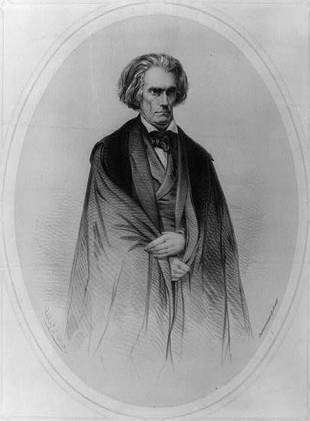
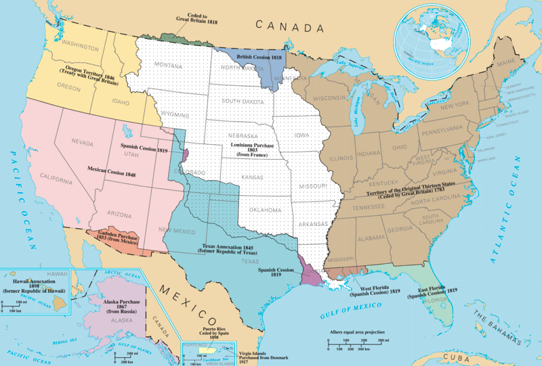
Period 4: 1800 - 1848
Louisiana Purchase: Beginning of Manifest Destiny
  Doubled the size of the US
  Jefferson switched from strict to loose interpretation
The Supreme Court in the early 19th Century:
  Helped assert federal power over state laws and determined the meaning of the Constitution
  Gibbons v. Ogden - Supreme Court ruled that the federal government, NOT states controlled interstate trade
Slavery:
  Defended in the South, seen as a “positive good”
Second Great Awakening
  Inspired many to achieve perfection
  Focused on secular reforms, especially abolitionism and women’s rights - Seneca Falls
Xenophobia - fear of foreigners (similar to nativism)

Slide 20
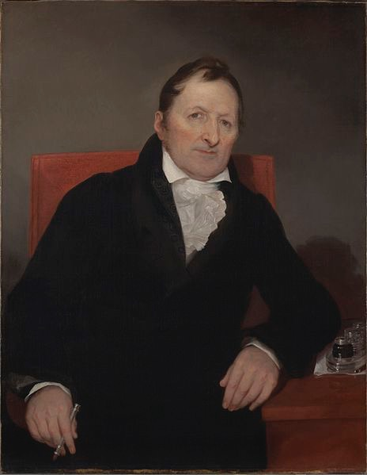
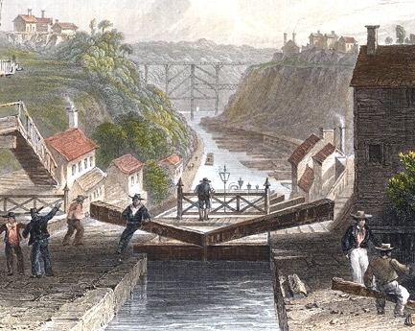
Period 4: 1800 - 1848
Textile Machinery - spinning Jenny
Steam engines - allowed boats to go AGAINST the current
Interchangeable Parts - Eli Whitney - increased production of goods
Canals - Erie, increase in shipping
Railroads - especially in the 1840s, faster shipment of goods and people
Telegraph - spread of information more quickly
Agricultural Inventions - steel plow, McCormick reaper

Slide 21
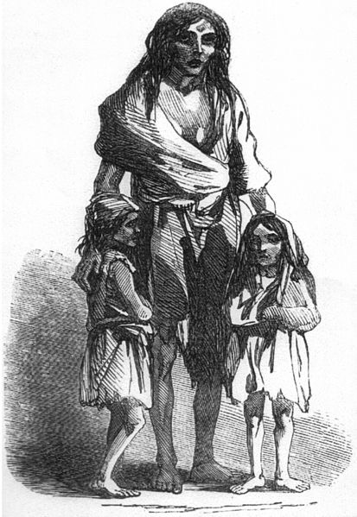
Period 4: 1800 - 1848
American System:
  Henry Clay!’s system, sought to unify the national economy
  3 parts: Bank of US, Tariffs which would fund, internal improvements
  Connected the North and Midwest more than the South
Migrants from Europe:
  Irish settled in cities, Germans on the frontier as farmers
  Settled in the East and Midwest
  Led to interdependence between the Northeast and Old Northwest
Market Revolution:
  Transformation in how goods were produced - more outside the home; an increase in technology and transportation as well

Slide 22
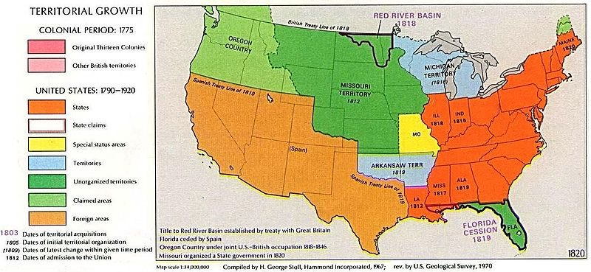
Period 4: 1800 - 1848
National Bank, Tariffs, and Internal Improvements
  Major political issues, regional interests trumped national concerns
Federal government attempts to assert authority over states brought resistance
  Hartford Convention, Nullification Crisis
Missouri Compromise (Compromise of 1820)
  Tallmadge Amendment - Never passed; proposed the gradual emancipation of slaves in MO
  3 parts: MO added as a slave state, ME added as a free state, 36°30’ - above free, below slave
    # of free and slave states were equal at 12
  Short-term solution, eventually, the Compromise broke down (Kansas-Nebraska Act, Dred Scott)

Slide 23
Period 5 Overview (1844 - 1877)
Test structure:
  Period 5 is roughly 13% of the exam
  Essay topics could include:
    Change and Continuity for African Americans
    The Civil War and Reconstruction as turning points
Why was 1844 - 1877 chosen for the dates?
  1844 = Election of James K. Polk
  1877 = End of Reconstruction
  This time period analyzes the causes for, and impacts of Manifest Destiny including tensions, the Civil War, and ultimately, the end of Reconstruction in 1877

Slide 24
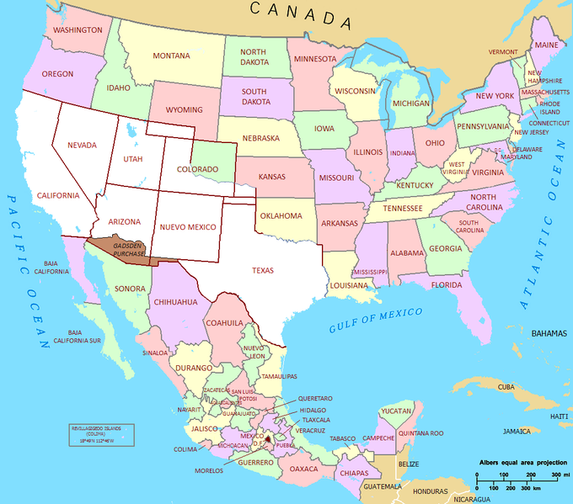
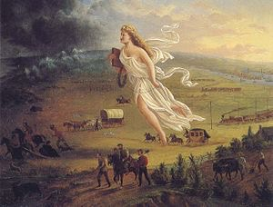
Period 5: 1844 - 1877
Manifest Destiny:
  Belief that it was the US’ God-given right to expand
  Built on a belief in white racial superiority and American cultural superiority
  Many political debates were focused on this issue:
    1844 election - Clay v. Polk
  Mexican-American War:
    US won, gained the Mexican Cession -> led to controversy over slavery in the territories
      Wilmot Proviso - proposed that slavery would be banned in al land gained from Mexican Cession

Slide 25
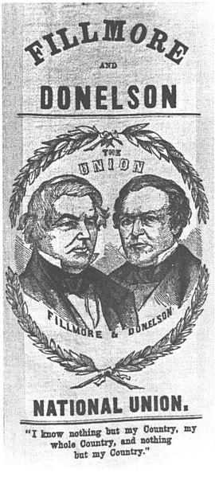
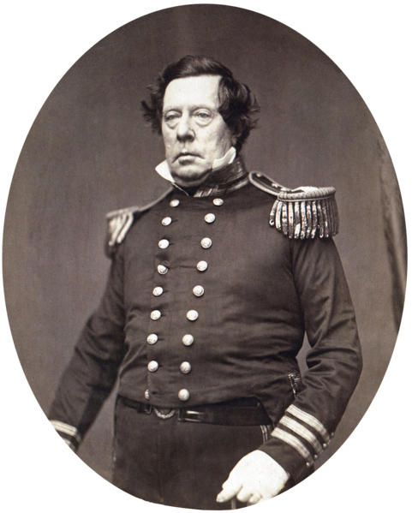
Period 5: 1844 - 1877
Asia:
  US sought to expand trade to other areas
  Matthew Perry in Japan
Influx of “Old immigrants” - prior to the Civil War, led to:
  A nativist movement
    Anti-Catholic
    Hoped to limit the power of the immigrants
      Know-Nothing Party

Slide 26
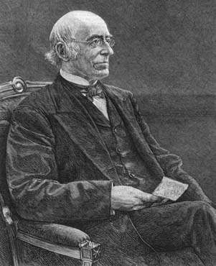
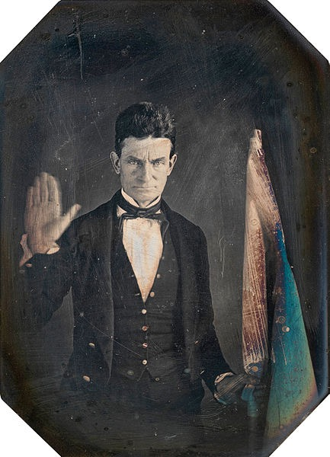
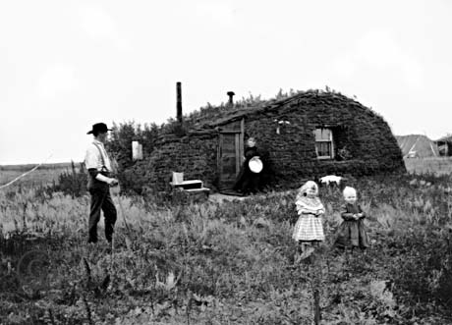
Period 5: 1844 - 1877
New legislation promoting national development
  During and after the Civil War
  Homestead Act - 160 acres of land - encouraged westward settlement
  Morill Land Grant - sold land and provided $ for colleges
Abolitionists:
  Small portion of the North, although were highly visible
  Used many methods against slavery, including:
    Fierce arguments - William Lloyd Garrison - The Liberator
    Helping slaves runaway - Underground RR
    Violence - John Brown
How was slavery defended in the South?
  As a “Positive Good” - John C. Calhoun
  Racist Stereotyping - “Jim Crow” Minstrel Shows

Slide 27
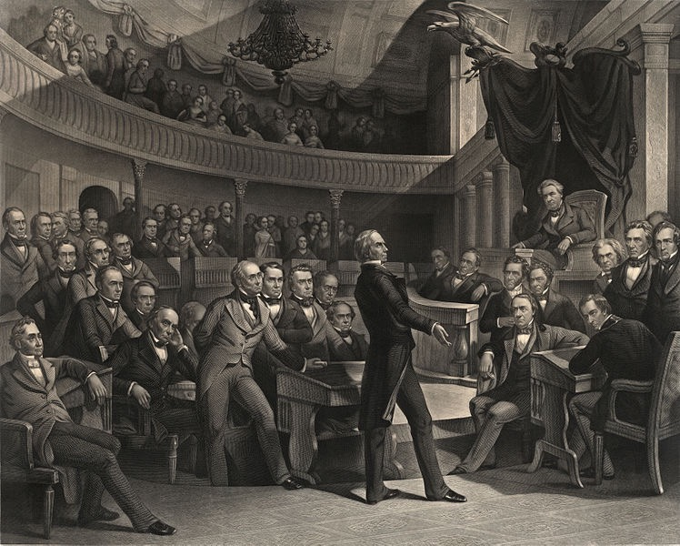
Period 5: 1844 - 1877
Proposals to resolve the issue of slavery:
  Compromise of 1850:
    Created to address the land from the Mexican Cession
    The country was on the brink of war
    5 parts:
      Popular Sovereignty in Mexican Cession; a new, more strict Fugitive Slave Law; Slave trade in D.C. was abolished; California was admitted to the Union as a free state - tipped the balance in favor of free states; Texas was paid $ to give up claims to bordering states
    Impacts of Compromise?
      North detested the Fugitive Slave Law - helped increase the abolitionist movement and non-enforcement of the law (essentially nullification)

Slide 28
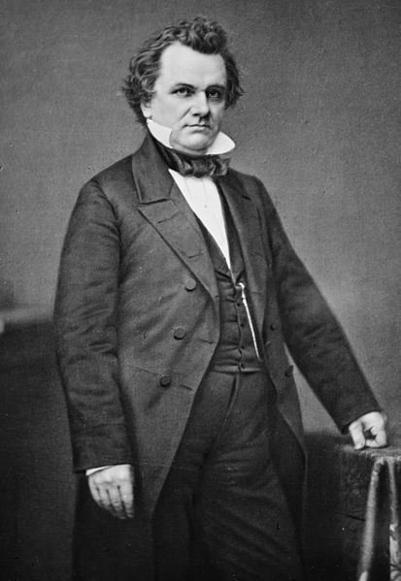
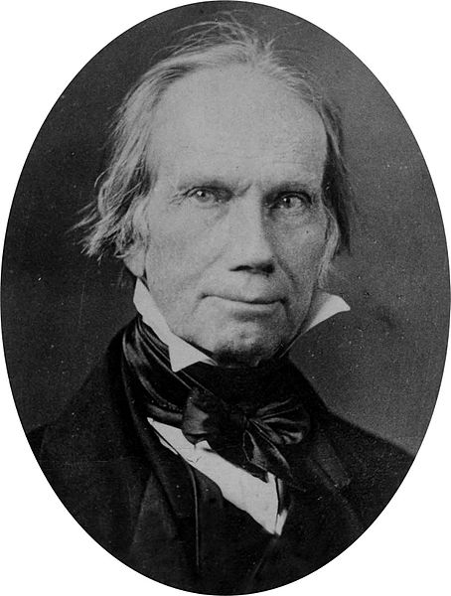
Period 5: 1844 - 1877
Proposals to resolve the issue of slavery:
  Kansas-Nebraska Act
    Steven Douglas (D-IL) sought to build a RR through the Nebraska territory
    He proposed this act, which would allow for popular sovereignty in Kansas and Nebraska
    The expectation was that Kansas would be slave, Nebraska would be free
    Overturned the Missouri Compromise of 1820
    Voters turn out in full force in Kansas -> “Bleeding Kansas”
Stephen, why are you overturning my compromise bro?

Slide 29
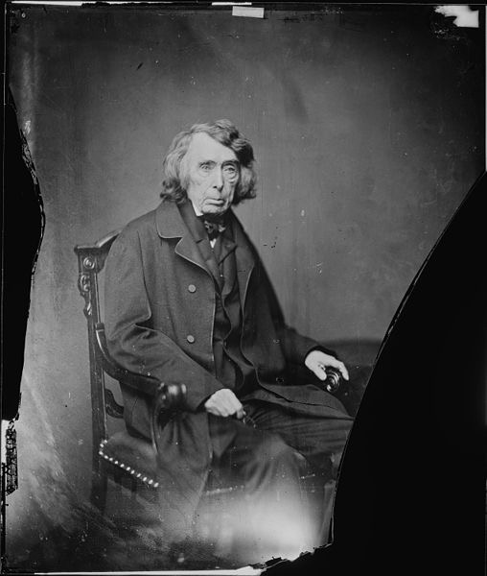
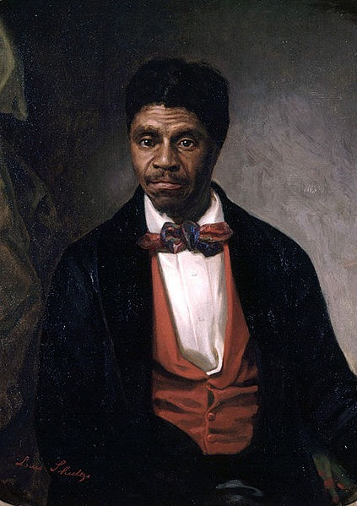
Period 5: 1844 - 1877
Proposals to resolve the issue of slavery:
  Dred Scott
    1857 Supreme Court Case that sought to settle the slavery question in territories
    The court ruled that:
      African Americans were not citizens and could not sue in court
      Slaves were property, could not be taken without “due process”
      The Missouri Compromise was unconstitutional and that Congress could not regulate slavery in the territories
    The North was furious, increased tensions between North and South

Slide 30
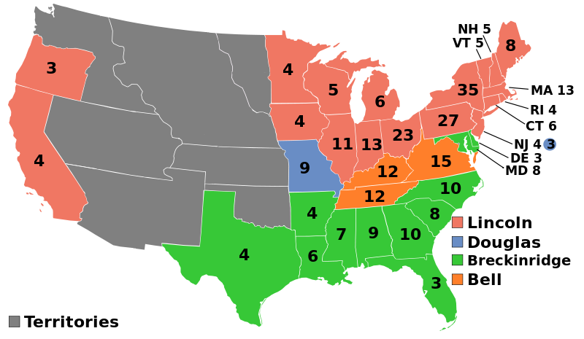
Period 5: 1844 - 1877
The Republican Party:
  Started as a sectional party in the North and Midwest
  Made up of many former Whigs
The Election of 1860:
  Lincoln ran on a free-soil platform
    This did not mean slavery would end, rather he opposed the extension of slavery
  Impact of this election?
    Immediate cause of Southern Secession, and ultimately the Civil War

Slide 31
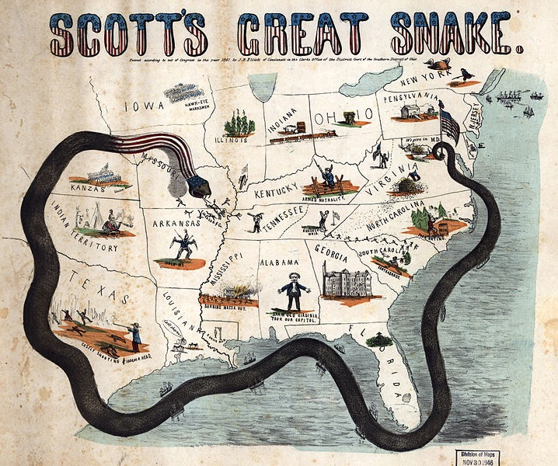
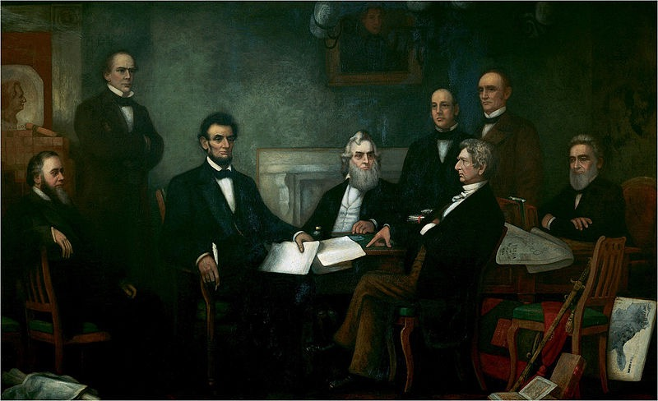
Period 5: 1844 - 1877
The Civil War:
  Emancipation Proclamation - freed slaves in areas of rebellion
    Impacts?
      Changed the purpose of the war
      Increase in black soldiers joining the military
      Helped keep Europe from aiding the South
    Could be compared with the Gettysburg Address, or the 13th Amendment
Why did the North win?
  Military Leadership (Grant and Sherman), Effective Strategies (Anaconda Plan, March to the Sea), Key Victories (Antietam), More resources and people

Slide 32
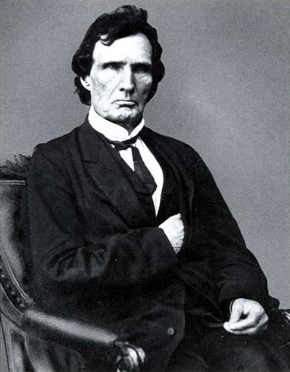
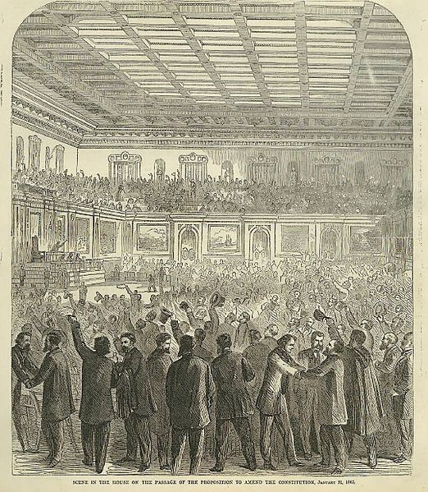
Period 5: 1844 - 1877
13th Amendment:
  1865, abolished slavery
  South tried to get around it with sharecropping:
    Freedmen worked on farms and exchanged labor for using land and housing
    Half of their crops were typically given to the land owner
    Sharecroppers had to borrow $ to get started
      Local stores gave loans at high rates (crop lien system)
Radical Republicans - Thaddeus Stevens, Charles Sumner
  Sought to increase power in the South and increase rights for African Americans
  They were not successful because:
    Reconstruction ended in the Compromise of 1877
    The North’s waning resolve to assist African Americans

Slide 33
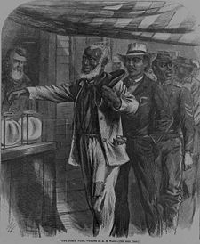
Period 5: 1844 - 1877
14th Amendment:
  Granted citizenship to African Americans and those born in the US
  Provided equal protection of the laws
15th Amendment:
  Provided suffrage for ALL adult males
Impact of these amendments on Women’s Rights Groups?
  They were split
  Some favored providing suffrage for blacks PRIOR to suffrage for women
  Others, did not support it unless women were granted suffrage as well

Slide 34
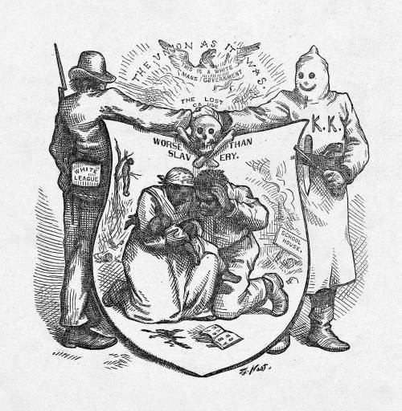
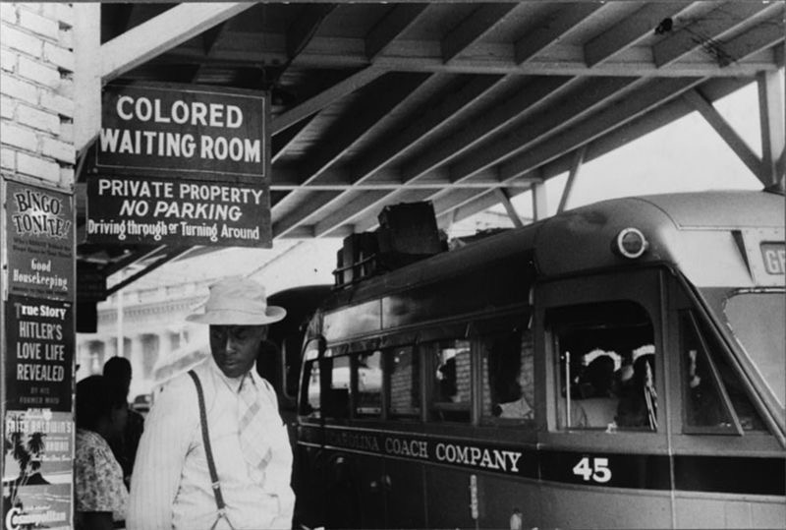
Period 5: 1844 - 1877
Other impacts of the amendments?
  Rights were stripped away from African Americans over time through:
    Segregation - Jim Crow (upheld by Supreme Court cases such as Plessy v. Ferguson’s “separate but equal”)
    Violence - KKK and the White League, lynching
    Local political tactics - poll taxes, literacy tests, grandfather clauses
  In the future (Period 8), these amendments will be used to uphold civil rights

Slide 35
See You Back Here For Part 2 (Periods 6 - 9)!
Please don’t forget me after APUSH
Thanks for watching!
If it’s BOLD, KNOW IT
Check out my Part 2 video
Good luck on the exam, you’ll do great!

