Slide 1
APUSH Review: Supreme Court Cases In The New Curriculum
Shoutout time: Mr. Armstrong’s class at Cerritos High School,
Everything You Need To Know About Supreme Court Cases In The APUSH Curriculum To Succeed In APUSH

Slide 2
The Court In The Early 19th Century
Key Concept 4.1, I, B:
“Supreme Court decisions established the primacy of the judiciary in determining the meaning of the Constitution and asserted that federal laws took precedence over state laws.”
What court case established the “primacy of the judiciary….”?
Marbury v. Madison - established Judicial Review
Supreme Court can declare a law unconstitutional

Slide 3
The Court In The Early 19th Century
Key Concept 4.1, I, B:
“Supreme Court decisions established the primacy of the judiciary in determining the meaning of the Constitution and asserted that federal laws took precedence over state laws.”
What court cases “asserted that federal laws took precedence over state laws”?
Gibbons v. Ogden - Congress has sole control over INTERstate trade, not states
McCulloch v. Maryland - BUS is constitutional, states CANNOT tax federal agencies

Slide 4
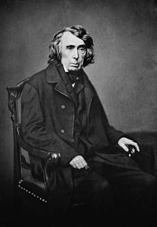
The Court In The Early 19th Century
Key Concept 4.2, I, C:
“Legislative and judicial systems supported the development of roads, canals, and railroads…….”
What court case supports this statement?
Charles River Bridge (1837)
Contracts could be altered to benefit the general welfare
Charles River Bridge company lost its monopoly on the Charles River

Slide 5
**Dred Scott** (Specifically Mentioned)
Key Concept 5.2, II, B:
“The courts and national leaders made a variety of attempts to resolve the issue of slavery in the territories…….. Dred Scott decision, but ultimately failed to reduce conflict”
What was the impact of the Dred Scott decision?
Declared that ALL African Americans were NOT citizens
Slaves were deemed property, could not be taken away
Congress could NOT legislate slavery in the territories - Missouri Compromise was unconstitutional
Split the Democratic Party along sectional lines (N/S)

Slide 6
The Court In The Late 19th Century
Key Concept 5.3, II, E:
“Segregation, violence, Supreme Court decisions…… stripped away African American rights…..”
What court case supports this statement?
Civil Rights Cases (1883):
Congress could NOT outlaw racial discrimination by private individuals and/or groups

Slide 7
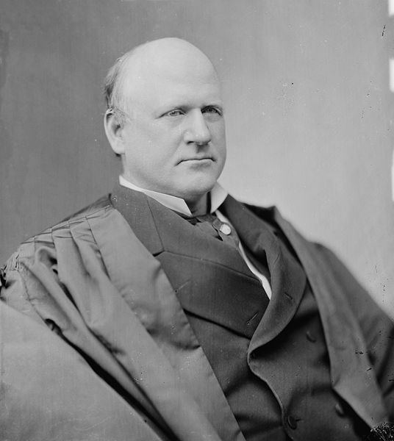
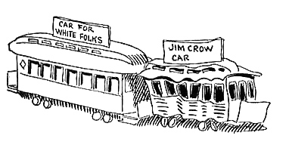
***Plessy v. Ferguson*** (Specifically Mentioned)
Key Concept 6.3, II, C:
“The Supreme Court decision in Plessy v. Ferguson that upheld racial segregation helped to mark the end of most of the political gains African Americans made during Reconstruction.”
What was the impact of this court case?
“Separate but equal”
The South focused on separate - facilities were never equal
Later overturned by Brown v. Board

Slide 8
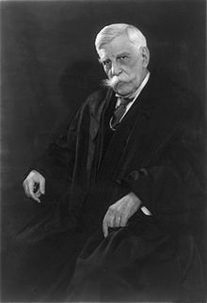
The Supreme Court and the WWI
Key Concept 7.2, I, C:
“Official restrictions on freedom of speech grew during WWI.”
What court case support this statement?
Schenck v. US:
“Clear and present danger”
During times of war and crisis, civil liberties decrease (connect to Lincoln’s suspension of habeas corpus during the Civil War)
Upheld the Espionage Act

Slide 9
The Supreme Court and the New Deal
Key Concept 7.1, III, B:
“… While conservatives in Congress and the Supreme Court sought to limit the New Deal’s scope.”
What court cases support this statement?
Butler v. US:
Declared the AAA unconstitutional
Schechter Poultry v. US:
Declared the NIRA unconstitutional
As a result, FDR proposed the Court Packing Plan, but the never had the support to create it

Slide 10
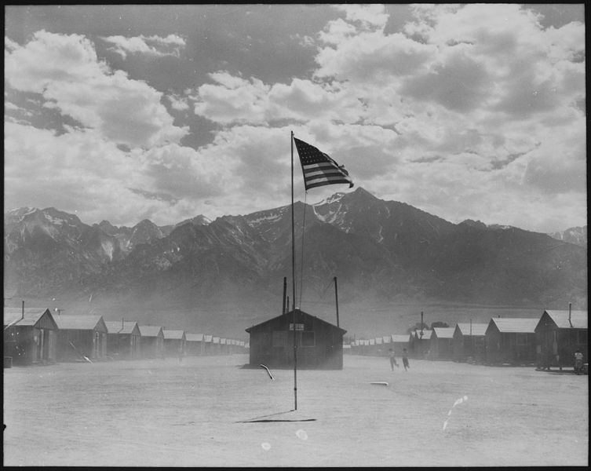
WWII and the Supreme Court
Key Concept 7.3, III, C:
“Wartime experiences also generated challenges to civil liberties, such as the internment of Japanese Americans”
What court cases support this statement?
Korematsu v. US
Upheld the legality of FDR’s executive order of Japanese internment
Fear of subversion
No evidence of ANY people interred were spying
Impact of court case?
During times of war, rights decrease

Slide 11
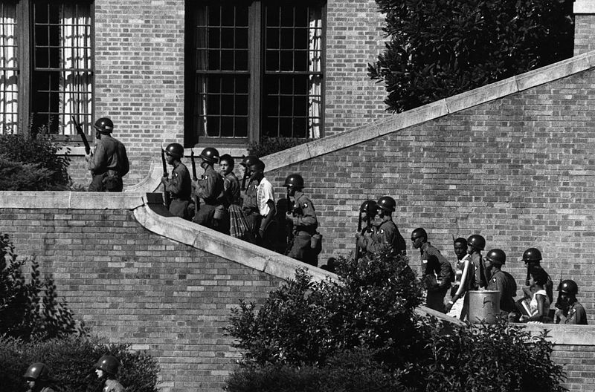
***Brown v. Board*** (Specifically Mentioned)
Key Concept 8.2, I, B:
“The three branches of the federal government used measures including desegregation of the armed services, Brown v. Board of Education… to promote greater racial equality”
What did Brown v. Board do?
Declared school segregation unconstitutional
Used the 14th amendment to support this
What was the impact?
Milestone in the Civil Rights Movement
Led to Southern resistance - Southern Manifesto, Little Rock 9, Massive Resistance

Slide 12
The Supreme Court During the 1960s (Great Society)
Key Concept 8.2, III, B:
“….. A series of Supreme Court decisions expanded civil rights and individual liberties”
What court cases support this statement?
Miranda v. Arizona:
People must have rights read to them at time of arrest (attorney, remain silent - 5th amendment)
Escobedo v. Illinois:
Right to an attorney at time of arrest
Tinker v. Des Moines
Students can wear black armbands as a sign of protest - free speech

Slide 13
Test Tips
Multiple-Choice and Short Answer:
If it is specifically mentioned, know the details of the case
Be able to provide examples of cases that support the statements made in the curriculum
DBQ and Essays:
Likely part of a larger theme - Civil Rights

Slide 14
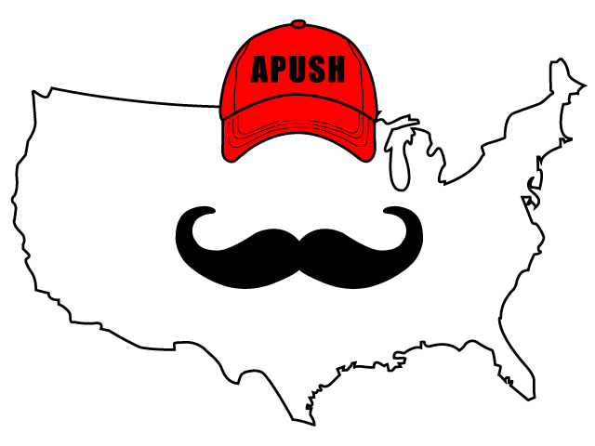
Thanks For Watching!
Best of luck on all your exams
Check out other review videos in the description

