Slide 1

APUSH Review: Give Me Liberty!, Chapter 9, 4th Edition
The “Common Man”
Missouri Compromise
“Corrupt” Bargain
Election of 1824
Please check out the description for additional videos related to this chapter and other resources!
Nullification Crisis
Bank War
Indian Removal Act
Democrats vs. Whigs

Slide 2

The Triumph Of Democracy
Jackson’s inauguration
Seen as the “Common Man”
Property and Democracy
States 14 onward had property requirements for voting
By the Civil War, only one state had property requirements
The Dorr War
Citizens in RI drafted a new state Constitution - chose Thomas Dorr as the new governor
  Although Dorr was arrested for treason, there was a push to end property requirements for voting

Slide 3
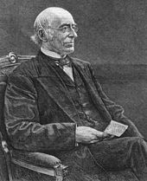
The Triumph Of Democracy
Tocqueville On Democracy
1840 - 90% of white males could vote
Alexis de Tocqueville - French writer that traveled in America in the 1830s
  Wrote that America had a unique identity
Even though the US saw expanding democracy, the Constitution limited the impact of American voters (Supreme Court, Senate, Electoral College)
Individual states set requirements for voting -> lead to issues after the Civil War
The Information Revolution
US had more newspapers read than all of Europe!
New newspapers with specific audiences:
  Freedom’s Journal - black newspaper
  The Liberator - called for the IMMEDIATE and UNCOMPENSATED end to slavery
  Cherokee Phoenix - Native American newspaper

Slide 4
The Triumph Of Democracy
The Limits of Democracy
Although democracy increased for white males and male immigrants, women and blacks faced many obstacles
Justification for limiting democracy to only white males?
  Blacks were seen as inferior, women had different roles - “cult of domesticity”
With the 19th amendment and Voting Rights Act of 1965 increased suffrage for women and African Americans
A Racial Democracy
Race, more than social class, divided America
Minstrel Shows:
  White actors portrayed African Americans in racist, stereotypical ways (“Jim Crow”)
Race and Class
1821 - NY eliminated property requirements for whites, required $250 in property for blacks
Blacks increasingly became disenfranchised in several states
Blacks also lost the ability to serve in the military, sue in court, etc.

Slide 5
Nationalism And Its Discontents
No Improvements For You!
The American System (Video in Description)
Original Bank of the US (BUS) expired in 1811, roads were primitive in early 19th century
Politicians like Henry Clay sought to improve the infrastructure (help the South and West) and protect new American industries
American System (3 Parts):
  BUS (1816), Infrastructure, and Tariffs (1816)
  Debates over funding for infrastructure - James Madison vetoed a bill to provide funding
Regional concerns often overshadowed national concerns during this time
Banks and Money
2nd BUS, like the 1st, was a private corporation
Provided loans to farmers, businesses, and purchase of land
Many state banks printed $ and the value fluctuated - BUS was intended to limit this
The Panic of 1819
BUS was part of land speculation (buying land in hopes of selling it at a higher price)
1819 - Panic - many banks began calling in loans - many farmers could not pay, lost their land

Slide 6
Nationalism And Its Discontents
The Politics of the Panic
Many Americans began to distrust banks, particularly the BUS
McCulloch v. Maryland (1819) - Supreme Court case that established the constitutionality of the BUS; established federal supremacy over states
The Missouri Compromise (See video in description)
Era of Good Feelings - term for Monroe’s presidency - 1 political party
3 Parts - MO added as a slave state, ME added as a free state, 36°30′ - above free, below slave, in LA Purchase Territory
  Tallmadge Amendment - never passed, would provide for gradual emancipation of slaves - blocked by the South
The Slavery Question
Jefferson detested the MO Compromise
Northerns wanted to keep slavery out of MO - limit the power of the South

Slide 7
Nation, Section, And Party
The US and the Latin American Wars of Independence
Monroe administration recognized new Latin American countries
Arguments used by Latin America was similar to the D.O.I.
Indians and free blacks were able to vote in many countries
The Monroe Doctrine
3 Parts:
  Europe could not colonize any new areas of Latin America
  US would stay out of European affairs
  Europe could not interfere with new nations
The Election of 1824
“Corrupt Bargain” - see video
No candidate received an electoral majority - thrown to House of Reps
Henry Clay threw support behind JQA, even though Jackson had most popular votes

Slide 8
Nation, Section, And Party
The Nationalism of John Quincy Adams
JQA supported the American System - Henry Clay was Secretary of State
As Secretary of State, JQA helped US purchase FL (Adams-Onis treaty of 1819)
“Liberty is Power”
Sought to promote agriculture, commerce, and manufacturing - took a loose interpretation of the Constitution
Increased tariff rates in 1828
Martin Van Buren and the Democratic Party
Senator from NY, helped create a party “machine”
Saw parties not as divisive, but as a way to unite individuals and increase involvement in government
The Election of 1828
Democratic Party created local and state parties - newspapers aided their cause
Election of 1828 - Adams v. Jackson
  Mudslinging - Jackson wins, higher voter turnout

Slide 9
The Age Of Jackson
The Party System
Parties rewarded supporters with jobs (“Spoils System,” “Rotation in Office”)
Newspapers played a LARGE role in politics
Democrats and Whigs
Issues that divided the parties - banks, tariffs, internal improvements (essentially the American System)
Democrats - favored a hands-off approach by the government, supported by farmers, city workers, laborers, etc.
Whigs - advocated the American System, supported by businesses and banks, farmers that benefitted from internal improvements
Public and Private Freedom
Democrats feared a strong central government
Under Jackson, the following occurred:
  Lowered tariffs, end of the BUS, decreased aid for internal improvements, no national debt!

Slide 10
The Age Of Jackson
Politics and morality
Temperance — favored by Whigs not Democrats; immigrants tended to supported Democrats
Whigs believed government could increase freedom
During Jackson’s presidency, local governments banned prostitution and alcohol in many areas
South Carolina and Nullification
Tariff of 1828 was known as the Tariff of Abominations
  Argued it benefitted the North at the expense of the South
Fear that a strong government that could impose tariffs could one day end slavery
Calhoun’s Political Theory
South Carolina Exposition and Protest - written anonymously by VP Calhoun - drew inspiration from VA and KY Resolutions
  Justified nullification
Daniel Webster - Senator from NE, argued in favor of the national government

Slide 11
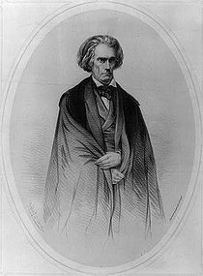
The Age Of Jackson
The Nullification Crisis
Calhoun argued for nullification, not disunion
Jackson viewed it as disunion
Tariff of 1832 - lowered tariff rates, still too high for the South’s liking
Tariff of 1833 - compromise tariff, lowered rates by 10% per year for 8 years
Force Bill - allowed the president to collect tariff using the military if necessary
Indian Removal
Many Americans sought to expand west - where Natives were living
Indian Removal Act - would force Natives to move west of the Mississippi
Jackson viewed Natives as “savages”
The Supreme Court and the Indians
Cherokee Nation v. Georgia - Court ruled Natives were NOT citizens, could not sue in court
Worcester v. Georgia - Court ruled Natives could not be forced to move, Jackson refused to enforce the decision
Trail of Tears - 18,000 Natives forced to move, 1/4 died on the way
William Apess - wrote A Son of the Forrest - called for harmony among whites and Natives

Slide 12
The Bank War And After
Biddle’s Bank (Video in Description)
Jackson, a “hard-money” advocate, distrusted banks, especially the BUS
Nicholas Biddle - president of the BUS
BUS charter of 1832 - passed by Congress to be a referendum on the election of 1832
  Jackson vetoed the bill; seen by some as overstepping his power
The Pet Banks and the Economy
Before the BUS expired in 1836, Jackson removed all government funds and placed them in state “pet” banks
Roger B. Taney - Jackson’s Treasury Secretary, later Chief Justice
The Panic of 1837
Specie Circular - government required all land to be purchased in gold and silver
Panic of 1837 led to a decrease in wages, high unemployment, and loss of land for many Americans

Slide 13
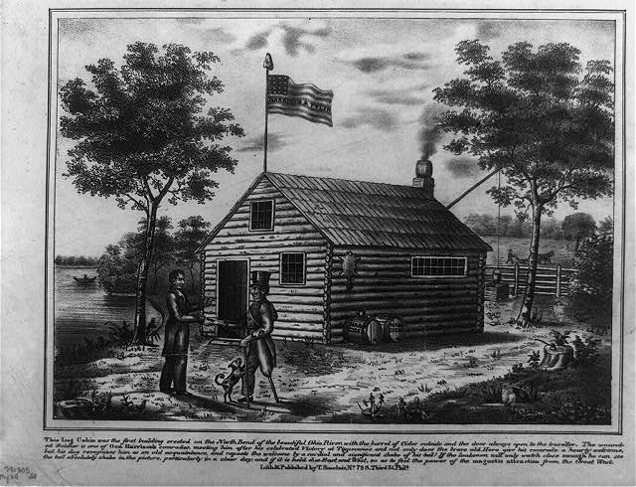
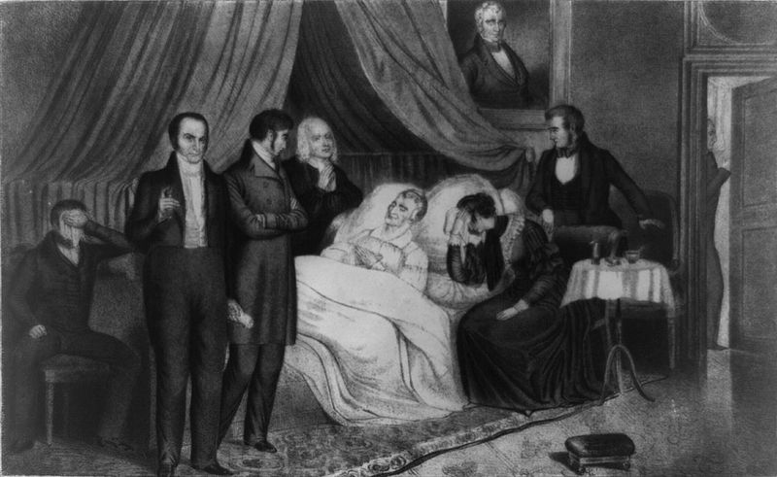
The Bank War And After
Van Buren in Office
Government removed its money from state banks, held it in the Treasury Department
Independent Treasury - federal $ separated from banks
The Election of 1840
William Henry Harrison (Whig) v. MVB
“Tippecanoe and Tyler Too,” “Log Cabins and Hard Cider”
Harrison, a War of 1812 hero like Jackson, won the election
Tyler, a former Democrat chosen to balance the ticket
His Accidency
Harrison dies 30 days into office
Tyler becomes president, vetoes Whig legislation, becomes a man without a party

Slide 14
Quick Recap
Property requirements
Minstrel shows
American System
Debates over tariffs, internal improvements, tariffs
Democrats
Whigs
Jackson’s presidency
Indian Removal Act
Nullification Crisis
Bank War

Slide 15
See You Back Here For Chapter 11!
Thanks for watching
Subscribe and share
Check out other videos in the description
Good luck in May!

