Slide 1
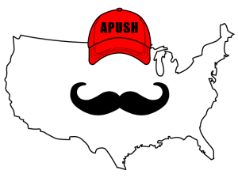
APUSH Review: Give Me Liberty!, Chapter 1, 4th Edition
Please check out the description for additional videos related to this chapter And Other Resources!

Slide 2
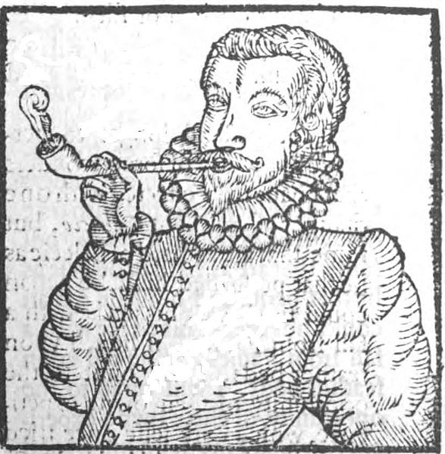

Global Competition and The Expansion of England’s Empire
The Mercantilist System
What is mercantilism?
  Colonies exist to benefit the mother country (England)
  Mother country would seek a positive trade balance (more gold and silver)
  Colonies provide raw materials and import goods
  Enumerated goods - goods that could only be traded on English ships (tobacco, sugar)
  Mercantilism was reinforced through the Navigation Acts
The Conquest of New Netherland
Royal African Company - monopoly of the slave trade
England gained New Netherland from the Dutch in 1664, became New York

Slide 3
Global Competition and The Expansion of England’s Empire
New York and the Rights of Englishmen and Englishwomen
Under English law, married women could not conduct business in their name and inherit property; this reversed Dutch law
Free blacks faced discrimination in New York City - couldn’t have skilled jobs
New York and the Indians
Covenant Chain - Agreement between England and Indians that benefitted both groups
  Iroquois Nation sided with the English in attacks on rival tribes in the New York area
  Iroquois later adapted a policy of neutrality

Slide 4
Global Competition and The Expansion of England’s Empire
The Charter of Liberties
Colonists began to demand “liberties of Englishmen,” including a say in taxation
Charter of Liberties and Privileges:
  Male property owners and freemen in NY could vote in elections every 3 years
  Included trial by jury, religious toleration for Protestants
The Founding of Carolina
Formed to check Spanish expansion in FL
Similar economics to Barbados - plantations
Colonists encouraged natives to attack Indians in Spanish controlled land
Fundamental Constitutions of Carolina:
  Elected assembly and religious toleration were created to attract immigrants
  Headright System of 150 acres!
Slavery became a key component of Carolina - rice

Slide 5
Global Competition and The Expansion of England’s Empire
The Holy Experiment
William Penn - proprietor
South to established religious toleration and peaceful relations with Natives
Pennsylvania was a refuge for Quakers
Elected Assembly was established that allowed suffrage for many and religious toleration
Quaker Liberty
Penn hoped to allow for equality for everyone, including women, blacks, blacks and Indians
  Quakers were against slavery
  Pacifists - positive relations with Natives
No established church in PA
Land in Pennsylvania
Immigrants from Western Europe flocked to PA - cheap land, religious toleration, and publicity
Fewer indentured servants went to nearby VA and MD - increased slavery in the Chesapeake

Slide 6
Origins of American Slavery
Englishmen and Africans
Like the Irish and Natives before, Africans were viewed negatively - “savages”
Race emerged in the 17th century
Anti-black stereotypes emerged - a continuity in pre-Civil War America
Slavery in History
Historically, slavery differed from slavery in the Americas, where:
  A single owner could own 100s or 1,000s of slaves
  Children of slaves became slaves as well
  Slavery was based on race

Slide 7
Origins of American Slavery
Slavery in the West Indies
Most slaves were sent to the West Indies and the Western Hemisphere
Reasons for the rise of slave labor in the West Indies:
  Plantation system - sugar
  Indentured servants refused to work
Slaves made up a majority of population -> strict slave codes
Slavery and the Law
Blacks could not serve in the VA militia
Poll taxes were established for African women

Slide 8
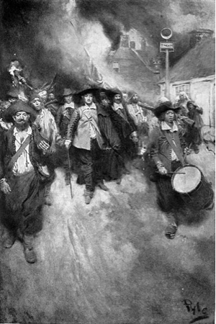
Origins of American Slavery
The Rise of Chesapeake Slavery
1662 VA law - slave status was based on the status of the mother
Religion did not alter a slave’s status
Bacon’s Rebellion: Land and Labor in Virginia
Tobacco led to expansion of farmland
  Some had little option but to farm on the frontier (Conflict with Natives)
  In the 1670s, many whites lived in poverty
Enter Bacon:
  Settlers sought protection from Natives, Governor Berkley refused
  Bacon and his followers sought: reduced taxes and removal of Natives

Slide 9
Origins of American Slavery
The End of the Rebellion, and its Consequences
Bacon and his followers burned Jamestown down
  Bacon became the temporary ruler, died shortly after
Aftermath:
  Property qualifications were brought back for voting
  Taxes were reduced
  Less reliance on indentured servants, more slaves
A Slave Society
1705 VA law - white supremacy was written into law; slaves were viewed as property
Blacks and whites had separate courts
Jamestown
Slavery =

Slide 10
Origins of American Slavery
Notions of Freedom
Slaves often ran away - advertisements in newspapers
VA changed its laws in the 1660s to avoid slaves claiming freedom

Slide 11
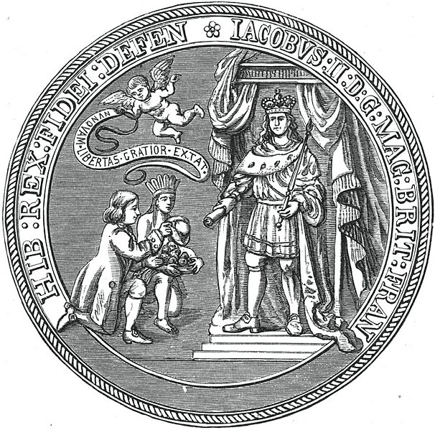
Colonies in Crisis
The Glorious Revolution
1688 - Parliament was established as supreme
William and Mary (Protestant) take over from James II
The revolution reinforced ideas of liberty for Englishmen
1689 - English Bill of Rights
The Glorious Revolution in America
Lords of Trade - established to supervise colonial affairs
MA charter was revoked in 1680s for violating Navigation Acts
Dominion of England:
  Combination of CT, Plymouth, MA, NH, RI, NY and Jersey
  Sir Edmund Andros was appointed ruler - very unpopular
    Imposed taxes without approval of colonial representatives

Slide 12
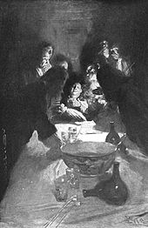
Colonies in Crisis
The Maryland Uprising
Andros was jailed in 1689 after news of the Glorious Revolution reached America
MD charter was revoked, and a Protestant-friendly government dominated MD
  Catholics couldn’t vote or hold office
Leisler’s Rebellion
Result of the impact of the Glorious Revolution and the fall of Andros in NY
Leisler, a German immigrant, took control of the city
Eventually, he was overthrown and executed

Slide 13
Colonies in Crisis
I am sad!
Changes in New England
Plymouth became part of MA in 1691
  Property requirements became a factor in voting, not church membership
  Governor was appointed by England, no more elections
English Toleration Act of 1690 - Protestants could worship freely - less emphasis on Puritans
The Prosecution of Witches
Witchcraft and magic played a large role in colonial America
  Witchcraft was punishable by death - hanging, crushed by stones
Women who were accused of being witches in Salem tended to be wealthy, or widows with $
The Salem Witch Trials
Widespread panic ensued in 1691-92in Salem
19 individuals were hanged
After the hysteria calmed down, colonists began to seek scientific explanations to explain phenomenon

Slide 14
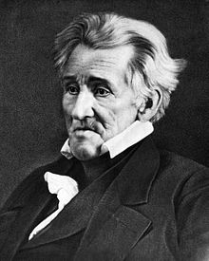
The Growth of Colonial America
A Diverse Population
In 1700, 90% of the English colonies was of English origin
Many immigrants in the 18th century came as indentured servants
Attracting Settlers
England sought to increase the population of colonies through cheap land and religious toleration
Scots-Irish - came over as farmers, teachers, were mostly Presbyterian
The German Migration
Many Germans emigrated due to religious freedom, economic hardships (little land)
  Settled in the frontier

Slide 15
The Growth of Colonial America
Who founded RI?
Religious Diversity
New branches of Christianity emerged in the 18th century
NJ, RI, and PA were the few colonies that separated church and state
  Taxes paid ministers, Jews and Catholics couldn’t vote or hold office
Indian Life in Transition
Immigrants associate liberty with land -> encroach on Native land
Native life drastically changed - shrinking populations, introduction of alcohol reeked havoc
Walking Purchase of 1737
  Indians lost (ceded) more land to PA government than anticipated
Regional Diversity
New England - small farms, local production
“Back country” grew rapidly in the mid-late 18th century
Middle Colonies (PA, NY, NJ) focused on growing grains

Slide 16
The Growth of Colonial America
The Consumer Revolution
Today’s consumerism was foreign to colonists - many produced homespun clothing
Tea became widespread in the colonies
Colonial Cities
90% of colonists lived in rural areas
Cities center on importing and distribution of goods
Colonial Artisans
Artisans had tremendous economic freedom
An Atlantic World
Sugar and tobacco were traded as far away as Eastern Europe
Interdependence linked Europe, America, Caribbean, and Africa
Smuggling by American merchants persisted under the lax enforcement of the Navigation Acts

Slide 17
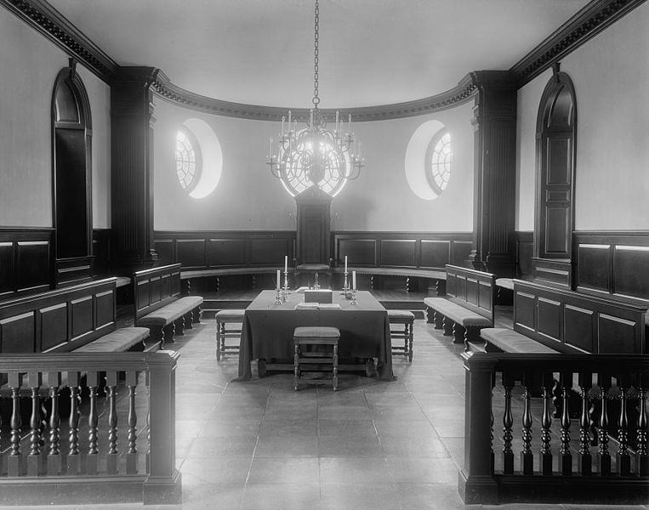
Social Classes in the Colonies
An emerging merchant upper class became powerful in NE
The South was dominated by wealthy land owners - tobacco and rice
These men dominated politics as well in their colonial governments
Anglicization (Process of becoming, or acting British)
Elite Colonists viewed themselves as Englishmen - imported fashion and literature from England
The South Carolina Aristocracy
Elite planters from SC were the richest in the 13 colonies
  High discrepancy of wealth - few people held much $
Fashion helped demonstrate one’s wealth
Freedom was defined as freedom from labor

Slide 18
Social Classes in the Colonies
Poverty in the Colonies
New England’s population grew from reproduction, not as many immigrants as other areas
Many colonists did not own land - only hope was moving west
10% of the population owned 50% of the wealth
The Middle Ranks
2/3 of all free men owned their own land - different than Europe
Families sought land and resisted efforts to have access limited (Natives, governments, etc.)
What problems were associated with moving West?

Slide 19
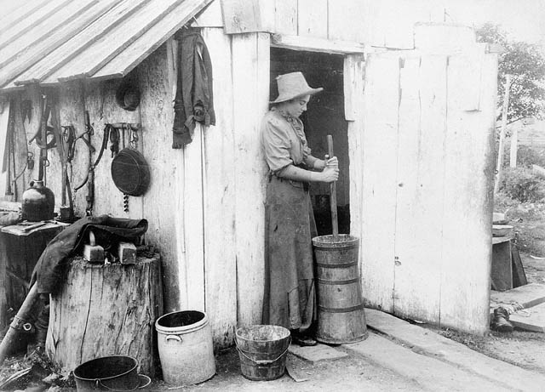
Social Classes in the Colonies
Women and the Household Economy
Women played an important role in families
  Cook, sew, churn butter - help alleviate poverty in families
  Expected to be be good wives and mothers (Republican Motherhood after Rev. War)
Primogeniture existed in many colonies - oldest son inherits the estate
North America at Mid-Century
Present-day US was quite diverse in the 1700s
  Pueblos in the SW, plantations in South, small farms in NE, fur trading in the Ohio Valley

Slide 20
Quick Recap
***Mercantilism***
Charter of Liberties and Privileges
Growth of slavery and slave laws
Bacon’s Rebellion
Glorious Revolution and its impacts
Dominion of England
English Toleration Act (impacts in New England)
Salem Witch Trials
Anglicization
Role of women in families and the economy

Slide 21
See You Back Here For Chapter 4!
Thanks for watching
Subscribe and share
Check out other videos in the description
Good luck in May!

