Slide 1
APUSH Review: Give Me Liberty!, Chapter 4, 4th Edition
Please check out the description for additional videos related to this chapter and other resources!

Slide 2
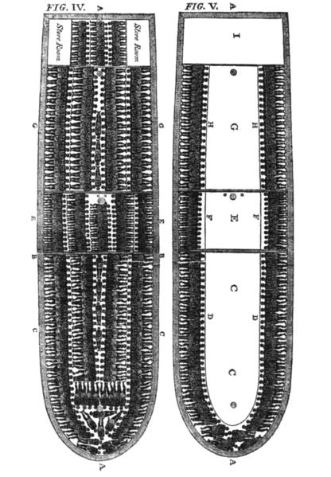
Slavery And Empire
Slavery in the British Empire in the 1700s was common
Many goods that were traded were produced by slave labor - sugar, tobacco, etc.
Atlantic Trade
Triangular Trade benefitted port cities and cities with little slaves
Liverpool and Bristol became banking centers
As time progressed, slaver
Africa And The Slave Trade
Europeans went further into the African coasts (Spain and Portugal)
The use of guns encouraged the capture of more slaves
The Middle Passage
1/5 slaves died on the forced journey y became more entrenched in the colonies -> harsher laws, more racism
Most slaves were sent to Brazil or West Indies

Slide 3
Slavery And Empire
Remember when I burned down Jamestown?
Chesapeake Slavery
Tobacco-based slavery was a main source of income for Chesapeake plantations
Post-Bacon’s Rebellion
Politicians were/had ties to planter elites and defended/encouraged the growth of slavery
Freedom And Slavery In The Chesapeake
A master’s power over slaves increased over time
Free blacks lost rights - couldn’t bear arms, loss of suffrage
Indian Slavery In Early Carolina
Creek Indians in SC and GA captured and sold slaves -> West Indies

Slide 4
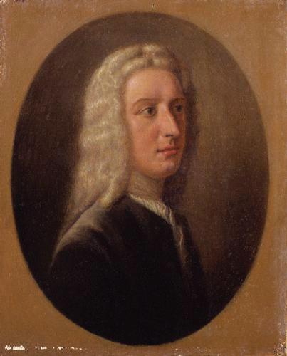
Slavery And Empire
The Rice Kingdom
Rice transformed the SC society - racism, elites in control
Introduction of indigo in 1740s
Rice plantations were enormous - lots of $ to drain swamps
Africans had some immunity to malaria
Task system - slaves required to complete certain tasks, then would be done
The Georgia Experiment
James Oglethorpe - GA was a “buffer” colony between SC and Spanish FL
Originally banned slavery, labor adopted SC’s plantation model
Slavery In The North
Slaves did exist in the north, just on a smaller scale
NE recognized slave marriages, slaves could sue and testify in court
Wage labor became more prominent in the north - could fire at will, less of a capital investment than slavery

Slide 5
Slave Cultures And Slave Resistance
Becoming African-American
Like Native Americans, Africans were a diverse group - spoke different languages, practiced many religions
New music, art, and literature emerged that combined European, African, and American aspects
African Religion In Colonial America
African religions practiced animism
Many African slaves continued to practice African religion, transitioned to Christianity
Combined aspects of both
African American Cultures
Chesapeake slave population reproduced more quickly
More contact with whites, learned English more quickly
SC and GA - arduous work on rice plantations
Less contact with whites
Northern slaves had more mobility than Southern slaves

Slide 6
Slave Cultures And Slave Resistance
Resistance to Slavery
Newspapers were often filled with ads for runaway slaves
NYC Slave Rebellion
Slaves set fires to houses, killed 9 whites
Many slaves were executed in response
Maroon Communities - made up of runaway slaves, distinct cultures
The Crisis of 1739 - 1741
Stono Rebellion (SC)
Slaves tried to flee to Spanish FL, killed whites along the way
Many slaves were executed
Stronger slave codes were enacted as a result

Slide 7
An Empire Of Freedom
British Patriotism
Impacts of conflicts with European countries (France?)
High taxes and military establishments
Commerce was seen as positive in the colonies
The British Constitution
In Britain, there was some limited government
House of Commons, Lords, and King
Many colonists throughout the mid-18th century viewed the British system as the freest in the world
The Language Of Liberty
Liberty began to be associated with resisting arbitrary government

Slide 8
An Empire Of Freedom
Republican Liberty
Republicanism - promoted public life participation by being economically independent
Belief that property-owners were the only ones to possess virtue
Liberal Freedom
Liberalism - focused on individuals and private life
Government should protect natural rights (John Locke)
Liberalism focused on protection of property (including slaves)
Many women and slaves began to challenge their state based on the belief of natural rights

Slide 9
The Public Sphere
The Right To Vote
Property requirements were a prerequisite to voting
Larger percentage of colonists could vote than in Britain - more land ownership
Voting was mostly limited to men and Protestants
Political Cultures
9 colonial governors were appointed by the crown/proprietors
SC - to sit on the assembly, one had to be wealthy
NE town leaders were generally the wealthiest
Colonial Government
***Salutary Neglect***:
Colonies were left alone by Britain, developed their own governments
Ended after F&I War in 1763
Some colonial assemblies had significant power - pay the governor’s salary

Slide 10
The Public Sphere
The Rise Of The Assemblies
Assemblies became more vocal over time
PA had a unicameral assembly - very powerful
Assemblies and governors sometimes butted heads
Colonies printed their own $ - later outlawed
British colonies were the most democratic of all in North America
Politics In Public
Politics were discussed in city taverns and clubs
Boston, NY, Philadelphia
The Colonial Press
75% of free male adults were literate; 33% of women
Ben Franklin’s Autobiography

Slide 11
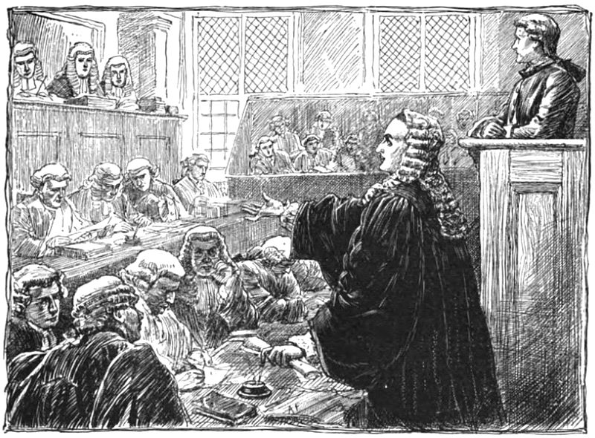
The Public Sphere
Freedom Of Expression And Its Limits
Freedom of Speech in Britain was reserved for legislators, not citizens
Prior to 1695, all printed material needed a government license
The Trial Of Zenger
1735 trial of a printer in NY
Printed negative remarks about the governor
Zenger was found not guilty, helped promote the idea of freedom of the press
The American Enlightenment
Focus on reason, began to attack traditions not based on merit, but hereditary privileges
Arminianism - reason could could help establish religious essentials
Deism - God created the world and then stepped back

Slide 12
The Great Awakening
Religious Revivals
Ministers became concerned with waning religious piety (decrease in religious participation)
Enlightenment, Commercialism, etc.
1st Great Awakening:
Religious revival in the colonies and Europe
Preachers used emotion - John Edwards, Sinners in the Hands of an Angry God
The Preaching Of Whitefield
Great orator from England - became very famous
New churches emerged as a result of his preaching - “New Lights”
The Awakening’s Impact
Preachers criticized commercialism, few condemned slavery
***New denominations emerged***
Questioning of traditional authority - forerunner to the American Revolution

Slide 13
Imperial Rivalries
Spanish North America
Controlled Mexico, SW US, Great Plains, LA Purchase after 1763
Colonized TX beginning in early 1700s
Presidios - military outposts
The Spanish In California
Many presidios were established in CA
Many natives died after Spain settled
Spain sought to assimilate the natives
The French Empire
Present-day Canada and Mississippi River Valley
Much smaller population than the British colonists (only 65,000)
Active trade alliances with Natives

Slide 14
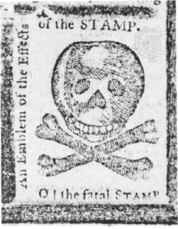
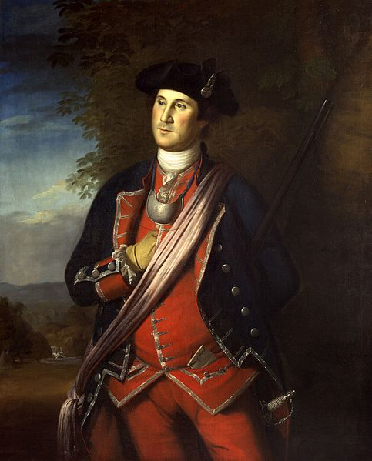
Battle For The Continent
The Middle Ground
Ohio Valley became very important for England, France, and Natives alike
Natives such as the Iroquois played Europeans off of each other
Ohio Company sought land recognition from France and ignited the 7 Years’ War
Balance of power was forever altered in North America
The Seven Years’ War
George Washington helped start the war between the British and French
Initially, the French and Natives were successful, later the British prevailed
France was removed from North America, Britain gained land in the Caribbean
A World Transformed
Peace of Paris (1763)
France lost Canada to Britain, Spain lost Florida to Britain
Massive debt for both Britain and France
British taxes would be resisted
French debt would help encourage the French Revolution

Slide 15
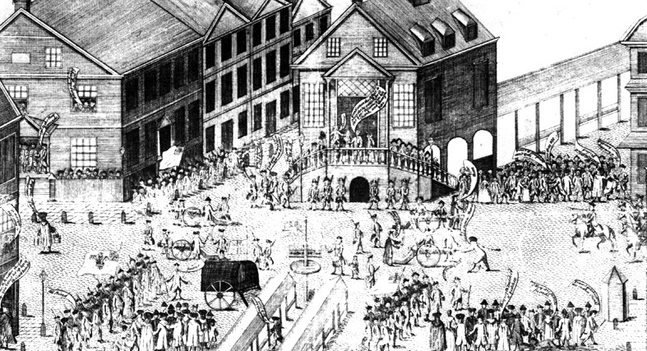
Battle For The Continent
Pontiac’s Rebellion
Natives in MI, OH, IN revolted against the encroachment of British colonists
Helped lead directly to the……..
The Proclamation Line
1763 - prohibited westward expansion beyond the Appalachian Mountains
Natives could NOT sell land to colonists
Colonists were FURIOUS - fought for the land in the 7 Years’ War
Pennsylvania And The Indians
Paxton Boys:
Group of Scots-Irish that massacred Native men, women, and children
Felt Natives were treated too well by the governor
Demonstrated the end of positive relations William Penn sought to establish with Natives

Slide 16
Battle For The Continent
Colonial Identities
Colonists became a more unified identity after the 7 Years’ War
Albany Plan of Union (1754)
Ben Franklin’s vision to unify the colonies - :Join or Die”
Plan rejected by the colonies and Britain
Many colonists were proud to be members of the British Empire in 1763……..

Slide 17
Quick Recap
Middle Passage
Slavery in the Chesapeake vs. SC/GA
Creation of GA
African religions/cultures and how they blended with America
Slave Rebellions - NYC and Stono
Voting requirements
Power of colonial assemblies
John Peter Zenger
Edwards, Whitefield, The Great Awakening and its impacts
7 Years’ War
Pontiac’s Rebellion -> Proclamation Line of 1763
Paxton Boys
Albany Plan of Union

Slide 18
See You Back Here For Chapter 5!
Thanks for watching
Subscribe and share
Check out other videos in the description
Good luck in May!

