Slide 1
APUSH Review: Give Me Liberty!, Chapter 6, 4th Edition
Please check out the description for additional videos related to this chapter and other resources!

Slide 2
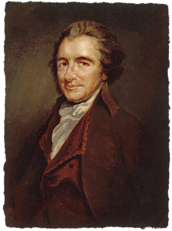
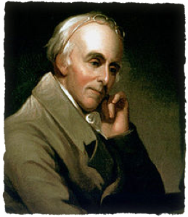
Democratizing Freedom
Expanding The Political Nation
After the Revolution, men still had control over household, wives, and slaves
Meanings of democracy:
Whole population voted -> fear of mob rule
After the Revolution, it came to mean greater equality (for mostly white men)
Artisans and small farmers began discussing politics, not just elites
The Revolution In Pennsylvania
PA was divided in early 1776 - pro-British and pro-independence groups
Leaders of the pro-independence movement:
T-Paine, Benjamin Rush, and others
New PA Constitution:
Unicameral legislature, no governor, eliminated property requirements for officeholding

Slide 3
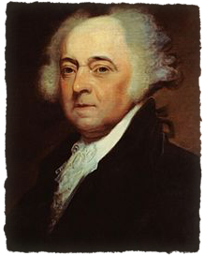
Democratizing Freedom
The New Constitutions
Americans believed governments should be republics - people were the ultimate authority
John Adams argued for “balanced governments” in states:
Bicameral legislature representing the wealthy and ordinary
Governorship and judiciary would provide balance
The Right To Vote
Southern states were the least democratic
In VA and SC, the governor was chosen by legislature (controlled by wealthy)
VT - no property requirements, nor poll taxes to vote
Democratizing Government
In NJ, women could vote if they owned property until 1807
All states except SC held annual elections - more accountable to voters

Slide 4
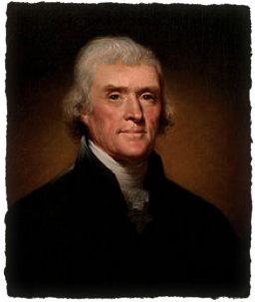
Toward Religious Toleration
Catholic Americans
During the Revolutionary War, Americans worked more with Catholics
French alliance
The Founders And Religion
Scotch-Irish in VA frontier sought to end taxes that supported Anglican Church
Many founding fathers were Deists - God created the world and stepped back
Jefferson Bible
Separating Church And State
Jefferson’s “Wall of separation”
States eliminated established churches
Many state constitutions promoted “free exercise of religion”
All states except NY barred Jews from participating in politics

Slide 5
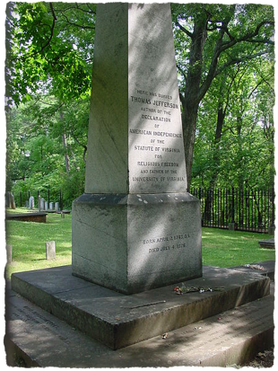
Toward Religious Toleration
Jefferson And Religious Liberty
Virginia Statute of Religious Freedom - forerunner to the first amendment
Jefferson’s epitaph
James Madison viewed America as an “asylum to the persecuted”
The Revolution And The Churches
Some churches saw new ideas challenge tradition
Young Moravians in NC challenged arranged marriages
New religious denominations emerged -> 1,300 in the US today
Christian Republicanism
Many viewed religious values as positive for the country - instilled moral qualities
Why was there large support for free, public schools?
To educate the electorate that would one day vote

Slide 6
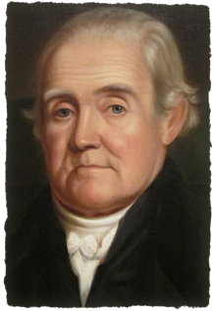
Defining Economic Freedom
Toward Free Labor
By 1800, there were virtually no indentured servants
North relied on “free labor”
The Soul Of A Republic
Noah Webster viewed equality as the most important right
Americans favored equal opportunity, not necessarily equality of condition
Jefferson favored a small government, but believed government should help promote freedom
VA abolished:
Entail: forbidding the division of land upon a person’s death beyond family
Primogeniture: eldest son inherits all property

Slide 7
Defining Economic Freedom
The Politics Of Inflation
During the Revolutionary War, prices of goods soared
Crowds sometimes seized food and other goods and sold them at a price they deemed ok
The Debate Over Free Trade
Congress set up price wages - sought to promote the public good
Shortly after, government price regulations stopped
Represents the conflict between promoting public good and economic freedom

Slide 8
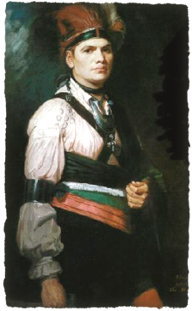
Defining Economic Freedom
Colonial Loyalists
Loyalists made up roughly 20% of the American population
Many tenants and slaves of large plantations sided with the British during the war
The Loyalists’ Plight
Newspapers that were loyal to Britain were suppressed
Quakers and other pacifists were arrested and lost property
Residents were required to take oaths, or lose the right to vote
60,000 loyalists left the US after the war -> creation of New Brunswick in Canada
Those that remained became part of society, but often did not receive their confiscated property
The Indians’ Revolution
Americans sought to expand before and after the war
Natives were divided in their support during the war, although many sided with the British
Native land was destroyed in conflicts with Americans

Slide 9
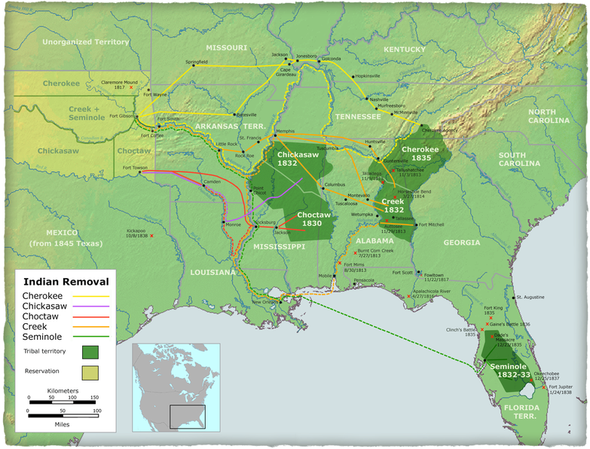
Defining Economic Freedom
White Freedom, Indian Freedom
Many Americans sought land that belonged to Natives, the government supported this
Jefferson, in particular, advocated this, which would support his agrarian vision
He believed Natives should move west of the Mississippi -> Andrew Jackson
Natives were left out of the Treaty of Paris of 1783

Slide 10
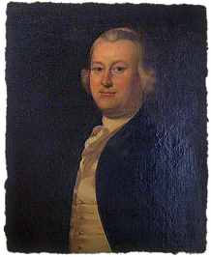
Slavery And The Revolution
The Language Of Slavery And Freedom
Some arguments for independence included that colonists were enslaved because they couldn’t vote in Parliament
James Otis - one of the few writers that argued blacks were British subjects as well
Those that cried for freedom often owned slaves
Obstacles To Abolition
More than 40% of the populations of VA, GA, and SC were slaves
Most founding fathers owned slaves
Slaveowners advocated that governments should protect property, including slaves
The Cause Of General Liberty
Quakers were early abolitionists
Benjamin Rush - argued that slavery would bring “national punishment”
So why was slavery accepted in governments? (Constitution)
Compromise was needed to gain support of the South
We hate slavery

Slide 11
Slavery And The Revolution
Petitions For Freedom
Not surprisingly, many slaves sought freedom and used ideas of the Revolutionary Era
Freedom petitions - introduced into courts by slaves to seek freedom
British Emancipators
Jefferson, Henry, and Madison had slaves flee to the British side during the war
100,000 slaves in the US did the same
In 1827, Britain compensated some slave owners
Voluntary Emancipations
Some slave owners in the Chesapeake emancipated their slaves in the 1780s
The further south, the less likely voluntary emancipation occurred

Slide 12
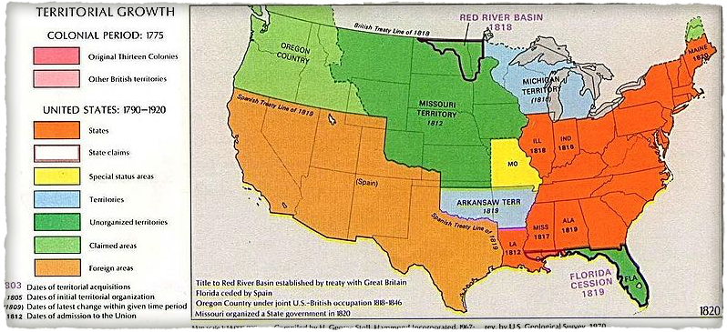
Slavery And The Revolution
Abolition In The North
1777 - VT banned slavery
Most emancipation laws were gradual -> children of slaves would be free at adulthood
Slaves still lived in the North until the 1830s
Free Black Communities
Abolition in the north created a division between free north and slave south -> MO Compromise of 1820
Many states allowed free blacks who met financial qualifications to vote (not VA, SC, GA)

Slide 13
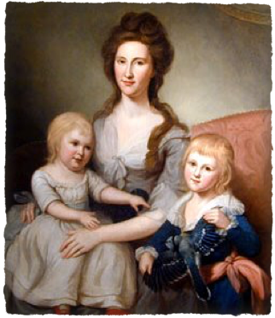
Daughters of Liberty
Revolutionary Women
Deborah Sampson - disguised herself as a man fought in the war
Many women contributed to the war effort through:
Homespun, passing information, medical treatments
Gender And Politics
Equality did NOT extend to women after the Revolution
Husbands still had legal authority over wives
Expectation was that women would be obedient
***Republican Motherhood***
Women were expected to raise children to be “good citizens”
Increased education opportunities for women
Unlike slavery, women’s rights did not become a major topic until years later
The Arduous Struggle For Liberty
The American Revolution had tremendous impact on the world
Inspired revolutions in France, Haiti, and Latin America

Slide 14
Quick Recap
State governments under new constitutions
Religion - Deism, “wall of separation”
Loyalists during the war
Impact of the war on Natives
Gradual emancipation
Women in the Revolutionary War
Republican Motherhood

Slide 15
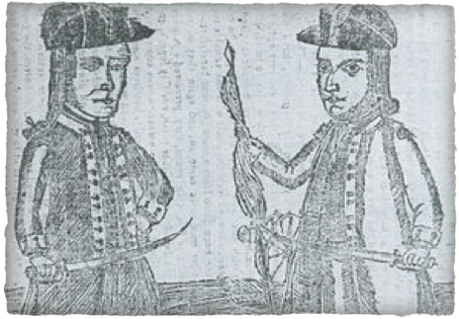
See You Back Here For Chapter 7!
Thanks for watching
Subscribe and share
Check out other videos in the description
Good luck in May!

