Slide 1
APUSH Review: Give Me Liberty!, Chapter 7, 4th Edition
Please check out the description for additional videos related to this chapter and other resources!

Slide 2
America Under The Confederation
The Articles of Confederation
Created a very weak central government - fear of too much power
Congress - unicameral, each state had one vote, regardless of population
National government had few powers - declaring war, foreign affairs, treaties
Congress and the West
100,000 Indians lived in land that extended to the Mississippi River
Selling land became an important source of revenue - federal government could NOT tax under the Articles
Settlers and the West
Settlers often paid little attention to land belonging to Natives
Land disputes erupted in many areas, especially Kentucky

Slide 3
America Under The Confederation
***The Land Ordinances***
1784 - established self-government
1785 - sold land in the Old Northwest:
  16th square mile of a section would provide $ for education
Northwest Land Ordinance of 1787:
  Eventually carved into 5 states - OH, MI, IN, IL, WI
  Once a territory reached 60,000 people, it could apply to become a state
  Slavery was prohibited in all the North West Territory
The Confederation’s Weaknesses
National government in debt -> couldn’t tax
Americans were barred from trading with the West Indies
States contributed to economic issues:
  Imposed tariffs, printed their own $
6 | 5 | 4 | 3 | 2 | 1
7 | 8 | 9 | 10 | 11 | 12
18 | 17 | 16 | 15 | 14 | 13
19 | 20 | 21 | 22 | 23 | 24
30 | 29 | 28 | 27 | 26 | 25
31 | 32 | 33 | 34 | 35 | 36

Slide 4
America Under The Confederation
***Shays’ Rebellion***
Rebellion of farmers in debt in MA (1786 - 1787)
  Protested farm foreclosures, attacked court houses
  Used similar tactics to protests of the 1760s and 1770s
The rebellion helped demonstrate to many that a stronger national government was needed (lasted several months)
  Better economic policies and a national military
Nationalists of the 1780s
Madison and Hamilton argued for a stronger government
Annapolis Convention:
  Meeting to discuss economic issues, led to a meeting in Philadelphia the next year to amend the Articles
    Turned into the…….
    Constitutional Convention

Slide 5
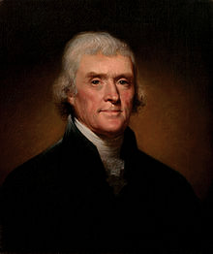

A New Constitution
Thomas Jefferson and John Adams were NOT at the convention
Most of the 55 delegates were wealthy and educated
The Structure of Government
Constitution established 3 branches of government
Debates over representation:
  VA Plan (Madison) - bicameral legislature based on population
  NJ Plan - unicameral legislature with equal representation (similar to Articles)
  Great Compromise - bicameral legislature - 1 house with equal representation (Senate), 1 based on population (House)
  **Note** Senators were originally elected by state legislatures, not the people (17th amendment)
The Limits of Democracy
Voting rules were left to the states
  Led to issues such as poll taxes, literacy tests, etc. after the Civil War
Electoral college elected the president, NOT the people
Runner up in a presidential election would become vice-president (12th amendment)
Executive and judicial branches reflected fears of allowing citizens to have too much say in government
I may have written the Declaration of Independence, but I was NOT at the Constitutional Convention

Slide 6
A New Constitution
Slavery in the Constitution
Fugitive Slave clause - a slaves would remain slaves, even if they escaped to a free state
National government could not interfere with slavery in states
Most early presidents owned slaves (Washington, Jefferson, Madison, etc.)
The Final Document
Ben Franklin helped persuade delegates to ratify the document
National economy was strengthened due to Congressional powers:
  Interstate trade, tariffs, coining money, etc.

Slide 7
The Ratification Debate And The Origin Of The Bill Of Rights
The Federalist
Also known as The Federalist Papers
85 essays (Hamilton, Madison, Jay), urged ratification of the Constitution
Hamilton argued the Constitution protected individual liberties, did not limit them
“Extend The Sphere”
Federalist #10 and #51 (video in description)
  Argued for separation of powers and benefits of a large republic, controlling factions (groups)
The more diverse the country became, the more liberties people had
The Anti-Federalists
Key figures such as Samuel Adams and Patrick Henry were weary of a strong central government
Biggest argument was a lack of Bill of Rights
Madison promised a Bill of Rights would be added after the Constitution was ratified

Slide 8
The Ratification Debate And The Origin Of The Bill Of Rights
The Bill of Rights
State Constitutions had their own Bill of Rights
Some Amendments:
  1 - Freedom of speech, press, religion, assembly, petition
  2 - bear arms
  4 - warrant needed to search a home
  5 - No double jeopardy, can’t be forced to testify against oneself
  9 - Rights not listed can’t be taken away
  10 - powers given to states (Federalism)
    Education, licensing professionals, etc.
Until the 20th century, the Bill of Rights ONLY applied to the federal government, NOT states (More in AP Gov)
No mention of God in the Constitution

Slide 9
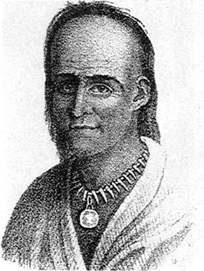
“We The People”
National Identity
Preamble references liberty, posterity (later echoed by Lincoln in the Civil War)
Indians were not considered Americans
No mention of slavery, referred to as “other persons”
Indians in the New Nation
Westward expansion led to debates over treatment of Natives
Treaties often only had support of a small portion of tribe, yet all and to abide by it
Little Turtle - leader of Miami Confederacy
  Defeated Americans in Northwest Territory, eventually were defeated at the Battle of Fallen Timbers
Treaty of Greenville:
  Natives lost a significant amount of land in Ohio and Indiana
Jefferson argued Natives could become members of American society:
  Focus on farming, abandon hunting -> Connect to Dawes Act of 1887
Indians were considered “civilized” when:
  Adopted America ways and gender roles
Many Natives still sought to keep autonomy

Slide 10
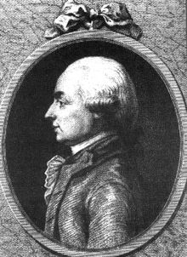
“We The People”
Blacks and the Republic
Not until the 14th amendment was citizenship defined in the Constitution
Some free blacks had rights - suffrage
Letters from an American Farmer - Hector St. John de Crevecoeur
  Wrote that American culture was similar to a melting pot
Throughout most of the 19th century, the US had a policy of open, unrestricted immigration
Jefferson, Slavery, and Race
Many Americans viewed blacks as intellectually inferior
Jefferson viewed Natives as nearly equal intellectually “Noble savages”
  Envisioned Natives becoming part of American society - did NOT favor intermarriages
Jefferson and others believed if slavery ended, they could not remain in America
American Colonization Society - sought to move free blacks to Africa; form of gradual emancipation
Principles of Freedom
Racism was increasingly used to justify slavery and the harsh treatment of African Americans, in spite of a country built on freedom

Slide 11
Quick Recap
Weaknesses of Articles
Land Ordinances, especially 1787
Shays’ Rebellion: causes and impact
VA and NJ Plans, Great Compromise
Federalist Papers and the Bill of Rights
Treaty of Greenville
Justification for slavery and treatment of slaves

Slide 12
See You Back Here For Chapter 8!
Thanks for watching
Subscribe and share
Check out other videos in the description
Good luck in May!

