Slide 1

APUSH Review: Give Me Liberty!, Chapter 8, 4th Edition
Judicial Review
Reasons for Political Parties
The French Revolution
“XYZ” Affair
Please check out the description for additional videos related to this chapter and other resources!
War of 1812
Henry Clay!
Nationalism
A Rebellion over Whiskey

Slide 2
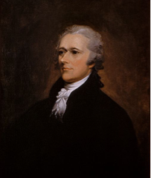
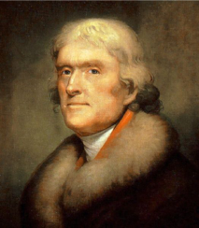
Politics In An Age Of Passion
Hamilton’s Program
Hamilton’s financial program (see video in description) was a contributor to the emergence of political parties
5 Parts:
  Federal government would pay of all debt plus interest
  New bonds would be issued to pay off old debt and the government would assume state debts
  ***Bank of the US (BUS)*** - issue notes and make loans to government
  Excise tax - tax on domestically manufactured goods (whiskey)
  Tariff - tax on foreign goods
  He also proposed government subsidies to industries, but that did not occur
The Emergence of Opposition
Hamilton favored trade with Britain, Jefferson and his followers favored agriculture
Jefferson feared Hamilton’s vision could create too powerful of a government
Speculators bought bonds for pennies on the dollar and sought to make a lot of $ under his plan
We Love Agriculture!

Slide 3
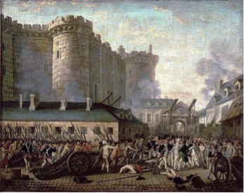
Politics In An Age Of Passion
We Shall Remain Neutral
The Jefferson-Hamilton Bargain
South opposed his plan - little manufacturing and fewer bond holders
Jefferson, strictly interpreted the Constitution and believed the BUS was unconstitutional
Ultimately, Jefferson accepted Hamilton’s plan and in return the new capital would be in the South (land from VA)
***The Impact of the French Revolution***
1789, French Rev began, many Americans supported
Almost immediately, war between France and Britain broke out
Washington issued a proclamation of neutrality in 1793 (even though the US had an alliance with France dating back to the American Rev.)
Britain continued impressment and confiscating US goods headed to France’s colonies
Jay’s Treaty (Britain):
  No mention of impressment, Britain promised to abandon posts (did not)
  Treaty was a direct contributor to the emergence political parties
  France was not happy…..

Slide 4
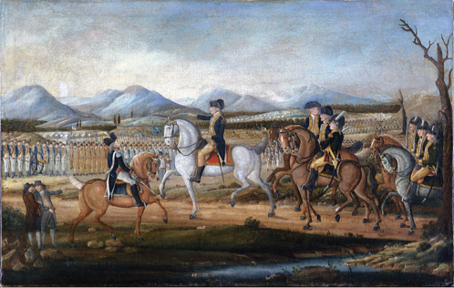
Politics In An Age Of Passion
Political Parties
Federalists:
  Pro-Hamilton’s financial plan, pro-British, favored manufacturing, New Englanders
  Favored wealthy and elites in public office
The Whiskey Rebellion
Farmers in PA rebelled against the new excise tax
Washington put down the rebellion
  Demonstrated the power of the new federal government - compare with Shays’ Rebellion under the Articles
The Republican Party
Led by Jefferson and Madison
  Pro-France, anti-BUS, favored farming (support of farmers too), believed in more democratic participation

Slide 5
Politics In An Age Of Passion
An Expanding Public Sphere
The creation of post offices helped spread information across the country
100s of newspapers emerged in the 1790s
The Democratic-Republican Societies
Argued that political liberty was more than just voting - involvement in politics
Blamed for inciting the Whiskey Rebellion, they disappeared in 1795
Immigrants tended to support the Republicans (Jeffersonians)
The Rights of Women
A Vindication of the Rights of Women - Mary Wollstonecraft
  Argued for more rights - education, paid employment - benefit single women
Hannah Adams - 1st woman to make a living from being an author
Calls for educational opportunities for women increased

Slide 6
Politics In An Age Of Passion
Women and the Republic
Women counted as population towards representation, but few believed women should vote

Slide 7
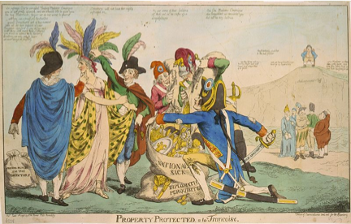
The Adams Presidency
The Election of 1796
John Adams vs. Thomas Jefferson
  Adams wins 71-68, Jefferson becomes VP
France and Britain continued to seize US ships trading with the other country
“XYZ” Affair:
  3 US diplomats sent to France, the French demanded a bribe to meet with them
  War hysteria ensues in the US -> Quasi-War with France
The “Reign of Witches”
Alien and Sedition Acts:
  Passed by the Federalists to silence political opposition (Jeffersonians)
Alien Act - President could deport foreigners deemed dangerous
Sedition Act - illegal to criticize the government (expired in 1801)
  Aimed at silencing supporters of Jefferson

Slide 8
The Adams Presidency
The Virginia and Kentucky Resolutions
Written by Madison and Jefferson in protest to the Alien and Sedition Acts
  They believed the acts to be unconstitutional
The resolutions were more symbolic, but later used by Southerners (John C. Calhoun)
The “Revolution of 1800”
Jefferson and Aaron Burr (running-mate) tied in electoral votes
  Finally, on the 36th ballot, the House chose Jefferson
    Ironically, Hamilton backed Jefferson
12th Amendment - separate ballots for President and Vice-President
Election of 1800 - peaceful transition of power between political parties
Slavery and Politics
If not for the 3/5 Compromise, Adams would have won in 1800
Many feared that the abolishment of slavery would be too politically divisive

Slide 9
The Adams Presidency
The Haitian Revolution
1791 slave rebellion - Jeffersonians did NOT support
Toussaint L’Ouverture - led the rebellion -> gained independence in 1804
Many slaveowners in US feared it would inspire slave rebellions here
Gabriel’s Rebellion
Planned rebellion in Richmond, VA
  It never materialized; 26 slaves were hanged
Like virtually all other slave rebellions, stricter laws were established after
  Blacks couldn’t gather on Sundays without Whites
  Owner emancipation became more difficult

Slide 10
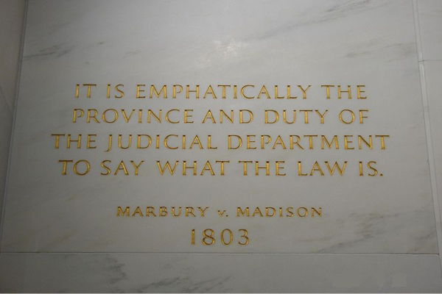
Jefferson In Power
Give Me My Papers, Yo!
“We are all Republicans, we are all Federalists”
Those imprisoned under the Sedition Act were pardoned
Jefferson reduced the size of the military
Judicial Review
“Midnight Judges” were appointed by Adams, Jefferson, through Madison (Secretary of State) refused to deliver the commissions
Marbury (one of the commission-less judges) sued Madison
The Supreme Court declared part of the Judiciary Act of 1789 unconstitutional, stated they could not help Marbury
The court case established ***JUDICIAL REVIEW***
Fletcher v. Peck - Supreme Court could declare state laws unconstitutional
According to John Marshall (Chief Justice), the government could NOT impair contracts

Slide 11
Jefferson In Power
The Louisiana Purchase
1795 - Pinckney’s Treaty - US gained access to MS River, right of deposit in N.O.
Jefferson sought N.O., ended up buying all of LA Territory - doubled the size of the US!
  Jefferson switched from strict to loose interpretation
Lewis and Clark
Explored the territory - sought a waterway to the Pacific
Acquired new plants and animals
Incorporating Louisiana
Free blacks in the Territory had many rights under the French and Spanish
They lost many of these rights upon the acquisition by the US

Slide 12
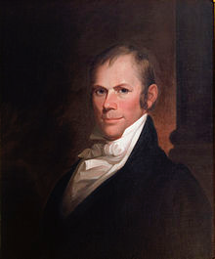
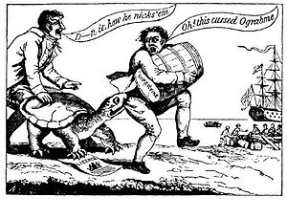
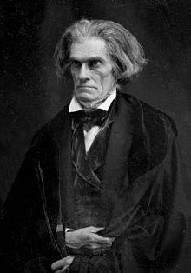
Jefferson In Power
The Barbary Wars
Barbary states demanded tribute from the US
Jefferson expanded the navy
Finally, after the War of 1812, the harassment stopped
The Embargo
Britain continued impressment - needed men to fight Napoleon
  6,000 American sailors were impressed
The Embargo Act cut off ALL trade with the rest of the world
  HUGE disaster for the US
1809 Non-Intercourse Act - banned trade with only Britain and France
Madison and Pressure for War
Madison (Secretary of State under Jefferson) easily became the next president in 1812
Macon’s Bill #2 - reopened trade with France - embargo placed on Britain
Warhawks - from the South and West
  Henry Clay! and John C. Calhoun
  Urged war with Britain, wanted to annex Canada

Slide 13
The “Second War Of Independence”
The Indian Response
Some Natives embraced becoming “civilized”
  Adopting farming - give up traditional Native lifestyle
Tecumseh’s Vision
Charismatic Native leader that resisted Americans
Battle of Tippecanoe - future president William Henry Harrison defeated Natives
The War of 1812
Causes - impressment, arming of Natives on the frontier
Most of the North was against the war (trading)
The White House was burned to the ground
Tecumseh was killed at the Battle of Thames
Andrew Jackson became an overnight hero - Battle of Horseshoe Bend and the Battle of New Orleans
Treaty of Ghent - ended the war, no territory gained or lost

Slide 14
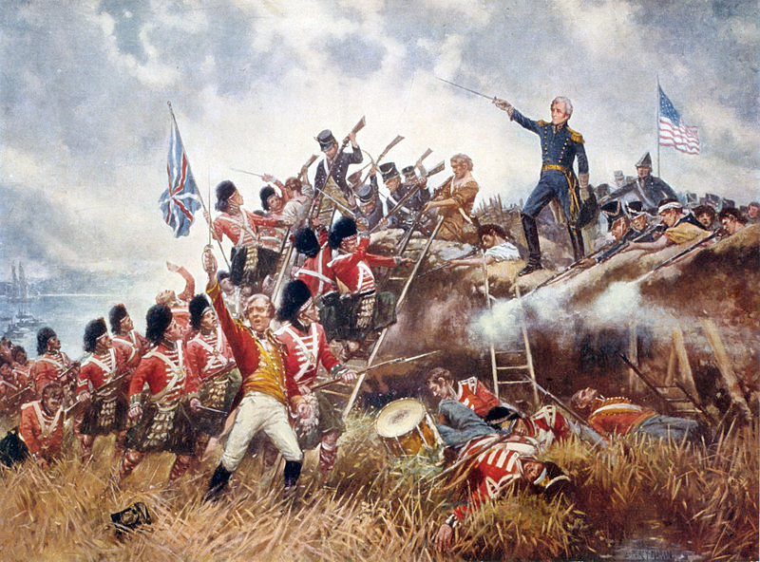
The “Second War Of Independence”
The War’s Aftermath
British and Native threat is essentially gone
HUGE increase in Nationalism in the US (Battle of New Orleans)
Canada did not embrace the US as previously thought
The End of the Federalist Party
Hartford Convention (December, 1814) - end of the war
Federalist meeting to share grievances, sought to amend the Constitution:
  Increasing requirements to declare war, impose an embargo, adding new states
The Federalists got a bad rap because of nationalism sweeping the nation

Slide 15
Quick Recap
Hamilton’s Financial Plan
Impact of the French Revolution
Whiskey Rebellion
Reasons for the emergence and characteristics of the first political parties
Whiskey Rebellion
“XYZ” Affair
Alien and Sedition Acts -> VA and KY Resolutions
“Revolution of 1800”
Judicial Review
Causes of the War of 1812
Impacts of the War of 1812

Slide 16
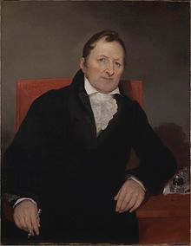
See You Back Here For Chapter 9!
Thanks for watching
Subscribe and share
Check out other videos in the description
Good luck in May!

